Slide 1
Math and Quantitative Reasoning Task Force Recommendations
Matt Clark, Woodland Community College, Math and Quantitative Reasoning Task Force
Ginni May, Area A Representative, Math and Quantitative Reasoning Task Force Chair
Craig Rutan, Area D Representative, Curriculum Committee Chair
Spring 2017 Plenary Session, San Mateo Marriott

Slide 2
Overview
The MQRTF
What is Quantitative Reasoning?
AB 705
EO 1100/1110
The MQRTF Recommendations – Part I
Future Work of the MQRTF

Slide 3
Math and Quantitative Reasoning Task Force
Why form the MQRTF?
Math Competency Requirement in Title 5
Quantitative Reasoning Requirement for CSU GE Breadth and IGETC patterns
General Education requirements are academic and professional matters
AB 705 and CSU EOs 1100/1110 are requiring some major curricular changes
Purview of both ASCCC and Discipline Faculty

Slide 4
Math and Quantitative Reasoning Task Force
Academic Senate for California Community Colleges (ASCCC)
Title 5 §53206 – The ASCCC role in formation of policies in regard to academic and professional matters, recognized as the voice of the community college academic senates before the Board of Governor’s and the Chancellor’s Office
California Mathematics Council Community Colleges (CMC³)
Affiliate of the American Mathematics Association of Two-Year Colleges (AMATYC)
Founded in 1972 to provide a forum through which community college mathematics faculty in Northern and Central California can express themselves professionally at a local, state and national level…
California Mathematics Council Community Colleges – South (CMC³-South)
Affiliate of the American Mathematics Association of Two-Year Colleges (AMATYC) and the California Mathematics Council (CMC)
Dedicated to the professional growth of mathematics educators in Southern California

Slide 5
Math and Quantitative Reasoning Task Force
Partnership with representatives from ASCCC, CMC³, and CMC³-South
Membership includes diverse perspectives on math and quantitative reasoning
Name | Affiliation | Role | College/Discipline | Email
Leslie Banta (co-chair) | CMC³ | Treasurer | Mendocino College/Math | lbanta@mendocino.edu
Ginni May (co-chair) | ASCCC | Area A Representative | Sacramento City College/Math | mayv@scc.losrios.edu
Jack Appleman | CMC³-South | Vice-Chair Activities Planning | Irvine Valley College/Math | jappleman@ivc.edu
Matt Clark | ASCCC | Delegate | Woodland Community College/Statistics | mclark@yccd.edu
Wade Ellis, Jr. | CMC³ | MAA Liaison, Speaker Chair | West Valley College/(Retired) Math | wade25@sbcglobal.net
Katia Fuchs | CMC³ | President | City College of San Francisco/Math
Donna Greene | ASCCC | Past Delegate | College of the Desert/Early Childhood Ed | dgreene@collegeofthedesert.edu
Mark Harbison | CMC³ | Past-President | Sacramento City College/Math | HarbisM@scc.losrios.edu
Toni Parsons | ASCCC | Past-Delegate | San Diego Mesa College/Math | mparsons@sdccd.edu
Larry Perez | CMC³-South | President | Saddleback College/Math | lperez@saddleback.edu
Dong Phan-Yamada | CMC³-South | Board Member | CSU Los Angeles/Math | tphanyamada@yahoo.com
John Stanskas | ASCCC | Vice-President | San Bernardino Valley College/Chemistry | pstanska@sbccd.cc.ca.us

Slide 6
Math and Quantitative Reasoning Task Force
Guided by commitment to equity…empowering students to be successful in a technologically evolving society
Research the various and diverse perspectives on appropriate content for math/quantitative reasoning education for non-STEM majors;
Develop recommendations on math and quantitative reasoning standards for non-STEM majors;
Develop a plan for how to provide opportunities for more students to consider STEM fields… and address the achievement gap by underrepresented groups;
Provide a report that includes the research results and recommendations to the ASCCC, CMC³, and others, such as the California Community Colleges Chancellor’s Office and Board of Governors; and
Request a response from ASCCC, CMC³, and other stakeholders.

Slide 7
What is Quantitative Reasoning?
It is the ability to solve and interpret problems using both computation and logic. It may include, but is not limited to:
understanding the power of compound interest in finance, or exponential growth in populations and climate change;
uses and misuses of statistics, especially in understanding a statistical analysis in order gauge the accuracy or validity of statistical results and ultimately a statistical study;
or how to use the principles of logic and rhetoric to make sound and valid arguments.

Slide 8
What is Quantitative Reasoning?
The ability to reason quantitatively is a stable combination of skills and practices involving:
the ability to read, comprehend, interpret, and communicate quantitative information in various contexts in a variety of formats,
the ability to reason with and make inferences from quantitative information in order to solve problems arising in personal, civic, and professional contexts,
the ability to use quantitative methods to assess the reasonableness of proposed solutions to quantitative problems,
the ability to recognize the limits of quantitative methods. Quantitative methods include the methods of computation, logic, mathematics, and statistics. Quantitative information is traditionally found in subject areas like mathematics, statistics, computer science, and logic.
From CSU QRTF Recommendations: https://www.asccc.org/sites/default/files/V.%20G.%20QRTF%20Final%20Report%2008-01-2016.pdf

Slide 9
AB 705
Colleges must maximize the likelihood that students enter and complete transfer level coursework in math in two semesters (three quarters).
Colleges can only place students into basic skills courses if they are highly unlikely to succeed at the transfer level.
Math placement is being considered for two separate groups: Statistics and Liberal Arts Math (SLAM) and Business, Sciences, Technology, Engineering, and Mathematics (B-STEM).
Guidance for default placement has not been determined, but direct placement into transfer level is possible for SLAM students.

Slide 10
CSU EOs 1100/1110
California State University Executive Order 1100
Eliminates explicit requirement of intermediate algebra for CSU GE Breadth B4 Quantitative Reasoning Courses—it was not required consistently in CSU, resulting in inequitable standards for transfer students
Intermediate algebra still required for majors courses
CSU trusts the CCCs to teach B4 courses at appropriate level

Slide 11
CSU EOs 1100/1110
California State University Executive Order 1110
Requires multiple measures for placement: courses taken, GPA, ACT, SAT, IB, AP, Smarter Balance/EAP
Eliminates prerequisite developmental education courses—pre-baccalaureate level limited to a 1-unit corequisite
Includes support such as corequisite models or stretch courses that could extend a course beyond one academic term
Requires Early Start program for those not fully prepared for college level writing or math

Slide 12
Math and Quantitative Reasoning Recommendations – Part I
C-ID: Overview
Process
MQR Pathways – Flow Chart
Descriptors
Foundations of Algebra for Math-Intensive Fields (draft)
Fundamentals of Algebra for Statistics or Liberal Arts (draft)
Elementary Mathematics (draft)
Bridge course from non-STEM to STEM (forthcoming)
“Drop back” Policy considerations
Professional Development
Data and Research
Title 5 Stipulation

Slide 13
Math and Quantitative Reasoning Recommendations – Part I
C-ID Descriptors
Less prescriptive, more flexibility than many existing descriptors – option colleges may consider – not a requirement!
May be broken into modules, tailoring to local needs
Courses may be offered as corequisite or prerequisite student support based on local placement policies

Slide 14
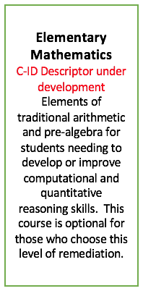
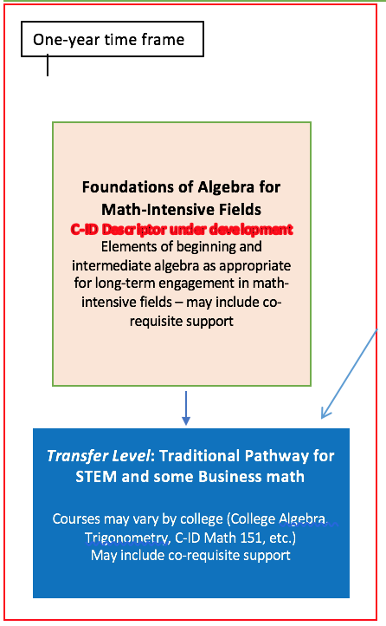
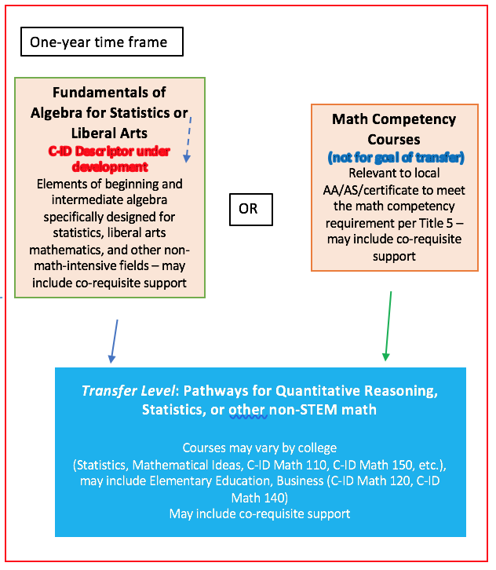
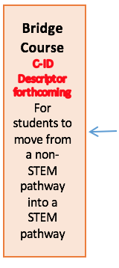
Math and Quantitative Reasoning A Sample of a Possible Sequencing

Slide 15
Future Work of the MQRTF
Finish C-ID Descriptors
Develop a plan for how to provide opportunities for more students to consider STEM fields… and address the achievement gap by underrepresented groups;
Create Recommendations – Part II

Slide 16
Questions and Comments

Slide 17
References
AB 705 (Irwin, 2017) https://leginfo.legislature.ca.gov/faces/billTextClient.xhtml?bill_id=201720180AB705
CSU EO 1100: https://www.calstate.edu/eo/EO-1100-rev-8-23-17.html
CSU EO 1110: https://www.calstate.edu/eo/EO-1110.html
MQRTF: https://asccc.org/directory/math-and-quantitative-reasoning-task-force

