Slide 1
Equity Considerations in Distance Education
Kathy O’Connor, Santa Barbara City College, DEETAC
Carrie Roberson, ASCCC North Representative
Fabiola Torres, @One, Glendale College
2019 Curriculum Institute- Decoding Your Curriculum
Saturday, July 13
9:00 am – 10:15 am

Slide 2
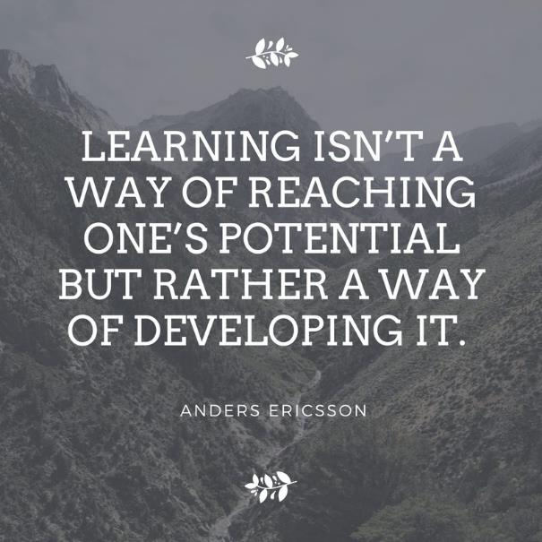
Notes:
Why are you here?

Slide 3
Here we are…
Instructional faculty pedagogy plays a crucial role in the online learning environment. Utilizing an equity framework, this breakout will provide strategies and recommendations for embedding high-impact practices in course design and online classroom practices to support faculty in reducing equity gaps by creating online classrooms that are welcoming, supportive, student-centered.

Slide 4
TODAY
Principles of EQUITY
Modeling Equity
ACTIVITY: Considerations for EQUITY in the online learning environment
Q&A

Slide 5
Principles of EQUITY in Distance Education
Understand the difference between equity and equality
Agree to common language to use in equity dialogue
Commit to accommodate differences in students’ life circumstances, aspirations, ways of learning, other
Engage in an ongoing process for sustained change through equity-focused inquiry, intentionally designed student experiences that yield more equitable and effective learning environments for students
Let go of assumptions that views student success as a matter of student behaviors/ characteristics that draws attention away from practices and influential factors that are within faculty control
Faculty must recognize implicit biases that lead to equity gaps, such as unconscious bias, microaggressions, stereotype threat, and privilege and power
Evaluate if equity-minded strategies meet student need

Slide 6
Modeling Equity
Access Webpage: https://tinyurl.com/asccc4equity
Webpage Content:
Equity & DE
Cultural Inclusivity
Significant Learning
Teaching Philosophy
Liquid Syllabus
Web Access to Peralta Equity Rubric

Slide 7
YOUR TURN!
Consider this…
What equity-minded practices facilitate deeper engagement and community building in the online environment?
What self-reflective processes can enhance or help you to build equity-minded practices into your online course environment?
What is one thing you can or will do when you go back to your campus?

Slide 8
QUESTIONS…& THANK YOU!
Kathy O’Connor
oconnork@sbcc.edu
Carrie Roberson
RobersonCa@butte.edu
Fabiola Torres
ftorres@glendale.edu

