Slide 1
The CVC-OEI Course Design Rubric and Your Curriculum
Michelle Pilati, ASCCC Past President
Meridith Randall, CVC-OEI Executive Advisor
Carrie Roberson, ASCCC North Representative
2019 Curriculum Institute
Friday, July 12
3:45 pm – 5:00 pm

Slide 3
TODAY
Realities!
History of CVC-OEI
Existing requirements
CVC-OEI Course Design Rubric TOOL
Curriculum Review Process
Activity
Questions & Answers

Slide 4
REALITIES!
Students and the student experience
System driven by legislation and law
Student need
114 ways of doing,
114 ways of being

Slide 5
History of CVC/Existing Requirements
History of the CVC-OEI
Change in Title 5 Section 55204, requiring student/student interaction as well as instructor/student interaction
Title 55206, requires a DE Addendum
Accreditation?

Slide 6
Support from ASCCC Resolution 09.03 (Fall 2018)
“encourage local academic senates, through their curriculum committees and online education committees, to adopt the CVC-OEI Course Design Rubric for local use…”
“… to explore the development of local peer online course review…”
“recommend that local academic senates work with their colleges to develop a plan to identify resources so that faculty who wish to participate in local peer online course review may do so.”

Slide 7
OEI Course Design Rubric TOOL

Slide 8
Rubric Origins
If CVC-OEI is going to facilitate statewide access to courses, it is important to take steps to ensure that the available courses are of high quality
Rubric focuses on course design as a means of encouraging the use of effective design to give all students the greatest chance of success
Developed following a review of wide-array of existing rubrics

Slide 9
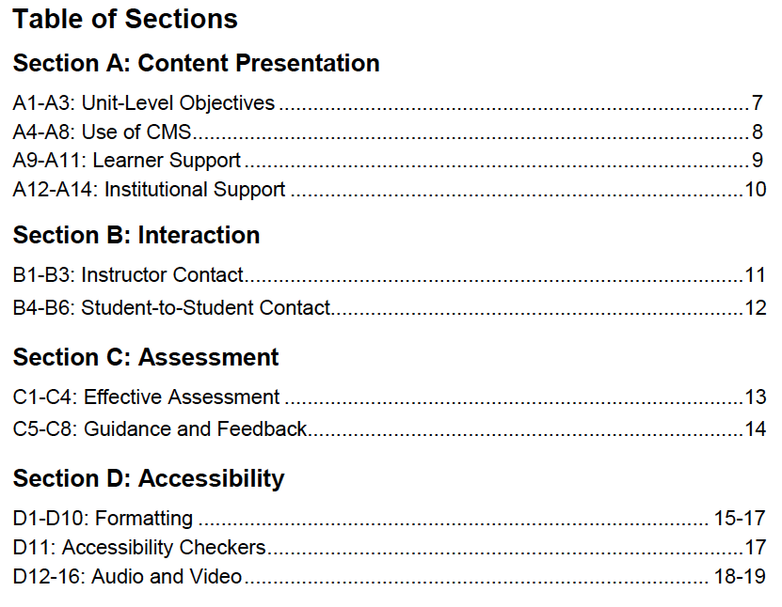

Slide 10
Elements of a DE Addendum
Need/Justification
Methods of Instruction: Instructor – Student Contact
Describe student assignments.
Describe the methods of student evaluation that will be employed.
What equipment and staff are necessary to support the course (for faculty and students)?

Slide 11
Elements of a DE Addendum
Describe how you will provide students with access to instructional materials and resources.
Describe how you will provide students with access to counseling and financial aid services.
Describe how you will accommodate students with disabilities.
Are additional resources or clerical support needed or anticipated to teach this course by distance learning?
Accessibility sign-off

Slide 12
Rubric AND DE Addendum
Learner support
Interaction
Assessment
Accessibility
Could the rubric be used to ensure course design is not only consistent with compliance needs, but truly facilitating student success?

Slide 13
Rubric > Action
How do you integrate the elements of the Rubric into action at the local level?
Have you taken steps to:
Increase the quality of your online offerings?
Implement a re-review of online courses?
Ensure that all courses are being taught to the COR AND addendum?
Ensure that all courses are fully accessible?

Slide 14
Rubric > Action
Require a review of all courses for elements of good course design
Mandated accessibility check of all courses
Re-review after X years
Provide design-oriented professional development into
Establish a local POCR process

Slide 15
Local POCR and Course Design Academy
Faculty can set up a local Peer Online Course Review (POCR) process OR submit their courses to the CVC-OEI Course Design Academy for assistance in aligning with the rubric
CVC-OEI provides training for local POCRs and a college can become a Certified POCR campus
In any event, after a course is aligned, it must be reviewed by a trained reviewer from outside the college
Many Online CTE Pathways grants intend to set up local POCRs

Slide 16
YOUR TURN! Activity
Identify 3 barriers to:
A. aligning courses with the Rubric and/or
B. getting your college to adopt the Rubric.
Propose 3 strategies to get around identified barriers.
Notes:
ALL

Slide 17
QUESTIONS…& THANK YOU!
Michelle Pilati mpilati@riohondo.edu
Meredith Randall
mrandall@cvc.edu
Carrie Roberson
RobersonCa@butte.edu

