Slide 1
2021 Stanback-Stroud Diversity Award Recipient Dr. Hossna Sadat Ahadi, Palomar College
Notes:
Good Afternoon – and Thank you all, Thank you to the Academic Senate for California Community Colleges for recognizing good and important work being done by faculty throughout our system – as we attempt to perfect our instutions of higher education to be the social and cultural capital so many students and communities deserve. Recognition of faculty who make a commitment to not only diversity and inclusion but to mitigating racism, exclusion and marginalization is at the heart of the Stanback-Stroud Diversity Award and I could not be more proud, grateful and humbled to be a small part of it. .

Slide 2
Toni Morrison
“Racism is a Scholarly Affair”
Notes:
\
In an interview with Toni Morrison, the interviewer asked her - do you think that there is something
inherent in in us in whites that undervalues someone whose skin is not the same color as ours
Morrison replied - it's not inherent at all it's taught and it's taught by theologians it's been taught by
scientist’s racism is a scholarly affair it is totally ingrained in the education that we receive
Here, she is speaking about the role that education (educational institutions – meaning educators, faculty, staff, administrators) play in teaching, perpetuating and enshriinging and the racism – a social construct useful to the beneficiaries thrives.
Echoing Carter G. Woodson’s sentiments of 1935 the mis education of the Negro.
Many know of the famous exert where Woodson states When you control a man's thinking you do not have to worry about his actions. You do not have to tell him not to stand here or go yonder. He will find his '' proper place'' and will stay in it. You do not need to send him to the back door. He will go without being told. In fact, if there is no back door, he will cut one for his special benefit. His education makes it neces­sary.
What is commonly not included is his statement about the educational system and the use of it to establish and maintain the social order of white superiority. The so-called modern education, with all its defects, however, does others so much more good than it does the Negro, because it has been worked out in conformity to the needs of those who have enslaved and oppressed weaker peo­ples. For example, the philosophy and ethics resulting from our educational system have justified slavery, peonage, segregation, and lynching. The oppressor has the right to ex­ploit, to handicap, and to kill the oppressed.
No systematic effort toward change has been possible, for, taught the same economics, his­tory, philosophy, literature and religion which have established the present code of morals, the Negro's mind has been brought under the con­trol of his oppressor. The problem of holding the Negro down, therefore, is easily solved. When you control a man's thinking ……
At this moment, in this nations story line, timeline, we are witnessing a broadening awareness of the inequity, injustice, exclusion, marginalization domination and oppression of people of color – It is often said, that there is now an awareness of injustice – a now a consciousness of racism in all of its complexity beyond that of the individual on into that to the structural, institutional, historical, environmental, systemic and geopolitical realm.
In response we are compelled to look at our instituions as part of the systems and structures that create, maintain or perpetuate such inequities – producing student outcomes and experiences that can be predicted by race – a fundamental manifestation of structural racism.
But many are approaching todays experience by being committed to becoming anti-racist instituion – though we are imperfect and may not even quite know what it means or how to do it… we are witnessing efforts to do so. Hopefully we move at the pace of the needs of the oppressed instead of at the pace and the comfort of the privilege – anytime you here, we are not ready for that yet, baby steps, lets get more on board – signal that the comfort of the privileged takes priority over the suffering of the oppressed, the suffering of the students.
Woodson went on to say The same educational process which inspires and stimulates the oppressor with the thought that he is everything and has accomplished everything worth while, depresses and crushes at the · same time the spark of genius in the Negro by making him feel that his race does not amount to much and never will measure up to the standards of other peoples.

Slide 3
Dr. Hossa Sadat Ahadi
Palomar College
2021 Stanback-Stroud Diversity Award Recipient
“Education is social justice activism in your classroom”
Notes:
He is speaking of the colonization of students' minds – I am here to celebrate to introduce you to an educator who had dedicated her life’s work to decolonizing education – her story is rich with personal richness of a family and community that loved and supported her, a clear consciousness of who she is and from whence she comes.. She has a story of immigration to this nation more than 35 years ago and had taken stock of her journey from that war exacts upon people’s lives and from a space where she as a girl may not have ben allowed access to an education to graduating from San Diego State University with a Masters degree Multicultural Community Counseling and Social Justice and a Doctorate degree in Community College leadership – her work, her scholarship, is focused on racial equity and decolonized teaching and antiracist education.
She co-authored a Rostrum article in November 2020 titled “Decolonizing Your Syllabus, an Anti-Racist Guide for Your College.” In December 2020, she was accepted into the Open for Anti-Racism inaugural cohort for the Anti-Racism Teaching Initiative for California community colleges.
Dr. Ahadi the founder of two affinity groups on my campus, Empowered Women and Asian Pacific Americans in Higher Education. She says “I will continue to elevate and validate students and faculty agencies relating to diversity, equity, and inclusion. I encourage other faculty to get involved with their local and statewide senates to systemically transform community colleges.” … “To eradicate racism in education, we must continuously challenge and dismantle it. When you decolonize your pedagogy and praxis, you will liberate your students from colonialism”
I introduce to you someone who has experienced the academy from every vantage pint. Community member Student classified staff, administration and now a Counseling faculty member at Palomar College – she so is uniquely positioned to understand the student experiences from multiple perspectives… Please welcome.. The 2021 Stanback Stroud Diversity Award recipient - Dr. Hossna Sadate Ahadi

Slide 4
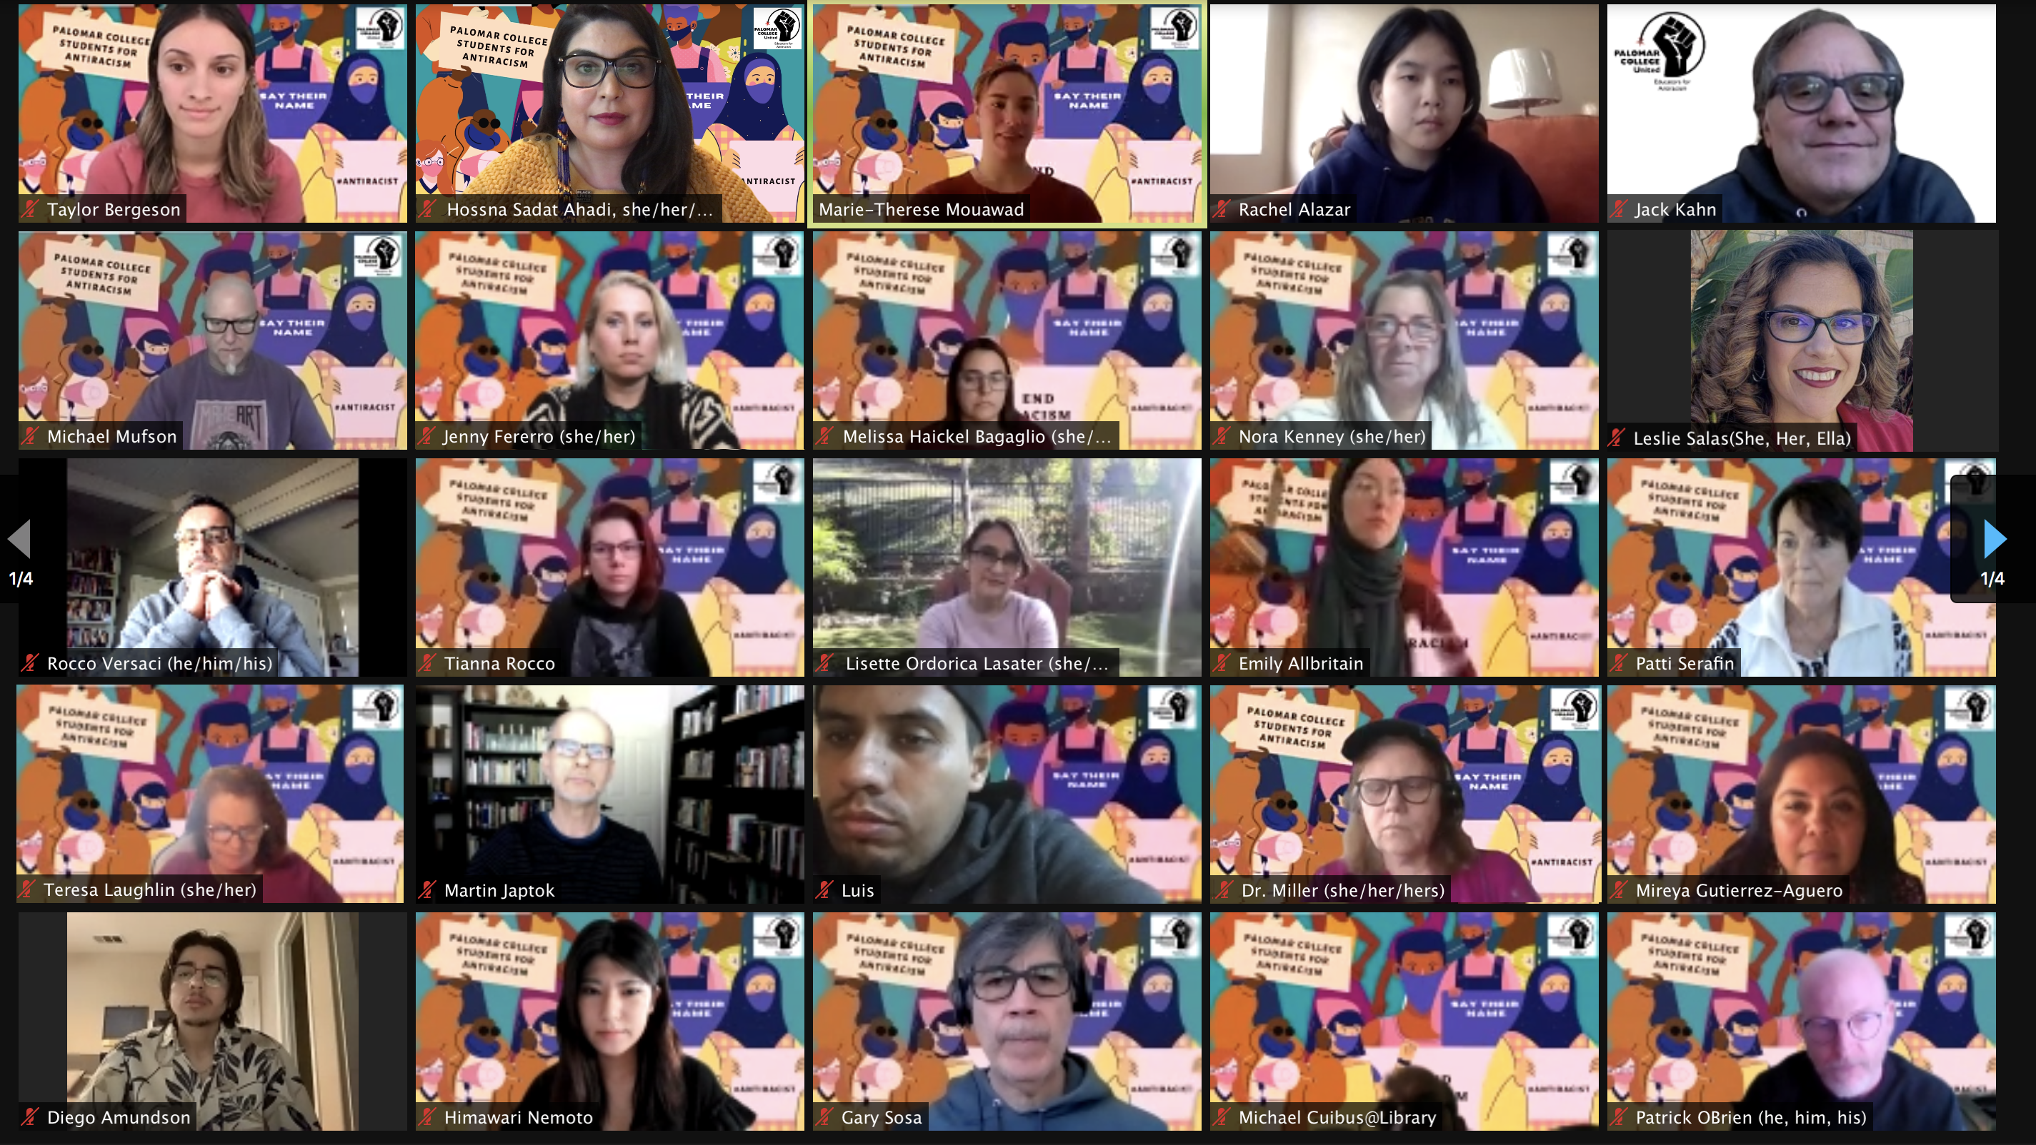
“To eradicate racism in education, we must continuously challenge and dismantle it” Dr. Hossna Sadat Ahadi

Slide 5
“When you decolonize your pedagogy and praxis, you will liberate your students from colonialism” Dr. Hossna Sadat Ahadi

