Slide 1
Area C Meeting—June 17, 2022
Erik Reese—ASCCC Area C Representative

Slide 2
Session Learning Outcomes
Build “local” relationships
Summarize Area C Meetings
Outline resolutions process
Locate resources

Slide 3
Introductions
Name
College
Discipline
Role/Title/Position
COVID lessons

Slide 4
Pair Share
Favorite childhood memory
Somebody who inspires you
Triumphs
Challenges
Leadership goal for the upcoming year
Notes:
NOTES: Commonalities and differences—embrace them!
Triumphs—something of which you are proud
Challenges on the horizon

Slide 5
ASCCC Areas
Four geographic areas called A, B, C, and D (map reference)
Area A
  29 colleges; 1 district senate
Area B
  29 colleges; 5 district senates
Area C
  26 colleges; 1 district senate
Area D
  33 colleges; 2 district senates
Notes:
Area A runs from the Oregon border through the Central Valley to Bakersfield
Area B encompasses the Greater Bay Area, from Mendocino to Monterey
Area C: Los Angeles and the Central Coast
Area D is Orange County, San Diego, the Inland Empire, and across the Arizona border

Slide 6
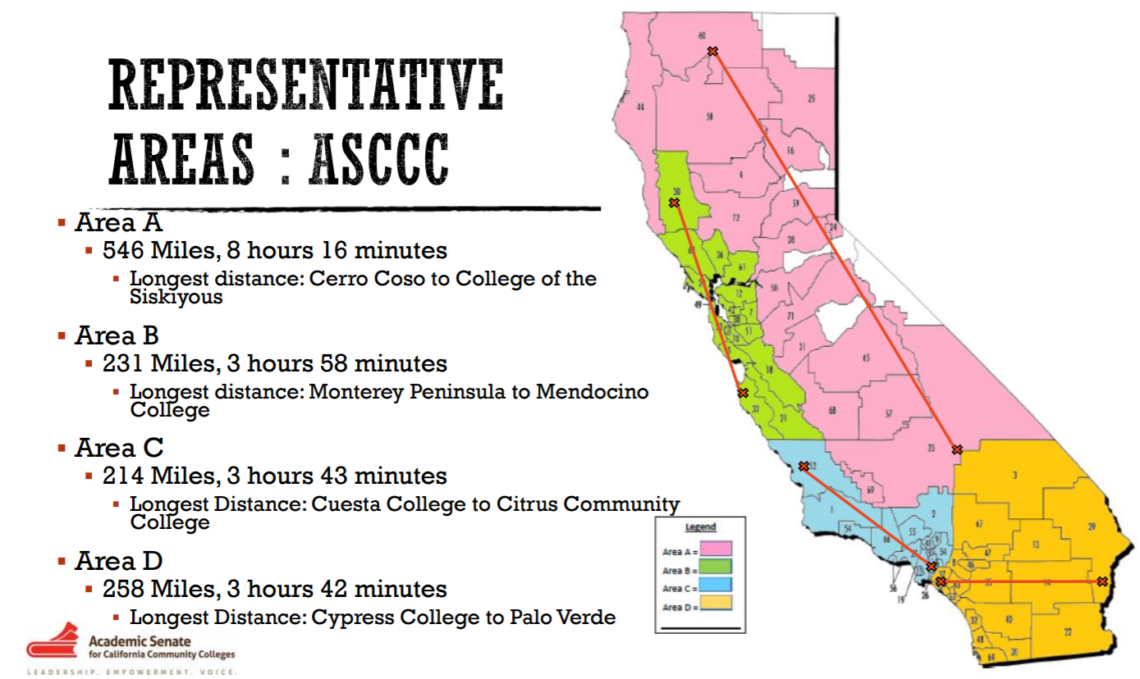
Representative Areas

Slide 7
Area C—Members
Allan Hancock College
Antelope Valley College
College of the Canyons
Cerritos College
Citrus College
Compton College
Cuesta College
East Los Angeles College
El Camino College
Glendale College
Los Angeles City College
Los Angeles CC District
Los Angeles Harbor College
Los Angeles Mission College
Los Angeles Pierce College
Los Angles Southwest College
Los Angeles Trade-Technical College
Los Angeles Valley College
Moorpark College

Slide 8
Area C—Members (Cont.)
Mt. San Antonio College
Oxnard College
Pasadena City College
Rio Hondo College
Santa Barbara City College
Santa Monica College
Ventura College
West Los Angeles College

Slide 9
Area Rep Duties—What do Area Reps do?
Provide information about ASCCC activities and resources
Provide communication to the field
  Listservs
Aid and support senate presidents & delegates prepare for Plenary
Facilitate Area Meetings
  Before and at Plenary
Notes:
Regional meetings
Exec Meetings at colleges
Senate presidents – Hayward readers

Slide 10
What is an Area Meeting?
President/Vice President report
Pre-session resolutions review
Newly proposed resolutions
Area triumphs and concerns
Special program/host highlights
Community building
Notes:
Pre-session resolutions—Time to send in amendments!

Slide 11
Resolution?
Formal process for ASCCC policy development
Record the will of the body (California academic senates)
Directs the work of the ASCCC
Implemented by members of the ASCCC Executive Committee and its committees
Notes:
Communities under the RESOURCES tab
Handbook under the COMMUNITIES tab
Technical Visits under SERVICES tab
Listservs under RESOURCES

Slide 12
Resolutions Process
Pre-Plenary Resolutions
  ASCCC executive and committees
  Area meetings
New Resolutions
  Registered faculty attendee at Plenary (with 4 delegate signatures)
Amendments
  Review and discuss at area meetings and Plenary
  At Plenary amendments require 4 delegate signatures
Mindful of deadlines and mandatory meetings for authors of resolutions and/or amendments
Notes:
Review Resolutions packet—explain this comes from Exec and committees
At actual Plenary—will include resolutions from Area meetings
New Resolutions—from delegates at Plenary:
If authors are in room—ask for background and rationale of new resolutions
Review New Resolutions—any amendments?
At Plenary—Amendments Deadline 12:30 p.m. Friday
Search website for other resolutions
Max 4 Whereas or Resolved
Spell out acronyms
Create a clear title

Slide 13
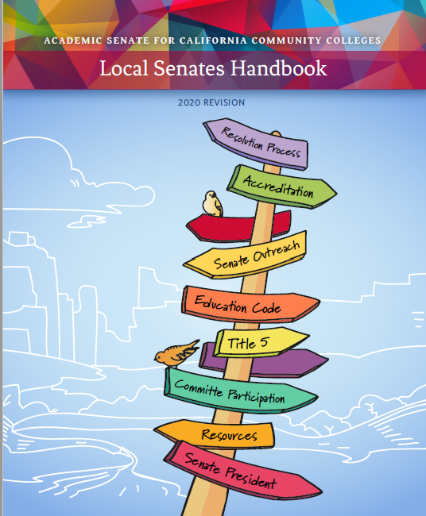
Resources
ASCCC website
Local Senates Handbook
Each other!
info@asccc.org

Slide 14
For what does “C” in Area C stand?
Pathable Wordcloud
  Enter a word starting with “C”

Slide 15
Reminders
Breathe
You can do it! You got this!
One need not have all the answers
  Let me get back to you
Do not have to know the solution to start the conversation
Styles differ wildly
info@asccc.org
Notes:
Let me confer with the officers and get back to you
Let me research this and get back to you
Deflect!

