Slide 1
Revisiting the Promises of AB 705: What Data Tells Us about AB 705’s Impact on Students of Color

Slide 2
Welcome
Description
With AB 705 being fully implemented for English and mathematics since in Fall 2019, longer at some colleges, it is time to investigate college implementations to determine whether they are closing long standing equity gaps and optimizing student success. The ASCCC Guided Pathways Task Force examined local and statewide data and have reported their findings in the Academic Senate White Paper, Optimizing Student Success: A Report on Placement in English and Mathematics Pathways. Join this session to explore data and findings presented in the ASCCC paper along with research from other stakeholders. Together presenters and attendees will highlight progress and discuss solutions to challenges. This session also includes a preview of an upcoming ASCCC survey intended to capture faculty perceptions of local AB 705 implementation.
Ginni May
Angela Echeverri
Cheryl Aschenbach

Slide 3
AB 705 (Irwin, 2017): A Quick Recap
CA Ed Code §78213
Maximize the probability that a student will enter and complete transfer-level coursework in English and mathematics within a one-year timeframe,
Use multiple measures including high school coursework, grades, GPA if available
Maximize the probability that students in ESL will complete degree and transfer-level requirements in English within a three-year timeframe
Ensures students are not placed into remedial education unless they are highly unlikely to succeed in transfer-level coursework
Close equity and achievement gaps
English and mathematics full implementation fall 2019
ESL full implementation fall 2020?

Slide 4
Statewide Perspective:
How Are We Doing?
Faculty statewide should be commended for their efforts to implement AB 705
Creating pathways
Evaluating and improving instructional methods
Designing support structures for their students.
Holistic approach in evaluating AB 705 Implementation – many contributing variables
Notes:
Ginni w/ Cheryl input
Point out outcomes and success data common across 2-3 of the highlighted reports: ASCCC paper, PPIC, MMAP/RP

Slide 5
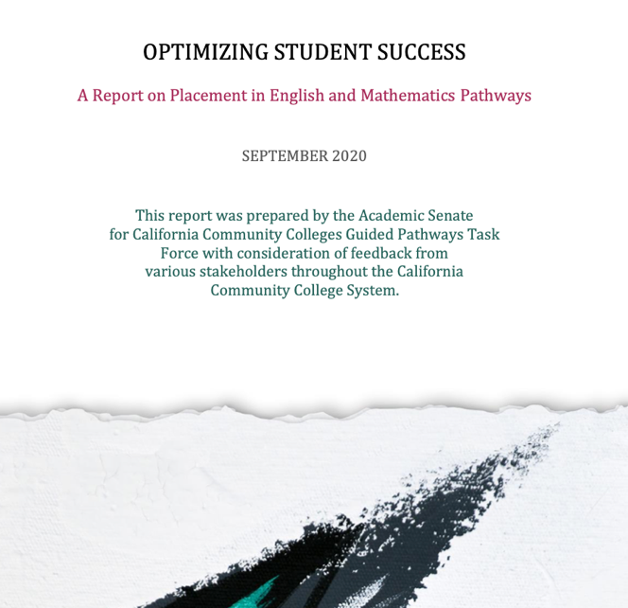
Statewide Perspective:
How Are We Doing?
ASCCC
Guided Pathways
Task Force
Optimizing Student Success: A Report on Placement in English and Mathematics Pathways
Notes:
Ginni w/ Cheryl input
Point out outcomes and success data common across 2-3 of the highlighted reports: ASCCC paper, PPIC, MMAP/RP

Slide 6
Statewide Perspective:
How Are We Doing?
PPIC Report from 2019 by Mejia, Rodriguez, and Johnson
RP Group MMAP Report January 2021
Notes:
Ginni w/ Cheryl input
Point out outcomes and success data common across 2-3 of the highlighted reports: ASCCC paper, PPIC, MMAP/RP

Slide 7
Statewide Perspective:
How Are We Doing?
More students taking transfer-level English and mathematics, especially in underrepresented groups
More students students succeeding in transfer-level English and mathematics, especially in underrepresented groups
Fewer students enrolled in credit English and mathematics statewide overall
Numbers of students not successful in transfer-level English and mathematics has increased, especially in underrepresented groups
Notes:
Ginni w/ Cheryl input
Point out outcomes and success data common across 2-3 of the highlighted reports: ASCCC paper, PPIC, MMAP/RP

Slide 8
Statewide Perspective:
How Are We Doing?
Access to transfer-level coursework has increased
Corequisite models are showing success for many more students
There is progress but equity gaps persist
Notes:
Ginni w/ Cheryl input
Point out outcomes and success data common across 2-3 of the highlighted reports: ASCCC paper, PPIC, MMAP/RP

Slide 9
Statewide Perspective:
Where Do We Need to Improve?
Equity Gaps Persist
STEM pathways
Opportunities for Students of Color
Notes:
Ginni w/ Cheryl input
Point out areas of improvement as noted by “unique” findings of one or more of the three reports

Slide 10
Let’s
take
a
closer
look

Slide 11
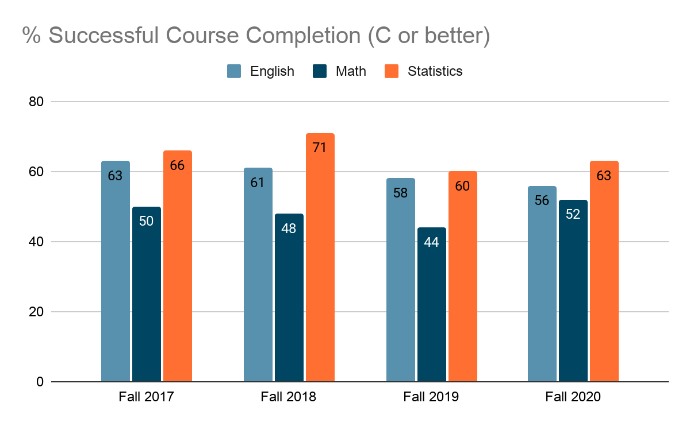
Local Perspective: Findings from LACCD
Notes:
Angela

Slide 12
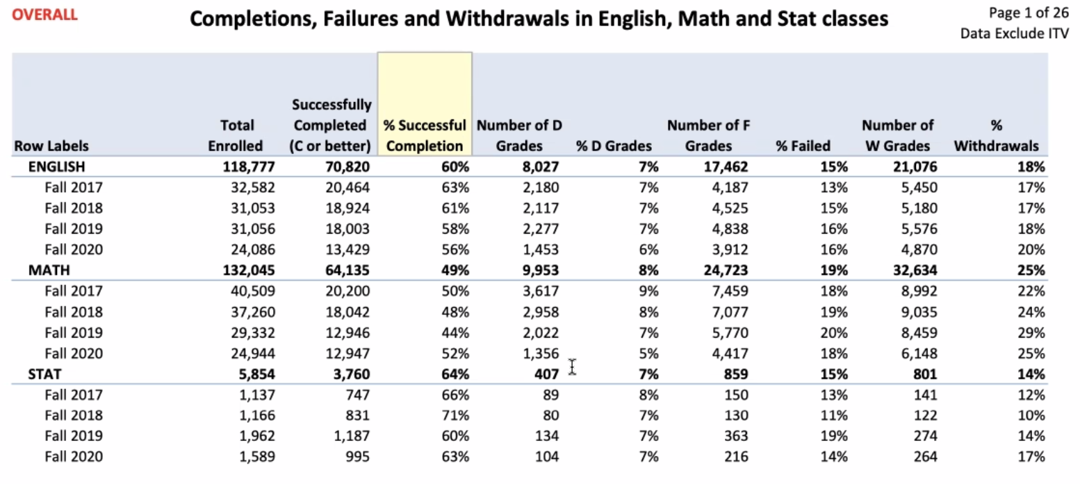
Local Perspective: Findings from LACCD

Slide 13
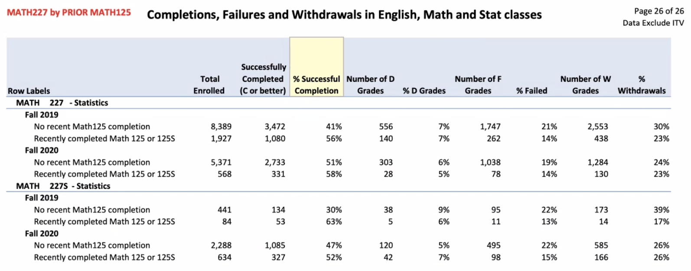
Local Perspective: Findings from LACCD

Slide 14
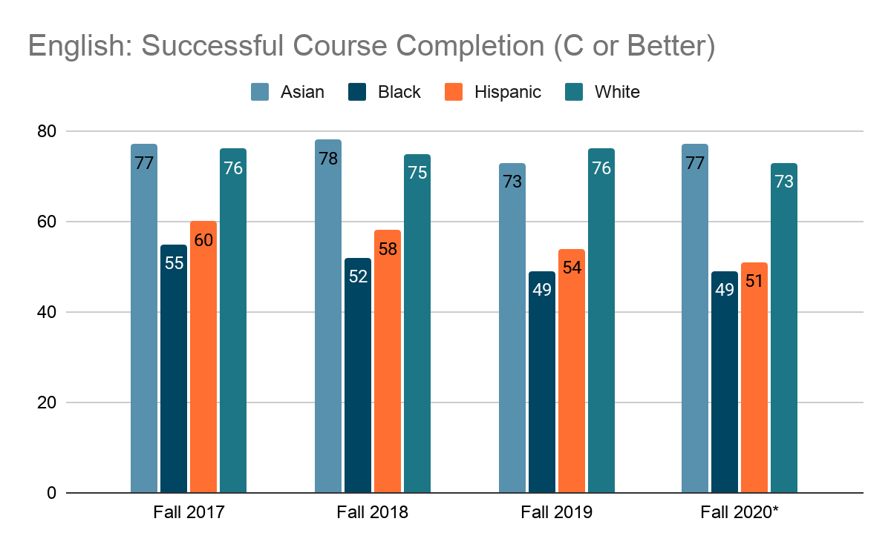
English Success Rates: Achievement Gaps Persist

Slide 15
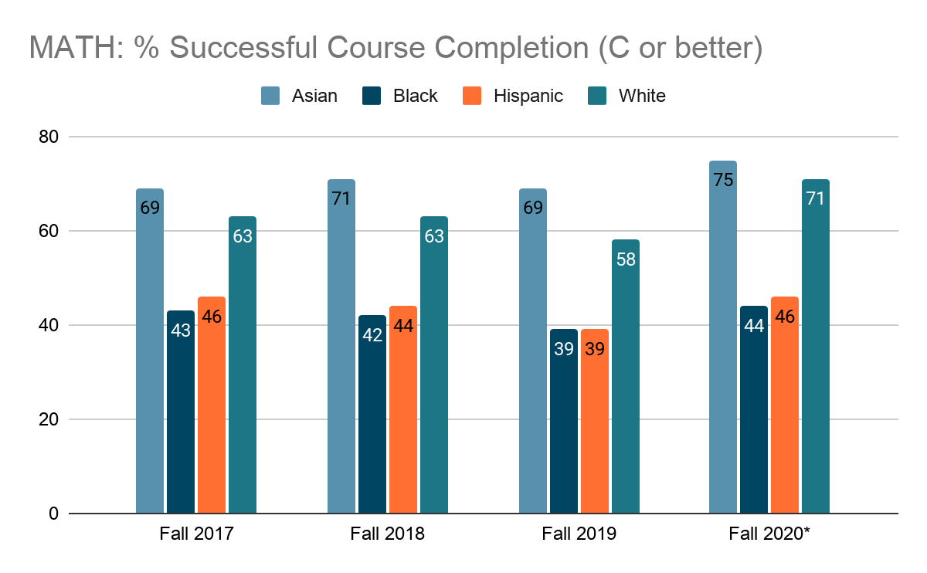
Local Perspective: Findings from LACCD
Notes:
Angela

Slide 16
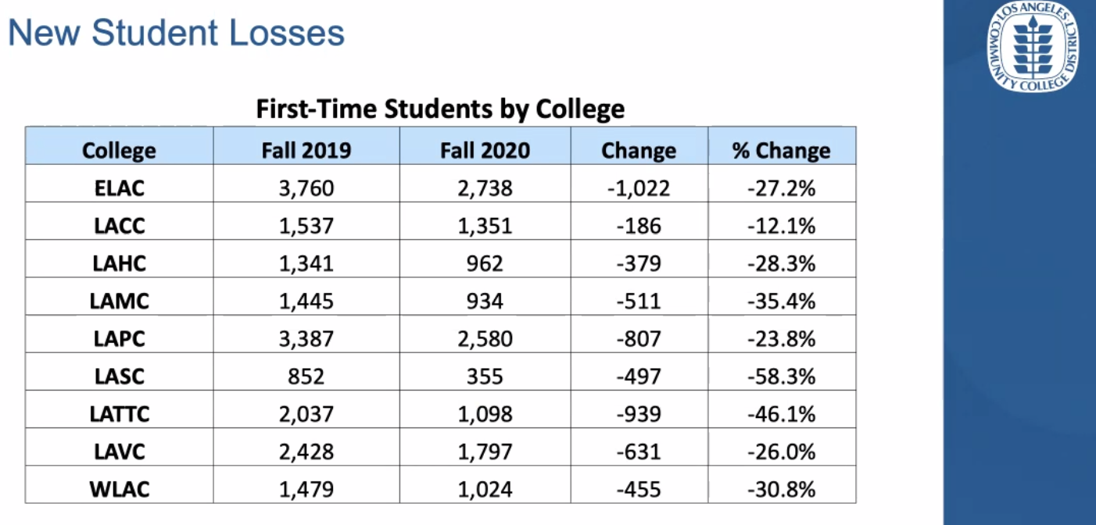
COVID Realities: Preparing for Post-COVID Education
Fewer first-time students enrolling in English and mathematics courses
Fewer first-time students enrolled at many colleges; gap years
Notes:
All (Angela lead)
Post-COVID - data re: impact on students, especially students of color (LA Times Article, Times article)
Preparedness gaps
Cannot make same assumptions about student preparation as we could pre-COVID
Google doc for participant engagement

Slide 17
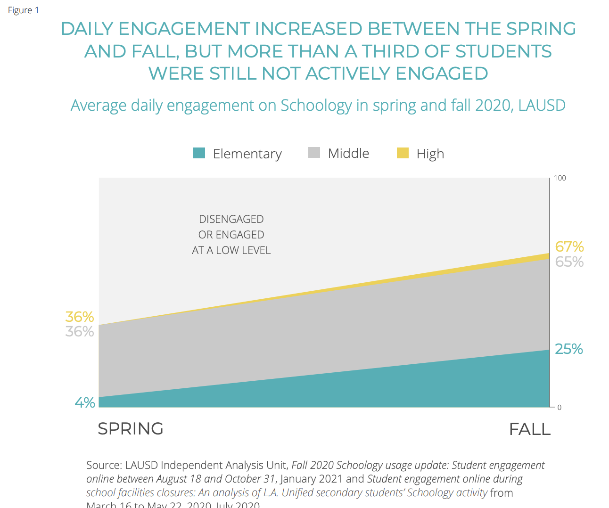
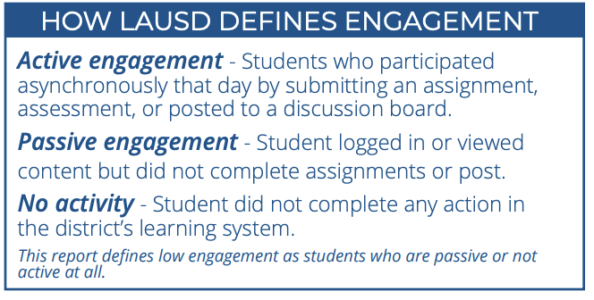
Impact of COVID-19 Learning Loss
Los Angeles Times article and LAUSD Educational Recovery Report More than ⅓ of LAUSD students are not actively engaged in online learning

Slide 18
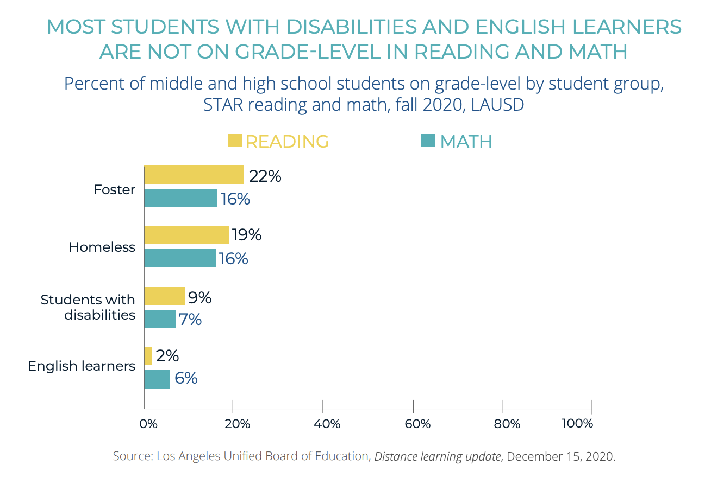
English Learners & COVID-19 Learning Loss
Los Angeles Times article and LAUSD Educational Recovery Report
Nearly 20% of LAUSD K-12 students are English learners
In spring 2020 fewer than half of English learners in middle and high school participated in distance learning each week
More than 94% of English learners are not at grade level in reading and math

Slide 19
What Can We do to Close Gaps?
First of all...
Work together
Avoid placing blame or pointing fingers
Stay focused on students and student needs
Share successes
Learn from challenges
Think creatively
Notes:
Cheryl w/ input from all
What actions can we take to support students & colleagues to proactively address increased gaps in preparation, effects of COVID stress and education breaks

Slide 20
What Can We do to Close Gaps?
Meet students where they are
Utilize guided self placement & onboarding tools to identify areas needing additional support
Explore additional support structures - think outside the box
Survey students!
Look at data from several viewpoints
Talk to students to identify their needs
Notes:
Cheryl w/ input from all
What actions can we take to support students & colleagues to proactively address increased gaps in preparation, effects of COVID stress and education breaks

Slide 21
Evaluating our placement protocols
Understanding:
Access and placement - Providing options for students, explaining those options
Enrollment - Helping students find the path to meet their goals
Student Support - helping students stay on their path, help students to get back on the path or a new path if goal changes
Notes:
Cheryl w/ input from all
What actions can we take to support students & colleagues to proactively address increased gaps in preparation, effects of COVID stress and education breaks

Slide 22
Evaluating Placement Protocols
How should decreasing success rates be analyzed, and how are they being addressed?
How do colleges balance throughput with success rates, retention, and persistence?
What are the specific factors that influence success in strategies such as Puente, EOPS, Umoja, and DSPS to optimize success and reduce equity gaps?
What opportunities exist to innovate and serve students with tailored guidance and support to optimize success from an individual student perspective?
How are full-time and part-time students served?
How are returning or continuing students served?
Notes:
Cheryl w/ input from all
What actions can we take to support students & colleagues to proactively address increased gaps in preparation, effects of COVID stress and education breaks

Slide 23
ASCCC Next Steps: Placement Survey
ASCCC delegates passed Resolution F20 18.01: Paper and Resources for Evaluating Placement in English, English as a Second Language, and Mathematics Pathways
2nd Resolved: Resolved, That the Academic Senate for California Community Colleges, in collaboration with system partners, write a paper on optimizing student success by evaluating placement in English, English as a Second Language, and mathematics pathways for consideration at the Spring 2022 Plenary Session.
Survey purpose: collect qualitative data to inform focus of paper

Slide 24
Questions?
Thank you!
info@asccc.org

