Slide 1


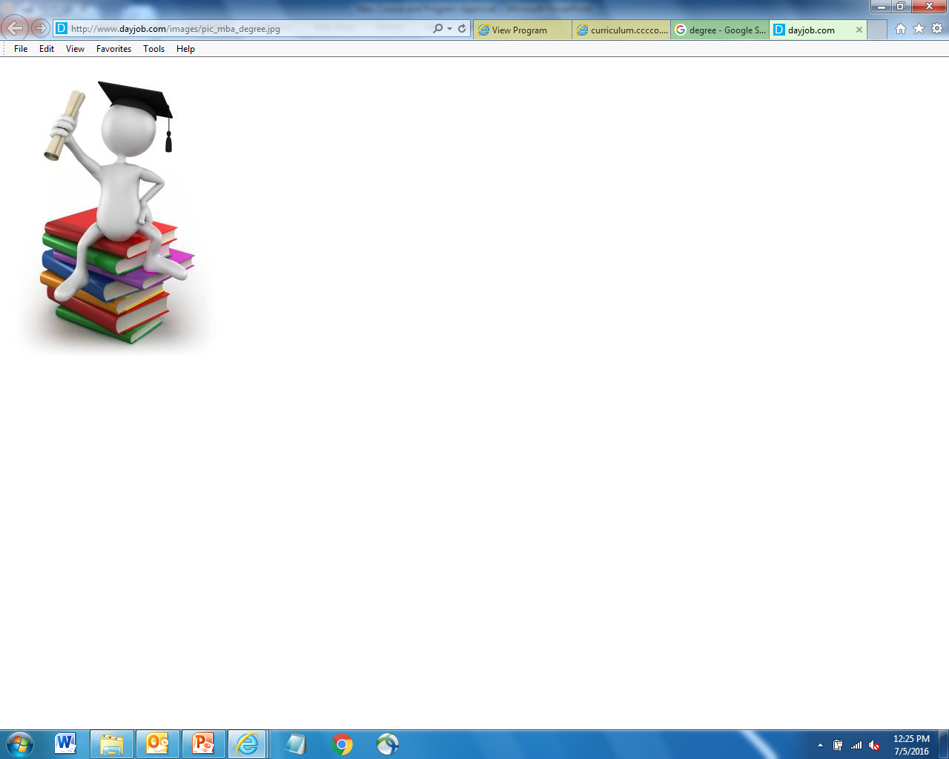
Associate Degree of Transfer
ADT Review
Raul Arambula
Kevin Olson
Academic Affairs Division
Chancellor’s Office

Slide 2

ADT Marketing Campaign
Funding -
  Total campaign investment of $11 million for five years
  $3 million campaign budget of for year one
  $2 million campaign budgets of for up to four additional years
  Campaign funding anticipated to end June 30, 2020
Increase transfer opportunities
English and Spanish focus groups
Radio and television commercials

Slide 3

ADT’s Awarded
ADT Review

Slide 4

Demographics for ADTs

Slide 5
Demographics for ADTs

Slide 6
Demographics for ADTs
Notes:
Challenges not to exceed the 60 unit requirement
Survey colleges to
Determine barriers?
How did colleges meet the 60 units?
Does decreasing math or science units to not exceed 60 units impact the students?

Slide 7

Transfer Model Curriculum
ADT Review
  Areas of Emphasis -
    Global Studies
    Social Justice
    Law, Public Policy, and Society
    Social Work and Human Services
ADT Review
Notes:
SB 440 mandated 4 areas of emphasis
Broader
College can choose to do them

Slide 8

ADT Review
Verify the completion of all the proposal fields
Ensure all the required CORs are attached
Match CORs to the courses listed in the Narrative and Course Report Section
Review Narrative for completion and accuracy
Verify total Unit count on the TMC
Verify Double Count calculation

Slide 9
ADT Review
GE Area (both CSU and IGETC) – incorrect or incomplete breadth requirement next to the course
Double count discrepancies
ASSIST Supporting Documents – incorrect report or not attached at all
Courses “expired” or not submitted to C-ID

Slide 10
ADT Review
Missing information in the Narrative or Education Code Section 66746(a) is misquoted or altered
  Degree should follow the convention “Associate in (Arts/Science) in (Discipline) for Transfer Degree”
    Associate in Arts in English
  Program requirements (when included) does not match template
  Name the baccalaureate program, specifies preparation for transfer to a CSU

Slide 11
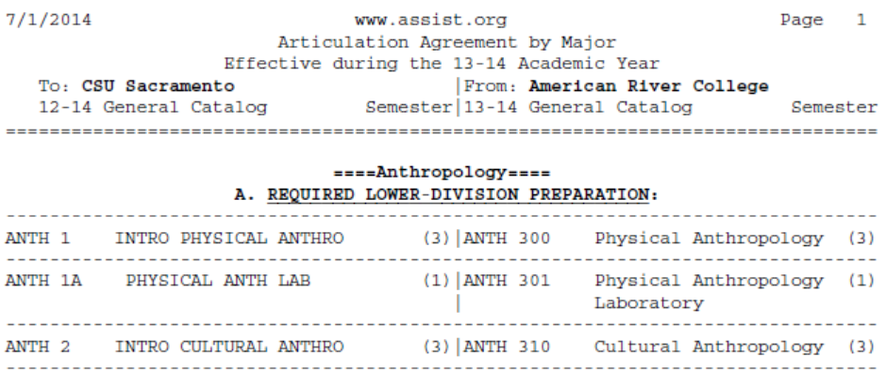
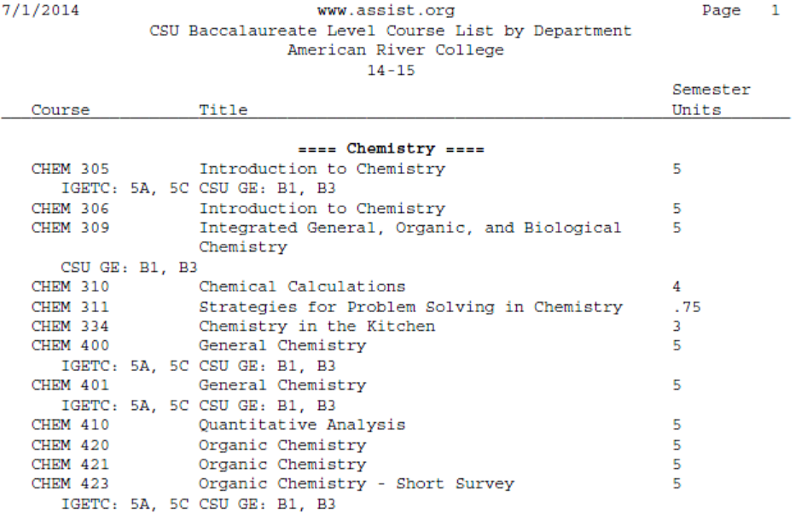
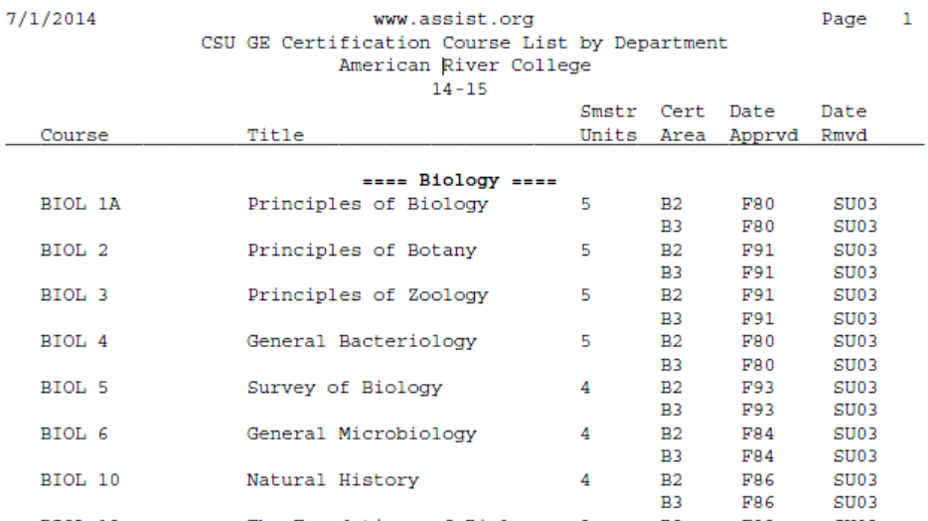
Correct ASSIST Documentation

Slide 12
Double Count Practice
3
3
3
3
3
3
9
9

Slide 13
9
3
3
3
3
3
3
3
3
3
3
3
3
3
3
3
3
3
30
39

Slide 14


Questions

