Slide 1
Dddd
Decolonizing Community Colleges:
Understanding History to Reimagine the Future Roberto D. Hernández San Diego State University

Slide 2
Sketch of Community Colleges’ Place within the Structures of Knowledge
Episteme (Eurocentrism)
World History-Universalism
Institutions: Academe/Universities
Humboldt Model
National Imaginaries
California Master Plan
4-year University
4-year Teaching College
2-year Community College

Slide 5
Ergo Cogito Sum or the Ego Cogito
I think therefore I am
Ego Conquiro
I conquer therefore I am
Four Genocides/ Epistemicides
Al-Andalus: Muslim and Judaic Peoples and Knowledges
Africa: Creation of the “Black” and destruction of the diverse Peoples and Knowledges of the continent
Americas: Creation of the “Indian” and destruction of the diverse Peoples and Knowledges of the continent
????

Slide 7
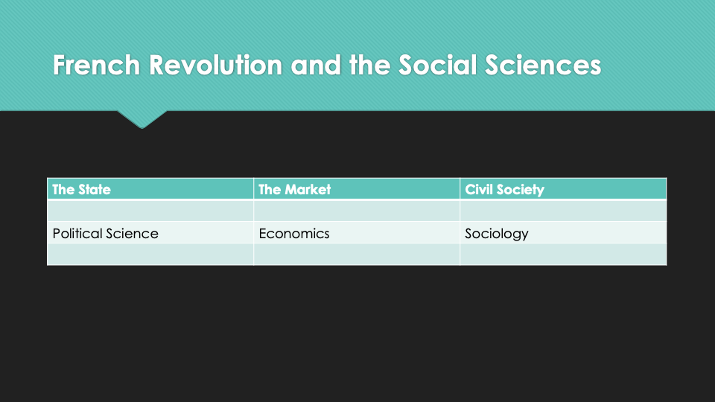
History?? Area Studies??
Anthropology?? Ethnic Studies??

Slide 8
Canonical Writing as Institutionalization of Eurocentrism
Across Disciplines, canonical authors tend to come from 5 countries.
-England
-Germany
-France
-U.S.
-Italy
Most of these authors are Men
Implications: ???
Let’s do the math!

Slide 9
Marx’s Philosophical Contributions
-Relation of "bourgeois philosophy" to class interests
-Opening for “scientific socialism” as serving proletarian interests
Contribution to the decolonization of knowledge
the actual 97-99%

Slide 10
We know the problem,
Ethnic Studies as antidote
Ethnic Studies as not just a history of groups
Ethnic studies as necessarily tackling socio-historical processes not peoples
Ethnic Studies as recognition of the entanglement of the structures of knowledge with diverse forms of power
Ethnic studies as not just Social Justice
Ethnic studies as not anti-racism or anti-racist education, but as the dismantling of the conditions of possibility that facilitate racism
Ethnic studies as a discipline that is not just interdisciplinary but inherently anti- or un-disciplinary
What now?

Slide 11
Ethnic Studies is not only a discipline, but an epistemic and pedagogical approach that is equity driven and culturally relevant. [difference in object of study vs. active subjects of history]
It should also be emphasized that in order to qualify as an Ethnic Studies course, it is not enough to add a unit on culture or race to the existing curriculum. The point of Ethnic Studies is to go beyond this simplistic supplemental or additive approach. Again, Ethnic Studies is not about adding “exotic” colors or flavors to the subject matter, but about the challenging of the fundamental underpinnings of the structures of knowledge.

Slide 12
How then do we decolonize community colleges?
Principles
We must recognize that CCs exist within a broader “constellation of institutions”
We can transform institutions but to decolonize we must deal with the epistemic infrastructure that sustains said knowledge structures
We must recognize the need to not just transform but abolish ourselves
Practices
Ethnic Studies by Ethnic Studies
Minimum required qualifications
Understand conceptual differences between ES and Diversity or Social Justice
????

Slide 13
Thank You!
Roberto D. Hernandez
rhernandez@sdsu.edu

