Slide 1
Defining and Measuring Student Success to Promote Equity and Address Individual Success
May 11, 2023
ASCCC Data and Research Committee

Slide 2
Webinar Description
What data tools are available to measure student success? Faculty work to develop student learning while preparing them for their individual goals: Be it transfer, career advancement, academic preparation, or personal enrichment. Student equity is central to and deeply intertwined with our focus on student success, and faculty are interested in ensuring our curriculum and student supports are meeting those equity-focused goals. Funding and statewide initiatives drive the metrics (e.g. throughput. transfer rates, etc...) that our system and many of our colleges prioritize, but often these metrics are considered in aggregate where the focus on individual students can be lost. Join the ASCCC Data and Research Committee for a discussion of how faculty define student success and share how to lay the foundations for designing good qualitative studies to contextualize quantitative data.
Notes:
Eric

Slide 3
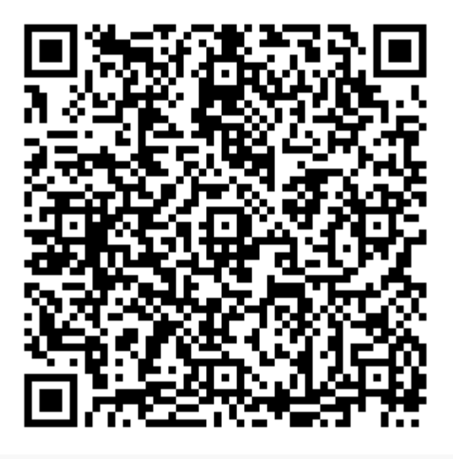
Defining Student Success
Who are you?
Why are you here?
How do you define student success?
Please respond to the questions above by completing our survey:
We will give some time for people to reply to the survey while we wait for people to come in.
Notes:
Eric

Slide 4
Who Are We?
Committee Members Presenting Today:
Emily Banh: Evergreen Valley College
Janet Fulks: Retired, Bakersfield College
Gina Lam: East Los Angeles College & ASCCC Researcher
Meridith Selden: Yuba College
Eric Wada: Folsom Lake College & ASCCC North Representative
Committee Members:
Brenda Edgerton-Webster: Grossmont College
Daniel Judge: East Los Angeles College
Erica Menchaca: Bakersfield College
Craig Rutan: Santiago Canyon College
Notes:
All

Slide 5
ASCCC Data and Research Committee
Purpose: The charge of the Data and Research Committee (DRC) is to assist local academic senates in using data effectively to evaluate educational programs and services to improve teaching, learning, and student success. The DRC will work with ASCCC Standing Committees, task forces, and other workgroups to establish and improve data-driven processes to advance inclusion, diversity, equity, anti-racism, and accessibility (IDEAA) in areas of academic and professional matters. The DRC may also conduct data analyses to assess the effectiveness of statewide issues and initiatives in areas of academic and professional matters.
Notes:
Eric

Slide 6
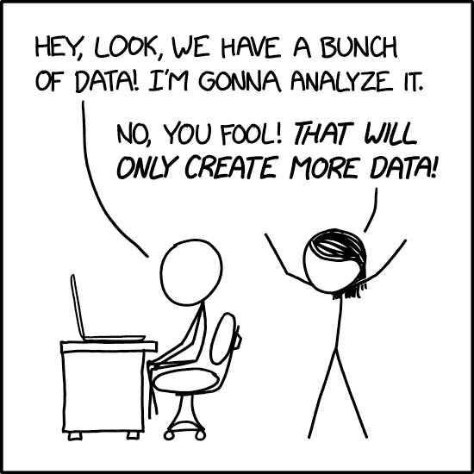
Agenda
Defining Student Success: A survey
Introductions
Student Success Metrics
Data sources: State dashboards and databases
Quantitative and Qualitative Data
How to Design a Qualitative Study
Data Coaching
Continuing the Conversations
Future Directions for ASCCC’s Data and Research Committee
Source: https://xkcd.com/2582/
Notes:
Eric

Slide 7
Webinar Outcomes
Once completed, participants will be able to:
Identify different types of data sources
Distinguish differences between qualitative and quantitative data and research methods
Recognize elements of survey designing
Get started on data coaching
Notes:
Eric

Slide 8
Statewide Data Sources
DataMart: CCCCO Data on enrollment, outcomes, etc….
Reports showing student counts, with demographic breakouts
Reports showing student outcomes in enrollments and programs, with demographic breakouts
Reports showing course characteristics, how the course was offered, and accounting method
LaunchBoard: CCCCO Data on progress, success, employment, earnings
Student Success Metrics
Successful enrollments
First time students
Learning progress
Momentum
Success
Employment
Notes:
Meridith

Slide 9
Statewide Data Sources
CalPass+: Longitudinal data K-12 to college and workforce.
To join Cal-PASS Plus, you need to complete a MOU and have it signed by an authorized signer (Deans, Chancellors, Vice Chancellors)
CA Dept Education: Provides access to reports and data about high school graduates meeting UC/CSU requirements
A-G Completion data can be disaggregated many ways including:
Absenteeism
Discipline
English Learners
Foster Youth
UC Transfer: Presents information on UC’s Applicants, Admits, and Enrollees.
CSU Transfer: Presents information on new undergraduate transfers from California Community Colleges
Notes:
Meridith

Slide 10
Quantitative vs. Qualitative Data
Data come in a diverse range of formats, giving us unique information. One distinction is between qualitative and quantitative variables.
Quantitative Data: Data that indicates the amount of the variable that is present
Rarely involve direct interaction with students
Often presented as summary statistics
Often used to answer questions of how much, how many, how often, etc.
Examples include number of units attempted, GPA, age, success rates, etc.
For qualitative methods - interviewing or quantitative surveying: both require strong questions.
Notes:
Meridith

Slide 11
Quantitative vs. Qualitative Research Methods
Data come in a diverse range of formats, giving us unique information. One distinction is between qualitative and quantitative variables.
Use specific methods to yield specific type of information- data
Qualitative data- at its simplest form is information expressed in words
Quantitative data- information expressed in numbers
Step 1:
What do you want to know?
What’s the issue you are having?
Step 2:
How to find out what you want to know?
What method are you going to use?
Step 3:
Who can answer your questions? Who can provide you a better understanding?
Which student group? Student demographic?
Which faculty members?
Notes:
Gina & Meridith

Slide 12
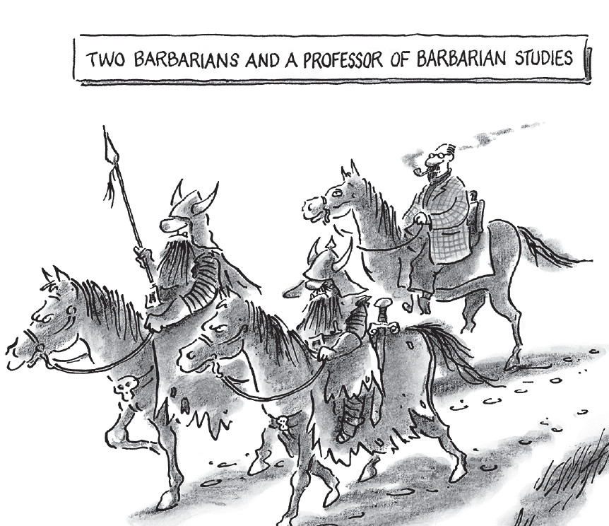
Qualitative Methods ->Qualitative data
Qualitative Methods
Interviews
Participant observation
Focus groups
Narrative feedback
Surveys
Qualitative data:
Interviews: data and info directly from respondents
Their perspective & understanding
Semi Structure- follow up questions
Participate obv: not relying on respondents accounts, but observe, participate, or experience
Uses an interpretive framework in combination with the scientific method: gives researchers depth of knowledge
Notes:
Gina

Slide 13
Qualitative Analysis: Answers
Sample responses one might receive:
Students explained that they had been placed in courses by counselors for general education requirements but were shocked to find the course was a pre-requisite for nursing and very detailed
Students described inadequate preparation in either pre-requisites or in high school
Students described not knowing how to study and prepare assignments from previous course work
Students described difficulty with the course schedule, number of assignments, need for study materials etc.
All of these highlight student experiences, perceptions, and stories that would not be captured from quantitative data.
Notes:
Gina

Slide 14
Qualitative Analysis: Designing a Survey
Who needs to be involved in survey design? Why?
How can life, educational, and career experiences be assets in designing equity-focused research?
How to involve collaborators?
Create an environment that welcomes input.
Work with appropriate offices to explain the benefits of expanding access to and involvement in research design.
Ask - What else should we ask? Did we miss any important factors?
Timeline for design (don’t underestimate), survey administration, analysis, preparation, and presentation.
Notes:
Gina

Slide 15
Qualitative Analysis: Challenges
Identifying students and incentivizing participation
Most students are busy, meet them where they are.
Find collaborators who could help include such a study into curriculum. Metacognition is a powerful learning tool regardless of discipline, and it reinforces good learning behavior in students.
Ask permission from students to share their responses
Checking language to fully understand what students perceive
Time to design, administer, and analyze the results
Resources: very least time and space
Notes:
Janet & Gina

Slide 16
Qualitative Data: Presenting the Data
Keep in mind:
What is the intent/ purpose of the research: What are you trying to understand? Do your responses help you better understand the issue?
Your subjects: who are you extracting information from
Equity-centered questions and research practices.
Your audience: who are you presenting this information to
Presenting the Data:
Frame the question
Present quantitative data for context and to organize the results.
“Trends in unit load, drop rate, success/completion lead to questions”
X students report ___ is a challenge or ___ is most helpful.
Persuasive methods:
Graphics, visuals, videos, student voices (live or recorded)
Know your audience. Prepare an elevator pitch and multiple methods of presenting your data.
Above all be ethical in your methods and presentation.
Notes:
Janet & Eric

Slide 17
What Can You Implement Next Term?
Example:
Surveying students beginning of the semester
I used this to confirm seat in class in the first week and is included in welcome letter
students get 1pt extra credit
Surveying students mid semester
Used this to decide what to do for the 2nd half of the semester- buy in from students
1 pt extra credit
Sample questions:
Why are you taking this class
What other responsibilities (e.g. work, childcare) do you have?
What do you already know about XYZ class topic?
How can I be helpful in facilitating your ability to learn?
Notes:
Gina

Slide 18
Data Coaching is…
promoting a culture of data inquiry campus-wide
training faculty, classified professionals, and administrators to talk about, examine, analyze, and interpret data to make informed decisions
empowering faculty, classified professionals, and administrators to question and talk about student data to address equity gaps
looking at data through the equity lens
Notes:
Emily

Slide 19
Data Coaching…
Promotes data literacy
Fosters a broad understanding across the college about the importance of data access and use
Helps educators use data to design and implement specific aspects of a particular student success initiative on campus
Tracks progress over time towards improving student success and more equitable student outcomes at the program and institutional levels
Notes:
Emily
Engage many campus stakeholders in understanding and making sense of data

Slide 20
Data Coaching: The Data Coach
An effective data coach:
is curious and interested in data
leads collaborative inquiries about data
can facilitate courageous conversations about equity gaps revealed in data
has trusting relationships will different constituent groups on campus
facilitates continual and regular discussions about data with their department, division, and campus
Notes:
Emily
Build a data coaching effort:
A study by the researchers of CA CC’s RP Group has identified three key steps for launching a data coaching effort. You should:
A study by the researchers of CA CC’s RP Group has identified three key steps for launching a data coaching effort. You should:

Slide 21
Data Coaching: Get Start!
Build your data coaching team
Train the data coaches
Track your progress over time
Take notes where your college gain traction
Report how data use contributes to program solutions that improve equitable student outcomes
Think long term
Identify sources of ongoing financial support in the budget
Notes:
Emily
Think long term: Sustain your data coaching practice by building it into your college’s planning and decision-making infrastructure

Slide 22
Data Coaching at Bakersfield College
Studies completed at Bakersfield College:
Comparison of Behavioral Stats and Math Stats
Library Usage
Effectiveness of Library Courses on plagiarism and research
Textbook Usage in Communications
Field Trip Value in Biology Courses
Developmental Education Support Strategies
Notes:
Emily
Build a data coaching effort:
A study by the researchers of CA CC’s RP Group has identified three key steps for launching a data coaching effort. You should:

Slide 23
Data Coaching at Bakersfield College
Key elements of Bakersfield College’s data coaching program:
Inclusive- all levels of faculty and classified professionals included
FERPA course required - a certificate of completion
Encouraged studies to improve practice
Required a report out and share findings with the campus
Stipends were provided
Meetings were in computer labs
Notes:
Emily
Build a data coaching effort:
A study by the researchers of CA CC’s RP Group has identified three key steps for launching a data coaching effort. You should:

Slide 24
Data Coaching at Evergreen Valley College
Content of Canvas Course on Data Coaching
Module 1: Introductions
Module 2: Data Analytics
Module 3: Data Analytics (Internal & External Data)
Module 4: Data Analysis
Module 5: Data Storytelling
Module 6: Surveying Students and Faculty
Notes:
Emily
Build a data coaching effort:
A study by the researchers of CA CC’s RP Group has identified three key steps for launching a data coaching effort. You should:

Slide 25
Data Coaching
Specific Modules 1, 5, and 6- EVC
Module 1: Introductions | Module 5: Data Storytelling | Module 6: Surveying Students and Faculty
Welcome/Overview Things to Know Learning Resources Data Coaching CCC Terminology Powerpoint about Data Coaching | Displaying Data Presenting Data Difficult Conversations about Data | Thoughts/Concerns about Surveying Literature (Student Survey) Literature (Faculty Survey)
Notes:
Emily
Build a data coaching effort:
A study by the researchers of CA CC’s RP Group has identified three key steps for launching a data coaching effort. You should:

Slide 26
ASCCC and Data Coaching Resources
CCC Data Coaching for Guided Pathways Development
RP Group Resources
ASCCC Data 101 Webinar (2021)
ASCCC Data 101 2010 Executive Committee Paper
Department of Education Course on FERPA https://studentprivacy.ed.gov/training/ferpa-101-colleges-universities
Bridging Research, Information and Culture. Guides for research developed collaboratively with ASCCC and RP https://rpgroup.org/BRIC/BRIC-inquiry-guides
Notes:
Build a data coaching effort:
A study by the researchers of CA CC’s RP Group has identified three key steps for launching a data coaching effort. You should:

Slide 27
Future Directions
Prioritize more data discussions at your Senate and committee meetings. What data needs or interests do faculty have?
Look for continued professional development next year. Suggest topics here, or communicate through various methods:
Consider expressing interest in the Data and Research Committee or other ASCCC committees for next year.
Work with your Academic Senate to request a local senate visit to talk about data.
Resolutions, for example, 13.02 (Fall 2019) which calls for:
Resolved, That the Academic Senate for California Community Colleges develop a resource, whether a paper or in some other form, in collaboration with systemwide partners to evaluate the current use of data and recommend effective practices; and
Resolved, That the Academic Senate for California Community Colleges explore and identify web resources that include promising practices for data analysis that faculty can utilize to better serve students and advance equity on college campuses.
Notes:
Eric

Slide 28
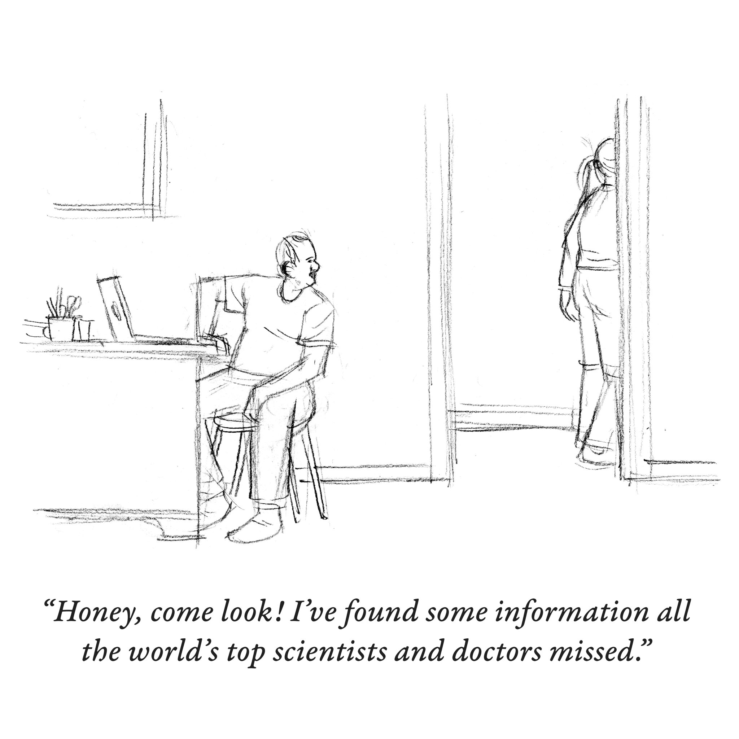
Questions and Discussion
Follow-up questions and
to request a local Senate visit:
info@asccc.org

