Slide 1
Addressing Equity Gaps by Using Outcomes and Assessment Data as Mirrors to Insuring Learning
ssssdssddsssdkdsksjsddksskjd
Notes:
ALL

Slide 2
Notes:
SAM

Slide 3
Ensuring Learning: A Pillar in Guided Pathways
Often thought examined at the institutional or program level
May use outcomes data to assess
A component of program review
A high-level view of student progress
Notes:
SAM

Slide 4
Examining Student Success Data
Program level outcomes can only be achieved if students successfully complete courses
Examining data can
Reveal bottlenecks within program
Reveal which students are succeeding and which are not
Reveal opportunity gaps within a program
Must be examined with an equity lens
Notes:
SAM

Slide 5
Examining Data with an Equity Lens
Collegewide Data
Generally available
Can be disaggregated using readily available resources (e.g., CCCCO Data Mart)
Can identify opportunity gaps for the college
Can be used to drive policy decision and programs
Notes:
SAM

Slide 6
Examining Data with an Equity Lens
Disaggregating Department-Level Data
Disaggregate by race and ethnicity
Can identify opportunity gaps for the department
Can drive department discussions
Notes:
SAM

Slide 7
Examining Data with an Equity Lens
Disaggregating Course and Faculty-Level Data Can
Reveal opportunity gaps within your classes
Cause self-reflection as to what you can control
Motivate professional learning opportunities
Drive curricular and pedagogical changes
Notes:
SAM

Slide 8
Windows & Mirrors
Instructor-Led Planning to Close Opportunity Gaps Reflected in Disaggregated Instructor-Level Data
Notes:
SAM
Now CCSF is going to talk about how they looked at faculty level data.

Slide 9
The delightful truth is that sometimes when we hear another out, glancing through the window of their humanity, we can see our own image reflected in the glass of their window.
Emily Style
Curriculum as Window and Mirror
Notes:
MITRA
Over the course of the past six years the English department at City College of San Francisco has been using Student Equity and Achievement (formerly Student Equity) state funding to support professional development that has been focused on equity. The particular work that we’ll share with you today relates to our department’s desire to give instructional faculty more agency in closing equity gaps in their own classrooms. So this is the framework that we began our conversation with--Emily Style’s 1998 essay, quoted here, gave us our initial foundation with an emphasis on our perceptions of ourselves as instructors and how that is reflected in our data as well as when we scrutinize our own practices.

Slide 10
English Community of Practice
Summer 2019
Session 1:
Building Equity into the first week of class
Session 2:
Instructor-led Planning Using Disaggregated Faculty-level data
Session 3:
Developing more equitable assessment strategies
Notes:
MITRA
Our community of practice had three sessions in the Summer of 2019; three full days where participants received hourly non-instructional pay and lunch to participate. Today we’ll do a deep dive into the second session where we focused on looking at disaggregated data as a window into our own classrooms.

Slide 11
English Community of Practice
Summer 2019
34 faculty (tenured and adjunct) received up to 5 years of disaggregated data, confidentially
Reading ahead of time to frame the discussion.
Explanation and Q&A directly from research office data analyst
One faculty models responding to her data
The group reflects on their own data
Notes:
MITRA
As part of our efforts to intentionally and pointedly take ownership of how classroom experiences influence equity gaps at the college, we took completion data to our faculty. We had 34 faculty opt in to get their own individual completion data. For whom it was applicable, faculty got to see over a 5-year span (summers included) where the equity gaps showed up in their own data. From there, we expanded on the homework we had given ahead of the session. Participants were given homework ahead of time to frame the conversation, outlining what disaggregated data is and how it can be used to lead to self reflection of classroom practices.

Slide 12
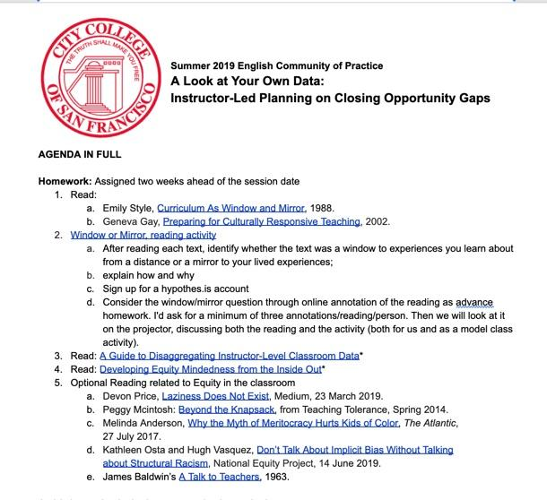
Framing the Windows and Mirrors
Before the Session
Notes:
MITRA
Participants were given homework ahead of time to frame the conversation, outlining what disaggregated data is and how it can be used to lead to self reflection of classroom practices.

Slide 13
Faculty Data
Faculty sign up ahead of time for the PD event and were informed about the faculty level data.
Assurances the faculty level data will not be used in evaluation.
Faculty name and a unique identifier are collected.
The Office of Research delivers the data to the faculty member directly.
The Set Up
Notes:
MICHELINE

Slide 14
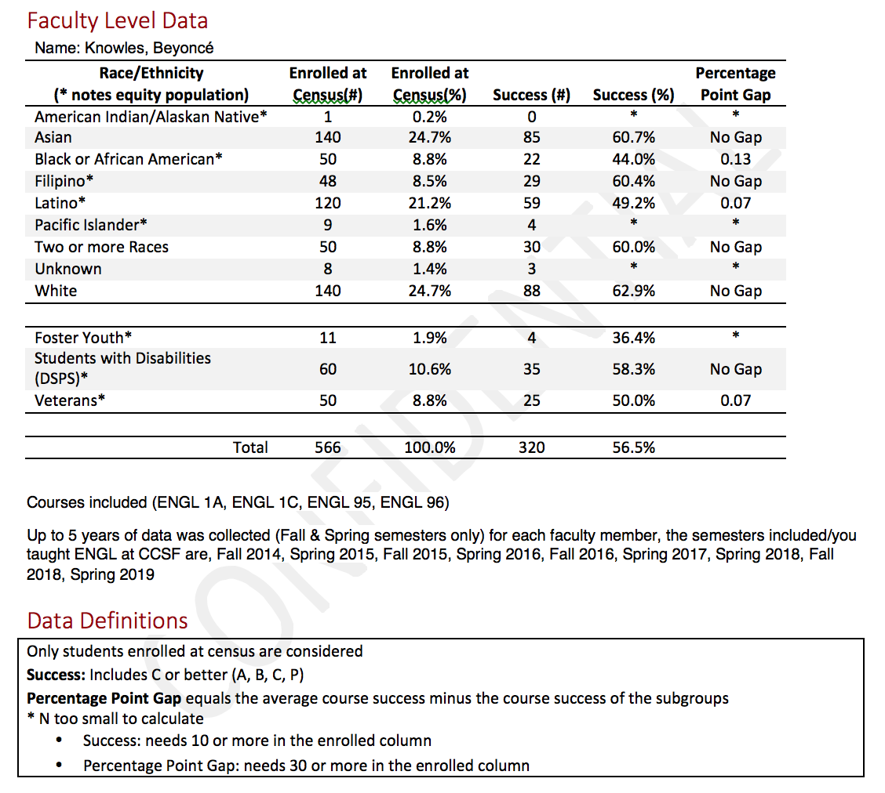
Primary instructor only
* Hide small sample sizes
Explicitly identify opportunity gaps
5 years of aggregate data
(if available)
Walk through each piece of the data sheet
Notes:
MICHELINE

Slide 15
Framing the Windows and Mirrors
During the Session
How does equity inform your curricular choices (such as, interpersonal relationships, classroom facilitation, curriculum, rules and policies, values and beliefs)?
With your data in mind, where in this work do you thrive?
With your data in mind, where do you see opportunities to improve your agency?
Notes:
MITRA
It was important for us to properly frame the conversation with common and shared definitions of the concepts we were discussing (equity, diversity, belonging) but to also give folks a clear idea of the data piece (disaggregated data handout). We asked faculty to consider their perceptions of their students and of themselves, and then once the got their data, we used Center for Urban Education guides to invite them to interrogate their classroom practice and curriculum choices.

Slide 16
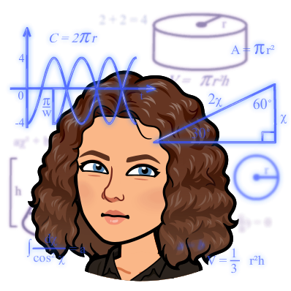
One Faculty’s Data
One faculty presents her data
She shares her reflection process after seeing her data
examines groups that are doing well in her classes
examines groups not doing as well
questions what parts of her practice encourage these data trends
A Window
Notes:
MITRA
Another frame we offered was to walk through a real life example from a colleague to interrogate and disrupt her own data. I offered my own data, revealing my own equity gaps to those participating.

Slide 17
What I think Works
Interactive, personal assignments
Timely and current topics
Student questionnaire
Learning names quickly
Required one-on-one conferences
Flexible office hours
“Attempts” at self deprecating humor
Sharing personal anecdotes
Get to class early; stay after
Assignments worth more as semester progresses
Notes:
MITRA

Slide 18
What Doesn’t Work
Focus on all-class discussions, rather than small group work
Publicly call out bad behavior
Course syllabus with punitive tone
Make assumptions
in attempts to
connect with
students
Focus on talkative students
Rely on pop culture references
Avoid interaction with students with language or other barriers in class discussions; intention is sensitivity to their comfort, but impact is exclusion.
Insufficient time spent on community building and only in the beginning of the term.
Notes:
MITRA
Also, content shifts occur regularly, but methodology stagnates so how I was teaching was also problematic. Sometimes we think if we just change the content we’re covering the bases of inclusive classroom practice that celebrates diversity of perspectives, but when it comes to the structures of teaching--like grading, establishing deadlines, content discussions--we fall back on old habits that we’ve picked up along the way and don’t always stop long enough to fully assess their efficacy. And this reflection should happen regularly because as we all know, one size does not fit all and our individual students need different things. So if we can create an environment where students are engaged, empowered and comfortable enough to share their needs, that’s how we can be more efficient as instructional faculty. We need to recognize the elements of curriculum trauma as well so that we don’t inadvertently do more harm than good.

Slide 19
A Participant’s Perspective
Notes:
KYLE

Slide 20
My Takeaways
Seeing my data was humbling and thought-provoking
I'm more aware that equity gaps exist in my classes
I’m anxious to see immediate improvement in my data.
Notes:
KYLE

Slide 21
Breakout Rooms
Let’s take a few minutes to reflect on your college, your data, and you.
Google Slides: https://docs.google.com/presentation/d/17u69gIhLc4spA4feTOj1kwPFOcxc4_roS7mUxfTBzaQ/edit#slide=id.gcee04cfa87_0_19
Digestion
Notes:
MICHELLE

Slide 22
The Facilitators’ Perspectives

Slide 23
What Worked
What Didn’t Work
Notes:
MICHELINE & MITRA
Worked: pairing research analyst with a faculty lead, Building community through ongoing community of practice work (building pd internally each semester for six years), the lunch break giving time to digest, clear direction and focus ahead of time
Didn’t work: when there’s not enough context to frame the session; agenda too full; transition between giving data and reflecting on the implications of the data needs more time and attention.

Slide 24
New Considerations
Navigating Remote PD and Addressing Anti-Racism
Sessions via Zoom
More frequent, shorter sessions
Meet with small groups
Handling data remotely
When to provide data to avoid distraction
How to provide data digitally and securely
Ensure time for folks to process privately and in groups, with ongoing support.
Engaging students in the conversation.
Inviting and encouraging faculty to interrogate their own practice as well as the structures that they work within to question effectiveness and validity.
Notes:
MICHELINE & MITRA

Slide 25
Academic Senate
Diversity, Equity, Inclusion and Belonging Resolution
Passed November 2020
Three-month drafting process
Cross-Constituency Collaboration
Equity Action Plan
Notes:
MITRA
On a more expansive level, more college-wide, we realized that after years of equity programming our gaps were standing still and that we wanted to encourage everyone across the college to see themselves as part of this effort and to see themselves as part of the solution.
The faculty at-large have made a commitment to equity through the passing of a resolution last November that defines core values and outlines action. As a result, we have created an Equity Action Plan that attempts to align CCSF activities with the asks in the resolution. The Action Plan is intended to highlight the work in progress and focus attention in areas that we can all work to ensuring that the resolution is not perfunctory, but part of a larger movement to make equity a common core of our work.

Slide 26
Equity Resolution Action Items
foster a campus-wide climate of mutual respect between all constituencies;
promote student leadership and inclusion in college governance
cultivate a culture of meaningful reflection, and continuous examination of our own institutional systems and processes;
engage in collegial conversations that remind all college constituents of our shared responsibility to eliminate racism and discriminatory language, processes and acts in all physical, remote and digital CCSF spaces;
commit to recruitment and hiring practices that prioritize attainment of racially diverse employees and employees who demonstrate equity-minded competence;
create jointly organized, college-wide dialogue.
These are 6 of 19 action items in the resolution; to see the entire list, access the entire CCSF Equity Action Plan here.
Notes:
MITRA
Here are a few of the resolves to give you a sense of the action items and perhaps highlight areas where the Senate and Senate committees can collaborate with this group.
The hope is to recognize and celebrate the core values of equity at the institutional levels, so that we may be able to continue the type of work we have begun in the English department with more support and participation college wide.

Slide 27
Questions?
ASCCC
Info@asccc.org
Mitra Sapienza
City College of San Francisco
msapienz@ccsf.edu

Slide 28
Documents
A Look at Your Own Data: Instructor-Led Planning on Closing Opportunity Gaps, Agenda, English Community of Practice, City College of San Francisco, Summer 2019.
A Guide to Disaggregating Instructor-Level Classroom Data, City College of San Francisco Office of Student Equity, Spring 2020.
Developing Equity Mindedness from the Inside Out, City College of San Francisco Office of Student Equity, Spring 2020.

