Slide 1
Accreditation Q and A
APRIL 6, 2020
ASCCC and ACCJC

Slide 2
Presenters
Stephanie Droker, President ACCJC
Ginni May, Treasurer ASCCC
Janet Fulks, Retired Instructor Bakersfield College, ASCCC on Guided Pathways, Interim ACCJC Staff Liaison
Stephanie Curry, North Representative and Accreditation Chair, ASCCC
Notes:
Stephanie C

Slide 3
Agenda
Covid-19 and its impact on our system
Overview of Resources in time of Emergency from ASCCC and ACCJC
Frequently asked questions about Accreditation during the crisis
Recommendations for local Academic Senates
Q & A (use the Q & A feature in the Zoom Webinar)
Chat or no Chat
Notes:
Stephanie C

Slide 4
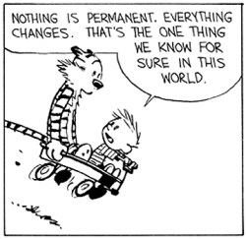
The COVID-19 Crisis
Change, Change, Change
Notes:
Stephanie C.

Slide 5
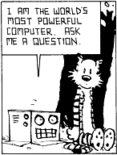
Question #1: Where do I go to get information and assistance
Official Guidance, Communication and Regulations can be found a these websites.
ASCCC COVID-19 Resources
ACCJC COVID-19 Resources
CCCCO COVID-19 Resources
US Department of Education COVID-19 Resources
Notes:
Stephanie C.

Slide 6
Question #2 How will this impact Distance Education and Correspondence Education
Definitions of Distance Education and Correspondence Education (Remote Education)
ACCJC Policy on Distance Education and Correspondence Education
Regular and substantive interaction
Comparable learning support (standards II.B.1, II.C.1)
Verification of student – registration, participation, completion, credit
Identification of Regular and Effective Interaction in a Zoom World
DE addendums/ CCCCO accommodations
What about Prison Programs?
Correspondence (no online capacity)
Notes:
Janet and Stephanie D.
DE and Remote Instruction= Correspondence Ed in Federal Regulations Define in Meeting (prison facilities) Policy on Distance Ed and Correspondence Ed (Add to Slide)
• Zoom and Correspondence Ed--Need regular and effective interaction—Need to document that the college defines it a regular and effective. Importance for Summer
This semester already had face to face so the regular and effective interaction has occurred
• Bullet points on DE accommodations from CCCCO

Slide 7
Question #3: Should we still be doing SLO Assessment and Program Review?
Academic Integrity and Student Learning Outcomes
From both the institutional side and the instructor side:
How do we know students are learning?
How do we know our teaching is effective?
How do we ensure course integrity?
Notes:
Ginni
Through SLO assessment – regardless of accreditation requirements
Using college approved LMS, email, and such

Slide 8
Question # 4: Are there any Accreditation concerns about the Clock Hour and Extended Semesters?
Federal regulations only mention reducing the academic calendar, not extending it
For concerns regarding clock hours, please have your ALO contact your ACCJC staff liaison
Notes:
Stephanie D.

Slide 9
Question # 5 What should we be communicating to students about changes?
Make sure students understand changes being made to instruction
Students should understand the implications of drops/withdrawals/grading options (such as P/NP)
Students should be aware of all the support resources available including student and instructional services
Make sure your catalog has language on EW
Academic Integrity and Students
Notes:
Stephanie C.
Janet - Discuss academic integrity with students –
It should be made clear that the option is Pass/No Pass and NOT credit/no credit
Make sure administrators, faculty and students understand the meaning of an EW

Slide 10
Question #6 What are the best ways to create documentation and evidence of changes?
Currently people need access to changes – post and save communications
We must clearly communicate with students Standard I.C. – Institutional Integrity – save web posting
Comparable learning support – II.B and II.C
Evaluate – you may learn something new
Notes:
Janet

Slide 11
Question #7 What can faculty do about Accreditation in a time of crisis?
Continue to follow local processes! – Have they gone away?
Colleges are still required to meet ACCJC Eligibility Requirements, Accreditation Standards, and Commission Policies – Rely on this.
Accreditation is driven by federal requirements – not state requirements
Code of Federal Regulations
Different from California Code of Regulations Title 5
Different from California Education Code
Notes:
Ginni --Processes/ Still have to do them, Required and priorities, Still need to meet requirements. Different that Title 5. Federal vs State Requirements—Local Decisions/ Directions of the Dept of Ed
Rely on the Accreditation Standards! Will cite a few.

Slide 12
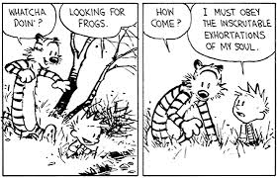
Question # 8 Are Colleges still responsible for completing ISERs, Annual Reports and other ACCJC required documents?
Still on schedule for ISERS and Annual Report – your ALO should contact the assigned staff liaison if there are concerns or issues
The college must consistently follow its policies regarding faculty participation in the review/approval of Accreditation reports
Notes:
Stephanie D.

Slide 13
Question #9 What is going to happen in Fall?
Commission has been in close communication with CCCCO staff, including the most recent memo on DE for the fall semester
As with the Spring semester, ACCJC will accept the information being sent to the CCCCO on DE from the colleges – which includes the listing of programs
Notes:
Stephanie D.

Slide 14
Question #10 What Can Local Academic Senates Do?
Clarify Regular and Effective Contact locally (Distance Education vs Correspondence Education)
Ensure quality education for Summer and Fall
Clarify Authentication and Comparable Services
Make sure processes such as SLO Assessment and Program Review still occur
Continue Review and Approval of Accreditation Reports
Ensure there are comparable support services for Distance Education and Correspondence Education students (including prisons) i.e. Students taking online courses need online support services.
Notes:
Ginni and Stephanie C.
I can cite a few standards for support.

Slide 15
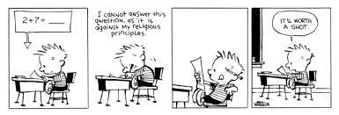
Q & A
Any Additional Questions?
Specific institution questions should be sent to the ACCJC through the colleges established Accreditation Process.

