Slide 1
Zen and the Art of Assigning Courses to Disciplines
Eric Narveson, ASCCC Standard and Practices Committee
Jeff Waller, ASCCC Curriculum Committee
Carrie Roberson, ASCCC North Representative
Julie Oliver, ASCCC Area A Representative

Slide 2
Housekeeping…
Pathable vs Zoom
How do I use chat?
How will I find the polls?
Where are the resource documents for this session?

Slide 3
Introductions
Please let us know who is here by using the Chat in the Pathable platform to add the following:
Name, college, discipline, leadership role
Also, please post your questions in the chat and we will address as many as possible throughout the session.

Slide 4
Today, we will discuss…
Why, who, and how? Legislation to local determination
What? Courses, disciplines, departments, min quals/equivalency
Basics- disciplines list, MQ’s/Equivalency
Principles for academic senates and relation to curriculum committees
Conflicts and Challenges
Scenarios
Effective Practices
You will want to have the MQ Handbook ready to use during this breakout.
Here is the link for the document: https://www.cccco.edu/-/media/CCCCO-Website/About-Us/Divisions/Educational-Services-and-Support/Academic-Affairs/What-we-do/Curriculum-and-Instruction-Unit/Minimum-Qualifications/cccco_2020_report_min_qualifications-a11y.pdf?la=en&hash=05CDC88FD9F1C0ABFA99B7D157889935F2204FE1

Slide 5
WHY? Legislation & Regulations
Title 5 §53200(c): “(1) Curriculum, including establishing prerequisites and placing courses within disciplines” ...also known as the 10+1!
Equivalency: Ed. Code §87359(b)
Minimum Qualifications: Ed. Code §87360(b)
Minimum Qualifications
Degrees and credits generally must be from accredited institutions (§53406).
An occupational license or certificate is required in certain instances (§53417)
A district may hire a person who possesses qualifications different from, but equivalent to, those listed on the disciplines list, according to criteria and procedures agreed upon by the governing board and the academic senate (§53430)
Second Minimum Qualification
Education Code section §87360 requires that sensitivity to and understanding of diversity be included in the district’s final hiring criteria.

Slide 6
WHO?
Local Responsibility
Assigning Courses to Disciplines
Department structure/boundaries
Equivalency Policy/Procedure

Slide 7
The Disciplines List
Specifies the minimum qualifications for each discipline
A “discipline” is defined as a grouping of courses that share common academic or vocational preparation, which are typically defined by a degree or degrees (MFA, MA, BA, MS, etc), or specific professional preparation.
Discipline is from the perspective of faculty preparation and faculty must meet the MQs for the discipline of the faculty member’s assignment.
Revisions to Discipline List is done annually
Board of Governors considers the recommendations of the Academic Senate and formally acts on them.
https://www.cccco.edu/-/media/CCCCO-Website/About-Us/Divisions/Educational-Services-and-Support/Academic-Affairs/What-we-do/Curriculum-and-Instruction-Unit/Minimum-Qualifications/cccco_2020_report_min_qualifications-a11y.pdf?la=en&hash=05CDC88FD9F1C0ABFA99B7D157889935F2204FE1

Slide 8
Local Minimum Qualifications
A college/ district may establish additional qualifications which are more rigorous than the state-established MQs.
However, local MQs cannot be less rigorous than the state-established MQs.
Equivalency must be established locally and must be at least equivalent to the minimum qualifications.

Slide 9
Disciplines vs. Departments
Departments are locally-defined organizational structures.
Instructional faculty teach courses assigned to disciplines, not departments.
Not the same as your local designator, a TOP code, or a FSA
Faculty must meet the MQs of the disciplines to which courses are assigned.

Slide 10
HOW?
Assigning Courses to Disciplines
Determine the minimum qualifications necessary to teach a
course.
Local academic senates maintain responsibility for placing
courses in disciplines (§53200(c)(1)).
All credit & noncredit courses must be placed within a
discipline or disciplines.

Slide 11
Options for Assigning Courses
Course assigned to a single discipline
Example: ENGL 101 assigned to English. The minimum qualifications for English provides adequate preparation to teach the course content.
Course assigned to more than one discipline with an “or”
Example: ARTS 101 assigned to Art or Graphic Design. The minimum qualifications for either discipline provide adequate preparation to teach the course content.
Course assigned to more than one discipline with an “and”
Example: HUMA 120 assigned to Humanities and Ethnic Studies. The minimum qualifications for both disciplines together provide adequate preparation to teach the course content.

Slide 12
Multiple Disciplines
Do not need to have more than one course outline of record (COR) or be listed in the catalog under multiple subject codes.
Example: ARTS 101 is assigned to Art OR Graphic Design on the COR. The college only maintains one COR for ARTS 101. The course is listed in the catalog ONLY as ARTS 101. However, faculty who meet MQ for Art or Graphic Design can teach the course.
May be “double-coded” or “cross-listed”—i.e., recorded on two or more CORs and listed in the catalog under each subject code.
Example: Social Psychology is recorded on two separate CORs, one as PSYC 120, one as SOCI 120. It is listed in the catalog under both subject codes. These courses should have identical CORs.

Slide 13
Local Disciplines Assignment
A district may locally assign any discipline on the state list for local use, but they do not have to use any particular discipline.
For instance, if a district has not locally adopted the discipline of Art History, it could assign all of its Art History courses to the discipline of Art.
In this case, the MQs for Art History classes in that district would be those defined for the Art discipline, not the Art History discipline (unless/until the district chose to change this).

Slide 14
Multi-College Districts
While some multi-college districts
have common courses, others do not.
Since your district has one set of minimum qualifications,
similar courses should be placed in the same discipline, even if they are called different things.
Your local process may be different than those in single
college districts.

Slide 15
Impacts
Single Discipline
Faculty who meet minimum qualifications or the locally-determined equivalent for THAT listed discipline are eligible to teach the courses within that particular discipline.
More than one discipline with an “or”
Faculty who meet minimum qualifications or the locally-determined equivalent in ANY of the listed disciplines are eligible to teach the course.
More than one discipline with an “and”
Faculty who meet minimum qualifications or the locally-determined equivalent for ALL of the listed disciplines are eligible to teach the course.

Slide 16
Disciplines | Courses
Earth Science | EARTH 1 GEOL 1 GEOL 6 OCEANO 1
Chemistry | CHEM 60 CHEM 101 CHEM 102 CHEM 211 CHEM 212 CHEM 221
Geography | GEOG 1 GEOG 15
Courses Assigned to Disciplines

Slide 17
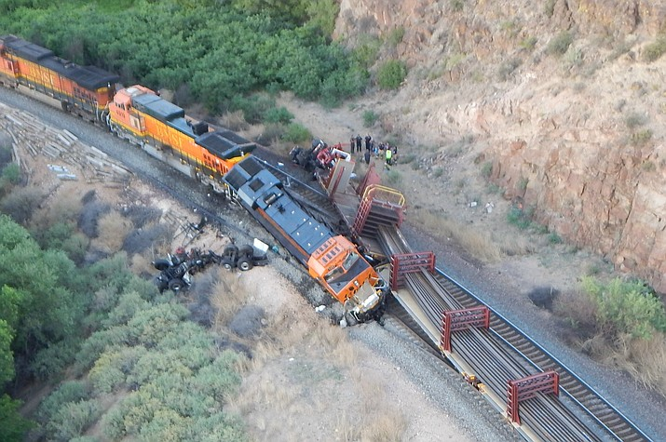
Conflicts When Assigning Courses
How does your local process deal with conflicts like this?

Slide 18
Scenario A Which Discipline(s) Would You Assign?
Multimedia Applications for the Web
Introduction to the use of multimedia components, images, typography, motion and audio, for designing websites. Software may include Photoshop, Dreamweaver, SoundEdit 16 and Flash. Projects include conceptualizing, storyboarding, and designing Web page layout. Application of design elements to Web page creation.

Slide 19
Scenario B Which Discipline(s) Would You Assign?
Introduction to Peace and Conflict Studies
Historical, social, and economic development of the world order along with a wide range approach integral to the examination of global studies, peace and conflict resolution. The study of peace and conflict areas to include the war system, war prevention, nonviolence, human rights, social justice, environmental sustainability and the role of the United Nations and other international governing bodies.

Slide 20
Scenario C Which Discipline(s) Would You Assign?
Introduction to Geographic Information System
This course introduces basic scientific principles of Geographic Information Systems (GIS) as they relate to working with data that have important spatial orientation and organization. Geometric and geographic concepts and theories are used to develop scientific methods for proper communication of the data and the solution of problems that have spatial relationships. Course covers basic concepts in mapping and orientation, the development of map scales and comparison of different coordinate systems and data error analysis.

Slide 21
Knowing what we know...
Ethnic Studies…
Interdisciplinary…
Challenges? Opportunities? Effective Practices?
YOUR TURN!

Slide 22
Effective Practices
List the discipline assignment on the COR.
Discipline faculty involvement
Curriculum Committee “training”
Establish principles for decision-making
Review policies/procedures
OTHER!!

Slide 23
Summary
All Courses must be assigned to a discipline listed in the Discipline’s List and the assignment of courses is under the academic senate’s/curriculum committee’s authority.
The process for assigning courses is locally determined and may differ from college to college
Create a clear local process that outlines who is involved and who makes the ultimate decision.

Slide 24
Resources
ASCCC Technical Visits
Who Gets to Teach That Course? (Rostrum article)
Untangling the Knots . . . (Rostrum article)
Equivalence to the Minimum Qualifications (2016 Paper)
CTE Equivalency Resources
CTE Minimum Qualifications Toolkit (Webinar)
Toolkit (Webpage)
Additional Spring Plenary Breakout
Friday 3:15pm “Disciplines List 101”
Revisions to Disciplines List-process and timelines

Slide 25
Thank you for joining us!
Any questions?
Email questions to info@asccc.org

Slide 26
