Slide 1
Data-informed Planning, Policy Development, and Decision-Making to Strengthen Students’ Success Breakout Session Thursday, November 3, 2022 3:30pm - 4:45pm
Notes:
LaTonya

Slide 2
Presenters
Alyssa Nguyen The RP Group - Senior Director of Research and Evaluation
LaTonya Parker ASCCC Secretary
Eric Wada ASCCC North Representative
Notes:
LaTonya

Slide 3
Description
Join us in an interactive session on how to make smarter data-driven decisions through examining research and creating inclusive approaches for advancing student achievement and institutional effectiveness, to informing policy and funding initiatives. In this breakout, we will explore how to use research to make data-informed decisions; discover how bias can impact your data-driven decision making, and learn how faculty can make better informed decisions, and empowering them to bridge student equity gaps.
Title: Data-informed Planning, Policy Development, and Decision-Making to Strengthen Students’ Success
Notes:
LaTonya

Slide 4
Agenda
About The Research and Planning Group (The RP Group)
Making Data Accessible and Meaningful
Working Together: Faculty; Institutional Research, Planning, and Effectiveness (IRPE) Professionals; and Accreditation Liaison Officers (ALO)
Q and A, sharing (as time permits)

Slide 5
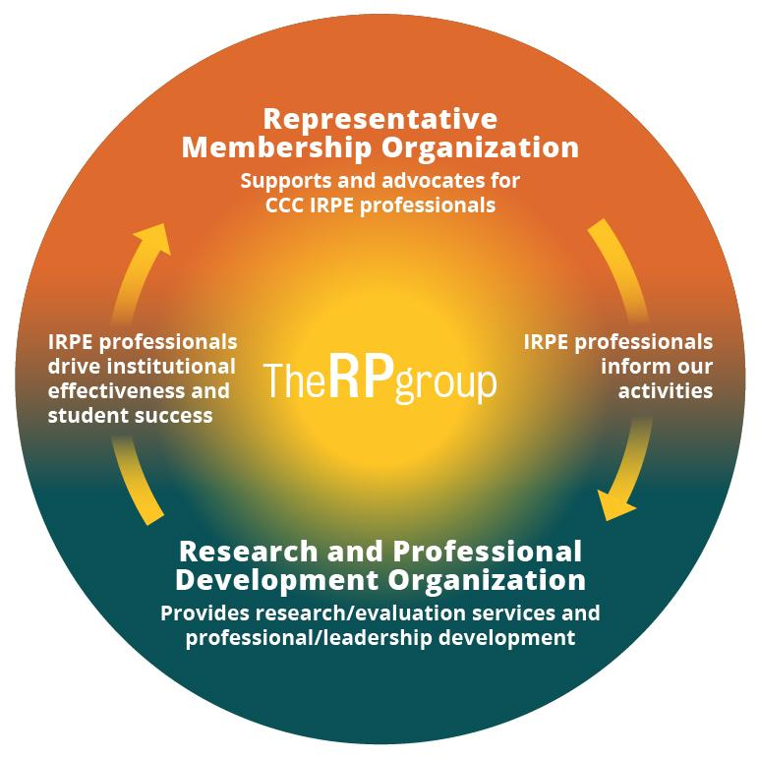
About The RP Group
Mission: As the representative organization for Institutional Research, Planning, and Effectiveness (IRPE) professionals in the California Community Colleges (CCC) system, the RP Group strengthens the ability of CCC to discover and undertake high-quality research, planning, and assessments that improve evidence-based decision-making, institutional effectiveness, and success for all students.
Services: Research, evaluation, planning, professional development, and technical assistance—designed and conducted by CCC practitioners
Organization: 501(c)3 with roots as membership organization
Notes:
Alyssa
What does the RP Group do?
How does the RP Group work with colleges?
What type of professional learning or development does the RP Group provide?

Slide 6
The RP Group Portfolio
IRPE Representation + Professional Development
The RP Conference (April)
Strengthening Student Success Conference (October)
Leading from the Middle Academy
Strategic Enrollment Management Academy
Webinars, Communities of Practice
Research, Evaluation, and Capacity-Building
Through the Gate Transfer Initiative
Multiple Measures Assessment Project
Statewide Surveys
Focus group studies
External Evaluation
Facilitation
Notes:
Alyssa

Slide 7
Making Data Accessible and Meaningful
How can data and research create lasting change?
What existing data can be leveraged to support data-informed decision-making?
In what ways could data be communicated to the college stakeholders?
In what ways have the data been fully integrated in college planning and decision-making?
Notes:
Alyssa

Slide 8
Notes:
Alyssa
BRIC Inquiry Guide
Community colleges today are faced with a series of important questions: 1. How can data and research create lasting change? 2. What data have we already collected that might help the college make better decisions? 3. In what ways should data be communicated to the college stakeholders? 4. In what ways have the data been fully integrated in college planning and decision-making?

Slide 9
Notes:
Alyssa
https://rpgroup.org/Portals/0/Documents/Projects/BRIC/POWERPOINT%20-%20Turning%20Data%20Into%20Meaningful%20Action_0.pdf
https://rpgroup.org/Portals/0/Documents/Projects/BRIC/POWERPOINT%20-%20Turning%20Data%20Into%20Meaningful%20Action_0.pdf

Slide 10
What’s Bias Got to Do With it?
Biases are sources that threat the integrity of a truth we are seeking
Can occur at any point of the research life cycle
Strategies to minimize bias:
Inclusive and collaborative design, implementation, and interpretation
Sampling methods
Statistical controls
Triangulation of findings
Positionality
Notes:
Alyssa
Research Life Cycle - from conceptualization, data collection, data analysis, interpretation, and publication

Slide 11
Engagement: Biases and Personal Experience
What are sources of biases experienced?
What are some examples of how the biases were managed?
Notes:
All

Slide 12
Working Together: Faculty; Institutional Research, Planning, and Effectiveness (IRPE) Professionals; and Accreditation Liaison Officers (ALO)
Accreditation Standards are Changing
Faculty Leadership (Academic Senate, Union, Department Chairs, Committee chairs, others)
IRPE Professionals (Administrators, Classified Professionals, Faculty)
ALOs (often an administrator, sometimes a faculty member)
Identify each group’s responsibilities, priorities, and challenges
Refine, augment, or redesign and then communicate planning processes that are understandable, reasonable, and doable by all
Be sure to explain the “How”, “Why”, and “When or how often” of the process
Notes:
Eric Attendees-Pause for Reflect and Share

Slide 13
Working Together:
Redesigning Transfer Experiences
Historical reporting of transfer
6-year transfer rates
Transfer-ready or transfer-prepared
Traditional view of transfer:
Binary outcome of whether students transferred or not
Refreshed view of transfer:
It’s a continuum
Notes:
Alyssa
Instead of standing here sharing what is or should be the secret sauce to moving from data to action - I am going to share an example of how college used data to engage across the institution to reimagine what transfer could look like for their students based on statewide and local data.
By reimaging transfer as a continuum –examples of taking this idea that transfer is a continuum and that everyone has a role to play to support transfer
And the ways in which they made information accessible and actionable to reimagine and redesign their transfer support structures for students –
from the data they examined to the connections with other major efforts such as guided pathways they connected this work to

Slide 14
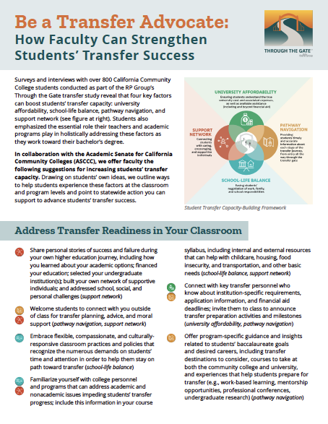
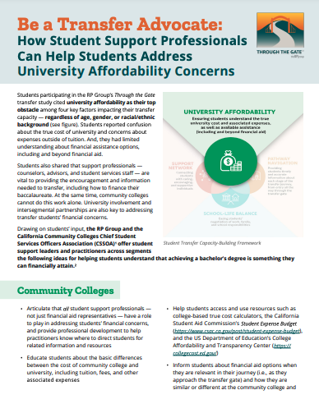
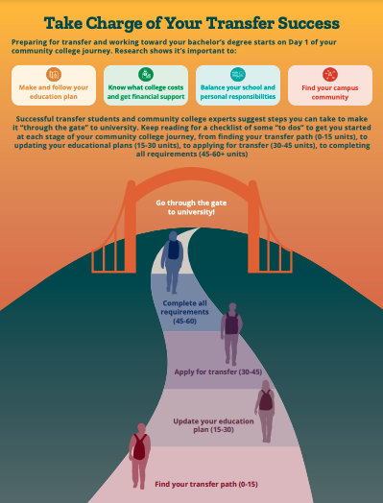
Working Together:
Redesigning Transfer Experiences at the state level
Notes:
Alyssa

Slide 15
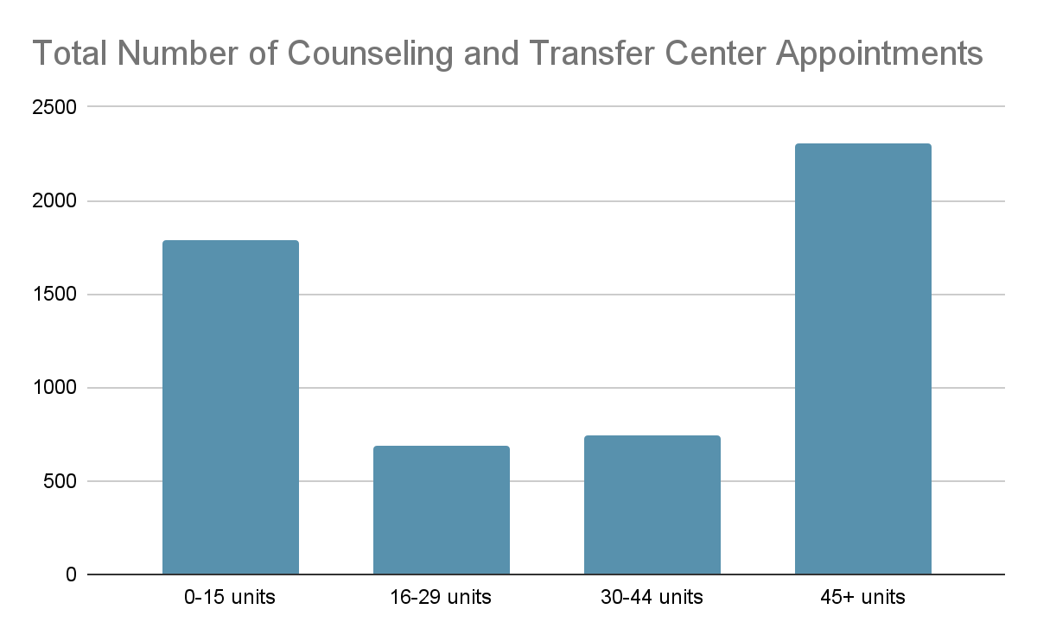
Working Together:
Redesigning Transfer Experiences at the local level
Local Transfer-Related Issues
1,900 students each year with 30+ transferable units
275 students with 72+ units
1,200 students within 3 units of completing a degree
Notes:
Alyssa

Slide 16
Q&A
Notes:
All

