Slide 1
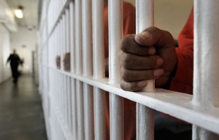
Beyond the Cell:
Former Incarceration and First Year College Success
Sabrena Turner-Odom, Ed.D.

Slide 2
Disproportionate Incarceration Rates in CA for Black Males
Source: California Department of Corrections and Rehabilitation data 2012; Current Population Survey data, 2012.
From: Just the Facts: California’s Prison Population, PPIC, 2013.

Slide 3
Statistics: Black Men and Incarceration
Black males make up 13.6% of the United States population and 40.2% of the prison population (Prison Policy Initiative, 2014).
1 out of 8 Black men in their twenties are incarcerated on any given day in America (Prison Policy Initiative, 2014).
Black youth accounted for 41% of all juvenile offenders in custody, and they were incarcerated at the highest rate of all youth in the country (Department of Justice, 2010).
Black men face harsher sentencing than any other imprisoned group and lower odds of being released on their own recognizance (Alexander, 2012; Wooldredge, 2012, 2015).

Slide 4
WHY IS THIS SIGNIFICANT TO HIGHER EDUCATION PROFESSIONALS?

Slide 5
In the United States, an average of 668,000 people are released from prison annually (Public Policy Initiative, 2014).
Once released from prison, many formerly incarcerated juveniles and adults enroll in community colleges across the nation (Johnson, 2003; Strickland et al, 2010).

Slide 6
Passage Program Data
Data provided by CCCCO, 2013

Slide 7
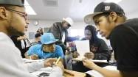
A Very Rough Road for Community College Students
February 12, 2012 | By Carla Rivera, Los Angeles Times
Photo by Kirk McCoy, L.A. Times, 2012

Slide 8
The mass incarceration phenomenon has created a wave of formerly incarcerated community college students who:
Face multiple social challenges
Suffer in silence
Possess limited formal educational experience
Bring strengths and assets with them to community college

Slide 9
PURPOSE
The purpose of this study was to understand and highlight the assets and strengths that formerly incarcerated men of color bring to community college campuses that support first year success.

Slide 10
RESEARCH QUESTIONS
What assets and strengths do formerly incarcerated men of color report before, during and after incarceration that support first year college success?
What are the implications for community colleges in responding to formerly incarcerated men’s assets and strengths that support first year success?

Slide 11
Frameworks
Conceptual
  A transformative approach to Student Success
  Equity
  Validation
  Teaching Strategies
  Campus Culture
  Environmental Factors
Theoretical
Social Capital Theory
Highlights the importance of access to social networks that provide benefits that flow from trust, reciprocity, information and cooperation
Achieving the Dream, 2014; Bensimon, 2004; Bensimon, 2007; Cooper et al, 2014; Harper, 2012; Ladson-Billings, 2014 Lin, 1999; Gonzalez et al, 2003; Rendón, 2006 Stanton-Salazar, 1997; U.S. Department of Education, 2012; Yosso, 2005

Slide 12
METHODOLOGY
Qualitative Study
Phenomenological Research Design
Goal of Phenomenology: To understand and describe the lived experiences of the participants totally from their own perspective (Husserl, 1945; Maxwell, 1996; Moustakes, 1994)

Slide 13
Data Collection
Setting | A small, urban community college in a diverse southern California community
Sample | Twenty-seven (27) formerly incarcerated male students of various ages, majors and time spent in jail/prison
Instrumentation | The researcher facilitated five (5) in-depth 2-hour focus groups with a maximum of seven (7) students per group

Slide 14
3 Phases of Data Collection
Before, During & After Incarceration
Focus group questions explored 5 topics:
View of Education
Motivation
Key Support Person
Character
Inner Strength

Slide 15
Emergent Themes in 3 Phases:
Before, During and After Incarceration

Slide 16
Phase I
Student Voices
Strengths and Assets
BEFORE INCARCERATION
Themes:
Inner Strength
Adaptability
Rebirth (dormant)
Peer Influence

Slide 17
Inner Strength - Before Incarceration
Inner Strength Before Incarceration | “I always knew I was smart. I just didn’t like school because it was too racially charged. Everyday I had to defend who I was, what I looked like or how I talked. I had to always be ready to defend myself. Someone would try me just about everyday until I was kicked out, and I was happy to leave.” (Sinjin)
Inner Strength Before Incarceration | “When I was a kid, poverty made education seem like a waste of time, so I ditched a lot and learned how to make money on the streets to eat. I didn’t see the foundation it would build for me as an adult.” (Slick)
Inner Strength Before Incarceration | “I hung around the veterans of the streets who are known as legends of the game, pioneers, and trailblazers, and I was able to perfect the savage persona of the streets that I needed to survive in that world. That savagery, that animalistic mentality was needed to survive. The more experience you have with that military mentality, the safer you are.” (Baridi)

Slide 18
Adaptability - Before Incarceration
Adaptability Before Incarceration | “If you’re not educated, you’re only privy to street culture. At one time I was illiterate, and you couldn’t put a book in front of me. I didn’t know then it was once illegal for Blacks to read.” (Baridi)
Adaptability Before Incarceration | “School was always hard for me. I had a hard time fitting in since grade school because I was always in trouble. When kids teased me I would retaliate and get in more trouble, but no one ever listened to my side of the story so I lost interest in school.” (Slick)
Adaptability Before Incarceration | “The streets are designed to make you grow up quick. Once you’re in the streets, everything is fast. You have no time to learn lessons. Street culture is like summer and winter sessions. Everything is quick. There’s no fall and spring in street culture, you know what I mean? [laughs] In the streets you learn this skill or that skill in less than a week, and if you miss a day, you might lose your life so you learn to trust your instincts and watch your back. (Baridi)

Slide 19
Peer Influence - Before Incarceration
Peer Influence Before Incarceration | “As a gang member, I never imagined a normal life. I thought this was the hand that life dealt me. I never knew I had options. I never knew I could walk away. I forfeited the option to use common sense and followed the crowd.” (Caveman)
Peer Influence Before Incarceration | “All of my role models were dropouts, and I wanted to be just like them because they were heroes on the street. They did what they wanted when they wanted to do it.” (Dolla Bill)
Peer Influence Before Incarceration | “I grew up with the mentality that if you went to school, you wanted to be White. That was the first lesson I learned in the streets. Education and knowledge was deemed a White man’s world and that comes from socialization and politics. That mentality was used to train me how to assimilate into that revolutionary culture. It was like teaching me that all White people were devils, which is not true because everybody has a little devil in them (laughs). But that’s what was needed to get my attention…to snap me back into my Blackness.” (Baridi)

Slide 20
Phase II
Student Voices
Strengths and Assets
DURING INCARCERATION
Themes:
Inner Strength
Adaptability
Rebirth
Peer Influence
Notes:
most, the need to survive and make money before incarceration transformed into deep self-reflection and a desire to gain knowledge as well as help others while incarcerated.

Slide 21
Inner Strength - During Incarceration
Inner Strength During Incarceration | “When you’re incarcerated, you can’t run. You’re forced to deal with problems on the spot, and if you run, you become prey.” (Victory)
Inner Strength During Incarceration | “Prison leaves you with no self-esteem and that’s a cold emotion. You’re left in a cell to feel savage and you start to believe that you are a savage because it’s your only means to survive. Then your human side comes out because you see and hear horrible things happening to people of other races too and you sit and say, man that’s cold blooded how we’re treated in here. (Caveman)
Inner Strength During Incarceration | “I needed to understand my case, stay healthy, and get out. Education was the only way to do it.” (Ali Baba)
Inner Strength During Incarceration | Sitting in a cell naked and beat up with no food for days, I was motivated to never go back to jail if I ever got out.” (Mr. Black)

Slide 22
Adaptability - During Incarceration
Adaptability During Incarceration | “I didn’t want to waste my time. I didn’t want to look at my time as confinement. I wanted to get something out of it. I wanted to leave prison after 96 months with something, so I took classes from Allen Hancock Community College and made As and Bs despite the Bureau of Prisons giving me books for class after half of the semester was over. I felt like they didn’t want me to succeed, but I kept studying. (Nationwide)
Adaptability During Incarceration | “I wrote weekly journals in prison about what I wanted for my life, and while reading what I was writing I started to realize that I wanted something better in life—something that I had never experienced. I wanted an education.” (Baridi)
Adaptability During Incarceration | “Big homies taught us Swahili or Arabic because the Mexicans had Spanish and the White boys had German. We had to communicate to one another in a language that the police and our enemies couldn’t understand. We had to warn each other when something was coming so we took learning and teaching Swahili seriously so we could protect ourselves. (Caveman)

Slide 23
Rebirth - During Incarceration
Rebirth During Incarceration | “I started watching TV and movies that showed Black people having fun at school. They looked like they were having a good time, and I wanted to experience that too.” (Dolla Bill)
Rebirth During Incarceration | “Guys with short time are put on yards with older guys that have done a lot of time. Lifers are more calm and less likely to engage in foolish conduct. They need to make that phone call once a week and have that visit from their kids. That’s much different from the younger guys fighting and cussing out police all the time. The older guys taught us patience. I brought that with me to college.” (Caveman)
Rebirth During Incarceration | “A guard told me, ‘You’ll be back.’ I thought to myself, ‘No I won’t because I have experienced being a slave.’ I had to choose to fight or flight and I chose fighting to learn.” (Victory)
Rebirth During Incarceration | “There were a lot of people who couldn’t read or write, so I helped guys by reading and writing their letters and it made me want to learn more when I got out.” (Ray)

Slide 24
Peer Influence - During Incarceration
Peer Influence During Incarceration | “The Homies in prison made me feel like a stand-up guy and smart. They were my family. I would do anything for them and I knew they would do anything for me. We were brothers.” (Iceman)
Peer Influence During Incarceration | “The Homies in prison motivated me. We had a support group. They made me feel normal like I was somebody. (Ray)
Peer Influence During Incarceration | “My cellie [cell mate] that was doing life told me to take advantage of my second chance and leave the gang life behind me. He always told me I was still young and had my whole life ahead of me. He told me to go to school and never come back to prison once I got out.” (Weezy)
Peer Influence During Incarceration | “Two Homies I did time with motivated me to get out and do the right thing. They knew I was a decent guy so they tried to keep me focused on what my life could be like when I got out.” (Jose)

Slide 25
Phase III
Student Voices
Strengths and Assets
AFTER INCARCERATION
1ST YEAR OF COLLEGE
Themes:
Inner Strength
Adaptability
Rebirth
Peer Influence

Slide 26
Inner Strength - After Incarceration
1st Year of College
Inner Strength After Incarceration | “I was so young when I was incarcerated. I was only in middle school. I was clueless about a lot of things regarding school. In the beginning, I just followed what everybody else did. I learned how to interact with teachers for the first time in college.” (Sinjin)
Inner Strength After Incarceration | “I made the Dean’s List and didn’t even know what it meant.” (Slick)
Inner Strength After Incarceration | “I felt out of place in college. The lies started coming back. Maybe I’m too old for college. School isn’t for me; it’s for other people. I was in a dark cocoon dealing with health issues and homelessness, but no one at school knew that. (Caveman)
Inner Strength After Incarceration | “The first time I felt like an outcast was during my first year of college. I didn’t know anyone and no one knew me. That was very different for me. The environment I came from everybody knew everybody so everybody knew I was about the business [committed to my obligations]. When I started college, I felt like I was in another world.” (Superman)

Slide 27
Adaptability - After Incarceration
1st Year of College
Adaptability After Incarceration 1st Year of College | “In 2015, it’s ironic that the same revolutionary rhetoric has been modified. Now education is pushed as the key to freedom. I feel like I was lied to, but now I’m so vulnerable because I’m like a piranha on academics. I feed off it. I’m like a shark and education is blood.” (Baridi)
Adaptability After Incarceration 1st Year of College | “I didn’t get any As my first semester, but I kept believing I could do better. I kept remembering all the promises I made myself when I was locked up. I had to keep reminding myself that I could not quit. Just like I taught myself reading comprehension in prison, I had to learn how to ask for help.” (Victory)
Adaptability After Incarceration 1st Year of College | “I didn’t know anything about talking to counselors and faculty about school. I finished several semesters without ever talking an instructor. I didn’t know it was important. Luckily, a professor made seeing her during office hours a part of an assignment. That’s when I learned how easy and helpful it was.” (Green Bay)

Slide 28
Rebirth After Incarceration - 1st Year of College
Rebirth After Incarceration 1st Year of College | “Being a part of the FYE program helped a lot. They helped with everything and I needed that because I didn’t know nothing about college. I met a lot of people who were confused just like me and we learned together. I’m still friends with a lot of the people I met in FYE.” (Turtle)
Rebirth After Incarceration 1st Year of College | “Getting an education was the last opportunity to do something positive for my future. My best friend was dead. I was the only person who could save me and just about everyday I felt like quitting because college is hard.” (Weezy)
Rebirth After Incarceration 1st Year of College | “The world sent me away and I came back to get all the knowledge I could. I promised myself to study hard everyday. My revenge for being locked up in a cage is to get all the knowledge I can and use it to expose and reverse how we are prey for the prison system.” (Mr. Black)
Rebirth After Incarceration 1st Year of College | “I took literature classes that pushed me to be more open about my feelings. They gave me permission to be myself and own my shit. When I saw myself in the literature, I found myself and learned to accept myself.” (Baridi)

Slide 29
Peer Influence - After Incarceration 1st Year of College
Peer Influence After Incarceration 1st Year of College | “People in my classes want to know what I think and they want to hold study groups with me. Maybe what everyone’s been telling me about how smart I am was right. Now, I think I’m pretty smart.” (Roccy Loc)
Peer Influence After Incarceration 1st Year of College | “An older student with a similar past told me to study more. He wasn’t being a hypocrite…he wasn’t out there on the streets. No…he was studying, working hard, typing papers, reading all day long. I saw that with my own eyes and thought, now, I have no excuse.” (Mr. Black)
Peer Influence After Incarceration 1st Year of College | “A tutor in my class told me to let him help me with my writing. I was too proud to ask for help, but he could tell I was giving up.” (Weezy)
Peer Influence After Incarceration 1st Year of College | “I met this brother one day who reminded me of me. At this time I had friends who looked out for me, so one day I approached him and said, “Look Homie, I’ve been here a minute so I can ensure you, the war is over. There’s nobody walking around here with Kisus [Swahili for knives]. You’re in a safe place. You can relax.” (Caveman)

Slide 30
Interpretations and Implications
Inner Strength | A strong desire to perform at a high level implies a strong will to succeed which is an asset for college success.
Adaptability | The ability to quickly adjust to environments infused with hostility and obstacles that present hidden challenges that perpetuate failure implies a hidden, yet important asset for college success.
Rebirth | The ability to reinvent oneself leads to the vulnerability needed to succeed in college.
Peer Influence | The importance of relationships with peers who have had similar experiences promotes sustainability to complete college.
Notes:
implies a strong desire for the participants to perform at high levels which is needed to persist and succeed in college.
During the transformation of beliefs and values, formerly incarcerated students learn to adapt. Adaptability implies the ability to quickly adjust to environments infused with hostility and/or obstacles that present hidden challenges that perpetuate failure and lack of opportunities for upward mobility.
Rebirth implies the ability to reinvent oneself through the transformation of beliefs and value. The rebirth process implies that the participants’ inner strength and ability to adapt to hostile environments leads to the vulnerability required to trust self and see oneself in others. This evolution of self that is triggered by inner strength and adaptability strengthens the commitment to achieve educational goals.
Relationships with peers represent the glue that holds the college completion process together. Peers who have had similar experiences with incarceration permit formerly incarcerated students to to use past experiences as a platform to access support that leads to college success. Influence from peers plays an intricate role in a formerly incarcerated student’s development of the courage needed to continuously build a strong core of beliefs and values that promote student success.

Slide 31
Implication for Policy
Formerly incarcerated students must be invited to collaborate with federal, state and local policy makers in order to bridge the gap of mistrust with institutions

Slide 32
Student Voices on Policy
Caveman | “Colleges have to understand the backgrounds of students like me and the reality of the deficiencies we show up with. It takes a special type of person to break through all our stuff. We even have a hard time processing it.”
Mr. Black | “When colleges reach out to students who have been incarcerated, they need to use people who have been through incarceration to support us or people who understand oppression and the struggle it takes to overcome it.”
Victory | “There should be counseling in place for us to get access to resources before we even enroll in classes because in order to do good work, we need a place to live, a place to study, and a job. We need the basics and when you’ve been incarcerated, you build up a wall and don’t trust anybody. You just can’t have anybody working with students like us because we’re fragile and we don’t have the foundation that other students have. Someone who hasn’t been locked up won’t understand this.”

Slide 33
Implication for Practice
Institutional agents should not discuss success factors for formerly incarcerated students of color without exposing the many layers of racism that shrouds common educational practices that are experienced by marginalized students on a daily basis.

Slide 34
Student Voices on Practice
“Community college is the best foundation of hope for anybody trying to change the conditions of their life. Parole and all those other agencies have failed. They’ve never done it. The record clearly shows that nothing has ever worked positively in my life until I landed here among my people who cared about me until I learned to care for myself.” (Caveman)
“Being incarcerated taught me to approach a problem by first attempting to fix it in house. Not go to a superior to fix it. We have been programmed to rely on each other.” (Victory)
“When true consciousness is identified and permitted to embellish the power within, our true purpose is revealed. Until then, we are only fragments of our true self that can get buried or snuffed out when you’re caught up in the struggle to survive. That’s why I’m good at helping students. I’m able to tap into their struggles, which are my struggles. I am them, and they are me.” (Baridi)

Slide 35
Recommendations
College Pathway Orientations in Prisons
Gender Specific Comprehensive Support for Formerly Incarcerated Students
Building Student Trust (BuST)
Faculty, Staff and Administrator Professional Development

Slide 36
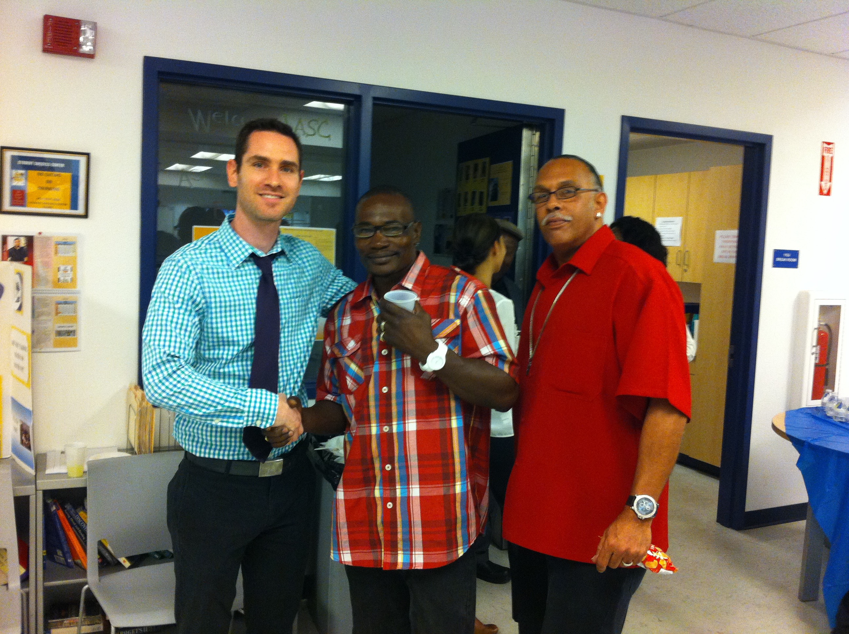
Faculty Champions Needed
Dr. Jon Breman, Professor of Music and two participants of this study at a “Celebrate Success” holiday party at
Los Angeles Southwest College

Slide 37
Thank You!
Sabrena.odom@gmail.com

