Slide 1
The Course is Approved. What Happens Next?
Sarah Harris, College of the Sequoias
Nili Kirschner, Woodland Community College, ASCCC Curriculum Committee

Slide 2
Session Outcomes
Identify considerations that come after course approval
Publication requirements
Financial aid considerations
General education, transfer, and articulation agreements
Suggest best practices for scheduling new courses

Slide 3
Publication Requirements
Curriculum Publications
College Catalog – including addenda
Schedule of classes
Student handbook
Promotional/outreach materials (fliers, website, social media, etc.)
Course outlines of record and addenda
Course syllabi
Guidelines and Regulations
ACCJC Accreditation Standards
Ed Code/ Title 5
CCCCO Program and Course Approval Handbook (PCAH)
CCC Legal Opinions & Advisories
Local Governing Board Policies
U.S. Department of Education
Title 5, Workforce Rehabilitation Act of 1973 (section 504 & 508)
Web Content Accessibility Guidelines (WCAG) 2.1

Slide 4
Title 5 Course Publication Requirements
§58104 (Dissemination of Information):
Courses must be published in the official catalog and/or addenda and listed in the schedule of classes
Courses which are established or conducted after publication of the general catalog or regular schedule of classes shall be reasonably well publicized
§55005 (Publication of Course Standards) – must be published prior to student enrollment:
Course type – degree-applicable credit course, nondegree-applicable credit course, community service offering
Transfer status
Whether course fulfills a major/area of emphasis or GE requirement
Whether course is offered on pass/no pass basis
§51006 (Open Courses)
Open enrollment policy statement for courses shall be published in the official catalog, schedule of classes, and addenda to the schedule of classes for which FTES is reported for state apportionment
§55041 (Repeatable Courses)
The district must identify all courses which are repeatable and designate such courses in its catalog

Slide 5
On Open Enrollment
Title 5 §58104: Courses must be published in the official catalog and/or addenda and listed in the schedule of classes.
Rationale: To ensure courses meet open enrollment regulations (§51006); if courses are not broadly advertised then they are only available to those students who happen to become aware of them and therefore the courses are not open
“Announcements of course offerings shall not be limited to a specialized clientele, nor shall any group or individual receive notice prior to the general public for the purposes of preferential enrollment, limiting accessibility, or exclusion of qualified students”
A catalog or schedule listing about a course or program that merely refers students to department representatives is not sufficient to meet the requirements for open enrollment
Violations of open enrollment can result in a loss of funding for courses

Slide 6
On Consistency
ACCJC Accreditation Standard I.C.1 & 2 (2014)
“The institution assures the clarity, accuracy, and integrity of information provided to students and prospective students, personnel, and all persons or organizations related to its mission statement, learning outcomes, educational programs, and student support services”
The institution provides a print or online catalog for students and prospective students with precise, accurate, and current information on all facts, requirements, policies, and procedures listed in the ‘Catalog Requirements’

Slide 7
What does this mean for best practices?
Although courses can be offered prior to listing in the catalog, it is not a best practice to do so:
Much of the course information required to be published prior to student enrollment lives in catalogs – such as whether a course fulfills a major/area of emphasis or GE requirement.
Open enrollment regulations and ACCJC requirements for information consistency mean that courses should be advertised in the same way to all students, and that college publications should be precise, accurate, and current.

Slide 8
Financial Aid Considerations
Most Financial Aid regulations (Title IV Eligibility and Certification) are tied to programs.
In general, financial aid eligible programs are:
A program that leads to an associates' degree
A transfer program of at least two academic years in duration that does not award a credential and is acceptable for full credit toward a bachelor’s degree.
A program of at least one academic year in duration (16 units) that leads to a certificate or other non-degree recognized credential and prepares students for gainful employment in a recognized occupation.
Federal regulations require that academic programs eligible for federal student financial aid be approved by the appointed State Authorizing Agency, if the state requires approval. The Chancellor’s Office requires approval of all programs of 16 units or greater.
The Financial Aid office must update the college’s Title IV Eligibility and Certification Approval Report (ECAR) and Program Participation Agreement (PPA) with the Department of Education for financial aid benefits, including any changes to eligible programs submitted for approval during the course of the year

Slide 9
What does this mean for best practices?
New courses intended for a new, financial aid eligible program should not be offered until the program is approved by the Chancellor's office and ACCJC (where applicable) and listed in the college catalog.
This is particularly true for CTE courses, where those courses are specialized, not otherwise transferrable, and not applicable to existing programs.
If the new courses are intended for transfer or General Education, the committee should exercise their best judgement about program approval timelines in relation to transfer and articulation deadlines.

Slide 10
General Education, Transfer, and Articulation Agreements
If the course is transferable, it may be submitted for transfer, GE, or articulation agreements.
For course units to transfer to UC, must be approved for UC Transfer Course Agreement (UC-TCA)
For transfer course to meet 4-year lower-division General Ed requirements, must be approved for CSU GE Breadth or IGETC patterns
For transfer course to meet specific major requirement at a 4-year institution, must have course-to-course articulation (or in some cases, C-ID approval)
Why wait?
Approvals are for current submission cycle, which really means the upcoming academic year – they are not retroactive
Courses need to be part of a program of study for veterans/federal financial aid, and may need articulation or GE approval to be included in an award

Slide 11
Submission Cycles and Scheduling
Transfer and articulation approvals are not retroactive, so it's best to wait to schedule a new course until it is approved.
Work with your Articulation Officer (AO) to understand the specific submission timeline for your college – process can take over a year, depending on when the course is approved in your cycle
UC-TCA submission is in June, July or August, with decisions reported the month after submission, effective for upcoming academic year
CSU-GEB and IGETC submissions are in fall term (by December), with decisions reported in late spring, effective for upcoming year
Course-to-course articulation and C-ID approvals are on a rolling basis, with unpredictable decision timelines

Slide 12
On Catalog Publication Timelines
Factors that affect the timeline for catalog production include:
Local and/or state curricular approvals
MIS end of term reporting and alignment of course data elements between local curriculum system, MIS Data Mart, and COCI
Securing regional consortia recommendation of CTE programs
Updating program maps, course sequencing, and degree audit software to reflect changes
Veterans certification of catalog for VA Educational Benefits; must be re-certified each time it is modified

Slide 13
On Course Scheduling
Many other local processes may impact how courses are scheduled. These include:
Local collective bargaining agreements and schedule development timelines
Room availability
Program sequencing and Guided Pathways
Additional review steps for Distance Ed, dual enrollment, etc.

Slide 14
What are some best practices for curriculum chairs?
Provide clear timelines and due dates for curriculum submission and approval.
Work collaboratively with key stakeholders, including articulation officers, accreditation liaison officers, curriculum specialists, and the financial aid office.
Curriculum processes do not end with local approval! Have a process to maintain updates in other systems such as: MIS data, SIS, COCI, Degree audit software (i.e. DegreeWorks), Assessment Management Systems, and others.

Slide 15
Best Practice: Curriculum Timelines
At College of the Sequoias, we provide recommended curriculum submission deadlines on a rolling basis, based on four categories:
Schedule Publication Deadlines
Catalog Publication Deadlines
Spring Catalog Addendum
Transfer, Articulation, and General Education

Slide 16
Curriculum Timeline, Ex. 1
For example, at COS our recommended timeline for Schedule Publication reads as follows:
Due to deadlines associated with the scheduling process, any course substantial changes that will impact the schedule (Unit/Hours Changes, Course Number Changes, Transfer or Credit Status, Changes to Subject Code, Changes to Pre- and Co-requisites) must be submitted to the Board of Trustees for approval no later than their January 2020 meeting in order to make the 2020 – 2021 catalog. Any course substantial changes that do not make this deadline will move to consideration for the next year’s catalog or the Spring addendum as appropriate (see addendum guidelines). For course substantial changes, follow the dates below:
Launched for Review no later than: September 27, 2020
Approved by Curriculum Committee: November 5, 2020
Submitted to Academic Senate: November 10, 2020
Submitted to Board of Trustees: January 10, 2021
The full timeline document is available on our website: https://www.cos.edu/en-us/Governance/Academic-Senate/Curriculum-Committee/Resources/Curriculum%20Timelines%202020-2021_v1.pdf

Slide 17
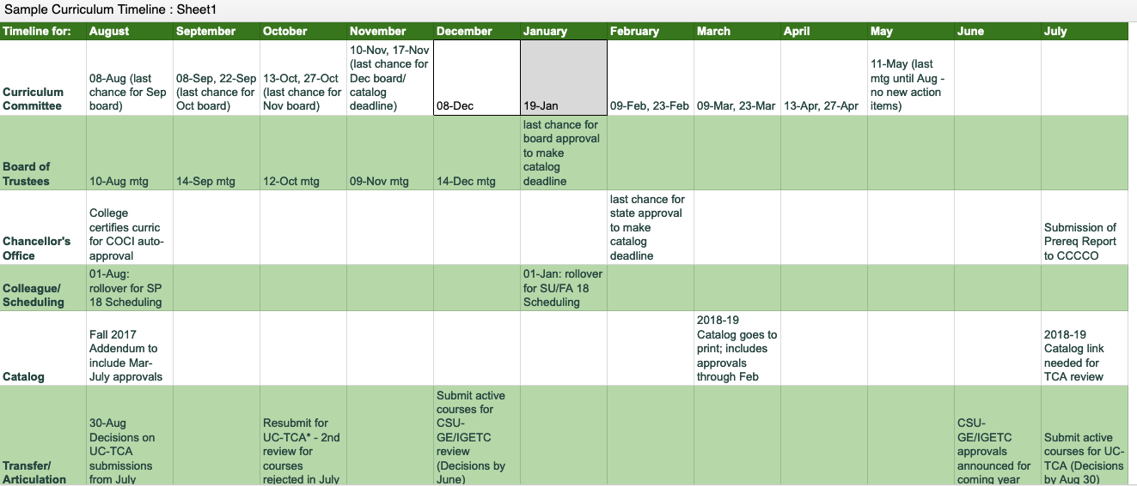
Curriculum Timeline, Ex. 2
Link to Sample Curriculum Timeline from Woodland Community College

Slide 18
Questions & Discussion
Join the California Community College Curriculum Chairs Listserv: https://groups.io/g/CCCCurriculumChairs
Sarah Harris: SarahHa@cos.edu
Nili Kirschner: nkirschn@yccd.edu

