Slide 1



Contextualized Teaching & Learning
CTE Leadership Institute
Academic Senate for California Community Colleges
May 6, 2017
Peter Simon
Senior Consultant
Career Ladders Project
Toni Parsons
Mathematics Department Chair
San Diego Mesa College

Slide 2

The Career Ladders
Project
fosters educational and career advancement through research, policy initiatives, and direct assistance to community colleges.

Slide 3
Objectives for Today’s Workshop
Present overview of contextualized teaching and learning (CTL)
Provide concrete examples of what CTL looks like in practice
Surface and address questions about how to develop or expand CTL at your college

Slide 4
Opening Question
What are one English skill and one Math Skill that you would love for your students to have and Why?

Slide 5
C
Embedded Remediation
Integrated
Learning
ontextualized
T
Linking Learning
Blended
Courses
eaching
&
Service Learning
L
Learning Communities
earning
Cohorts

Slide 6
What is Contextualized Teaching and Learning?
CTL is a group of instructional strategies designed to link the learning of basic skills with academic or occupational content by focusing teaching and learning directly on concrete applications in a specific career context that is of interest to students.

Slide 7
“That is the greatest idea ever – the fact that all our courses are integrated.” – CTL Student

Slide 8
Why Contextualized Teaching and Learning?
Most people learn better and faster, and retain information longer, when they are taught concepts in context because it:
    Makes learning relevant
    Deepens understanding of concepts
    Engages students in content areas early, leading to better retention and persistence
    Increases learner confidence & enthusiasm
    Enhances interest in long-term goals & education

Slide 9

Different Ways to Accomplish CTL
Foundational or general education courses with embedded subject matter material
Career technical or academic courses with embedded foundational skills instruction
Linked courses or learning communities (often organized around theme)
Team teaching of courses

Slide 10
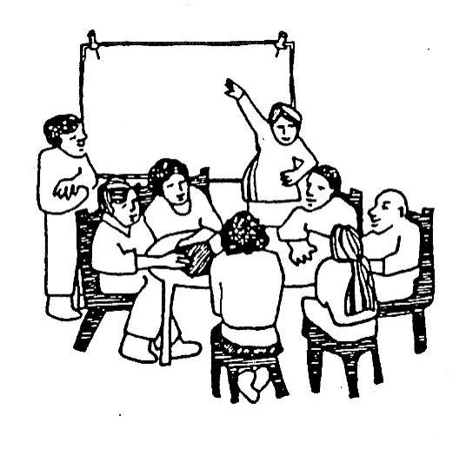
A Key Element is Faculty Collaboration
Form Team that becomes a “Faculty Learning Community”
Meet Regularly/On-going Communication
Adequate time/resource for front end development
Include Counselors!
Synchronize syllabi – progression of skills
Joint Projects
Spend time in each other’s classes
Experience rewards of collaborative teaching

Slide 12
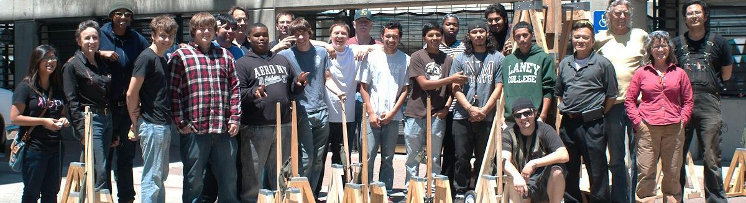
Examples of CTL

Slide 14
Task One: Doing Inventory
Adding Liters & Milliliters
Dr. Turkoglu wants to know how much saline solution the clinic currently has. He has asked you to give him the total in liters. After checking the storage area and the individual patient rooms, you find 11 liter containers and a total of fifteen 250 milliliters vials of saline solution. How much saline solution, in liters, does the clinic have?

Slide 15
Steps
Look at the steps again.
Step 1: In order to find the total amount of milliliters, multiply 15 vials by 250 milliliters per vial.
250 mL per vial
× 15 vials
3750 mL
Step 2: Now convert milliliters into liters. In order to help you, refer to the conversion chart above.
3750 mL = ______ liters
According to the conversion chart, liters are three places to the left of milliliters, so you move the decimal point to the left three places. Thus, 3750 milliliters is equal to 3.75 liters (we could also refer to this as 3 liters and 750 milliliters).

Slide 16
Steps
Step 3: Add your total 3.75 liters to the original amount of liters (11).
11.00 liters
+ 3.75 liters
14.75 liters
Answer: Lindsay can report to Dr. Turkoglu that there are a total of 14.75 liters of saline solution (14 liters and 750 milliliters is another representation for this quantity, however since the quantity was asked for in liters, the answer should be 14.75 liters).
9 in.

Slide 17
Practice
A: Add these Quantities (Simplify all Answers)
1) 3 liters 250mL
+ 800 mL
Click Here
2) 5 liters 660 mL
+ 3 liters 600 mL
Click Here
3) 35 liters 1200 mL
+ 50 liters 150 mL
Click Here
4 liters 50 mL
9 in.
9 liters 260 mL
86 liters 350 mL

Slide 18
English 836 Writing Development
Career Advancement Academy (CAA)
Automotive Technology
Essay #1 Writing Due: 2/21/12
For 1.5-2 pages of your best writing, and using the expository essay conventions that we have discussed in class, explain your thesis (opinion) to the following Writing Question: Why are have you decided upon a career in the automotive field? If you are in the CAA program, but you are not planning on an automotive career path, apply the WQ to your personal career path.
You can, if you wish, focus on various factors that have guided you towards this career path: economic, passion, job security, family, natural aptitude…et cetera.
You will need to integrate quotes from a few—emphasis on few—sources to defend your career path.
Grading: This will be graded on a Pass (P)/No Pass (NP) basis. Make an earnest effort on the essay, and you will pass. OK?
**This essay should represent two weeks worth of effort**
REMEMBER: This is a pass/fail essay. I view this essay as a practice essay; I will expect to see your best sentences, and I expect to see that you are trying to use the expository conventions.

Slide 19
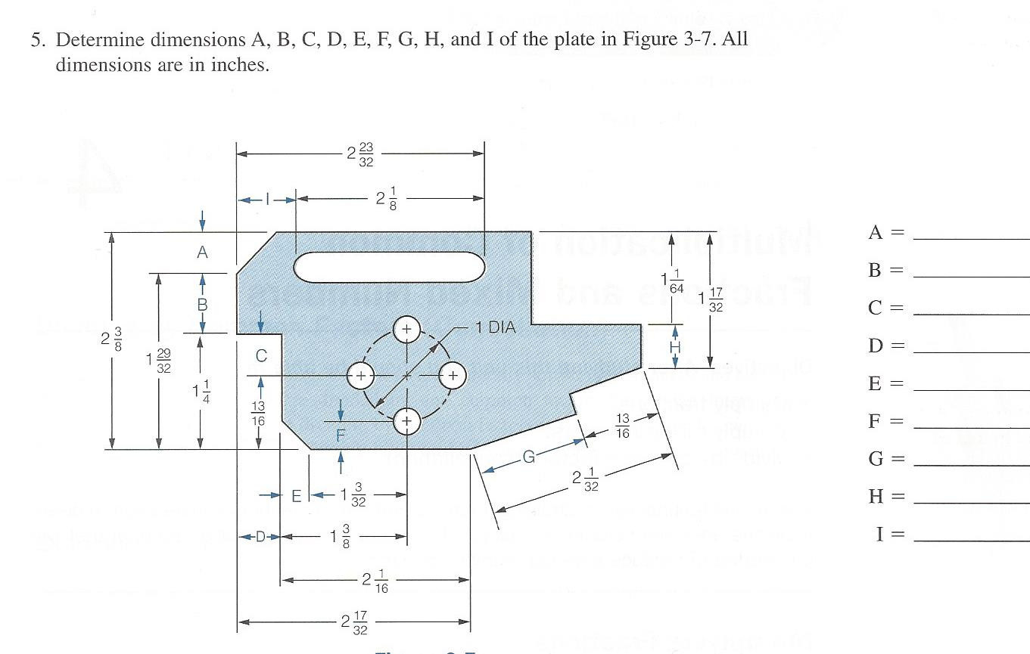
Providing context for critical thinking;
Problems have visual aids that support the addition & subtraction of fractions

Slide 20
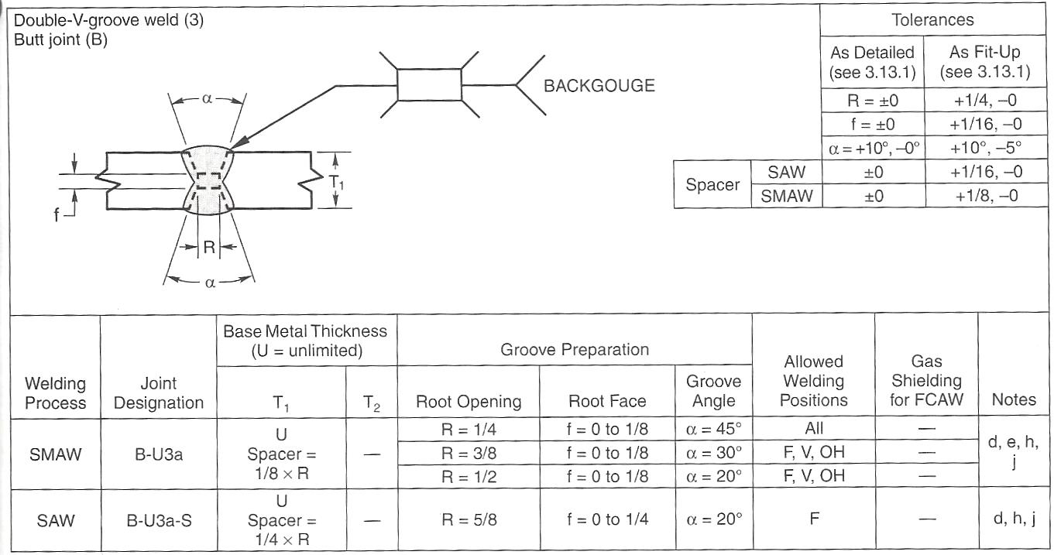
Math in Fit-up

Slide 21

Examples of CTL
Iron Hearts
IRON HEARTS
Students read poetry about “polishing” their hearts in English class
Write vignettes about their own transformation in welding
Create metal hearts in welding

Slide 22


Brian’s Heart
“I could shape it anyway I wanted, nothing was impossible. It was great to work through the entire process of fabricating metal, the fire, the forming, the fusing … the freedom.”

Slide 23
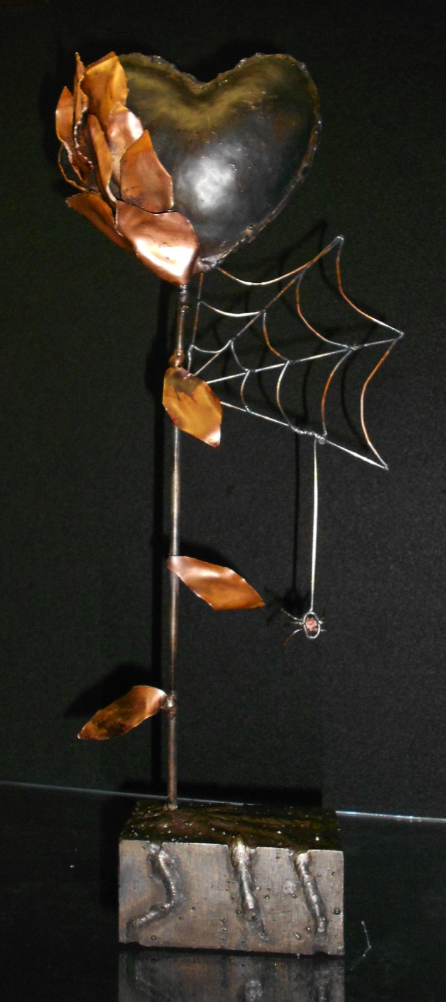
Monica’s Heart
“My journey started with a feeling of intimidation and ended with a feeling of accomplishment …I can do this and I made it mine!”

Slide 24

Many Varieties of Published Materials

Slide 25

Math 220/221: Technical Math
Co-created by Math, Welding and Machining faculty at Peralta District
4 units
Taught by math faculty
Contextualized to each skilled trades department
Required for the certificate in each department
Degree Applicable

Slide 26

English for Special Uses (ESU)
Advanced level ESL students
Contextualized English language skills improvement for CTE
Critical thinking, teamwork, and autonomous learning strategies
Concurrently or supplemental to credit
Easily tailored to different subjects

Slide 27
Biology Basic Skills/NC Reading (Co-requisite)
Reading
Compare and Contrast
Study Skills
Preparing for lab and lab reports
Interpreting graphs and diagrams
Latin and Greek root words
Analyzing text
Drawing conclusions
Study plan for biology
Memorization
Preparing for lecture and lab exams
Lack of reading and critical thinking skills by credit biology students

Slide 28




Adult School to Community College Skilled Trades Pathway
IBEST Bridge
Bridge Prep
Community College faculty (credit)
Bridge 1
English
Math
College skills
Intro CTE
Course:
Wood Technology
Beginning ESL or ABE;
Career Awareness
Intermediate ESL / English; ABE and GED Math
Adult school
Adult school
Adult School faculty (non-credit)
Skilled Trades Credit
Certificate and
Degree Programs at
Community College

Slide 29
EARLY CHILDHOOD EDUCATION (ECE) and
ENGLISH AS A SECOND LANGUAGE NON-CREDIT PROGRAM
(2 SEMESTERS TOTAL)
CHDEV 502
CHDEV 503
Child Dev. for Family Childcare Providers
1.5 hrs.
8 weeks/ 3 hrs./wk.
8 weeks/ 3 hrs./wk.
8 weeks/ 3 hrs./wk.
8 weeks/ 3 hrs./wk.
Infant/Toddler Development 1.5 hours
Introduction to Infant/Toddler Curriculum
1.5 hrs
ECE Curriculum for Family Childcare
1.5 hrs.
CHDEV 504
CHDEV 505
English for Infant/Toddler Development 1.5 hrs.
English for Infant/Toddler Curriculum
1.5 hrs
English for Early Childhood Development
1.5 hrs.
English for Early Childhood Curriculum
1.5 hrs.
ESL 502
ESL 503
ESL 504
ESL 505
8- week Modules: Aligned ECE & ESL 3 hrs. a week
Designed as “on ramp” or Prep for Credit-bearing ECE Pathway and/or Employment
Enhanced Non-Credit (CDCP)
Joint Project of Merritt ECE and Laney ESL Departments
Certificates of completion after every 2 modules
Notes:
Beth will go through plus will mention Adult School feeding into this college based program and will provide embedded adult school ESL teachers to assist students transitioning to credit ECE classes

Slide 30

ACCEL Consortium Gateway to Health Careers:
Co-taught at adult school by college health instructor + adult school ESL Teacher
Bridge to entry-level Allied
Health classes at college
Repeatable
Shuttle Between Consortium Adult Schools to make up adequate cohort
ESL class contextualized to Allied Health careers _ terminology

Slide 31
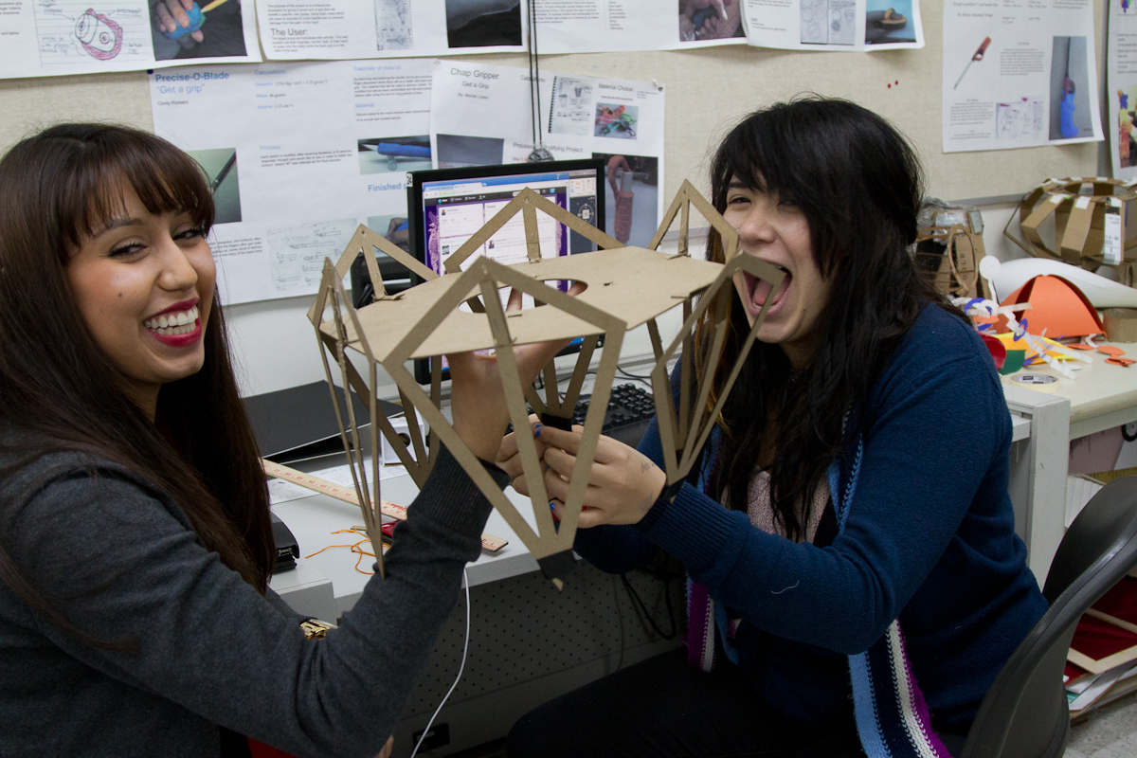
Pasadena City College Design Technology Pathway

Slide 32
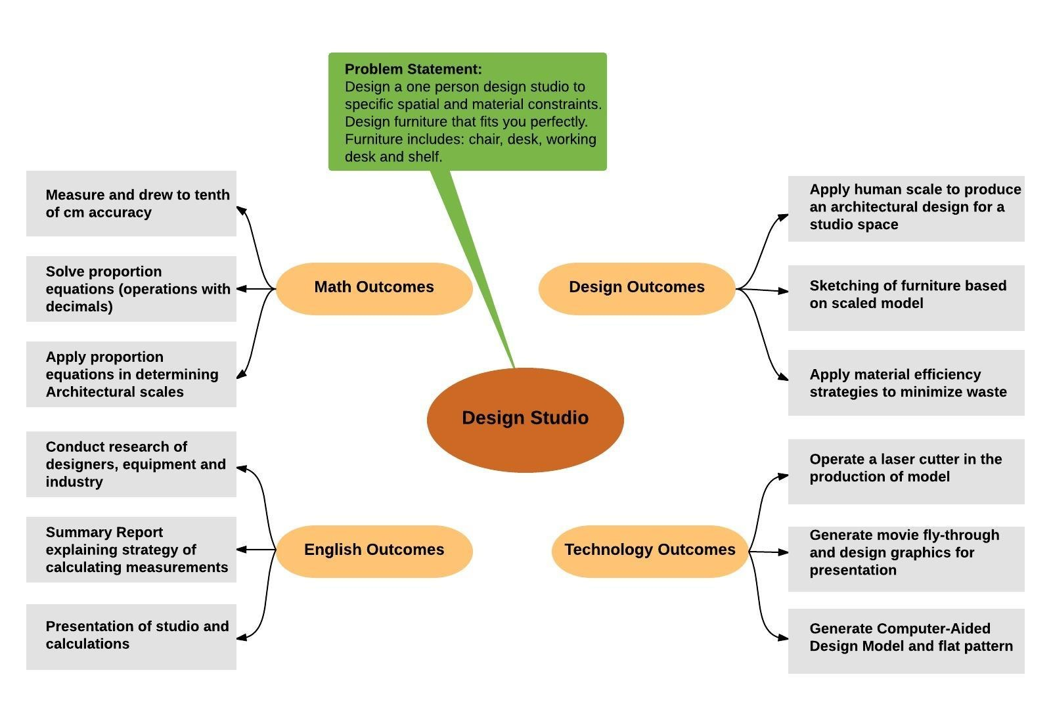
Pasadena City College Design Technology Pathway

Slide 33

Laney College
English 1A for CTE
4 units
Contextualized to the workplace
Reserved for CTE students only
Degree applicable
Transferable

Slide 34
Integrative Learning – Linked Courses
(from University of Wisconsin – Eau Claire)
“What It Means to Be Human”
Combined Semester Project for Psychology 230 (Human Development) and English 150 (Introduction to Literature)
Purposes: <from syllabus>
Develop and demonstrate your understanding of connections between disciplines of English and Psychology
Demonstrate your insights gathered from the bundle theme: What It Means to Be Human
Offer you an opportunity to explore more deeply a course topic that has interested you
Develop your skills in critical and creative thinking, reading, writing, and reflection
Identify for you some new insight you have gained from this experience
Assignment: Student writes paper or develops creative project that is reviewed and graded by both instructors – one grade awarded for both classes

Slide 35
Rubric Used for Grading Integrated Assignment

Slide 36
SAMPLE OF COMMON ASSIGNMENT – ENGLISH 1A AND GEOLOGY 30
Essay #2: Can We Mitigate the Damage Done to Our Environment?
We have read several articles that describe the ways we are retrieving the resources necessary to maintain our lives and lifestyles, and the impact these means of retrieval are having on our natural environment. The impact is not only destroying our ozone through CO2 emissions, but disturbing and destroying ecosystems, killing wildlife and plant species.
Your task:
Research one of the major environmental threats caused by resource consumption—food production, deforestation, deep water drilling, hydraulic fracking, energy consumption, water consumption, water pollution—and the solutions being proposed to monitor the resource’s use or misuse. Write an essay outlining the problem and evaluating the proposed solutions.
Assignment requirements:
Eight reliable journalistic or scholarly sources
8-10 pages
An annotated bibliography

Slide 37
Increase in Use of Term “Integrated Curriculum” in Medical School Literature 1983 - 2013

Slide 38
What the research tell us about how CTL helps students

Slide 39
Outcome Data
Students in contextualized developmental math courses compared to standard math courses:
327% more likely to pass contextual course
387% more likely to pass degree applicable coursework in the same semester
400% as likely to pass transfer-level course in the same semester
167% more likely to pass degree applicable coursework in the subsequent semester
W. C. Wiseley. Effectiveness of Contextual Approaches to Developmental Math in CCCs . Univ. of Pacific, May 2009
Notes:
Explain why this looks like this

Slide 40
Questions?
Discussion

Slide 41




FOR MORE INFORMATION:
Peter Simon
psimon@careerladdersproject.org
Toni Parsons
mparsons@sdcccd.edu
www.CareerLaddersProject.org

Slide 42


