Slide 1
Equity High Jump: Content Review and Disproportionate Impact
Kale Braden, ASCCC North Representative
Michelle Grimes-Hillman, ASCCC Curriculum Committee Chair
James Todd, Interim Vice-President, Student Services, Modesto Junior College

Slide 2
Some Context

Slide 3
Title 5, §55000: Curriculum-Definitions
(f) “Content review” means a rigorous, systematic process developed in accordance with sections 53200 to 53204, approved by the Chancellor as part of the district matriculation plan required under section 55510, and that is conducted by faculty to identify the necessary and appropriate body of knowledge or skills students need to possess prior to enrolling in a course, or which students need to acquire through simultaneous enrollment in a corequisite course.
Your college may use content review to establish Prerequisites & Corequisites

Slide 4
Title 5, §55003: Policies for Prerequisites, Corequisites and Advisories on Recommended Preparation.
(c) A district governing board choosing to use content review as defined in subdivision (c) of section 55000 to establish prerequisites or corequisites in reading, written expression or mathematics for degree-applicable courses not in a sequence shall first adopt a plan…
Your college needs a Content Review Plan

Slide 5
Title 5, §55003: Policies for Prerequisites, Corequisites and Advisories on Recommended Preparation.
(g)(2) the district establishing the prerequisite or corequisite conducts an evaluation to determine whether the prerequisite or corequisite has a disproportionate impact on particular groups of students described in terms of race, ethnicity, gender, age or disability, as defined by the Chancellor. When there is a disproportionate impact on any such group of students, the district shall, in consultation with the Chancellor, develop and implement a plan setting forth the steps the district will take to correct the disproportionate impact.
You need to measure the impact, determine if it is disproportionate, and plan for disparities.

Slide 6
Title 5, §55502: Matriculation-Definitions
(d) “Disproportionate impact” in broad terms is a condition where access to key resources and supports or academic success may be hampered by inequitable practices, policies, and approaches to student support or instructional practices affecting a specific group. For the purpose of assessment, disproportionate impact is when the percentage of persons from a particular racial, ethnic, gender, age, or disability group, who are directed to a particular service or course placement based on an assessment test or other measure is significantly different from the representation of that group in the population of persons being assessed, and that discrepancy is not justified by empirical evidence demonstrating that the assessment test or other measure is a valid and reliable predictor of performance in the relevant educational setting.

Slide 7
Student Equity Planning and Disproportionate Impact

Slide 8
Student Equity Funding and Plans
2014 June—Governor & Legislature appropriate $70 million of Student Equity funding to the CCCs.
The planning process must:
Be coordinated with other categorical programs.
Include faculty, student services and other constituencies.
Include and disaggregate student populations along the lines of Gender, Race/Ethnicity, Foster Youth, Veterans and Low-Income students.
2015—Governor proposes an additional $100 million in of Student Equity funding for 2015-16; May revise brought $85 million, for a total of $155 million in 2 years.
Initial Student Equity Plans were due January 1, 2015; revised plans due November 23, 2015.
Student Equity Plans should include strategies for mitigating disproportionate impact and addressing student achievement gaps. This includes addressing curriculum (sequences, scheduling, prerequisites, etc.), classroom pedagogies, and other institutional structures that may affect the success of student populations.

Slide 9
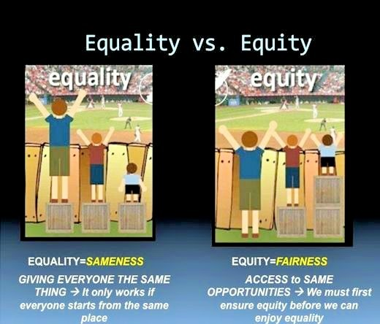

Slide 10
Elements of Student Equity Plans
Research Success Indicators
Access
Course Completion
ESL and Basic Skills Completion
Degree and Certificate Completion
Transfer
Goals
Activities
Budget
Evaluation
*Disaggregated by student groups

Slide 11
Student Equity Plan Populations & Addressing Disproportionate Impact
American Indians or Alaskan natives
Asian
Black or African American
Hispanic or Latino
Native Hawaiian or Pacific Islander
Whites
Some other race
More than one race
Current or former foster youth
Students with disabilities
Low income students
Veterans
*Populations to be addressed by gender.

Slide 12
Monitoring and Measuring Disproportionate Impact
Colleges can decide on and utilize any evidence-based method of monitoring and measuring disproportionate impact and achievement gaps.
Most common are examining rates using a proportionality index or an “80% index”.
Disproportionate impact occurs when “a condition where access to key resources and support or academic success may be hampered by inequitable practices, policies and approaches to student support or instructional practices affecting a specific group.” (CCCCO equity plan template, 2014).

Slide 13
For example, using the 80% Rule…
Compares outcomes/achievement rates of all other groups to that of the reference group
The reference group is the highest performing group
Ethnicity | Pass Rate | Group Success Rate / Reference Group Rate | 80% Rule Comparison Value
African American | 56% | 56% / 76% | 0.74
American Indian/Alaska Native | 66% | 66% / 76% | 0.87
Asian | 76% | 76% / 76% | 1.00
Filipino | 68% | 68% / 76% | 0.89
Hispanic | 63% | 63% / 76% | 0.83
Pacific Islander | 66% | 66% / 76% | 0.87
White | 75% | 75% / 76% | 0.99

Slide 14
Responding to Disproportionate Impact
When Evidence of Disproportionate Impact exists, colleges must create a plan to mitigate the disproportionate impact and address achievement gaps.
Questions to consider:
Which individuals or campus groups should be involved in the action plan?
What institutional factors may have contributed to the findings?
Is attainment of the prerequisite skill level similarly correlated with performance in the target course for each student group?
Does attainment of the prerequisite skill level over or under predict student performance for specific groups?
What other information is needed to gain a fuller understanding of the issue?
How are you currently monitoring disproportionate impact on your campus?
Smith, Beth, Meuschke, Daylene, and Hays, Bri. (2013). “Monitoring Prerequisites”. ASCCC Curriculum Institute. Presentation.

Slide 15
Mitigating Disproportionate Impact
Sample Strategies for Faculty Consideration
Examine curriculum and class activities to determine if they are culturally relevant to all groups
Examine instructional practices to assess micro-messages that may be conveyed to students
Reflect on verbal and non-verbal communication with students to determine if these interactions are equally relevant/engaging to all groups
Provide learning assistance/support (tutoring and supplemental instruction)
Others?
Smith, Beth, Meuschke, Daylene, and Hays, Bri. (2013). “Monitoring Prerequisites”. ASCCC Curriculum Institute. Presentation.

