Slide 1
Critical Conversations for Educational Program Development
Randy Beach, ASCCC Executive Committee Lorraine Slattery-Farrell, ASCCC Executive Committee

Slide 2
Description
Designing a new degree or certificate program requires faculty to do a comprehensive analysis of student and community needs, course and program learning outcomes, developments in industry standard, the expectations of transfer institutions, and the availability of college resources. Meanwhile, credit, noncredit, and CTE programs all face different questions and approval processes. In this breakout, presenters will lead a discussion on effective practices for degree and certificate development for credit, noncredit, and CTE programs that are data informed and student-centered and can exist within the framework of guided pathways.

Slide 3
What Brings You Here?
What questions do you have? What misconceptions have you seen? What barriers do you face?

Slide 4
Resolution 9.02 Spring 2016
Resolved, That the Academic Senate for California Community Colleges develop a paper on effective practices for developing and revising all educational programs and bring the paper to the Spring 2017 Plenary Session for approval.

Slide 5
What Does Title 5 Say?
Title 5 §55000 (m) “Educational program” is an organized sequence of courses leading to a defined objective, a degree, a certificate, a diploma, a license, or transfer to another institution of higher education.

Slide 6
What About T5 and ACCJC?
ACCJC’s definition of a program is broader than T5
Definition includes instructional programs, student and learning support services programs, and resource management
Metrics for program evaluation vary between academic programs and others
student learning outcomes for academic programs
service or administrative outcomes for non-academic programs

Slide 7
Why Create a Program?
Five Areas Listed in T5:
Appropriateness to the Mission Programs must be directed at the appropriate level for community colleges. Programs must address a valid transfer, occupational, basic skills, civic education, or lifelong learning purpose. Programs should also be congruent with the mission statement and master plan of the college and district.

Slide 8
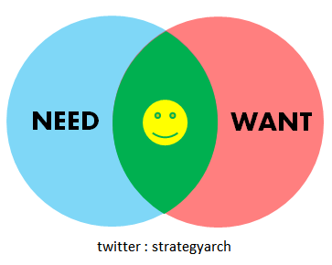
Why Create a Program?
Five Areas Listed in T5:
Need New programs that meet stated goals and objectives in the region must not cause harmful competition with an existing program at another college. Need is determined by multiple factors, including but not limited to; educational master plan, accreditation standards, program review, economic development interests, labor market data, and community surveys.

Slide 9
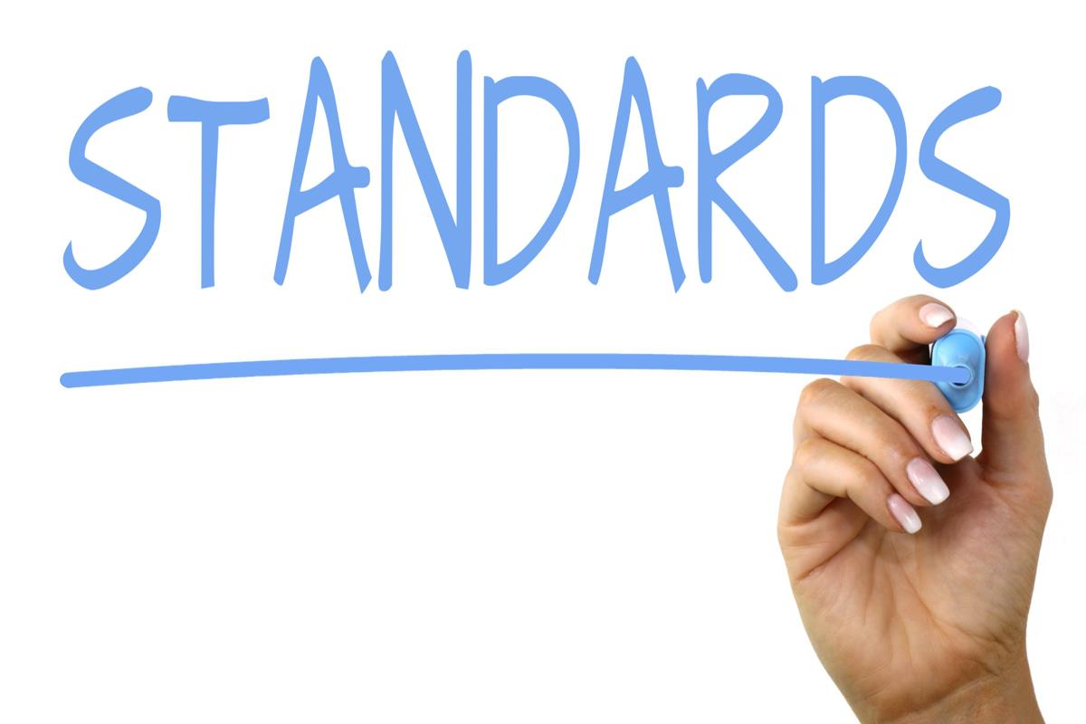
Why Create a Program?
Five Areas Listed in T5:
Curriculum Standards Title 5 mandates that all credit and noncredit curriculum be approved by the college curriculum committee and the district governing board. CTE credit programs must be reviewed by Career Technical Education Regional Consortia. The proposed program must be consistent with requirements of accrediting agencies as applicable. Programs are designed so that successful completion of the program requirements will enable students to fulfill the program goals and objectives.

Slide 10
Why Create a Program?
Five Areas Listed in T5:
Adequate Resources In developing a new program, the college commits to offering all of the required courses for the program at least once every two years. Hence, the college must have adequate resources for faculty, facilities and equipment, and library and learning resources.

Slide 11
Why Create a Program?
Five Areas Listed in T5:
Compliance The design of the program must not be in conflict with any law including state and federal laws.

Slide 12
Additional Considerations for CTE
Industry Needs
Advisory Boards for CTE Programs
Labor Market Data
Regional Consortia Recommendation
Stackable Credentials

Slide 13
Benefits of Creating a New Program
Such benefits may include, but are not limited to the following:
Increased opportunity for students
Increased student success
Increased student retention
Increased enrollment
Increased employment in the region
Enhanced regional economic development
Improved transfer rates

Slide 14
Asking the Right Questions to Develop a Program
Is there documentable student interest that warrants creating the program?
Are local transfer institutions expressing an interest in developing the program?
Does the college’s or program's accreditation status or license to operate require the program?
Is there a legislated requirement that the college offer the program?
Is there an employment market where students may benefit from the proposed program?

Slide 15
Asking the Right Questions to Develop a Program
Will the program lead to employment that provides graduates with a sustaining wage?
Can the student learning outcomes of the program be met by an existing program or can an existing program be revised to address those program student learning outcomes?

Slide 16
Vital Considerations and Impacts
When new programs are created, faculty should consider the following:
Impacts on enrollment in existing programs and overall enrollment management
What to do if enrollment doesn’t materialize
Availability of faculty, staff and other HR resources
Facility and space needs

Slide 17
Types of Programs: A Refresher
Bachelor of Arts (BA) Bachelor of Sciences (BS) Associate in Arts for Transfer (AA-T) (60 units) Associate in Science for Transfer (AS-T) (60 units) Associate in Arts (AA) (60 units) Associate in Science (AS) (60 units) Certificates of Achievement (18 or more semester degree-applicable units or 27 or more quarter degree-applicable units)*
* At this time, a proposal is being considered to revise the minimum number of units for certificates of achievement in Title 5.

Slide 18
Types of Programs: A Refresher
Certificates of Achievement (12 or more semester degree-applicable units or 18 or more quarter degree-applicable units) which require approval by the CCCCO in order to be included on a student's transcript.*
Certificate of less than 12 units that may be created and does not require approval by the Chancellor’s Office; however, these certificates are not transcriptable and cannot be called a “Certificate of Achievement,” “Certificate of Completion” or “Certificate of Competency.”*
* At this time, a proposal is being considered to revise the minimum number of units for certificates of achievement in Title 5.

Slide 19
Types of Programs: A Refresher
Noncredit Certificate of Completion (a sequence of Career Development and College Preparation (CDCP) courses in short-term vocational or workforce preparation areas.
Noncredit Certificate of Competency (a sequence of Career Development and College Preparation (CDCP) courses in ESL or Elementary & Secondary Basic Skills

Slide 20
Which Program Type Is The Right One?
The following guiding questions may help faculty determine the program structure that best serves students:
What level of preparation must students achieve to be considered proficient in a discipline, field, or industry?
What type of program is recognized as appropriate or valuable in the eyes of employers in the field or industry?
Which degree-applicable skills or courses are needed to help students achieve the program student learning outcomes? How many courses will a student need to take to achieve those outcomes?

Slide 21
Which Program Type Is The Right One?
The following guiding questions may help faculty determine the program structure that best serves students:
What is the value of general education to achieving the program’s student learning outcomes?
Can students benefit from the program without the program appearing on their transcript?
How flexible should the program be to best serve the students who will benefit from this program?
How will a student’s financial aid eligibility be impacted by the program?

Slide 22
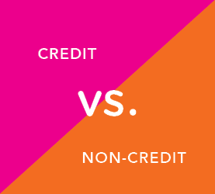
Credit vs. Noncredit Programs
CCCCO approval needed
10 categories of noncredit courses
Noncredit enhanced funding (CDCP) (Education Code 84760.5)
English as a Second Language
Basic Skills
Short-term Vocational
Workforce Preparation

Slide 23
Community Service Courses or Programs
Programs providing educational offerings to serve a community’s unique needs.
Education Code § 78300(a), a college district may “establish and maintain community service classes in civic, vocational, literacy, health, homemaking, technical and general education.”
Includes classes in the visual and performing arts and many other areas, and are designed to provide instruction and to contribute to the physical, mental, moral, economic, or civic development” of participants.
Community services classes provide no credit units and are offered outside the regular college credit and noncredit programs.

Slide 24
Community Service Courses or Programs
Title 5 explicitly states that general apportionment funds may not be used to fund community services
Students who pay a fee intended to cover the full cost of the course
Community services class fees cover the direct costs of instruction such as the costs of the instructor or supplies and indirect administrative costs such as staff support and facilities costs
Community services program is not required to be included in the college’s catalog and does not generate full-time equivalent student (FTES) apportionment

Slide 25
Grant-Funded Programs
Partnerships with external agencies or seek local, state, or federal funding sources.
Typically these funds may only be used for a specific purpose and reporting is required.
Programs established through external funding, should be led first and foremost by faculty in consultation with administrative partners.
Faculty and administration should mutually agree on processes for applying for external funding sources and the dispensation and reporting around those funds as part of its budget process.

Slide 26
Role of Faculty and Administration
10 + 1 typically place “educational program development” in “rely primarily”
Determination of student need by faculty, with support from administration
Administrative or industry partners may be the impetus for a program
programs are developed based on stated student learning outcomes determined by faculty in consultation with students, administrators, advisory boards, and other stakeholders.
Courses are developed in alignment with program student learning outcomes that support students’ end goals (employability/transfer)

Slide 27
Program Evaluation: SLOs
Program evaluation is a process by which institutions seek improvement of instructional delivery and learning outcome success through introspection and reflection upon the program’s components, processes, and systems
SLO assessment of program student learning outcomes and the use of assessment data to inform program planning are central to several accreditation standards
SLO assessment should be done regularly and with adequate documentation that the assessment results are used in planning
Faculty can “own their SLOs” and ask questions that they want to know the answers to and are relevant for them

Slide 28
Program Evaluation: Data
Program statistics and data should ask relevant questions
Data on course and degree/certificate completion are mandated at the federal and state levels, and by accrediting bodies.
The data should be accessible and consistent with the CCCCO.
Data disaggregated by student demographics can be difficult to interpret and draw conclusions
Colleges should develop a culture of “data literacy” and offer professional development opportunities for anyone involved in program review to feel comfortable discussing data and performance metrics that have been adopted by the college

Slide 29
Guided Pathways and Program Development?
Begin with the end in mind
Consider curriculum in pedagogical and scheduling terms (program mapping)
Consider how programs relate to each other (meta majors / stackable certificates)
Consider supports needed for students to enter/complete the program
What’s the “right math” for the program (AA/AS/ADT)?

Slide 30
“
QUESTIONS?

