Slide 1
General Education Guided Pathways
Sequencing + Scheduling to Facilitate Student Success
Nate Donahue, ASCCC At-Large Representative, Santa Monica College
Heather Rau, Curriculum Analyst, Butte College
Dorrie Richer, Curriculum Analyst, Butte College

Slide 2
Communities of Interest Program Thinking
Creating Program Maps
The California Guided Pathways Project is designed to provide students with clear educational program maps which simplify the course selection process while maintaining opportunities for exploration

Slide 3
Establishing a Process
Guided Pathways Project
Counselors + Department Chairs collaborate to create program maps with GE specific recommendations
Program maps were entered into an online database for use on the newly-developed Guided Pathways website http://www.butte.edu/guidedpathways/
Areas of Focus
• Mapping Pathways to Student End Goals
• Assist Students to Choose and Enter a Pathway
• Maintain Student Progression on the Pathway
• Ensure Students are Learning

Slide 4
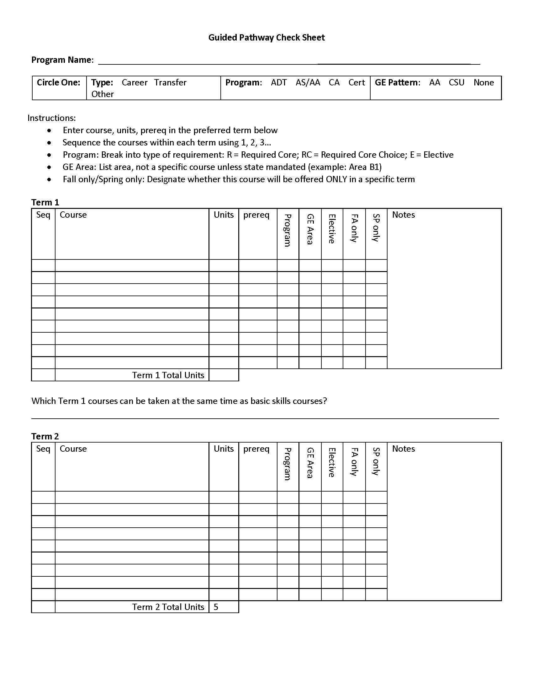
Map Template Used in Creating Degrees, CofA’s + Small Certificates

Slide 5
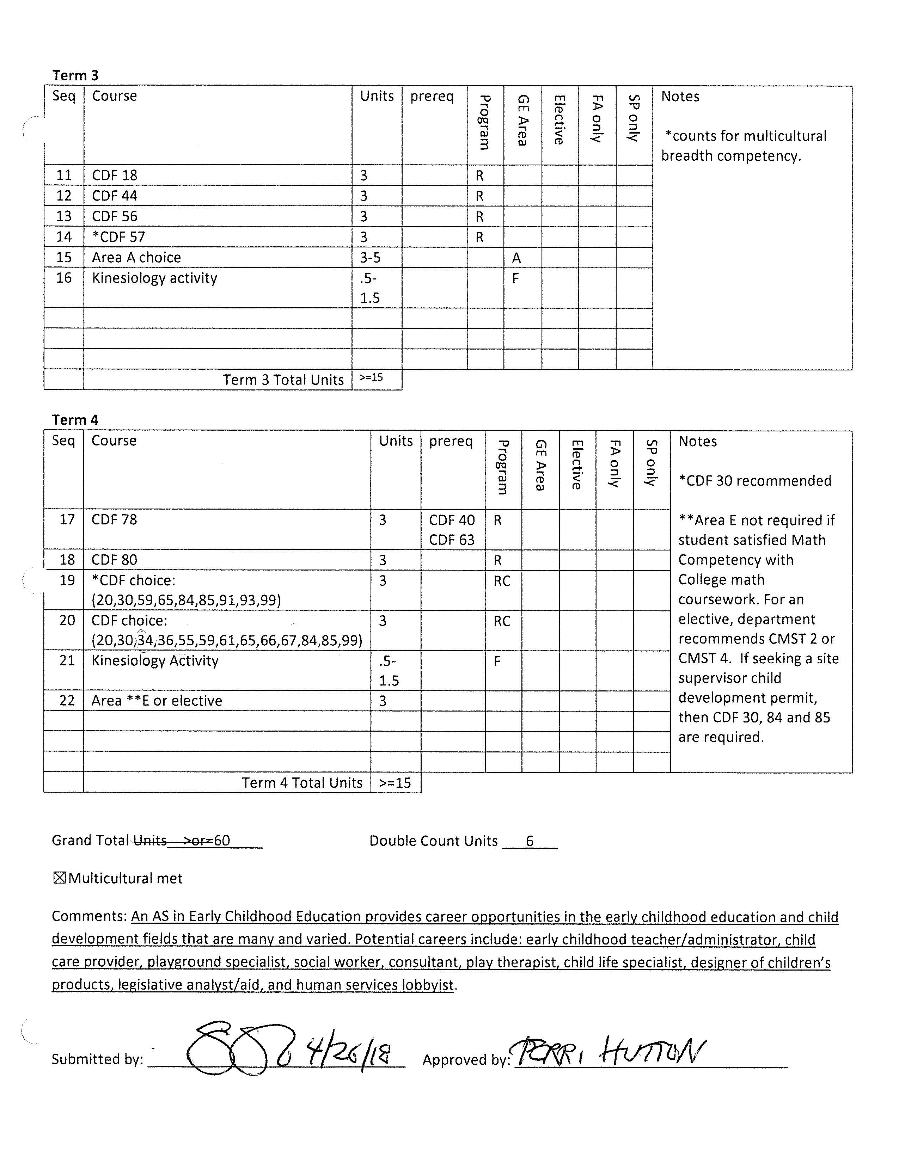
Completed Map in Child Development: Early Childhood Education
Notes + Comments ensure students have the information necessary to make informed decisions

Slide 6
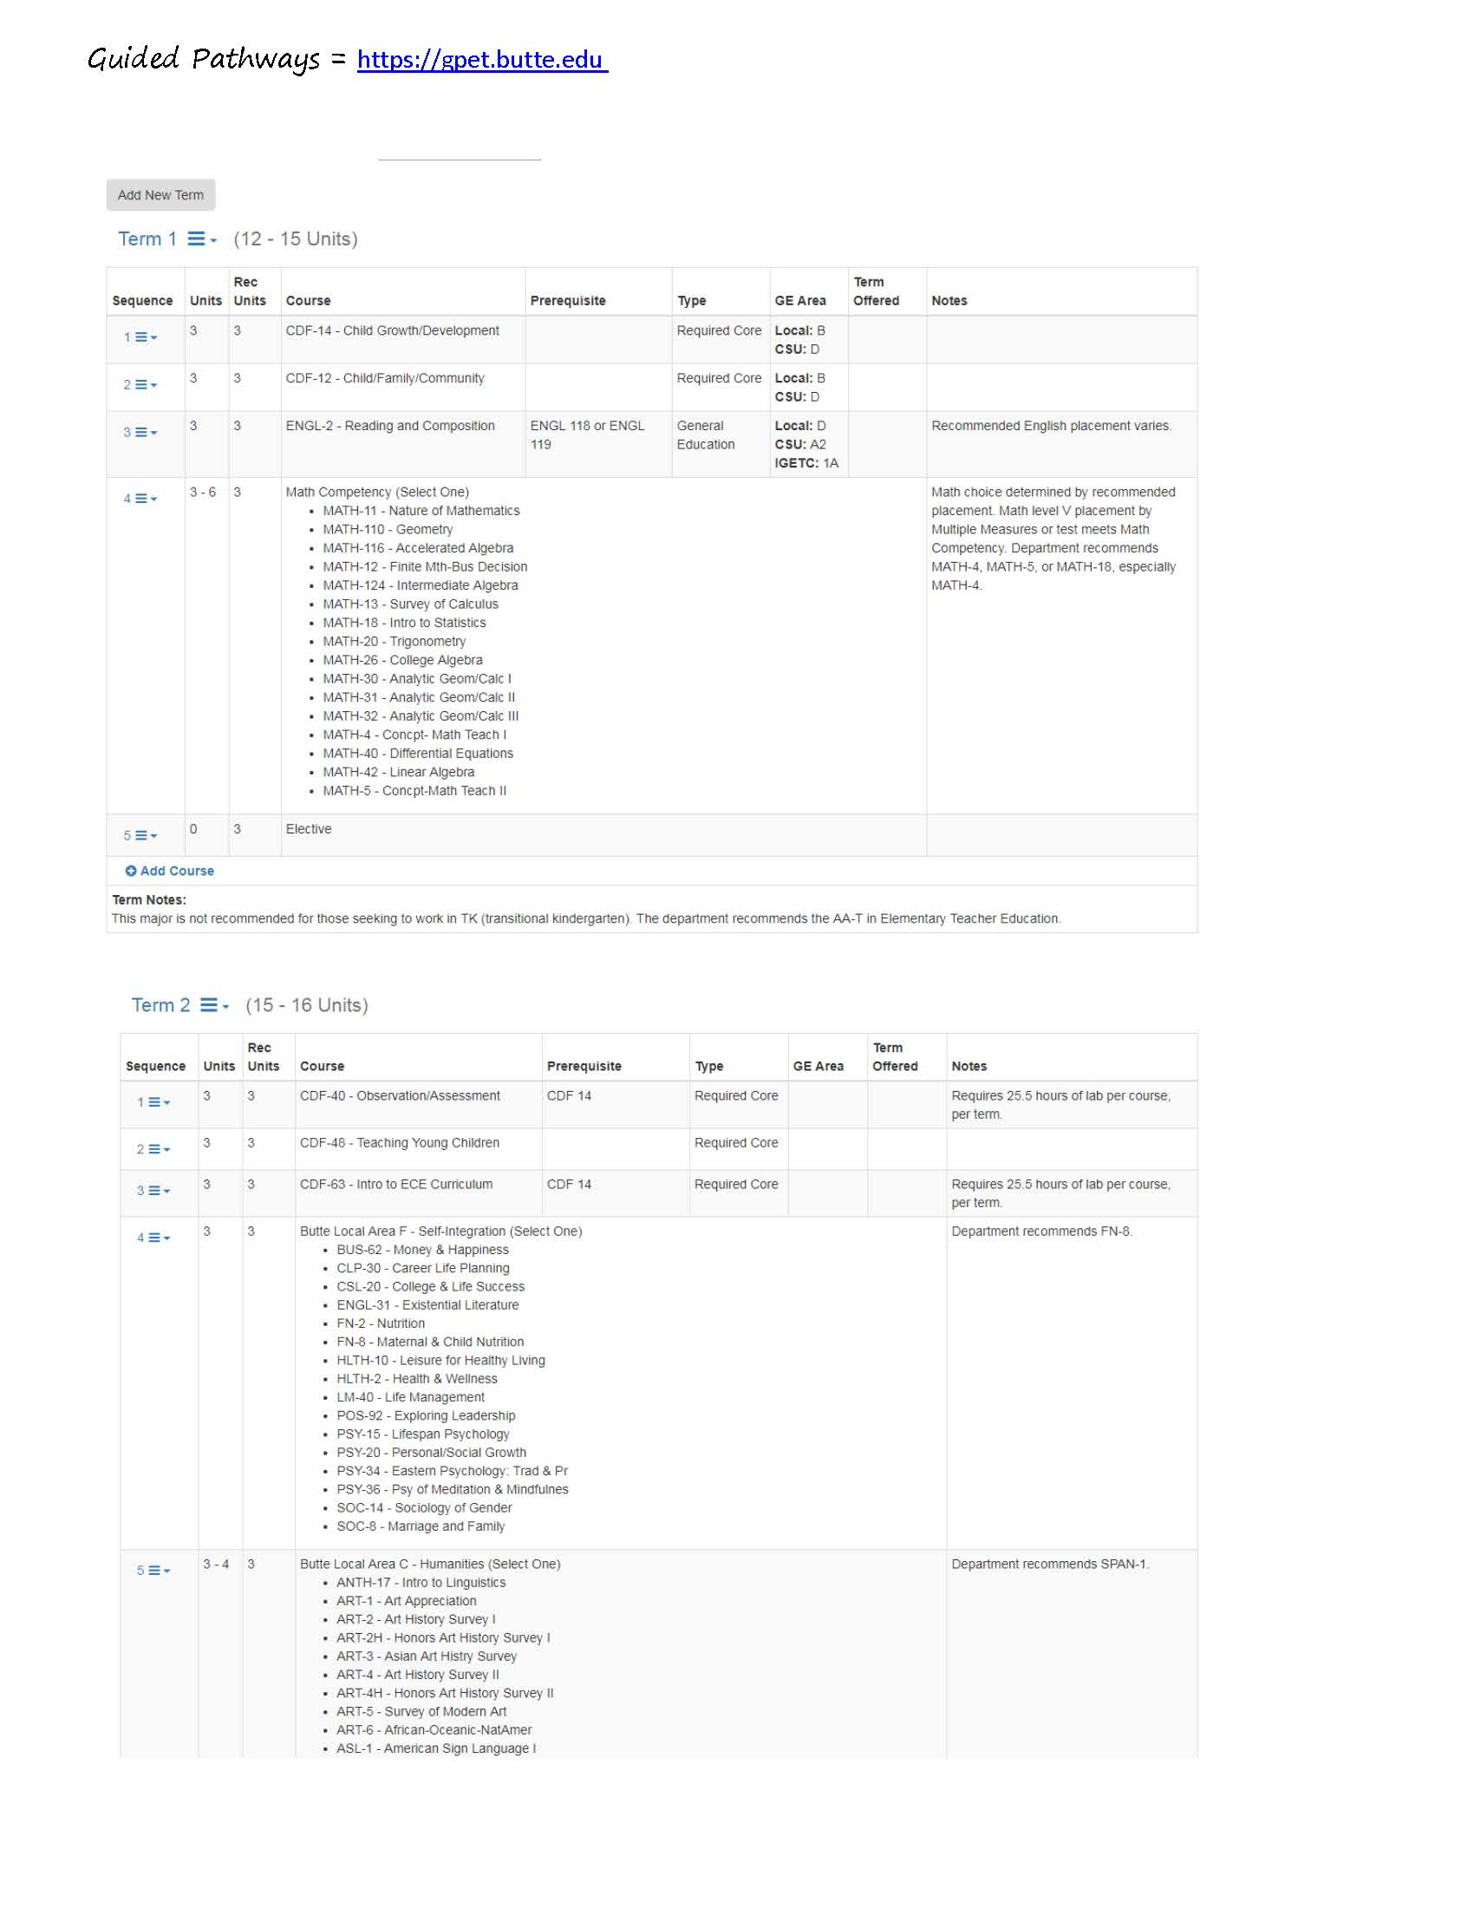
Student View From the Online Tool – Live August 1, 2019

Slide 7
Program Maps
Scheduling Scheme
Offering students maximum flexibility and highly structured experiences to encourage program completion
Aligning local GE with the CSU and UC systems to ensure students experience a seamless transition from the junior college to a four year institution

Slide 8
Maintaining the Process
Guided Pathways Project
Course and program information is uploaded annually from CurricUNET for catalog creation
This information is uploaded to our “homegrown” Guided Pathways Tool
Maps are duplicated as a batch file, then manually updated to reflect curricular changes
Maps are updated annually allowing both the Guided Pathways Tool and the catalog to be synchronous
The process is date driven to allow for correct course file and program requirement selection
AB 705 compliant

Slide 9
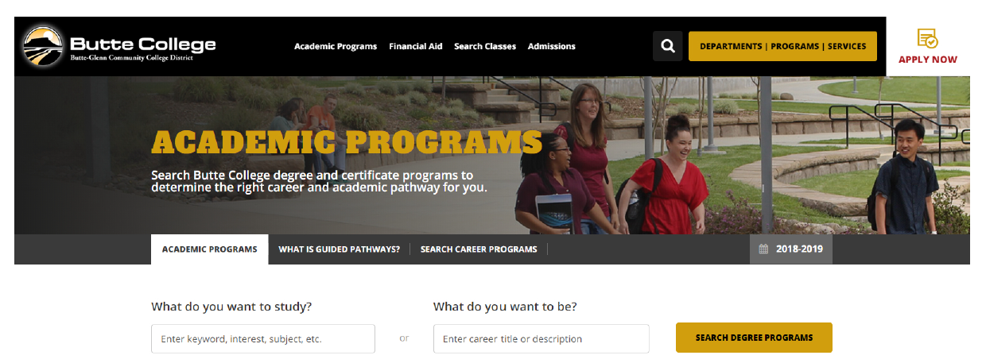
9
The Guided Pathways Tool allows students to explore education and career opportunities by Communities of Interest or by keyword search

Slide 10
Areas of Interest assist students in selecting an educational goal with options for local, CSU and IGETC General Education

Slide 11
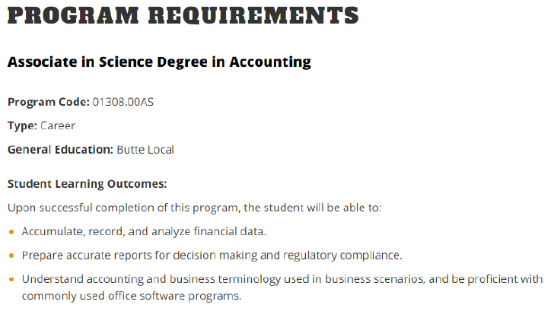
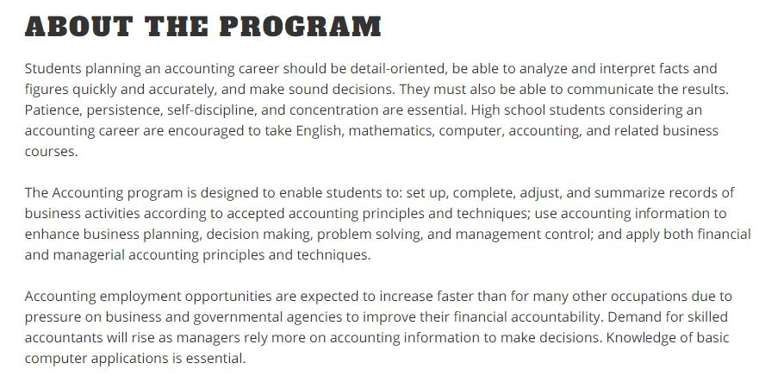
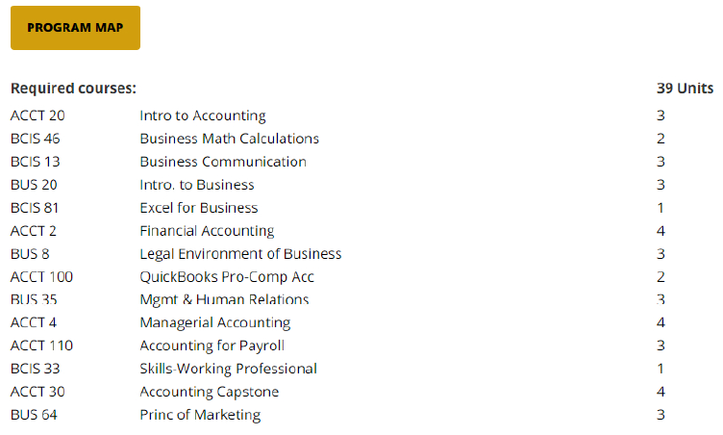

Slide 12
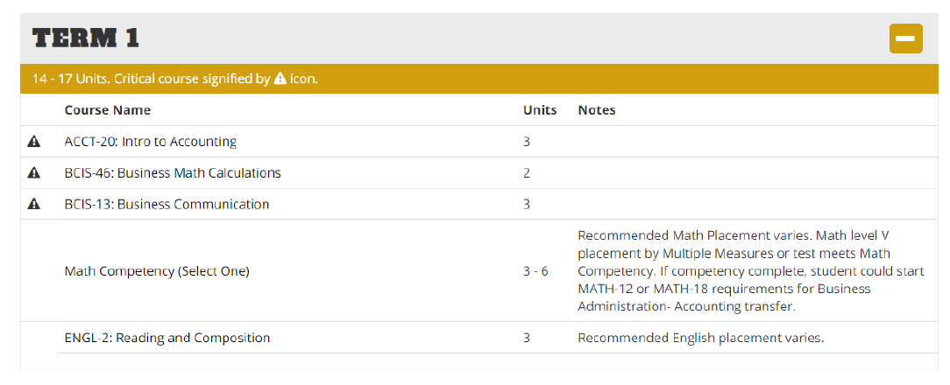

Slide 13
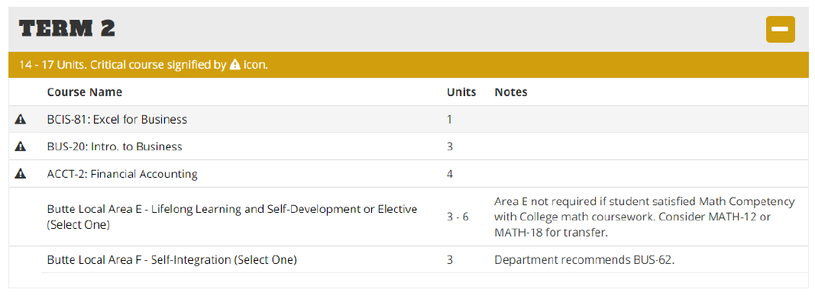
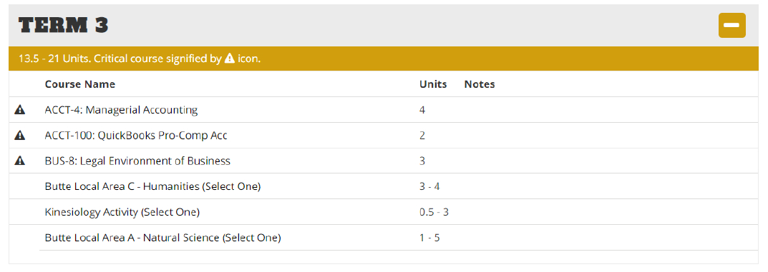

Slide 14
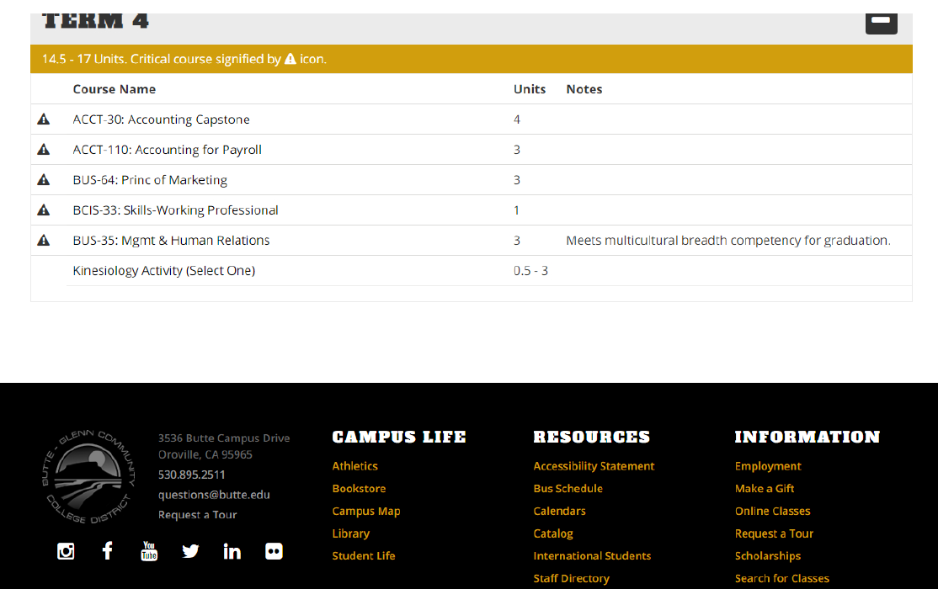

Slide 15
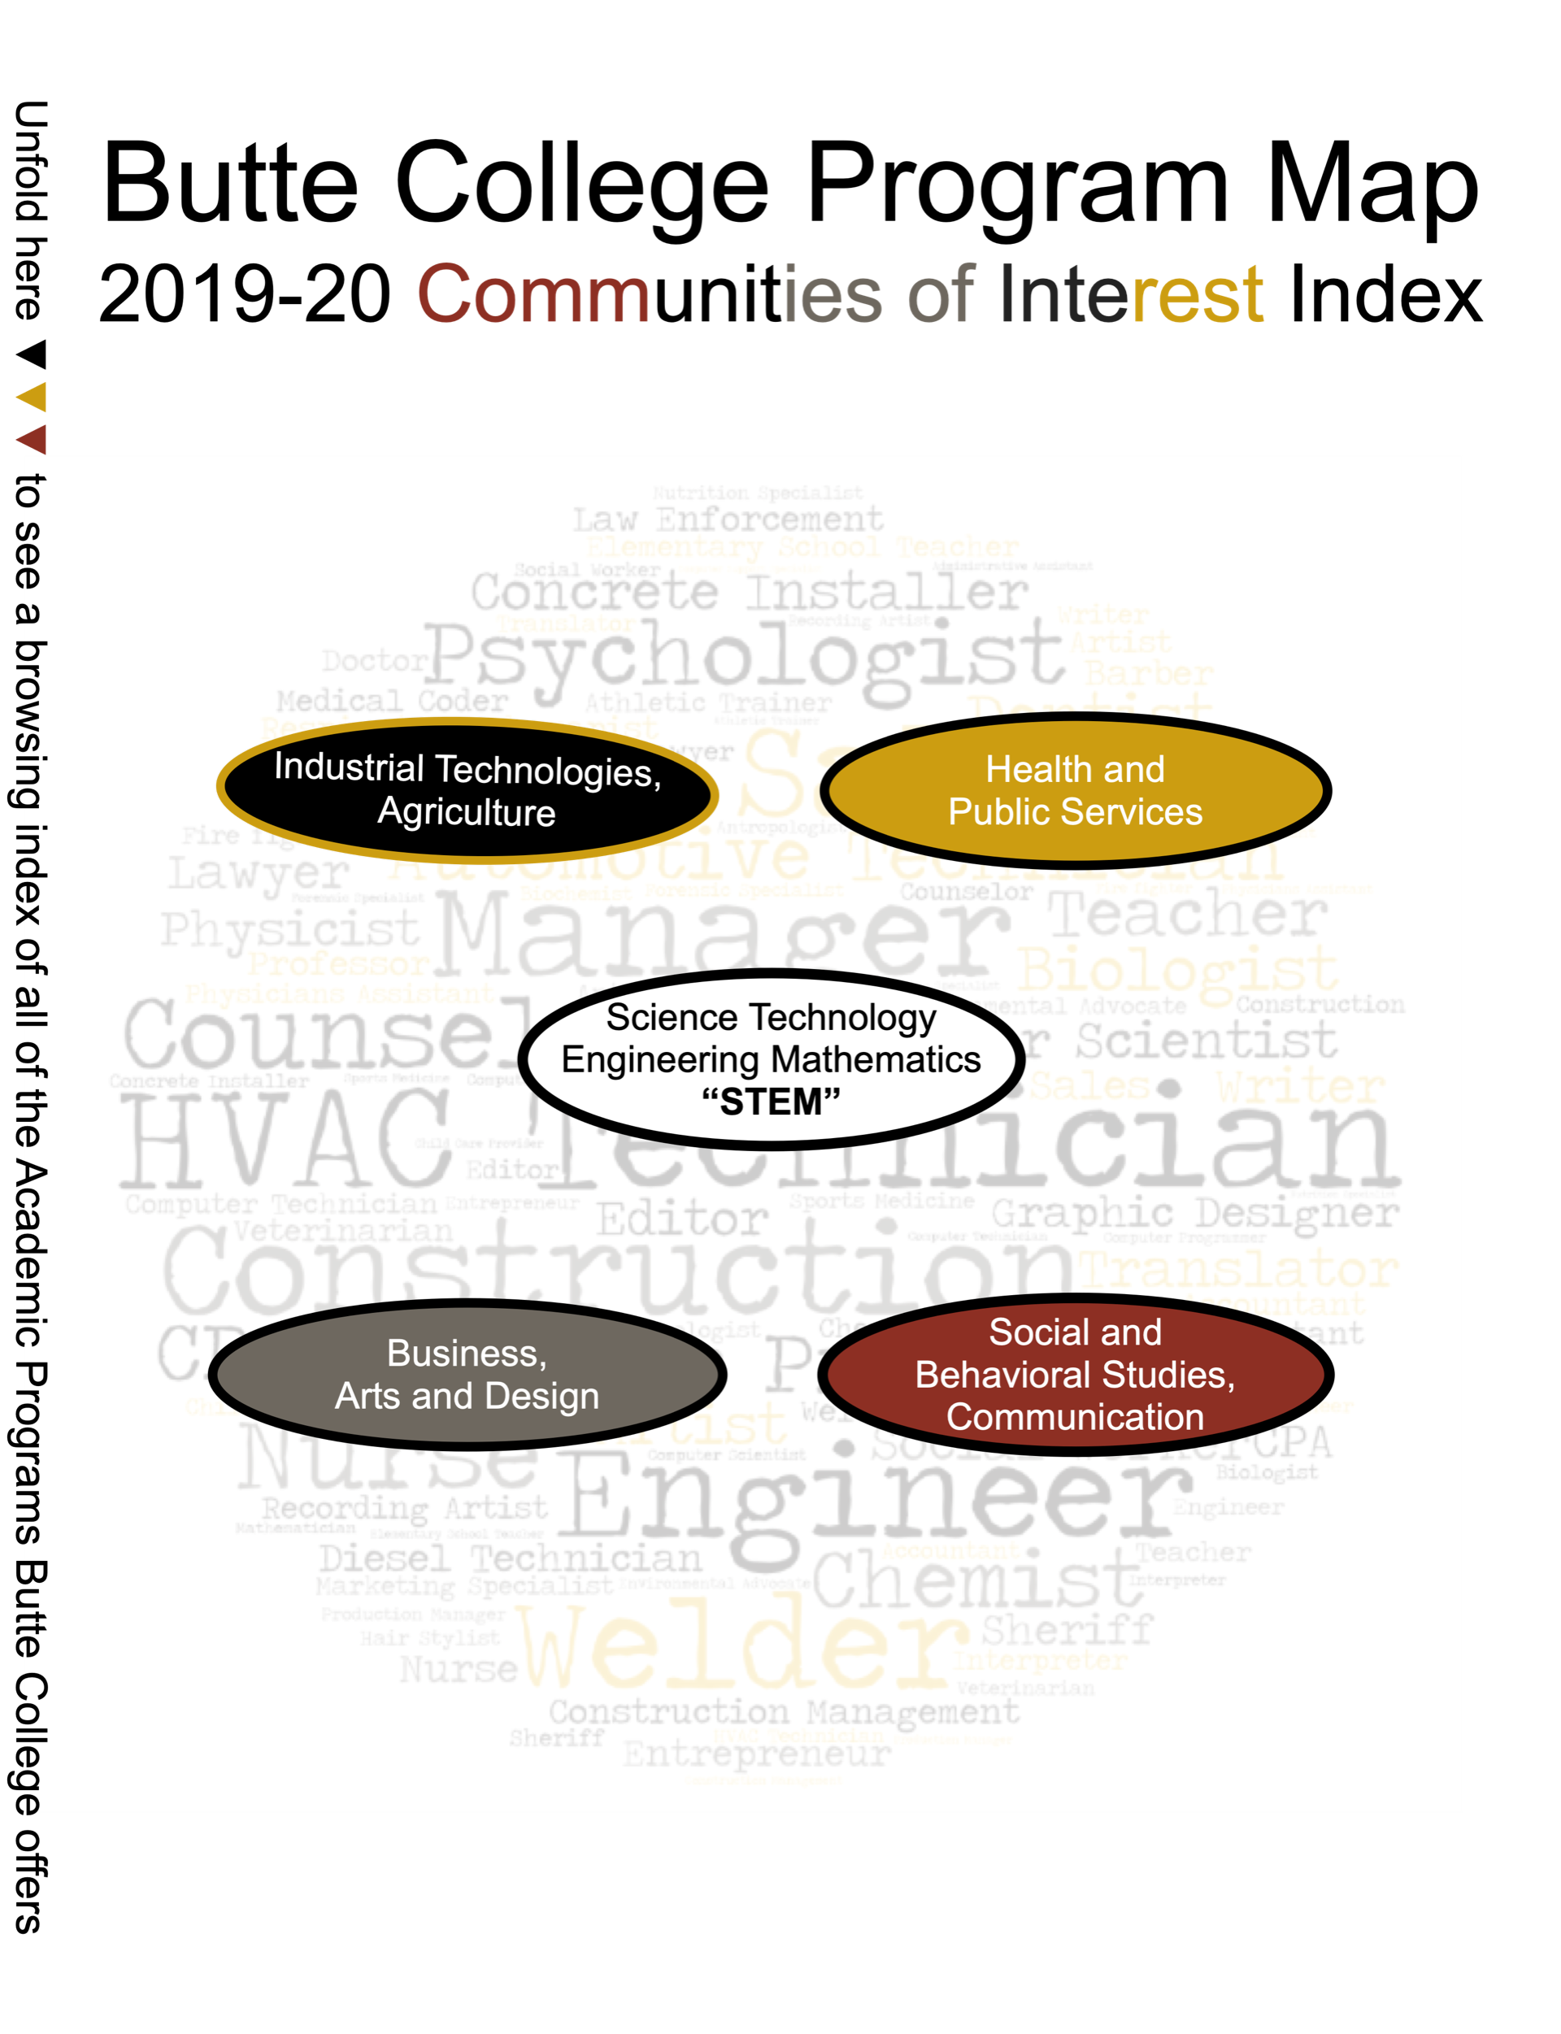
Communities of Interest
To offer students a visual representation of programs, degrees and certificates, the catalog now includes a Communities of Interest Pictorial Index

Slide 16
Large Photo Slide
16

Slide 17
THANK YOU
Donahue_Nathaniel@smc.edu
Rauhe@butte.edu
Richerdo@butte.edu
A big thank you to Donna Davis, Guided Pathways Faculty Coordinator + Robert White PhD, Curriculum Chair

