Slide 1
Effective Practices
for Training your
Curriculum Committee
Michelle Hillman, Long Beach City College
Jennifer Johnson, Bakersfield College
Eric Wada, Folsom Lake College
2019 Curriculum Institute

Slide 2
Description
Title 5 §55100 and §55130 require that those involved in the curriculum review and approval process are trained. Committee membership and operating procedures may evolve, therefore there is a need for regular and ongoing training. Approved curriculum is reviewed by others who may not be affiliated with the Chancellor’s Office, the idea of training can also extend beyond the requirements. Are there additional training opportunities for committee members to review curriculum while keeping student equity in mind? Join us for an interactive discussion where we brainstorm ideas for effectively training the curriculum committee.

Slide 3
Objectives
Discuss requirements for curriculum committee training
Discuss variations in local processes
Discuss options for ongoing training

Slide 4
Introduction

Slide 5
Annual Training

Slide 6
Requirements of Certification
Colleges are certifying that all approved curriculum will align with all requirements outlines in Education Code, Title 5, and the 6th edition of the Program and Course Approval Handbook
College must have a board policy related to the credit hour. Policy must be submitted to the CO with the certification memo.
College must have a cooperative work experience plan that has been approved by the local governing board (plan does not need to be submitted to the CO)

Slide 8
Curriculum and the Law
CA Education Code
Statute
Determined by legislation
Title 5
Interprets Ed Code into regulations
Determined by Board of Governors

Slide 9
Curriculum and the Law
Chancellor’s Office Program and Course Approval Handbook (PCAH)
Establishes specific guidelines for implementing Title 5
Developed by Chancellor’s Office with Academic Senate (ASCCC) and CCC Curriculum Committee (5C – formerly SACC)

Slide 10
Curriculum and the Law
Chancellor’s Office Guidelines and Memos
Further clarify implementation of Title 5
E.g. AB 705 Memos
ASCCC papers and reference guides
Papers on COR, effective approval processes, etc.

Slide 11
Curriculum, the Law, and You
You ensure:
quality and accuracy of the curriculum
our approvals meet the expected state, local, and transfer standards
that we uphold the requirements for apportionment
that we uphold the accreditation standards, specifically Standard II.A.3
that we accurately report the MIS data (CB codes)
All of the above are elements to look for in the Course Outline of Record (COR)

Slide 12
Curriculum and the Law
The course outline of record (COR) is a legal document that must contain certain required elements that are outlined in §55002 of Title 5.
The COR serves as a legal contract between the faculty, student, and the college.
The COR ensures consistency among all sections of a course.

Slide 13
Required Elements of the COR
Element | Credit | Noncredit
Unit value | X
Total contact hours | X | X
Outside of class hours | X
Total student learning hours | X
Conditions of enrollment | X
Catalog description | X | X
Objectives | X | X
Content | X | X
Reading and writing assignments (or others as appropriate) | X | X
Other outside of class assignments | X | X
Methods of instruction | X | X
Methods of evaluation / grading policy | X | X

Slide 14
ASCCC's 2017 Paper
The Course Outline of Record: A Curriculum Reference Guide Revisited:
“The course outline of record (COR) is a document with defined legal standing that plays a critical role in the curriculum of the California community colleges.”
The COR "has both internal and external influences that
impact all aspects of its content, from outcomes to teaching methodology, which, by extension, impact program development and program evaluation."

Slide 15
Annual Training: Participants
Who?
Include subcommittees?
When/Where?
Do you schedule a special meeting?
Are there opportunities for continuing training?
Why?
It’s required!
How?
Are there ways to get new members up to speed?

Slide 16
Local Process

Slide 17
Local Processes:
Curriculum Committee’s Role
Education code and Title 5 delineate the authority of the Curriculum Committee.
We are a subcommittee of the Academic Senate.
How does your local committee intersect with the Senate?
Curriculum is the first of the 10+1 and is almost always rely primarily.

Slide 18
Local Processes:
Curriculum Committee’s Role
The committee recommends courses/programs for approval.
Does your committee make recommendations directly to the Board?
Final authority for approval of courses and programs rests with the BOT.

Slide 19
Local Processes:
Committee Members
By definition, these processes will differ. The following questions are for you to consider as you prepare to train and work with your Curriculum Committee.
Who is a member of the Curriculum Committee?
Who votes?
Who reports?
Are there ways to ensure diversity in committee composition?
How often do meetings occur?

Slide 20
Local Processes:
Committee Members
Member responsibilities include:
REPRESENT Departments and serve as a point of contact/resource.
REVIEW curriculum to ensure complete and accurate data, compliance, and consistency
Assignment to a discipline, min qualifications
Avoiding duplication of existing curriculum
Multi-college district?
Appropriateness to college mission
Integration of elements of COR (content, objectives, assignments, etc...)

Slide 21
Local Processes:
Committee Members
Committee members are responsible for knowing:
The law
CCCCO Guidelines
District policies and regulations
College mission
C-ID, articulation, and transfer institution requirements
Advisory board requirements/recommendations

Slide 22
Local Processes:
Committee Chair
Curriculum Chair responsibilities include:
Establish positive relationships with CIO, AO, Curriculum Staff, and Faculty
Learn as much as you can about regulations and current issues at the state level.
Prioritize meeting agenda items and keep agenda moving & on schedule
Ensure all voices are heard
Remind the CC the important role they have to ensure we continue to provide our students with quality curriculum
Be familiar with how to resolve and/or manage conflict

Slide 23
Local Processes:
Technical Review
Technical Review
Who sits on this committee?
Suggestions: Chair, AO, Librarian, DE faculty, Administrator, Curriculum Specialist, Others?
Are there defined roles?
Who votes?
Who reports?
How does this committee function?
Compliance matters, grammar, etc...

Slide 24
Local Processes:
Approval Process
Title 5 requires special considerations when approving:
Prerequisites, Corequisites, Advisories, and other limitations on enrollment
Distance Education
How are the above approved?
Who is involved in making these approvals?

Slide 25
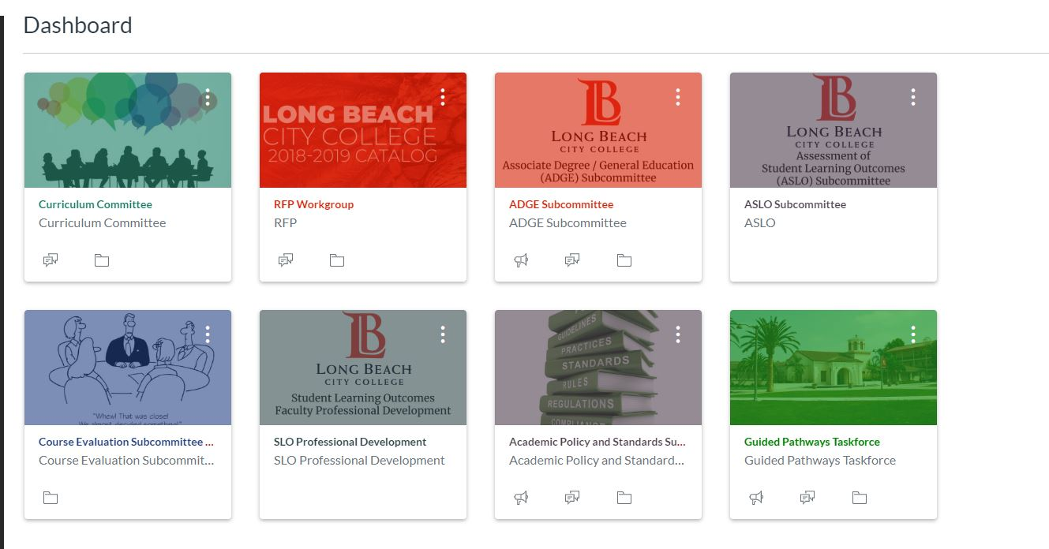

Slide 26
Ongoing Training

Slide 27
Ongoing Training:
Initiatives / Pressures in the CC
Equity: Does the committee use equity mindedness and flexibility to bring and use multicultural and inclusive perspectives
Legislation: AB705
Funding formula: 70/20/10

Slide 28
Ongoing Training
See a resemblance?

Slide 29
Ongoing Training:
Tools and Process
Handbook
Provides evidence of local adherence to state code and regulation
Provides a record of local policies and procedures
Can be used to provide local historical perspective/philosophies regarding curriculum matters
Provides an invaluable resource for faculty in the curriculum process
LMS
Flex and PD workshops

Slide 30
Ongoing Training:
Evolving Trends
Anticipate and Include
Anticipate issues/conflict
Include and inform areas that are impacted by curriculum decisions

Slide 31
Any Questions?
Thank you for
attending this session!

