Slide 1
You Got This! The Resolution Writing Breakdown
Thursday, June 16 at 2:00 p.m. - 2:45 p.m.
Amber Gillis, ASCCC South Representative
Michelle Velasquez Bean, ASCCC Treasurer

Slide 2
Session Description
Resolution writing may be scary to some, or it may be exhilarating to others. That is okay! We are here to break down the process and give you an overview of what is to come at a future plenary session. It is vital for faculty leaders to understand the ASCCC resolution process as it is the way the faculty body expresses its official positions on . 11 . academic and professional matters and legislation. During this session, attendees will learn the nuts and bolts of resolution writing, as well as what happens after a resolution has been voted up or down by delegates. Attendees will also receive an overview of the Resolutions Handbook, the parliamentary process for debating and voting on resolutions at a plenary session, and how to use resolutions locally at a college or a district. Come ready to practice and ask questions.

Slide 3
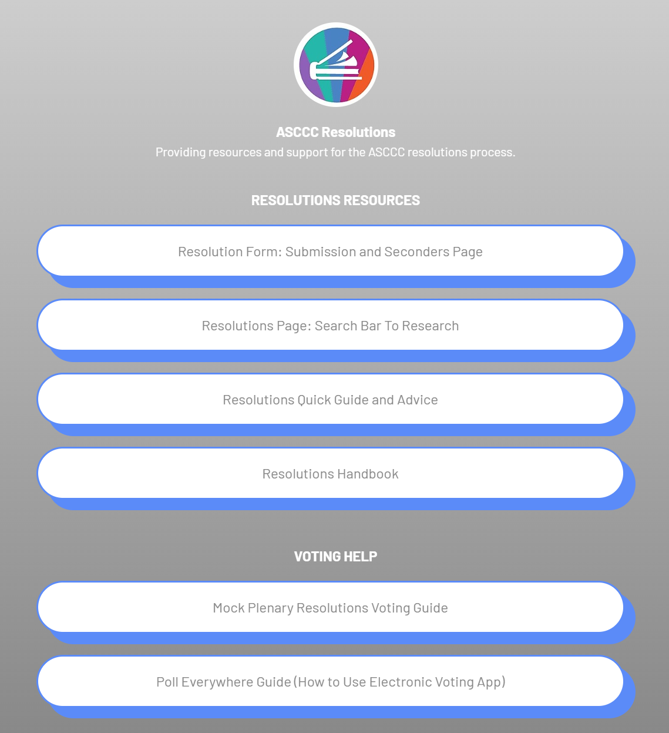

LinkTree with Helpful Resolutions Pages
Resolutions Seconders Page online form
Link to ASCCC Resolutions page
Resolutions Quick Guide
Resolutions Handbook
Mock Plenary Voting Guide
https://linktr.ee/ascccresolutions

Slide 4
Why do we do resolutions?
To identify and record the will of local academic senates of the California community colleges (CCC)
To set the direction for the ASCCC as a whole
To direct members of the Executive Committee and ASCCC committees to act in response to approved resolutions
To provide a process for faculty to highlight important issues and policy, which may be identified by
  ASCCC Committees/Taskforces
  ASCCC Executive Committee
  Local academic senates
  Individual faculty from the CCCs

Slide 5

Resolutions are . . .
Used for a bottom-up democratic process
Debated by the body at fall and spring plenary sessions
Voted on by the delegates of local academic senates
Used for
adopting ASCCC papers
approving changes to the Disciplines List
establishing positions on pending legislation
addressing conflict and affecting statewide change and not for addressing specific, individual local problems
Notes:
“The Academic Senate acknowledges that democracy can be a messy enterprise. Whereas top-down governing processes found in monarchies and dictatorships are incredibly orderly, democracies typically employ chaotic, bottom-up processes with lots of conversations, multiple levels of politicking, and rapid changes of opinion.”

Slide 6

The ASCCC
Resolution Process
Pre-plenary resolutions packet developed by the Executive Committee through ASCCC committees. Distributed at Area meetings.
Amendments and new resolutions generated at Area meetings. Resolutions packet updated by ASCCC Resolutions Committee.
Contacts/authors of resolutions meet at designated mandatory plenary breakout session to review resolution concerns.
Resolutions and amendments must be submitted to the Resolutions Committee Chair before the posted deadline each day of plenary session.
Plenary Area meetings held to discuss resolutions and write amendments.
Resolutions and amendments are debated and voted upon on the last day of the plenary session.
Packet finalized and distributed to the field. Adopted resolutions drive the work of the ASCCC.
Notes:
Only Emergency/Urgent resolutions accepted on 2nd day of plenary!

Slide 7

What do you mean by “packet”?
The “packet” is what the ASCCC calls the collection of resolutions that are currently in circulation ahead of and during a plenary session.
The “packet” is a fluid document as it is regularly updated before and during area meetings and plenary sessions.

Slide 8
Order of Resolutions and Amendments in the Packet
In order to allow for discussion and debate on resolutions across the topics in the packet, the Chair (ASCCC President) will call the resolutions in this order:
  All .01 Resolutions and amendments
  All .02 Resolutions amendments
  All .03 Resolutions and continuing through the resolutions
For Example, if we had the resolutions and amendments for debate in the packet below, they would be listed in this fashion*:
    1.01 (First resolution in the packet)
    1.01.01 (Amendment to the first resolution in the packet)
    3.01 (First of the diversity and equity section resolutions)
    4.01 (First resolution of the last section in the packet)
    1.02 (Second resolution in the Academic Senate section of the packet)
    3.02 (Second resolution in the diversity and equity section of the packet)
NOTE: During debate, the Chair will read amendments to a given resolution first and the body will debate and vote on amendments prior to debating and voting on the potentially “perfected” resolution.

Slide 9
Packet Organization
We use the following symbols to communicate to the body when new resolutions and/or amendments make their way into the packet prior to and during plenary sessions:
* Indicates the Resolution/Amendment is on the Consent Agenda
+ Indicates Resolution/Amendments from the Area Meetings
# Indicates Resolution/Amendments from the Open Comment Period

Slide 10

Who can propose a resolution?
Standing committees, ad hoc committees, or taskforces of the ASCCC
Attendees at the Area meetings
A local academic senate
Any registered faculty attendee at a plenary session if signed by four voting delegates as seconders

Slide 11

Nuts and Bolts: Before Writing
Must research and check for the following before writing your resolution:
Duplication of ASCCC position
Reversal of ASCCC position—requires 2/3 vote
Assurance issue is within senate purview—academic and professional matters
Consideration that issue is not a strictly local concern
Clarity, readability, and formatting

Slide 12
Sample Resolution
What do you notice about the resolution?
6.02 S21 Support AB 417 (McCarty, 2021) as of March 8, 2021
Whereas, Current and formerly incarcerated students face significant barriers in pursuing their educational goals, especially in higher education, due to restricted access to educational opportunities, instruction, materials, and services stemming from legal policies and financial limitations; and
Whereas, The Academic Senate for California Community Colleges has numerous positions supporting the provision of equitable educational opportunities and support services for current and formerly incarcerated students; and
Whereas, The Academic Senate for California Community Colleges has long supported providing educational opportunities and services to current and formerly incarcerated students, as demonstrated by Resolutions F19 3.06, S17 5.01, S17 7.02, S17 17.02 as well as numerous Rostrum articles and presentations at ASCCC events;
Resolved, That the Academic Senate for California Community Colleges support AB 417 (McCarty, 2021) – Rising Scholars Network: justice-involved students as of March 8, 2021.
Contact: Adrienne C. Brown, Legislative and Advocacy Committee
“Whereas” statements are factual
“Resolved”s are actionable
Notes:
Ask audience to point out features of Res—Spend at least a few minutes here

Slide 13
Nuts and Bolts: 4 and 4 Requirements
ASCCC Format:
No more than four “whereas” statements
No more than four “resolved” statements
Your name and college as CONTACT
Sample
Whereas, Blah, blah de dah; and
Whereas, Ho may hum;
Resolved, That the Academic Senate for California Community Colleges diddly to the doodly bop.
Contact: Elemeno Pea, ABC College
Notes:
Point out that ALL resolutions’ Resolveds start this way . . .
Don’t forget your name as the CONTACT

Slide 14
Nuts and Bolts: Resolution Writing
“Resolved” statements should be supported by “Whereas” statements
“Resolved” statements should “stand alone” in case divided
Consider using first “Whereas” as an introduction
Use each “Whereas” statement for one reason in support or defense of the “Resolved” statements
Be as direct as possible and cite research and other resolutions as needed
Be sure the title of the resolution accurately reflects the content and intent of the resolution
Write out names in first reference with acronym in parenthesis; then use acronym for subsequent reference

Slide 15
Nuts and Bolts: Amendments
Write amendments to help clarify intent and/or expand the scope of a resolution
Submit amendments using typographical features such as underlining and strikethroughs—not track changes
Review the title after adding an amendment—amend the title if necessary
Make sure amendments don’t result in inconsistencies within a resolution or reverse the intent of the resolution (better to vote the resolution down)
Include contacts for each amendment

Slide 16
Sample Amendment
#5.01.01 S21 Amend 5.01
Amend the 4th Whereas
Whereas, The development and implementation of a guided pathways framework was interrupted by COVID 19 campus closures and necessitates systemic change that requires at least ten years for full sustainability, which allows for inquiry, implementation, assessment, and evaluation;
Add a 3rd Resolved
Resolved, That the Academic Senate for California Community Colleges work with the California Community Colleges Chancellor's Office to advocate for a one-year extension due to COVID-19 disruptions to spend Guided Pathways funding in order to allow colleges to continue to implement the framework and time to plan for long-term sustainability.
Contact: Kelly Rivera, Mt San Antonio College

Slide 17
Nuts and Bolts: Words Matter
Carefully consider word choice:
Use qualifiers sparingly, such as any, every, all, never, none, etc.
Use “recommend” carefully—be clear about what is being recommended
Contemplate using “ensure” or “require”—ask if it is within ASCCC’s power and purview
Decide when appropriate to use “assert” or “affirm”—it implies a position
Consider when to use “support”—ask if this will require funding support
Use “work with” (collaborate with system partners) rather than “make”—focus on the action and goal

Slide 18
Consent Calendar
Resolutions are placed on the consent calendar if
  deemed non-controversial
  do not reverse a previous position
  do not compete with another proposed resolution
Consent items will be marked in packets with an asterisk *
Consent items will be voted on together at plenary session
Resolutions and amendments submitted
last day of plenary will not be placed
on consent calendar
Consent items can be pulled just before the voting begins at the plenary session
Reasons to pull items from consent include
  moving a substantial amendment,
  desire to debate or vote against the resolution
  desire to divide the motion
  desire to move for adoption by acclamation

Slide 19

Your Turn to Write!
Mock resolutions due today, THURSDAY, JUNE 16 before 6:00 p.m.
Mock amendments due tomorrow FRIDAY, JUNE 17 before 1:00 p.m.
Mock Plenary Session is SATURDAY, JUNE 18 at 9:45 a.m.
All mock resolutions and amendments should be submitted electronically with the online form and signature page (4 seconders required) found at https://tinyurl.com/ASCCCResolutions
Mock Plenary Resolutions packet will be sent to you for Saturday’s Mock Plenary Session

Slide 20

Online Resolution and Signature Page
https://tinyurl.com/ASCCCResolutions

Slide 21
What happens at the Mock Plenary?
The Chair (ASCCC President) will read the resolutions’ titles and resolveds.
Any attendee wishing to debate will indicate PRO or CON, their name, and college in the chat or at the in-person pro or con microphone.
Moderators will facilitate the pro/con debate que and the chair will call on the next faculty to speak or unmute.
  Each speaker will have 3 minutes each to debate.
  Debate will be limited to 15 minutes on each item, unless extended through a parliamentary motion.
To make a parliamentary motion, attendees may ask questions or make motions by
  typing PM, name, and college in the Zoom chat or
  lining up at the parliamentary microphone
Voting will be electronically tabulated using PollEverywhere app

Slide 22

After General Plenary Sessions?
Resolutions are assigned to ASCCC committees, Executive, Committee, Executive Director, or other pertinent individuals.
Failed resolutions may be brought to a future plenary session.
Adopted resolutions are tracked on the ASCCC website and internally.
Action on some resolutions included in ASCCC annual reporting.

Slide 23

Faculty Leadership Institute Mock Plenary
Saturday at 9:45 a.m.
All invited to vote and participate in debate
Using PollEverywhere to vote
Mock resolutions needed!
  Consider practicing resolution writing
  Some resolutions have evolved into plenary resolutions
  Silly resolutions welcomed but can only be directed at the ASCCC President
Notes:
Nonsensical, silly resolutions directed a past ASCCC President to take his hair out of a ponytail or wear shinny, shinny shoes.
Some used to garner feedback early and as a basis for resolutions submitted to actual Plenary (13.03 F17—Robert L Stewart)

Slide 24


Quick Breakout Brainstorming & Row Talks
In your breakout rooms or in your row with colleagues, BRAINSTROM RESOLUTION IDEAS
5 minutes

Slide 25
LinkTree with Helpful Resolutions Pages AGAIN
Resolutions Seconders Page online form
Link to ASCCC Resolutions page
Resolutions Quick Guide
Resolutions Handbook
Mock Plenary Voting Guide
https://linktr.ee/ascccresolutions

Slide 26

Bringing It To Resolution Writing:
A Fun Follow-up and Practice for Mock Plenary
Friday, June 17 at 10:30 a.m. - 11:45 a.m.

Slide 27
Important Senate Resources for Delegates
Senate Delegate Roles and Responsibilities:
http://asccc.org/sites/default/files/DelRolesRespon09.pdf
Resolutions Handbook:
http://www.asccc.org/sites/default/files/ResolutionHandbookFinalFA17_0.pdf
Senate resolutions web page (searchable):
http://asccc.org/resources/resolutions
ASCCC Bylaws:
http://asccc.org/about/bylaws

