Slide 1
California Community Colleges Bachelor’s Degree Program Update
Jolena Grande, Cypress College
Njeri Griffin, Chancellor’s Office
Dr. Bonnie Hunt, EdD, MPA, RRT, Modesto Jr. College
Craig Rutan, ASCCC Data and Technology Specialist, Santiago Canyon College

Slide 2
History of the Bachelor’s Degree Program
In September 2014, Governor Jerry Brown signed Senate Bill 850 (Block) in to law. This legislation allowed up to 15 community colleges to be selected as baccalaureate offering institutions.
The Chancellor’s Office received 34 applications to participate in the Baccalaureate Degree Pilot Program.
By May 2015 the Board of Governors approved the 15 Baccalaureate Degree Pilot Program colleges.

Slide 3
$6 million was received for implementation support and professional development for the BDP programs. Each BDP district received $350,000 and NOCCCD received a grant for $750,000 for professional development activities
BDP Handbook committee created guidelines to establish the parameters for offering bachelor’s degrees
Title 5 regulations authorized the BDP Handbook

Slide 4
Programs that Started in Fall 2016
Antelope Valley – Airframe Manufacturing Technology
Bakersfield – Industrial Automation
Feather River – Equine and Ranch Management
Foothill – Dental Hygiene
Rio Hondo – Automotive Technology
San Diego Mesa – Health Information Management

Slide 5
Fall 2016 Programs Continue
Santa Monica – Interaction Design
Shasta – Health Information Management
Skyline – Respiratory Care
West Los Angeles – Dental Hygiene

Slide 6
Programs that Started in Fall 2017
Cypress – Mortuary Science
MiraCosta – Biomanufacturing
Modesto – Respiratory Care
Santa Ana– Occupational Studies
Solano – Biomanufacturing

Slide 7
Spring 2018 Graduates
Bakersfield College, Cypress College, Feather River College, Foothill College, San Diego Mesa College, Santa Monica College Shasta College, Skyline College, West Los Angeles College
Total of 113 Graduates

Slide 8
Spring 2019 Graduates
All 15 BDP Colleges will have graduates in Spring 2019
Antelope Valley, Bakersfield, Cypress, Feather River, Foothill, MiraCosta, Modesto, Rio Hondo, San Diego Mesa, Santa Ana, Santa Monica, Shasta, Skyline, Solano, West Los Angeles
Total Number of Graduates will be reported to MIS in fall 2019

Slide 10
Establishing a BDP Program
There is currently no legislation that will allow for the establishment of additional programs. However, if the opportunity comes colleges can do the following:
Look at job growth in the area to see what program would benefit from a bachelor’s degree.
Ensure the program is not offered at CSU or UC.
Work with local industry for buy-in and to create a program that would allow students graduation to work.
Ensure that program shows that a bachelor’s degree is needed in the field.
Ensure that the college can sustain the program without funding from the state.

Slide 11
Cypress College Bachelor of Science in Funeral Service
Design
Development
Implementation
Outcomes

Slide 12
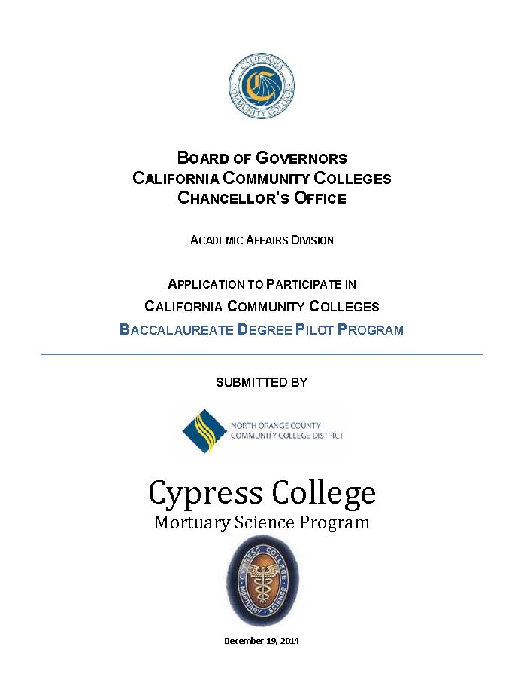
2015 Initial Design (version 1.0)
Initially drafted using CSU/UC template and the CSU-GE/IGETC pattern
Considered the ABFSE accreditation standards
Mirrored other BS degrees currently offered in the discipline
2020 Vision (version 2.0)

Slide 13
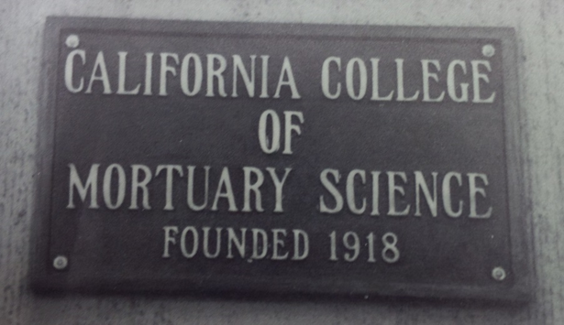
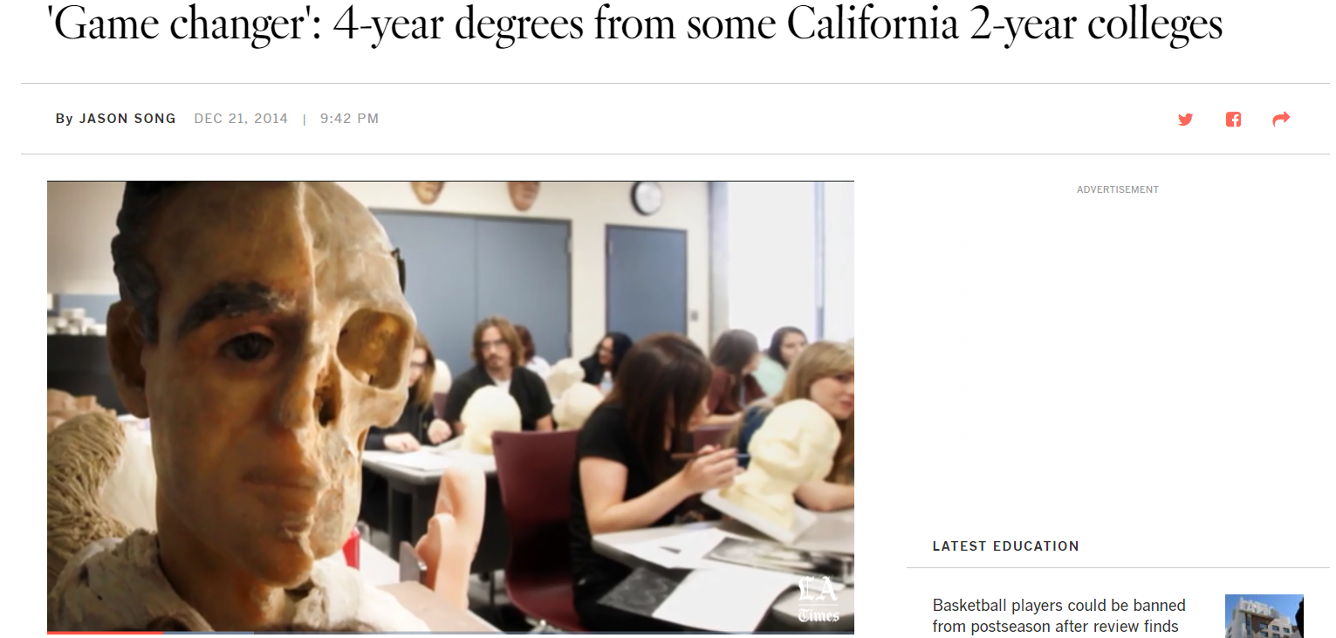
Program Development
Outreach
Pathways
Marketing

Slide 14
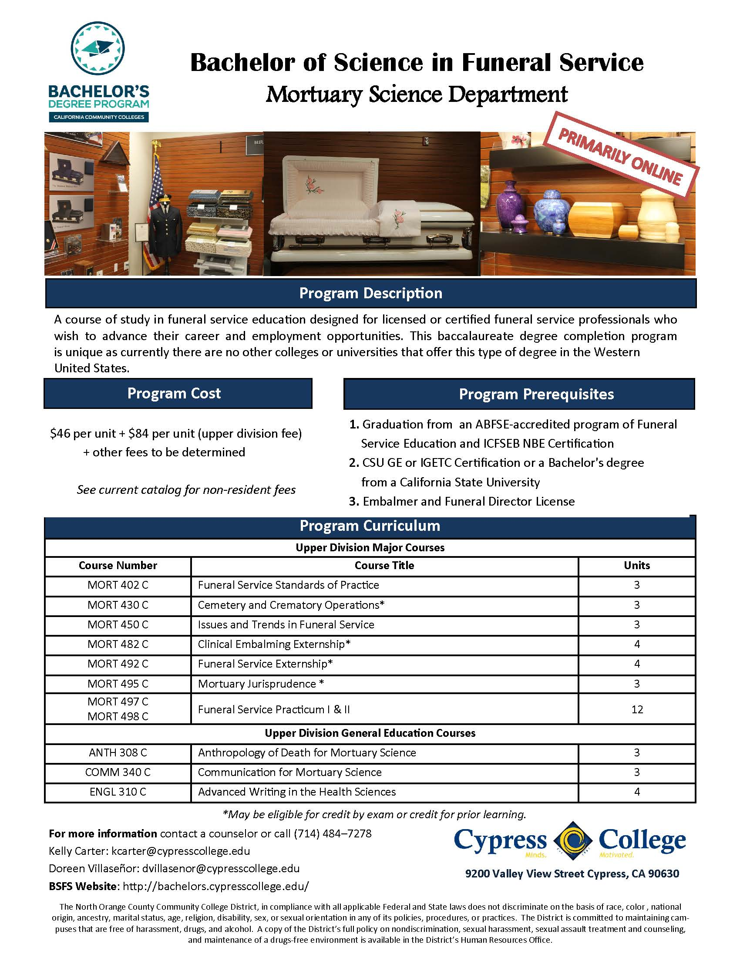
2017 Implementation
Curriculum approval and offerings
Enrollment and orientation
Credit for prior learning

Slide 15
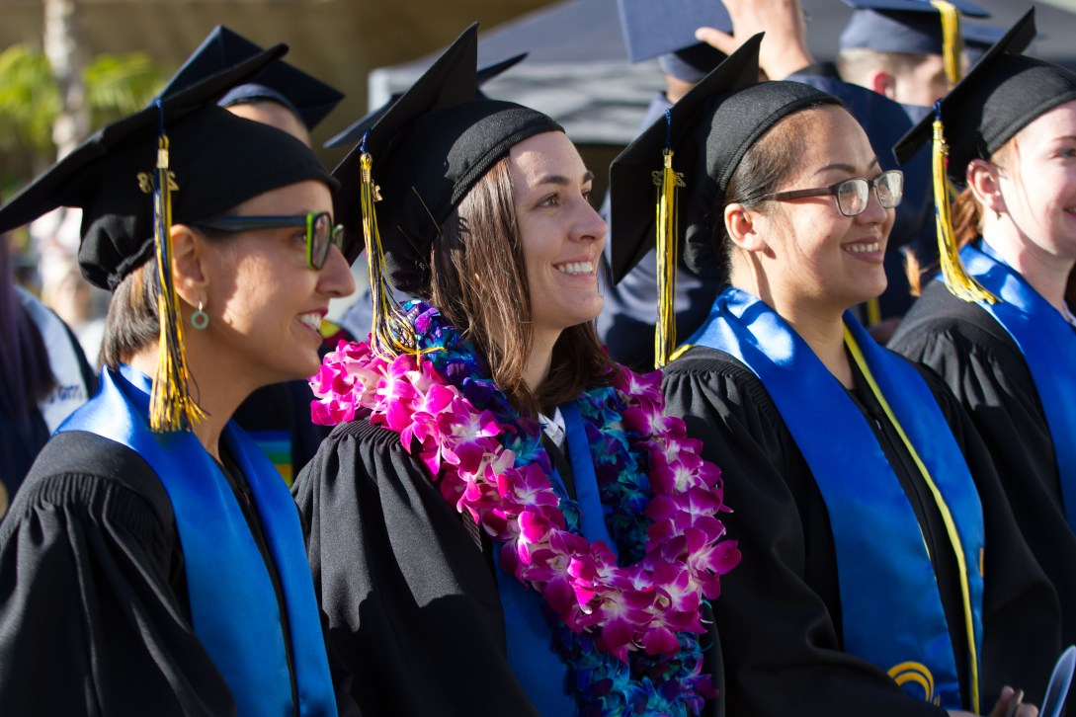
Outcomes
2017 Enrollees
2018 Graduates
2018 Enrollees
2019 Graduates

Slide 16
Student Successes

Slide 17
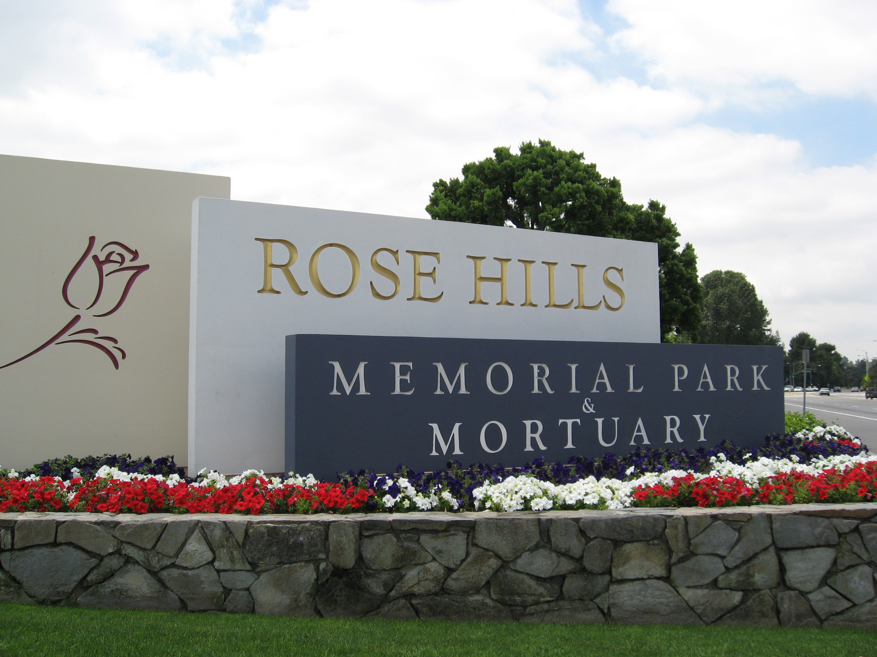
Successes
Promotions
Wage increases
Leadership positions
Graduate school

Slide 18
Challenges

Slide 19
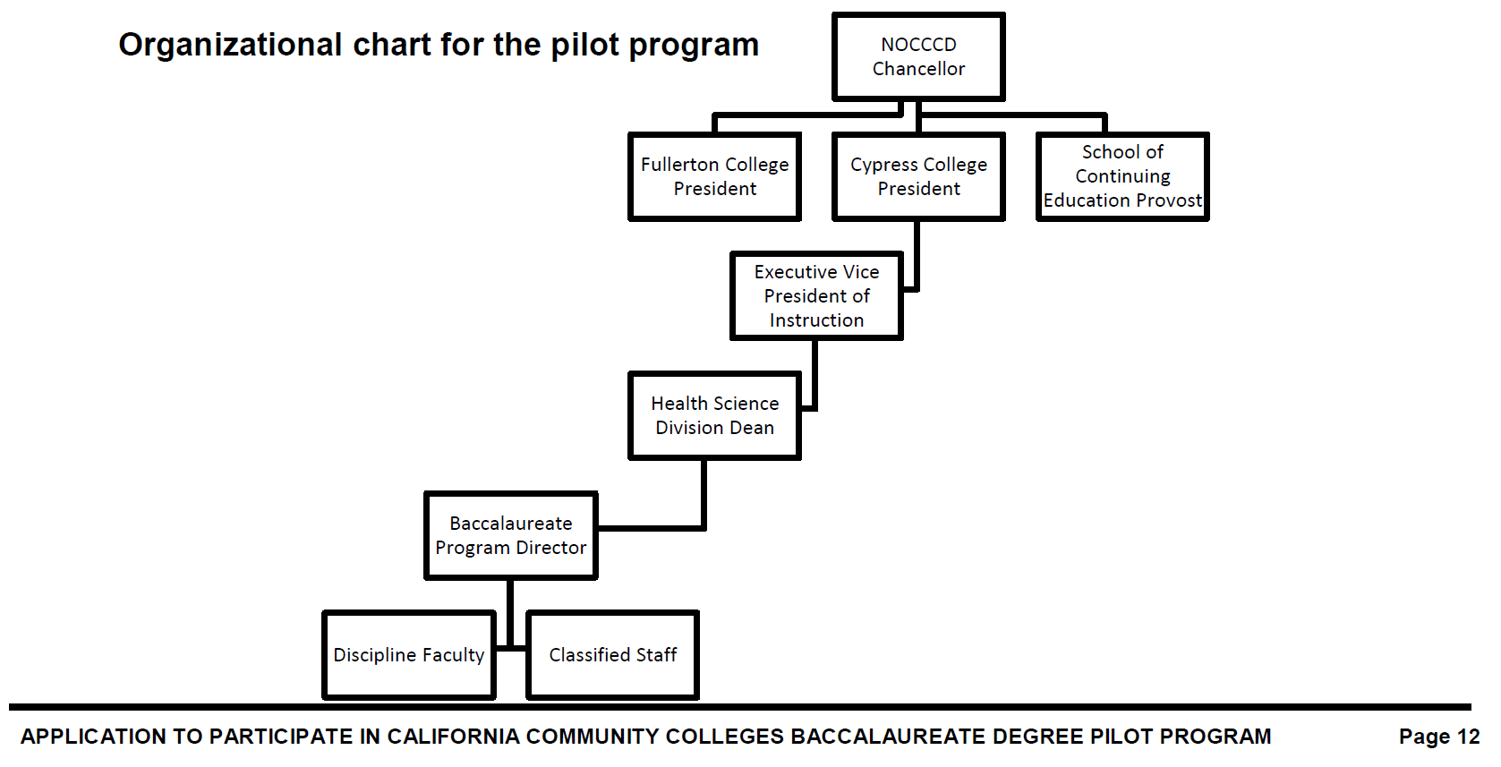
Challenges
Champions
Continuity
Criticisms

Slide 20
Articulation

Slide 21
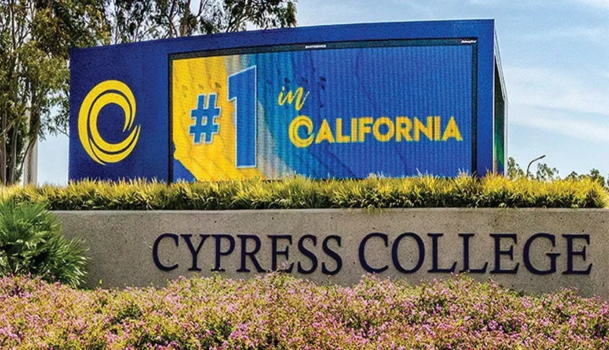
Articulation

Slide 22
Modesto Junior College Bachelor’s of Science in Respiratory Care
Modesto Jr. College/Skyline College Bachelor’s of Science in Respiratory Care

Slide 24
Respiratory Care Profession
21, 000 Licensed Practitioners (California)
Licensure – Credential and Associate Degree Completion
2/3 Associate Degree Prepared
Limited Bachelor’s Degree Programs in California
Movement Towards Bachelors Degree Requirement
American Association for Respiratory Care (AARC)
California Society for Respiratory Care (CSRC)
Committee on Accreditation for Respiratory Care (CoARC)
California Respiratory Care Board (RCB)

Slide 25
Movement Towards a B.S. Degree

Slide 26
Extensive Process
Application Submitted to CCC Chancellor's Office
Site Visit – CCC
Approved (CCC and ACCJC)
2+2 Hybrid Program with target for Online offering
Developed Curriculum (including Higher Division GEs)
Lots of Symposiums, Sessions, Conferences
Marketing
Faculty
Application process (Application Criteria)

Slide 27
Program Design
Working Adults
15 Month/Accelerated Program
Online
8 Weeks/Sessions (2 courses)
16 Week Semester
40 units
28 Respiratory Core Courses
12 Upper Division GE Courses
Final Capstone Project

Slide 28
Curriculum
Disease Management & Healthcare Promotion (3)
Clinical Review of Healthcare Research (3)
Medical Sociology: Health and Diversity (3)
Education and Teaching Strategies in Healthcare (3)
Advanced Pharmacology and Critical Care (3)
Psychology of Stress, Illness and Death (3)
Healthcare Leadership and Operations Management I, II (3,4)
Pulmonary Diagnostics, Rehabilitation, and Sleep (3)
Medical and Bioethics (3)
Advanced Neonatal and Pediatric Critical Care (3)
Organizational Behavior (3)
Capstone Project (3)

Slide 29
Challenges
Ongoing marketing – community
Enrollment - Transition from A.S. Program
39 Lower Division General Education
CoARC Accreditation
College community awareness
Pilot Status

Slide 30
Student Success

Slide 31
Support/Next Steps

Slide 32
Supporting BDP Colleges
Aligning lower division courses with lower division at BDP Colleges so that students can have a seamless transfer.
Work with the CTE-C-ID Model Curriculum Workgroup to establish model curriculum for the BDP College programs.
Contact your local senator or assembly member and let them know you are supportive of legislation that would take the colleges out of pilot status.

Slide 33
Moving Forward with BDP - ACCJC
ASCCC and the Chancellor’s Office have agreed that baccalaureate degree students should complete a minimum of 41 units of general education (36 lower division and 6 upper division).
ACCJC requires that students complete a minimum of 36 units of general education (27 lower division and 9 upper division).
ACCJC requires more lower division GE that Title 5 §55063

Slide 34
Moving Forward with BDP - GE
Colleges are required to impose GE requirements that satisfy the Chancellor’s Office and ACCJC.
This means that students will be required to complete 45+ units of general education to complete a baccalaureate degree.
If the BDP is to become permanent and expand, the CCCs must develop their own general education pattern.

Slide 35
Next Step for GE?
Written and Oral Communication (6 - 9 Semester Units)
English Composition
Critical Thinking
Oral Communication
Quantitative Reasoning (3 Semester Units)
Natural Sciences (including one laboratory course) (6 Semester Units)
Biological Sciences
Physical Sciences

Slide 36
Next Steps for GE (2)?
Arts and Humanities (3 - 6 Semester Units)
Social and Behavioral Sciences (3 - 6 Semester Units)
9 units of upper division GE would still be required. ASCCC should work with ACCJC to try and lower this requirement to 6 units.
ASCCC may want to create a task force to examine this issue and bring a recommendation to a future plenary session.

Slide 37
Additional Steps to Move Forward
Baccalaureate degrees should be given the same point value in the SCFF as ADTs.
There needs to be a systemwide way to track students that enter the program as freshmen, as juniors, and to distinguish those students from students that take an upper division course because they are interested.
All CO level technology must fully integrate the baccalaureate programs and not treat them as separate or temporary.

Slide 38
Additional Steps (2)
The Legislative Analyst’s Office is currently collecting data to submit a report to the Legislature about the programs. This report is due in February 2020.
Colleges with a baccalaureate program should inform students in AS programs that lead into a BDP that this option is available for them.
In order for the Legislature to make the programs permanent and consider expanding the programs beyond the first 15, we must work together as a system to make them as successful as possible.

Slide 39
Questions?

