Slide 1
Decolonizing Community Colleges: Understanding the History to Imagine the Future: Follow-Up Session Mayra Cruz, ASCCC Treasurer Sharon Sampson, Grossmont College
Eileene Tejada, Ph.D., Napa Valley College April 15, 2021 2:30-3:45 pm
Notes:
Mayra with both(1min)Welcome and Introductions
This session is a follow-up discussion of the general session on Decolonize got Community Colleges: Understanding the History to Imagine the Future. This breakout will provide an opportunity to reflect on ideas, possibilities, wisdom, and actions presented during the general session. The session will feature an interactive component on decolonizing curriculum practices and creating spaces and resources for continuous dialogue to actualize epistemological disruption in the curriculum.

Slide 2
Notes:
Mayra (2 min)
ASCCC map suggested native-land.ca
We begin today by acknowledging that we are holding our gathering on the land of the Nisenan Nations, the location of the ASCCC Office on One Capitol Mall, Sacramento, who have lived and continue to live here. We recognize the Nisenan Nations and their spiritual connection to the ocean and the land as the first stewards and the traditional caretakers of this area we now call Sacramento. As we begin, we thank them for their strength, perseverance and resistance. We also wish to acknowledge the other Indigenous Peoples who now call Sacramento their home, for their shared struggle to maintain their cultures, languages, worldview and identities in our diverse city.
We begin today by acknowledging that we are holding our gathering on the land of the your Indegenious Nations (where I am currently located)
who have lived and continue to live here. native-land.ca
We recognize the _______Nations and their spiritual connection to the ocean and the land as the first stewards and the traditional caretakers of this area we now call ______ (region or town) (each presenter mentions their indigenous nation and region)
As we begin, we thank them for their strength, perseverance and resistance.

Slide 3
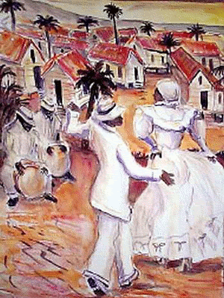
Yubá
Is the most sacred of Puerto Rican Bomba rhythms.
Notes:
Eileene (2-3min)
Its intention is to transmit the suffering and wisdom of the ancestors. This rhythm is ubiquitous throughout the African diaspora.
Eileene plays the drum.

Slide 4
General Session
Decolonizing Community Colleges:
Understanding the History to Imagine the Future
Debrief
Notes:
15 minutes (each take one question)
Questions to debrief using the chat and open mic:
If this is your first time hearing the word decolonization, how do you feel, share your thoughts about decolonization or your understanding of the meaning of decolonization. (Mayra)
How have you benefited from colonization? or How have you been harmed? (Eileene)
Why is it relevant to decentering whiteness? (Sharon)

Slide 5
Lift Up
His(her)story
Decolonization
Anti-racist Pedagogy
Inclusive Curriculum
Strategies
Q&A
Notes:
Sharon (1 min include the next slide, slide 6)

Slide 6
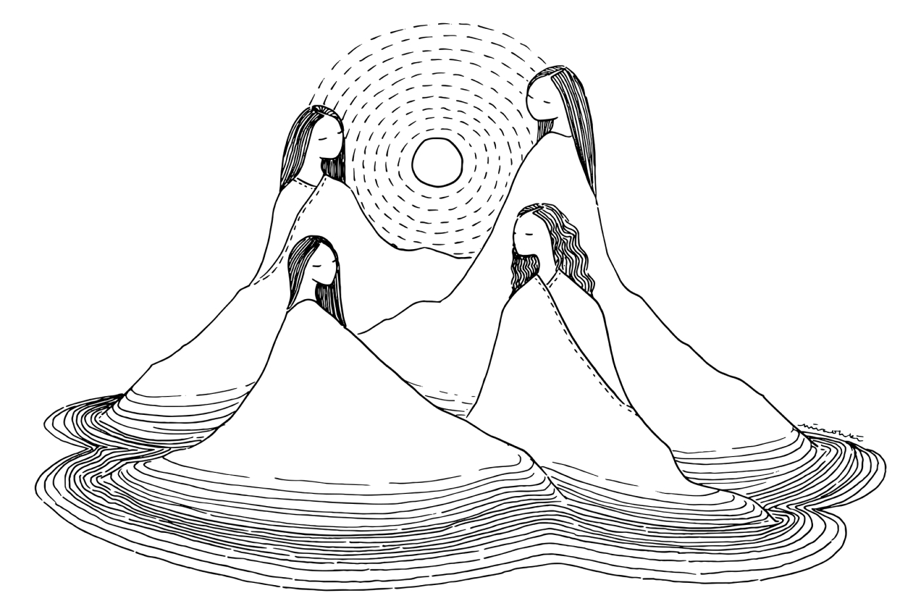
HIS(HER) STORY
Notes:
Sharon
“White historians shared the view of the general white public — the view of the Founders –that black people did not exist in the world that mattered. Even in the writing about slavery, where blacks might logically be considered the principal subject, the habit was to write about it as an abstract social or economic institution, to see it as provocative of sectionalism and as a contributing cause of the Civil War. The slave’s testimony was never sought and never recorded by historians.
Michael Zinn: The People’s History
“I was influenced by my own experience, living in a black community in the South with my family, teaching at a black women’s college, and becoming involved in the movement against racial segregation. I became aware of how badly twisted was the teaching and writing of history by its submersion of nonwhite people. Yes, Native Americans were there in the history, but quickly gone. Black people were visible as slaves, then supposedly free, but invisible. It was a white man’s history.
https://www.motherjones.com/politics/2004/11/missing-voices-our-world/”

Slide 7
Background
The concept of decolonization grows from Fanon's book The Wretched of The Earth. His focus was to decolonize the political systems and then economics and then the culture vis-a-vis the mind. What his analysis reveals is the geographies of the terrain that need to be decolonized to truly liberate those oppressed.
Ngugi and Chakrabarty (2000), refer to decolonization as a process that de-centers the Eurocentric vision on a global scale. Mary Louise Pratt, a Stanford scholar, refers to this decolonizing process as an "awakening of a 'planetary consciousness' " (Betts, (31)).
Notes:
Sharon (5min)
Practices that sustain colonization are a type of violence.
Social/cultural -denial of slavery
Economic disparities-@ the CCC we attempt to improve social mobility by disrupting social disparities by using a colonized curriculum. We continue to perpetuate the very systems we claim that we are attempt to dismantle.
Representation- who is not represented in the curriculum

Slide 8
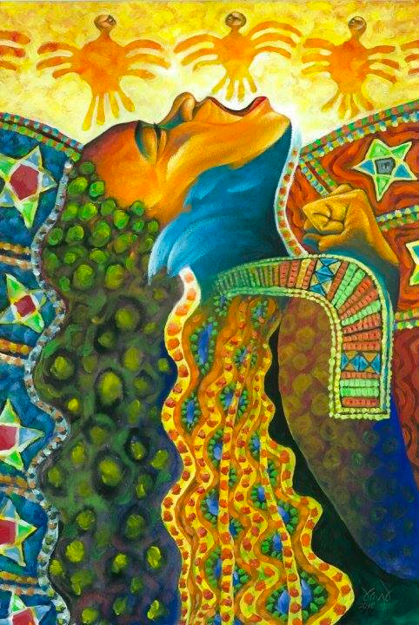
DECOLONIZATION DEFINED
Notes:
Eileene (5 min slides 8-9)

Slide 9
Decolonization is a process that de-centers the Eurocentric worldview, epistemologies, and pedagogies.
In addition, the process of decolonization would also include the introduction of those epistemologies, pedagogies, methods, and praxes from below deSousa Santos' Abyssal Line.
That is indigenous, African, and Asian epistemologies, pedagogies, methods, and praxes. (Tejada 2020)
Notes:
Eileene
Dismantle of neoliberalism.

Slide 10
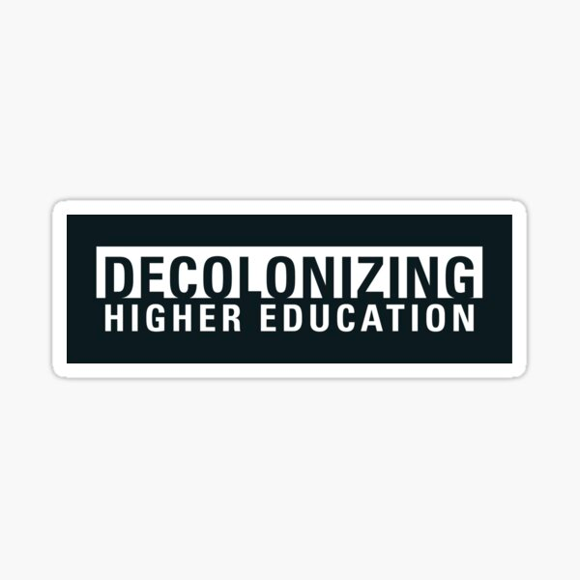
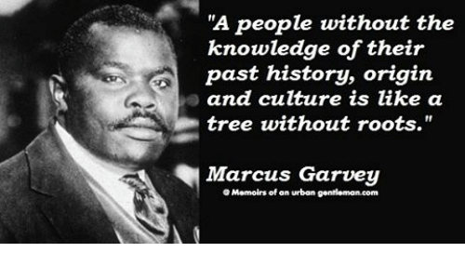
Notes:
Mayra (5 min slides 10-11)

Slide 11
DECOLONIZATION
A two-fold process involving:
restructuring resource allocation to be more equitable across the institution
ensuring the epistemologies, curricula, and pedagogies are the autobiography or the faculty and students
HIGHER ED
Notes:
Mayra

Slide 12
Decolonization of
Defined as confronting and challenging the colonizing practices that have influenced education in the past, and which are still present today.
Higher Education
Decolonization of higher education is defined as confronting and challenging the colonizing practices that have influenced education in the past, and which are still present today.
Notes:
Eileene (2 min)
Part of this interrogation is considering the classroom space and enacted pedagogies: are they equitable? Are they anti-racist? Enacting an anti-racist pedagogy is more than adding diverse content to a course or broader curriculum; it is “about how one teaches, even in courses where race is not the subject matter” (Kishimoto, 2018, pp. 540, emphasis in original).

Slide 13
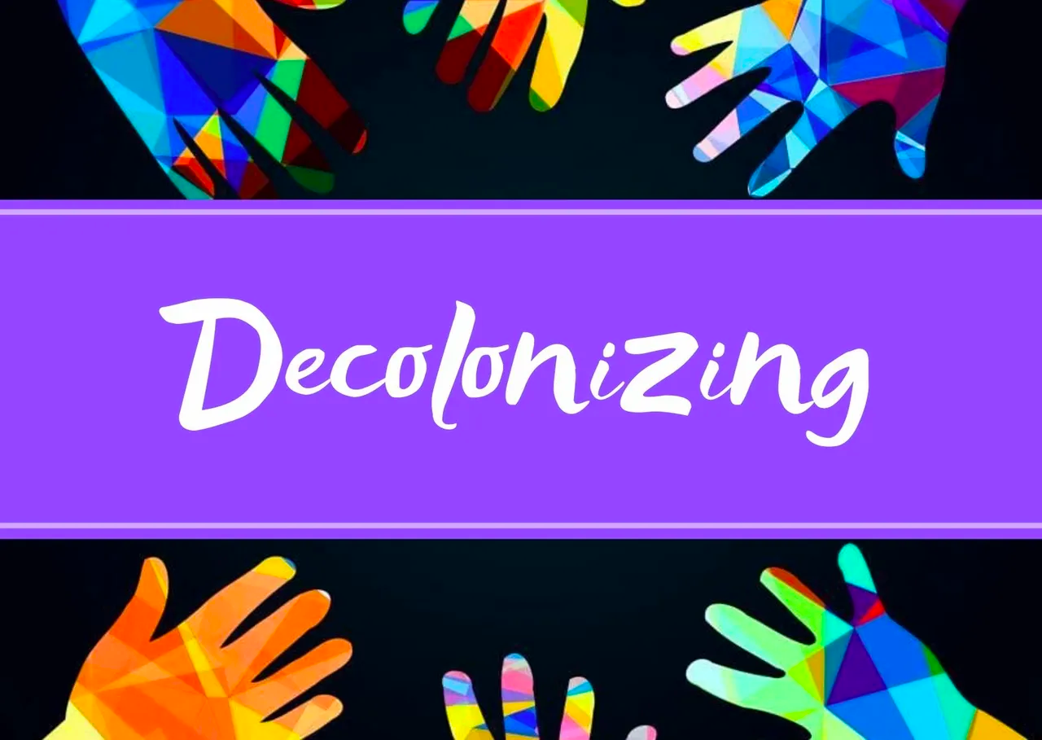
WHAT DOES IT INVOLVE?
Higher Education
Notes:
Eileene (5 min including slide 14)

Slide 14
Decolonizing
The Decolonizing Process using
de Sousa Santos’ Framework--
The Abyssal Line
Eurocentric Epistemologies
(Above the Abyssal Line)
————————————————
(Below the Abyssal Line)
Indigenous Epistemologies, African Epistemologies, Asian Epistemologies,
Epistemologies of European Peasant women
Process
Notes:
Eileene-Decolonization involves valuing and revitalizing Indigenous knowledge and approaches and weeding out settler biases or assumptions that have impacted Indigenous ways of being.
Indigenization is a collaborative process of naturalizing Indigenous intent, interactions, and processes and making them evident to transform spaces, places, and hearts.

Slide 15
ANTI-RACIST PEDAGOGY
Notes:
Sharon (5min including slide 16)

Slide 16
What Is
Thoughtful consideration of authorial voices in learning materials
Conscientiously realigning the power structure within the learning environment to include learners as active participants in the learning process
Includes African, Asian, Indigenous and other perspectives and approaches
Engagement in discussion to actively combat racism in our fields
Constant evaluation of the course design
Antiracist Pedagogy?
Notes:
Sharon
Anti-racist pedagogy can be applied to any academic discipline as a way to explain and address the pervasiveness of racism. This framework calls on actively acknowledging and opposing racism by leveraging tools and strategies to design inclusive courses with more representation.
Just as being anti-racist is an iterative process, so too is the process of employing anti-racist pedagogy.
"Anti-racist pedagogy is not about simply incorporating racial content into courses, curriculum, and discipline. It is also about how one teaches, even in courses where race is not the subject matter." (Kishimoto, 2018, p.540). Anti-racist pedagogy requires students and instructors to engage in critical analysis and self-reflection to reveal structural inequities.
In the context of post-secondary education, this involves including Indigenous perspectives and approaches.
Indigenization benefits not only Indigenous students but all students, teachers, staff members, and community members involved or impacted by Indigenization.

Slide 17
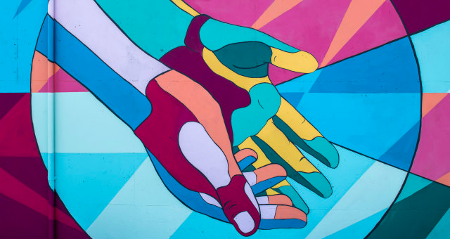
THE WHY
Notes:
Mayra (5min including slide 18)

Slide 18
The Why
Native Americans, African Americans,, Latinx, and AAPI communities have histories of racial violence, dispossession, and oppression caused by European and White American colonialism and Imperialism, resulting in persisting socio-economic inequities.
Native Americans, African American, Latinx, and AAPI subgroups students continue to face ongoing social toxins and trauma within and external to educational institutions, “American schooling ideologies because its “official” curricula silence the voices, sensibilities, and lived experiences of dispossessed youth of color throughout the country.” (Camangian, 2015)
Out of estimated 2.1 million students, the community colleges in California are comprised of approximately 68% minorities. Latinx students compromise the majority of minoritized students, followed by African American, Asian Americans and Pacific Islanders.
LGBTQIA+
Notes:
Mayra
“Denying dispossessed youth [who come from colonized and dispossessed communities] an education that prepares them to confront the toxic unjust social conditions of their everyday life intensifies the colonial conditions that they face.” (Camangian, 2015)

Slide 19
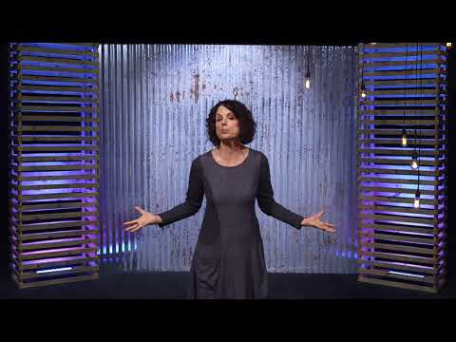
Let’s Be Open to Change
Notes:
Sharon (video starting @ 14:11-15:08)
Robin DeAngelo
https://youtu.be/h7mzj0cVL0Q

Slide 20
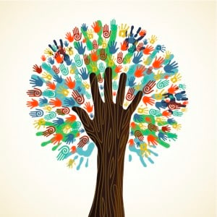
COMMITMENT TO
ACTION
Notes:
Sharon (3min including slide 21)

Slide 21
Notes:
Sharon

Slide 22
Notes:
Eileene facilitates (10min)

Slide 23
Resources
Betts, Raymond F. (2012). "Decolonization A Brief History of the Word." Beyond Empire and Nation: The Decolonization of African and Asian Societies, 1930s-1970s. Ed. Els Bogaerts and Remco Raben. Brill.
De Sousa Santos, Boaventura. 2014. “Beyond Abyssal Thinking FROm Global Lines to Ecologies of Knowldeges.” In Epistemologies of the South: Justice Against Epistemicide, 118-135. London: Paradigm Publishers.
Love, Bettina L. How to Make Anti-Racism More Than a Performance Education Week: Equity & Diversity. January 12, 2021. Retrieved from https://www.edweek.org/leadership/opinion-empty-promises-of-equity/2021/01
Tejada, Eileene. (2020) Presentation: "Puerto Rican Bomba as Ceremony: An Afro-Taíno Practice of Re-Membering, Restoring, and Revisioning," Bomba Research Series. Semilla Cultural. October 10.

Slide 24
For more information contact:
info@asccc.org
Mayra Cruz
cruzmayra@deanza.edu
Sharon Sampson
sharon.sampson@gcccd.edu
Dr. Eileene Tejada
etejada@napavalley.edu
Notes:
Mayra (1min)

