Slide 1
Implementing Inmate Education ASCCC Curriculum Institute 2020
Peter Fulks, FacFaculty Lead
Peter SilveFulks, Faculty Lead
Alec Griffin, Faculty Lead
Silvester Henderson, ASCCC, At Large Representative Peter Fulks, Cerro Coso College
Alec Griffin, Cerro Coso

Slide 2
The Student Voice
“I was transferred to Cal City prison as a disciplinary action [18 months earlier]. When I arrived here, there was a buzz around the facility that I have never experienced in this environment [I'm a multi-termer]. Everywhere I turned, people were talking about what classes they have, what homework was due, how many units they needed to complete their degree. I found myself on the outside of conversations involving topics like politics, social behavior, psychology, different periods of art, etc. I had to see what this was all about.
After this semester I will have an accumulated 36 units and on track to complete my first degree by this summer or fall. I have a counselor that keeps me accountable with progress reports, makes sure that I have books and supplies, and helps me...set short and long term educational goals. I now plan to transfer to a CSU on release for my Bachelor’s.
For the first time in a long time, I don’t feel like a “lost cause.”
-California City Correctional Facility Student (over 45 years of age)

Slide 3
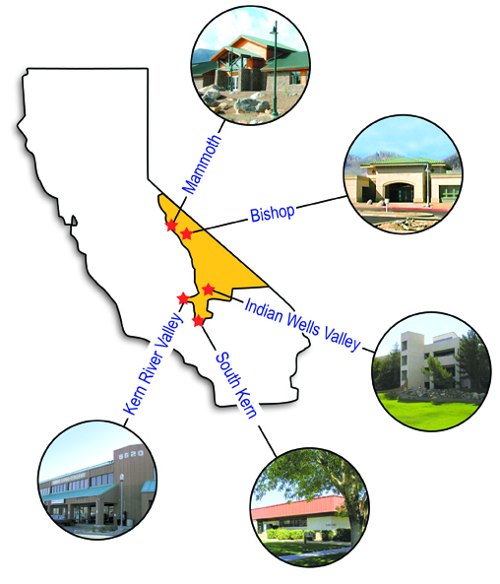
Who We Are
Cerro Coso
Community College
Kern Community College District
Serves 18,200 square miles
6 campuses, 2 prison sites, and 12+ dual enrollment high schools
> 50% of enrollments are online

Slide 4
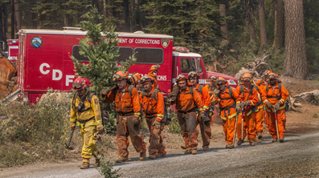
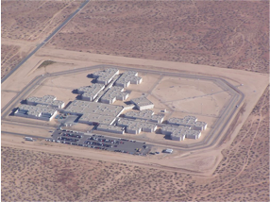
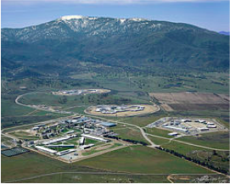
Incarcerated Student Education Program
California City Correctional Facility
Warden: George Jaime
Level 2
~2,500 population
442 students AY2019
+500 on waitlist
California Correctional Institute - Tehachapi
Warden: William “Joe” Sullivan
Level 1-4 on 5 yards
~4,300 population
675 students AY2019
+100 on waitlist
Owens Valley Fire Camp
Bishop

Slide 5
Nationwide Incarcerated Population
2,200,000
INCARCERATED NATIONALLY
700,000
RELEASED YEARLY FROM PRISON
68%
RETURN TO PRISON IN 3 YEARS
83%
RETURN TO PRISON IN 9 YEARS
*Bureau of Justice Statistics most recent report 5/2018
numbers are approximate for incarcerated populations & budgets based on recent national reports

Slide 6
https://bakersfieldnow.com/news/local/prison-inmates-graduate-college?jwsource=cl

Slide 7
Success Rate Comparison– By Course

Slide 8
Success Rate Comparison– By Course

Slide 9
Success Rate Comparison– By Course

Slide 10
Success Rate Comparison– By Course

Slide 11
Success Rate Comparison– By Course

Slide 12
Success Rate Comparison– By Course

Slide 13
Success Rate Comparison– By Course

Slide 14
Success Rate Comparison– By Course

Slide 15
Success Rate Comparison– By Course

Slide 16
Success Rate Comparison– By Course

Slide 17
Success Rate Comparison– By Course

Slide 18
Success Rate Comparison– By Course

Slide 19
Success Rate Comparison– By Course

Slide 20
Success Rate Comparison– By Course

Slide 21
Success Rate Comparison– By Course

Slide 22
Success Rate Comparison– By Course

Slide 23
Success Rate Comparison– By Course

Slide 24
Success Rate Comparison– By Course

Slide 25
Success Rate Comparison– By Course

Slide 26
Success Rate Comparison– By Course

Slide 27
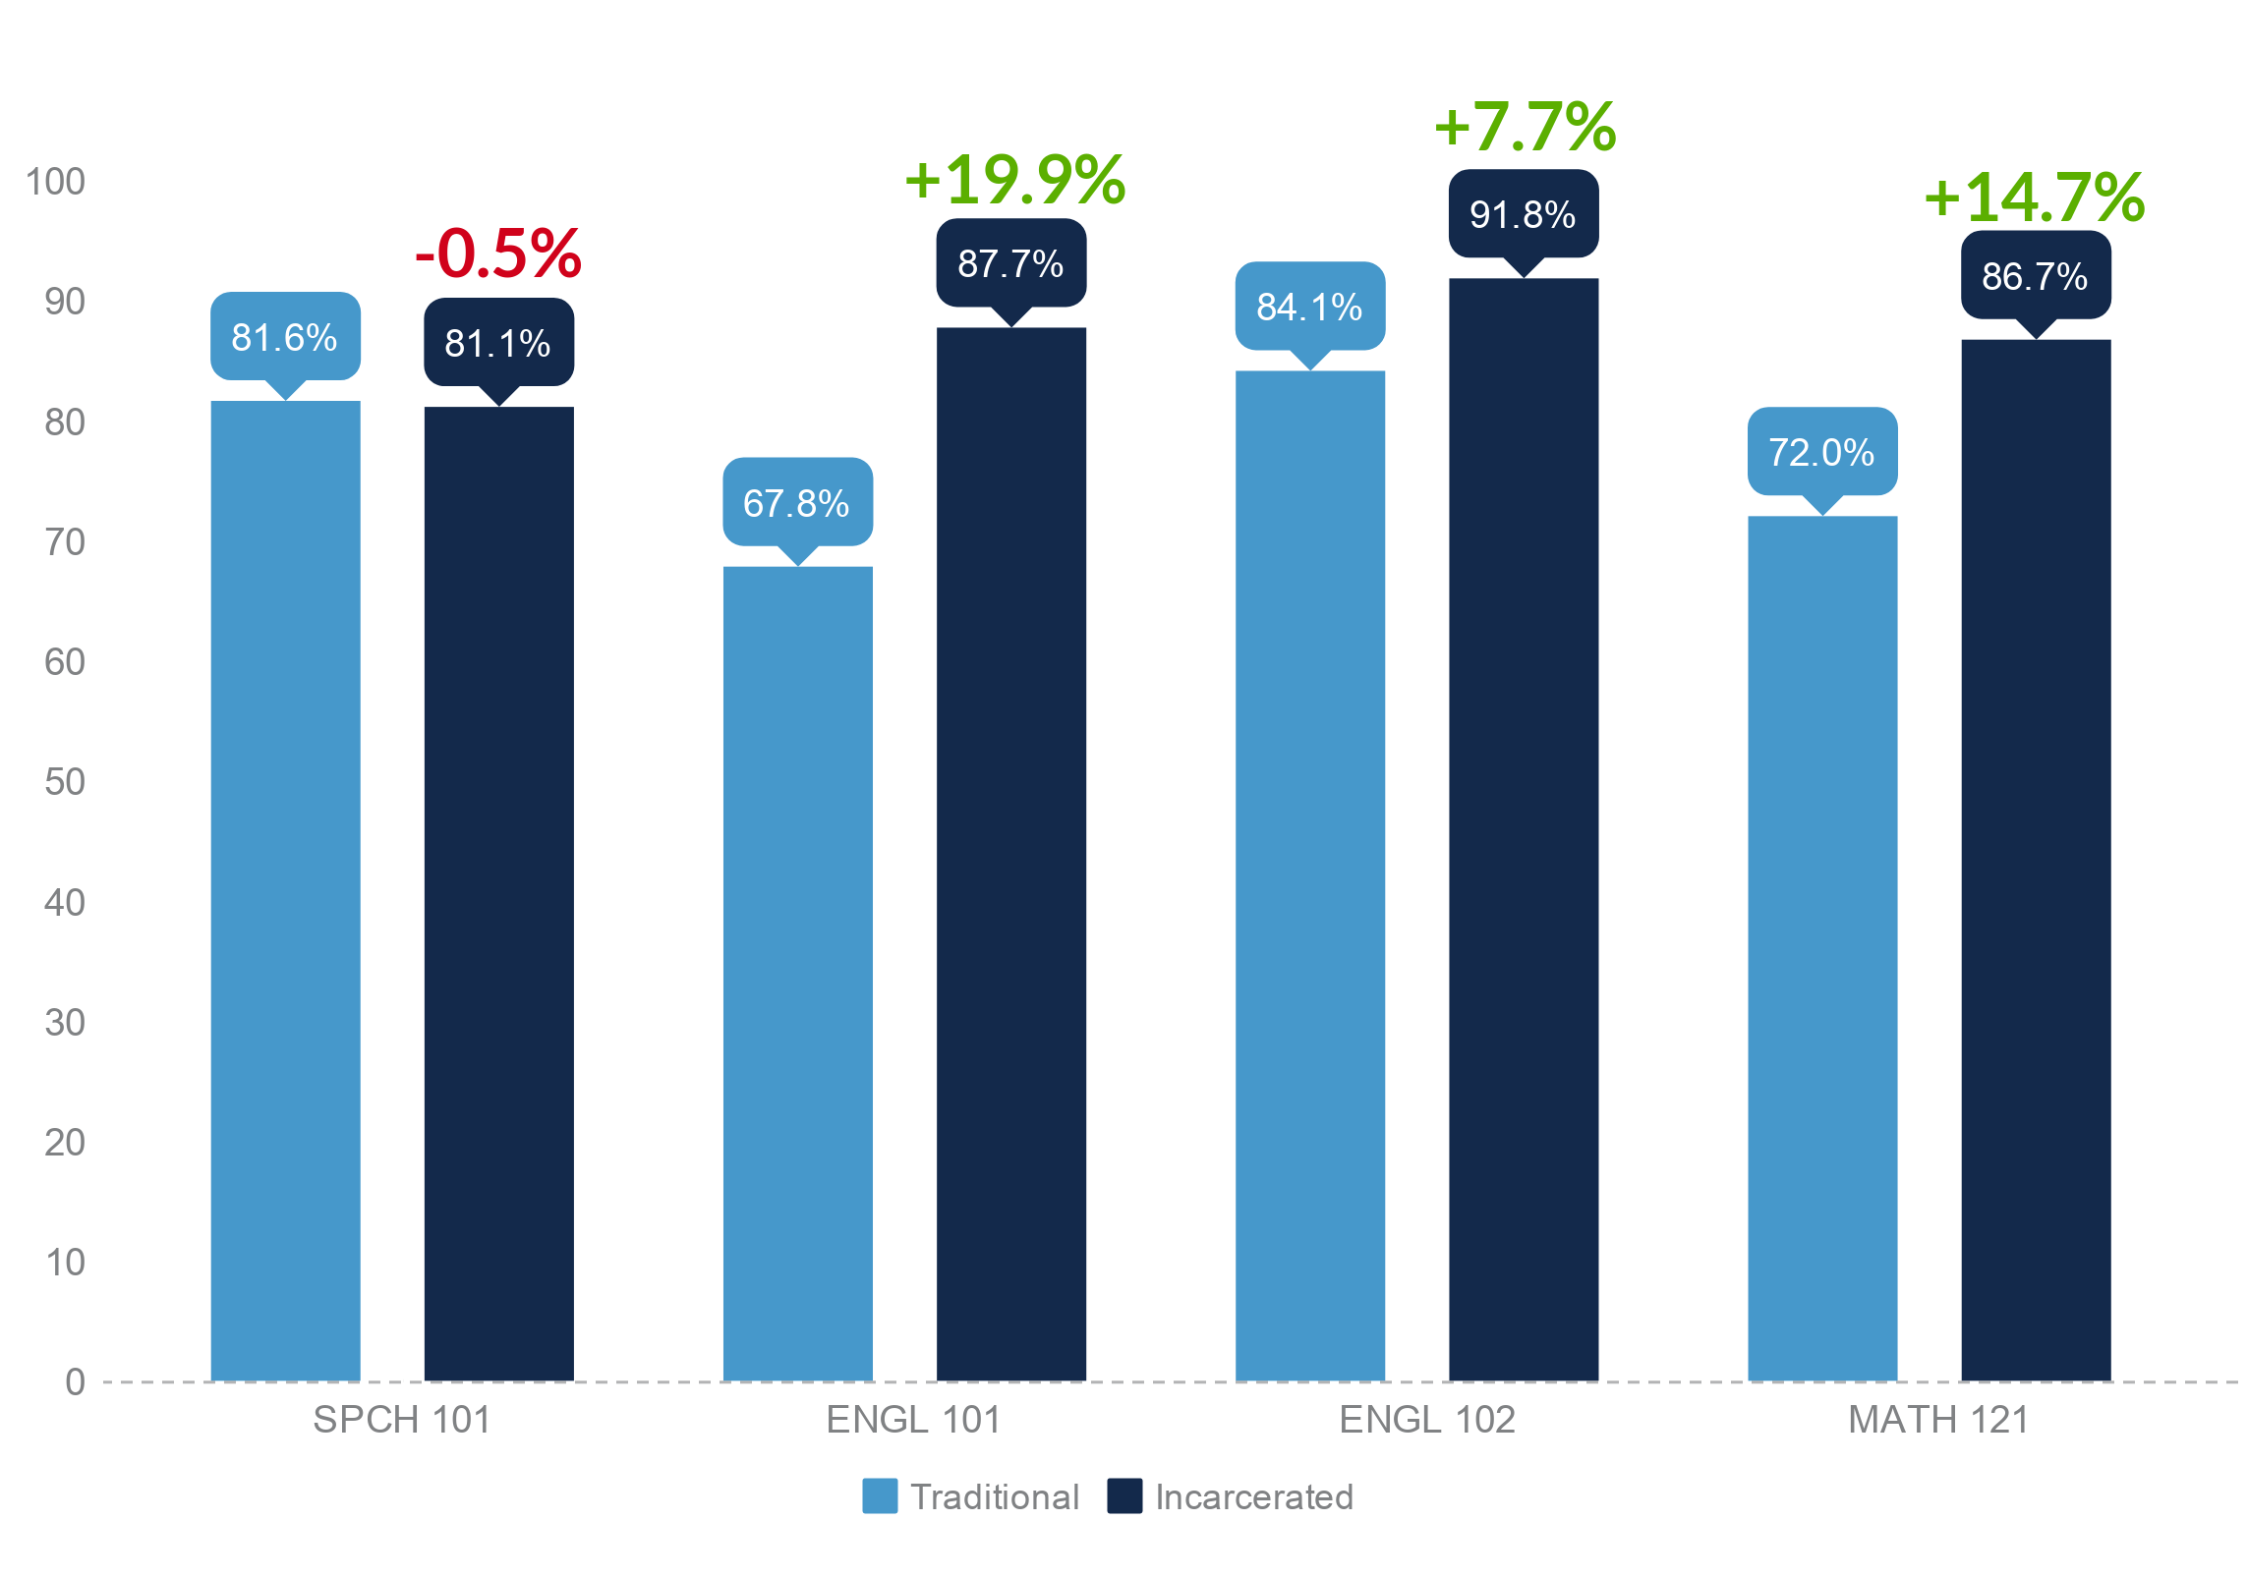
Golden Four: Success Rate Comparison

Slide 28
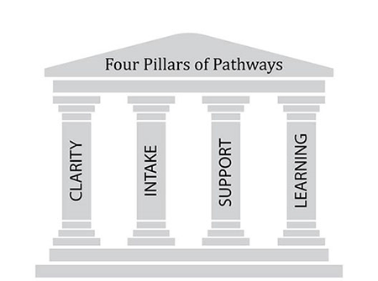
Guided Pathway Implementation
California City Correctional Facility
New! Associates Degree for Transfer
Administration of Justice
Anthropology
Business Administration
English
Psychology
California Correctional Institute - Tehachapi
New! Associates Degree for Transfer
Administration of Justice
Anthropology
Psychology
AA/AS with IGETC Pathway on all Facilities
Liberal Arts and Sciences – Humanities
Liberal Arts – Behavioral Sciences
Notes:
Goal #1: Increase Completions
Goal #2: Increase Transfers

Slide 29
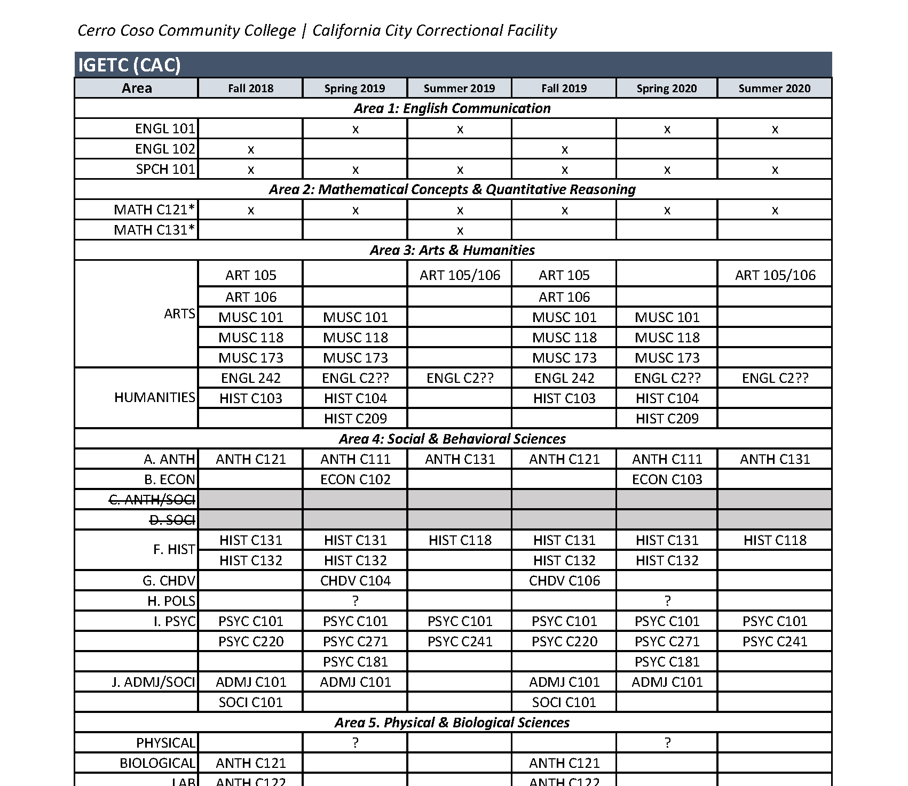
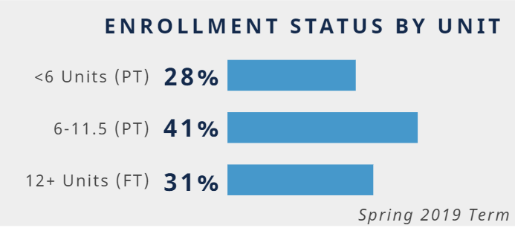
Degree Completion (Clarify the Path)
Incarcerated Student Education Program

Slide 30
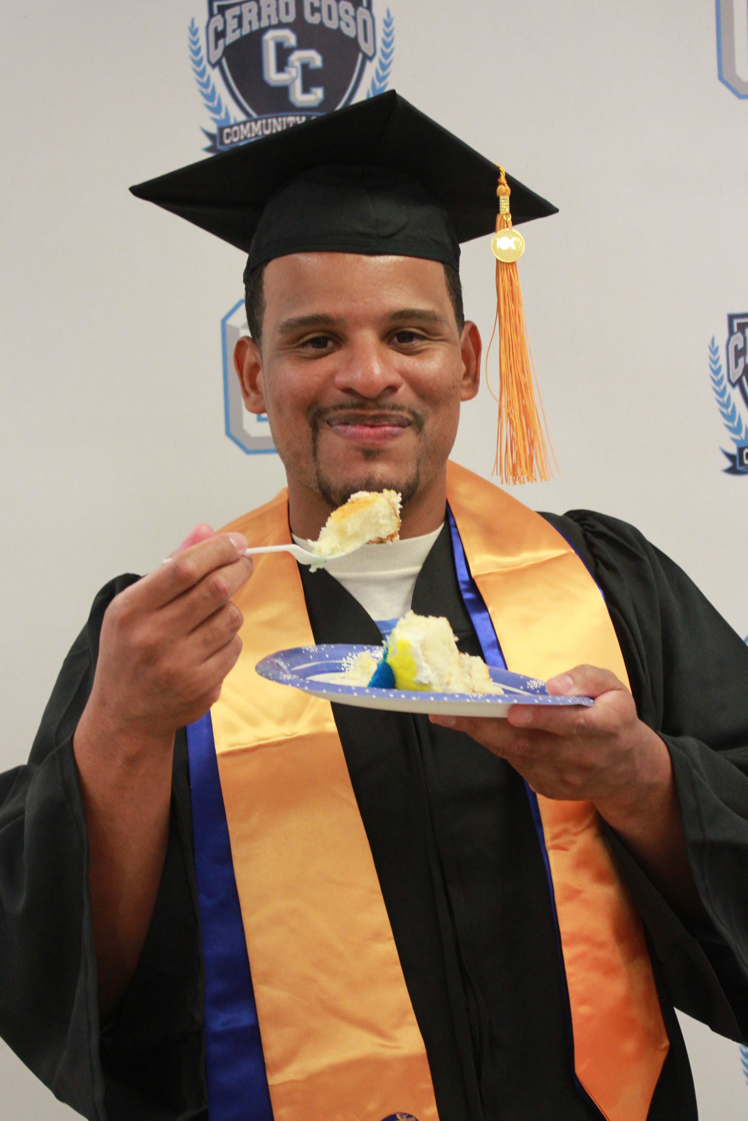
Integrated Support Services (Intake)
Intake of Students into the Path
Registration and Scheduling includes:
Pre-Registration orientation/informational to prospective students
Face-to-face registration
Student informed scheduling and interests
Work assignment time consideration
Work directly with “Inmate Assignment” office
Alternating course times and offerings (for example 2 x 1.5 hr and 3 hour classes
Notes:
Goal #1 - Goal #3

Slide 31
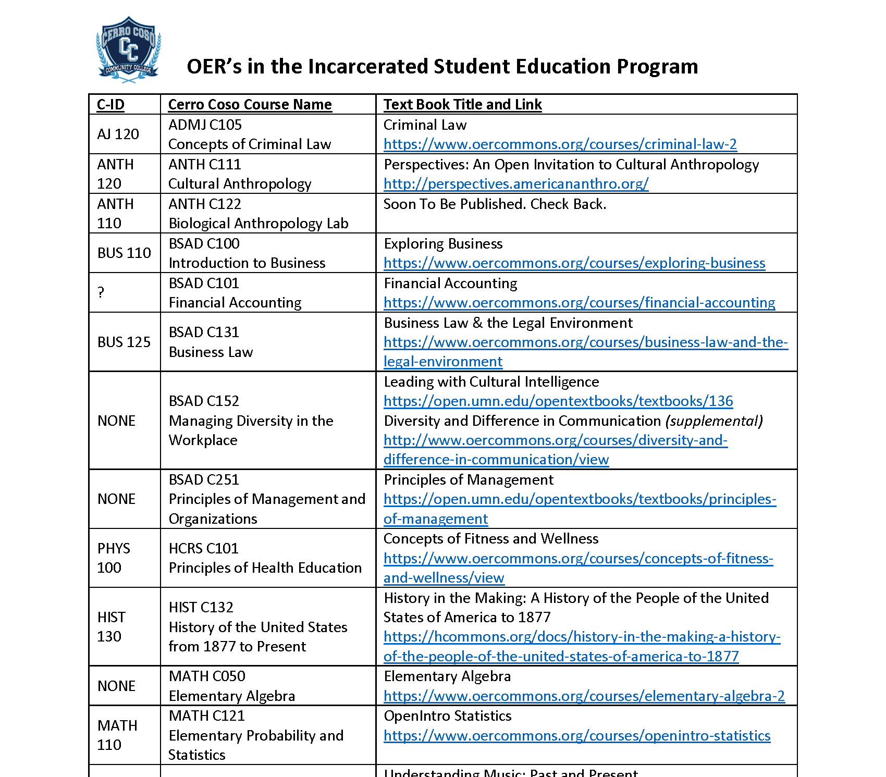
Resources (Support the Path)
Spring 2019
400
Additional books were printed
at the start of fall 2019 semester
Notes:
Goal #4: Reduce equity gaps

Slide 32
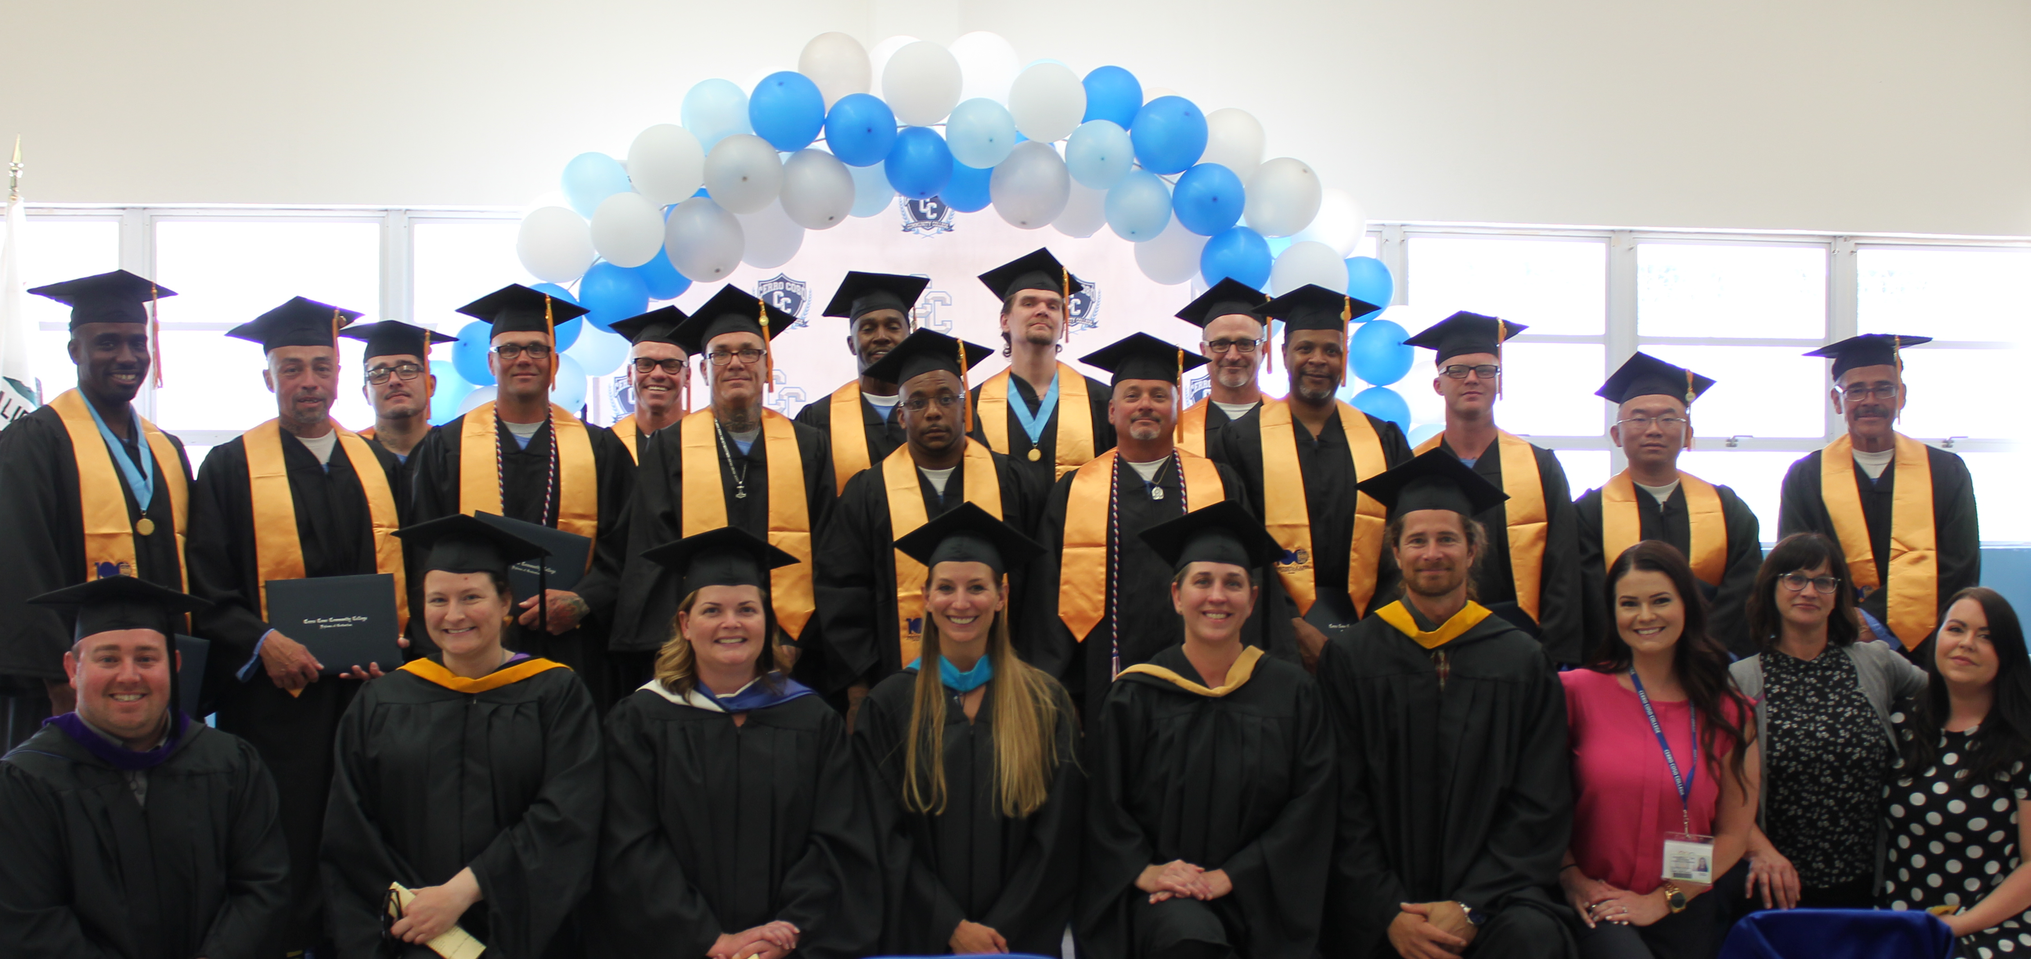
Resources (Support the Path)
For Example:
400
Additional books were printed
at the start of fall 2019 semester
400 books
300 pages/book
$0.017 per page
$2,040 printing cost
+$0.29 bind/book
=$2,156
Notes:
Goal #4: Reduce equity gaps

Slide 33
Resources (Support the Path)
For Example:
400
Additional books were printed
at the start of fall 2019 semester
400 books
$150/book
=$60,000
Compared to $2,156
Notes:
Goal #4: Reduce equity gaps

Slide 34
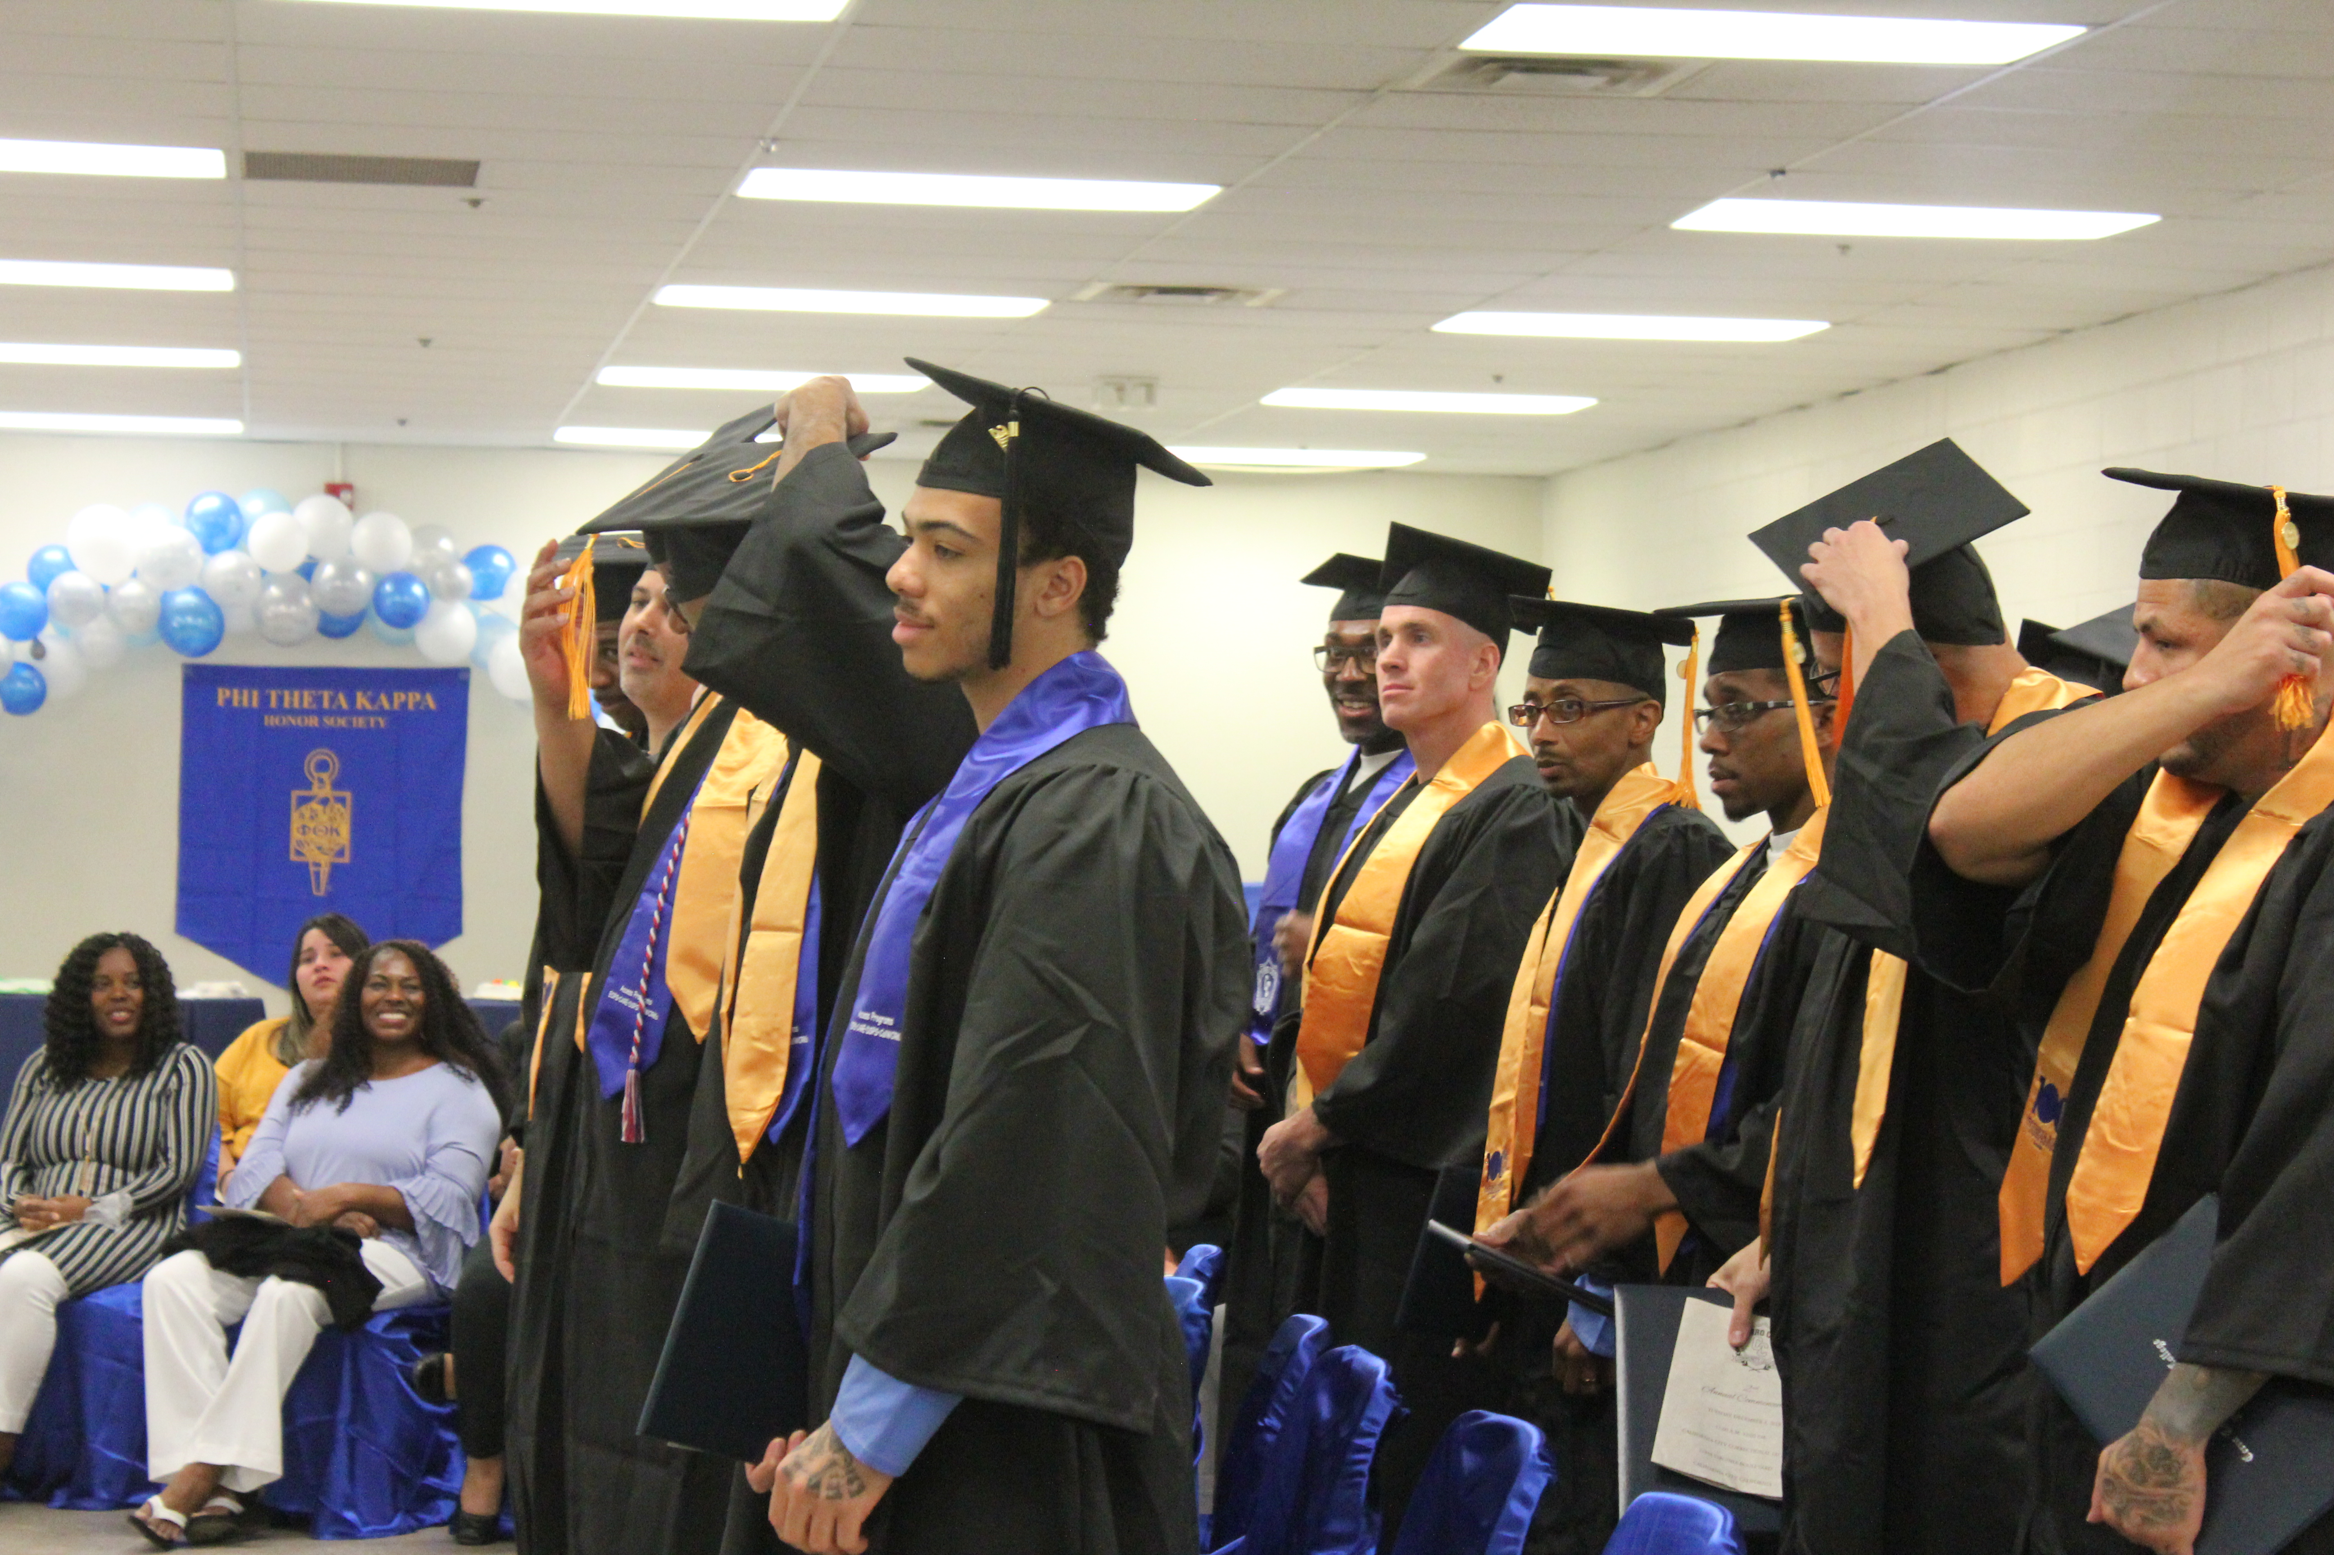
Student Services (Support the path)
Support Services for ISEP
COLLEGE C101: Becoming a Master Student
Embedded counseling
APA/MLA workshops
LIBRARY C100: Introduction to Library Research and Bibliography

Slide 35
Participatory Governance: ISEP Committee (Program support)
Academic Senate Resolution to address institutional inequities with prison education program and unique programmatic needs
Accepted by College Council and established as standing committee that addresses Administrative, Faculty and Student concerns and innovations for incarcerated students
Charge is to innovate and recommend policy to the Board and develop procedures and best practices for California’s Community Colleges serving prison populations

Slide 36
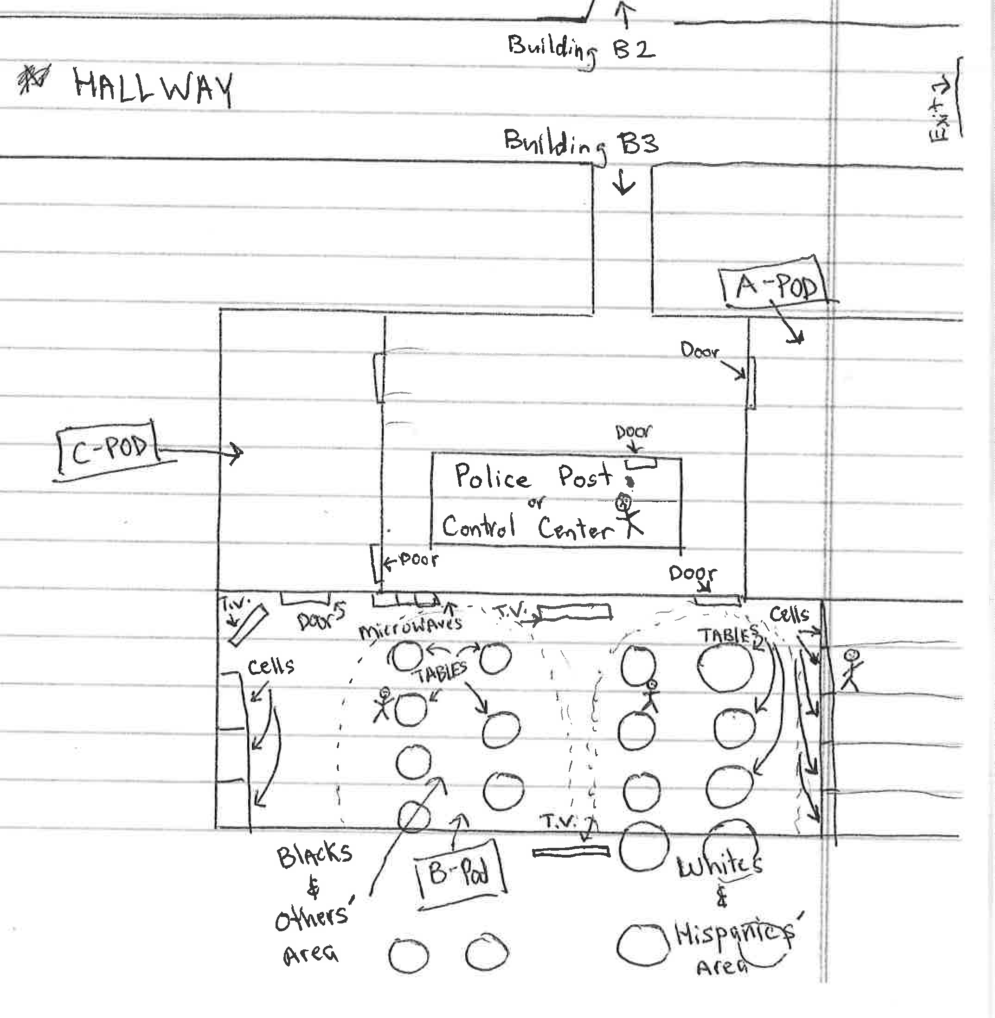
Barriers To Education:
Jobs
Lockdowns
SAP Programs
Disallowed Materials
Court Mandated Programming
Court Visits
Controlled Movement
Literal Oppression
Racial Segregation

Slide 37
Programmatic Barriers

Slide 38
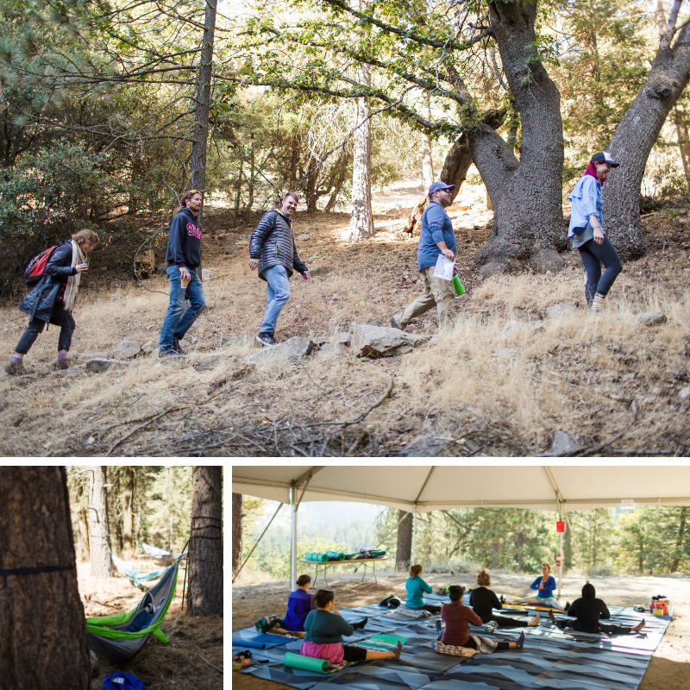
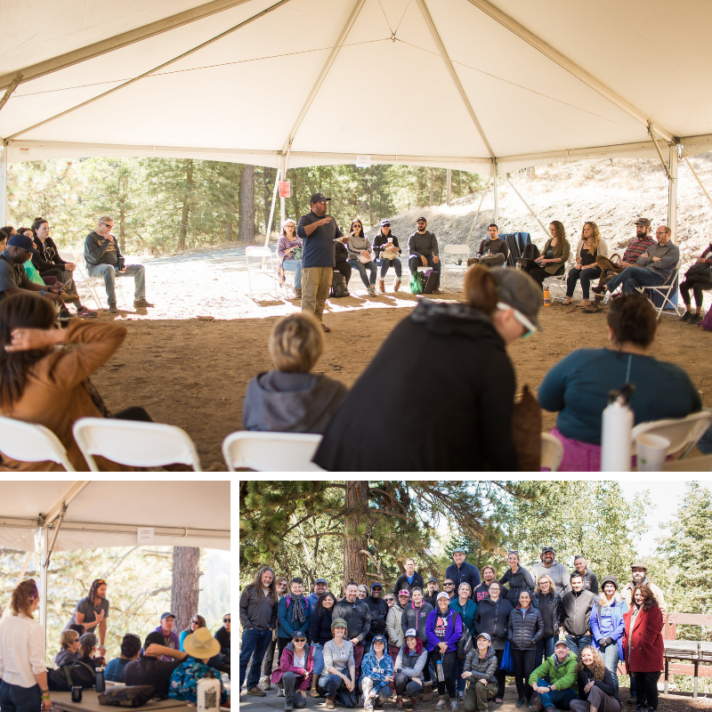
Where we are now…

Slide 39
Questions and Comments
Please feel free to contact each of us for more information.
Silvester Henderson shenderson@losmedanos.edu
Peter Fulks peter.fulks@cerrocoso.edu>
Alec Griffin alec.griffin@cerrocoso.edu
THANK YOU FOR COMING

