Slide 1
In Search of IDEAA—Critically Evaluating Your Academic Senate’s Foundational Documents with Purpose and Intentionality Erik Reese, Area C Representative, ASCCC Juan Arzola, At-large Representative, ASCCC
Notes:
Juan will present this slide.

Slide 2
Breakout Session Description
“Every system is perfectly designed to get the result it gets.” This quote relates to the need to redesign systems that are inefficient or not producing the desired results. Join us in this interactive breakout session as we discuss critical reexamination of local academic senate foundational documents (constitution, by-laws, handbooks, policies, and more!) with the specific purpose and intent to design a system that increases the representation of perspectives that are missing from shared governance and leadership spaces.
Notes:
Erik will present this slide.

Slide 3
Breakout Session Outcomes
Understand the basic functions of foundational documents and how they might contribute to the lack of diversity in perspectives;
Critique local practices at your institution through an equity lens; and
Identify possible practices to promote inclusion of missing voices.
Notes:
Juan will present this slide.

Slide 4
Important Definitions
California Community Colleges Chancellor’s Office (CCCCO) Important Definitions
Equity
Equity mindedness
Colorblind
Antiracism
Inclusion
Diversity
Accessibility
Cultural Humility
Tokenism
Microaggressions
Notes:
Juan will present this slide. Make sure to provide a period to discuss the definition and understanding of the following:
Equity, Colorblind, and Cultural Humility

Slide 5
The Basis of Academic Senate Authority
Four sources of Academic Senate Authority and 10 + 1
California Education Code
Title 5 Regulations
Board of Governors’ Standing Orders
Chancellor’s Office Guidelines
Notes:
Erik will present this slide.

Slide 6
Academic Senate Founding and Procedural Documents: Actualizing Legislative Authority and Decision-making
Constitutions
By-laws
Handbooks
Board Policies and Administrative Procedures (BPs/APs)
Robert’s Rules
Participatory/Shared Governance Evaluations/Surveys
Notes:
Juan will present this slide.

Slide 7
Structuring and Formalizing Faculty Shared Governance Spaces
Academic Senate
Membership
Officers
Senators
Voting
Non-voting
Elections
Term limits
Other considerations
Release Time for Officers
Goals/initiatives and accomplishments
Notes:
Juan will present this slide.

Slide 8
Structuring and Formalizing Faculty Shared Governance Spaces (cont.)
Committee System
Executive Committee
Standing Committees
Membership
Co-chairs
Elections
Term limits
Other Considerations
Goals and accomplishments
Notes:
Erik will present this slide.

Slide 9
Structuring and Formalizing Faculty Shared Governance Spaces: Multi-College Districts
Multi-college Districts
Membership
Officers
Senators
Voting
Non-voting
Elections
Term limits
Other considerations
Release Time for Officers
Goals and accomplishments
Notes:
Erik will present this slide.

Slide 10
Structuring and Formalizing Faculty Shared Governance Spaces: Multi-College Districts (cont.)
District Academic Senate and Committee System
Executive Committee
Standing Committees
Membership
Co-chairs
Elections
Term limits
Other Considerations
Goals and accomplishments
System flowcharts/models
Notes:
Erik will present this slide.

Slide 11
Examining Senate Systems and Processes with Equity-mindedness
Senate and Committee “Colorblind” Charge/Mission
Limiting Access to Leadership Opportunities
Employment Qualification (full-time, tenured only?)
Effect on Part-time Colleagues
Effect on Non-tenured, Probationary Colleagues
On-boarding/Training Program for New Faculty Hires or Incoming Senators
Robert’s Rules: A Necessary Evil?
Lack of Intentional Inclusionary Recruitment Strategies
Dangers of Tokenism
Intentionality
Tapping folx to encourage leadership
Notes:
Juan will present this bullet
Erik will present this bullet
Juan will present this bullet
Erik will present this bullet
Juan will present this bullet
Erik will present this bullet
Make sure to check in with each other to see if the other would like to add on to the conversation.

Slide 12
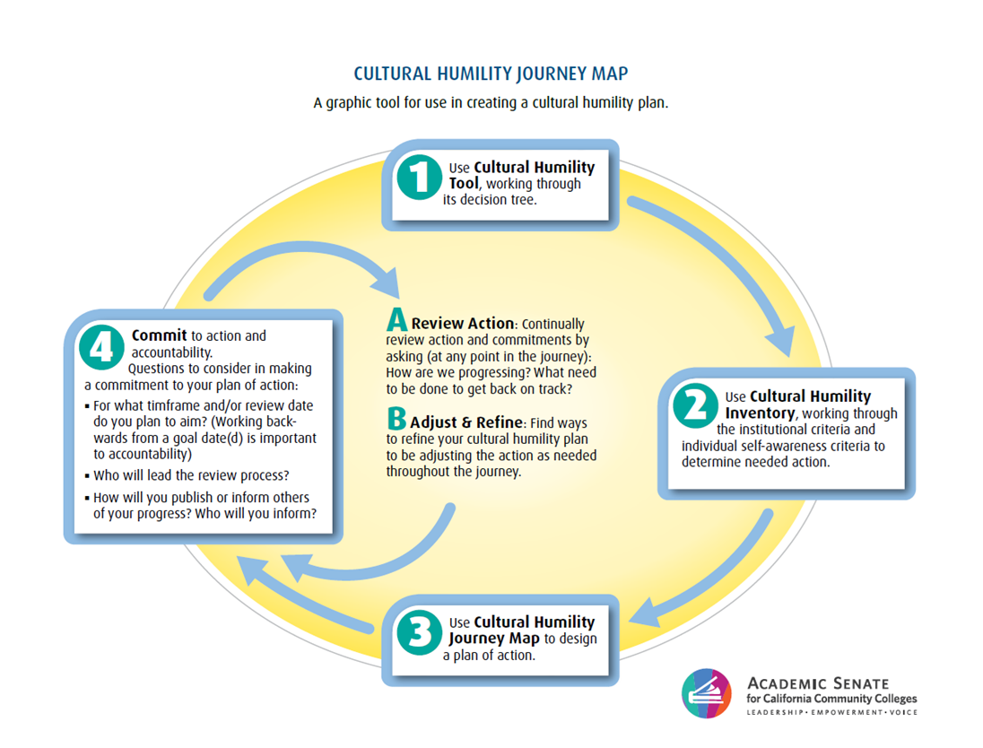
Additional Considerations: Becoming an Antiracist Organization
Cultural Humility versus Cultural Competency
Cultural Humility Toolkit
Cultural Humility is a journey.
Notes:
Juan will present this slide.
Check in with Erik for any additional commentary.
This journey map is circular to indicate that we need to revisit our work, our thoughts, and our actions.
This is a lifelong journey involving self-reflection. The work continues as we continue to build on the progress or the lessons learned.
Set goals and take action.
Commit to your plan and the action.
Review and revisit your commitment; refine and adjust your actions and plan as and when needed.
It’s and ongoing journey (moving towards sustainability)--look back to be informed of how to move forward.

Slide 13
From Conversation to Practice
Standing Committee Example
Who is missing?
Why do we do it this way?
Challenges with Adopting IDEAA Framework to Guide Your Academic Senate Systems and Practices
Be Prepared for Opposition
Develop and Adopt Organizational Norms to Guide Senate Debate and Discussion
Understand IDEAA work is a journey
Notes:
Erik will present this bullet–Use a conversation starter from your document
Juan will present this bullet

Slide 14
Thank You!
Questions?
info@asccc.org

