Slide 1
Leveraging Guided Pathways as a Framework for Equity: A Suite of Resources
Notes:
Ginni

Slide 2
Presenters
Sarah Harris, College of the Sequoias, Guided Pathways Task Force
Jeffrey Hernandez, East Los Angeles College, Guided Pathways Task Force
Ginni May, ASCCC Vice President, Guided Pathways Task Force Chair
Meridith Selden, Yuba College, Guided Pathways Task Force
Friday, April 16
1:30 – 2:45
Notes:
All

Slide 3
Description
At the beginning of the systemwide Guided Pathways efforts, the ASCCC formed the Guided Pathways Task Force (GPTF) and visualized a Guided Pathways framework with teaching and learning encompassing all. Even though the GPTF is nearing its end, the Guided Pathways work of the ASCCC continues. Join this session to learn of a suite of resources designed to assist local academic senates to leverage guided pathways efforts as a framework for equity.
Notes:
Meridith

Slide 4
Overview
Brief Overview of Guided Pathways
The ASCCC Guided Pathways Task Force (GPTF)
Guided Pathways: A Framework for Diversity, Equity, and Inclusion (DEI)
The 2021 Suite of Guided Pathways Resources
What do you need/want from the ASCCC in 2021-22?
Notes:
Jeff

Slide 5
A Brief Overview of Guided Pathways
Notes:
Ginni

Slide 6
All Hands on Deck!
Meta Majors | Program Maps | Guided Onboarding | Wrap-Around Student Services | Student-Centered Course Scheduling
Notes:
Ginni

Slide 7
Where Did Guided Pathways Come From?
Grew from “pay to play” programs
American Association of Community Colleges Pathways Project – 3+1 California Community Colleges participating
California Guided Pathways Project (some called it the Demonstration Project) – 20 colleges participating
Approved by the governor in the 2017-18 Budget Act - California Education Code §§88920-88922
Most recent – California Guided Pathways Demonstration Project : 2020-22 Cohort – 40 colleges participating?
Notes:
Ginni

Slide 8
How Did 114 or 115 CCCs Get Guided Pathways?
Guided Pathways Award Program (actual title in Ed Code: California Community College Guided Pathways Grant Program)
$150 million over 5 years – 10% for CCCCO; 90% for CCCs
All funds must be spent by June 30, 2022
114 colleges participating – participation required only to receive funds
AB 19 (Santiago, 2017) – College Promise will only be awarded to students attending colleges that are part of Guided Pathways Award (Grant) Program
Notes:
Ginni

Slide 9
Guided Pathways Funding
90% for CCCs = $135M
Year 1 – 25%
Year 2 – 30%
Year 3 – 25%
Year 4 – 10%
Year 5 – 10%
Notes:
Ginni

Slide 10
The ASCCC and Guided Pathways
Teaching and Learning
Guided Exploration and Progression
Academic and Student Support
An ASCCC visualization of Guided Pathways
Clear Pathways and Programs
Notes:
Ginni
The ASCCC is committed to supporting local academic senates in the continuing work of their college-wide redesign and leveraging their guided pathways frameworks to advance diversity, equity, and inclusion

Slide 11
Guided Pathways and The 10+1
Clear pathways and programs
Curriculum
Guided Exploration and Progress
Curriculum
Academic and Student Support
Curriculum
Teaching and Learning
Educational Programs
Degree and Certificate Requirements
Student Preparation and Success
Student Preparation and Success
Educational Programs
Student Preparation and Success
Educational Programs
Student Preparation and Success
Curriculum
Program Review/Accreditation
Professional Development
Notes:
Ginni

Slide 12
ASCCC Guided Pathways Task Force Goals for 2020-21
Notes:
Ginni

Slide 13
Guided Pathways: A Framework for DEI
Major Objectives of Guided Pathways Institutional Redesign:
Close equity, achievement, and opportunity gaps
English, English as a Second Language, and Mathematics Pathways
Streamlined student journey so that financial aid is not wasted on unnecessary course taking
Curriculum that is culturally responsive as well as relevant to students’ career and future educational goals
Student Self-Agency: students are provided with clearly defined pathways and program maps to choose their self-determined educational goals
Notes:
Ginni then Jeff

Slide 14
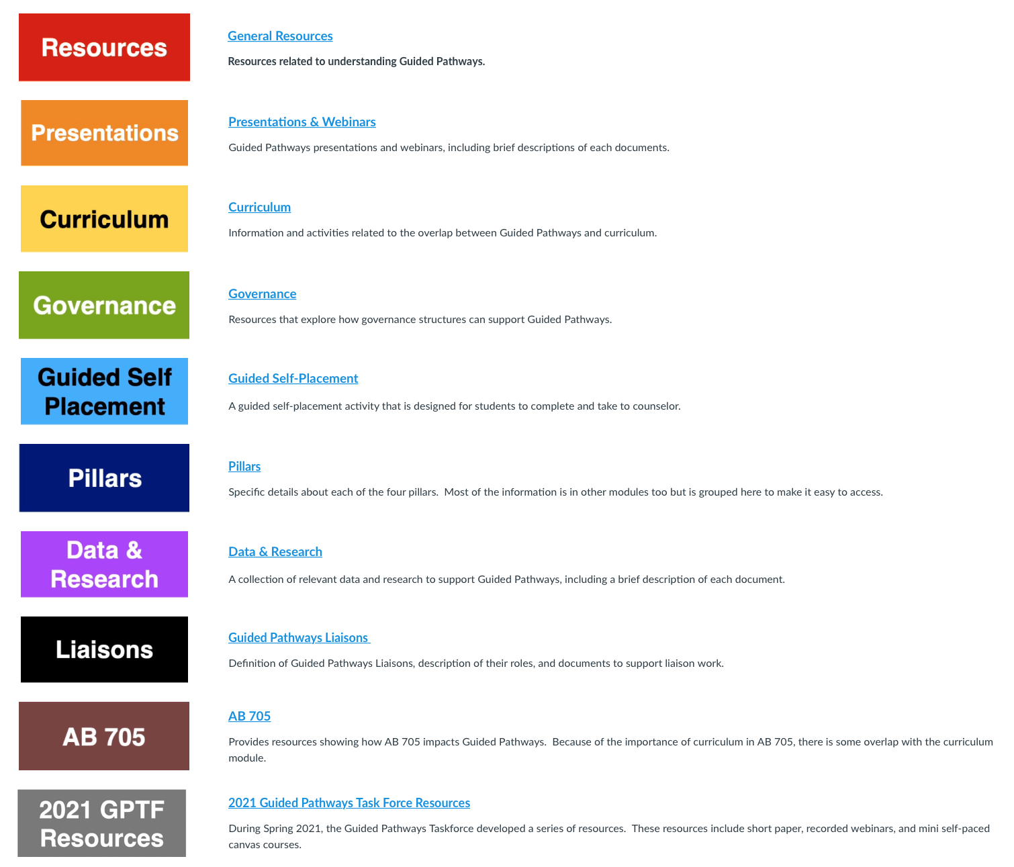
Canvas
Here’s a list of the existing resources in canvas
Notes:
Meridith

Slide 15
Canvas
Here’s a list of the existing resources in canvas
Notes:
Meridith

Slide 16
The 2021 Suite of Guided Pathways Resources
Ensuring Learning - Sarah
Data 101: Data Literacy and Data Coaching
Incorporating Student Voice into Guided Pathways Design - J
Aligning Guided Pathways with Equity-Minded Actions - J
Meta Major and Program Mapping
Student Support
Guided Pathways, Curriculum, and Program Review
Sustaining and Institutionalizing Guided Pathways within Governance Structures
Scheduling: A Student-Centered Approach - G
Notes:
Meridith

Slide 17
Ensuring Learning
“Designing with the End in Mind” means leading with learning.
The fourth pillar is arguably the most important – all other work should ultimately lead to this goal.
Ensure learning using intentional outcomes.
Focus on DEI goals with thoughtful and intentional disaggregation of learning assessment data.
Student voice is a critical component of this process.
Related GPTF Resources Include:
Mini-Paper available in Canvas
Using Data to Ensure Learning Webinar
Moving From Compliance to Improvement – Joint Webinar with ASCCC Accreditation Committee
Ensuring Learning by Understanding Transfer and Careers Webinar and PPT
Notes:
Sarah

Slide 18
Incorporating Student Voice into Guided Pathways Design
We include student voice to reduce assumptions and increase awareness of students’ lived experiences in and out of the classroom and the impacts of those experiences on learning and student success.
In doing so, we ensure the voice of students facing barriers, particularly disproportionately impacted students.
Incorporating student voice applies to inquiry, design, implementation, and evaluation in Guided Pathways redesign and may include
Treating student engagement as an ongoing and iterative process
Ensuring equitable student representation
Creating conditions for full student access
Preparing students for the opportunity
Intentionally leveling the playing field in the presence of power dynamics
Honoring student involvement
Notes:
Jeff

Slide 19
Aligning Guided Pathways with Equity-Minded Actions
With its emphasis of breaking down barriers to student success, Guided Pathways (GP), ultimately, is about advancing student equity.
Money allocated for GP to serve as “The How” for accomplishing Vision for Success goals, including closing equity gaps in 10 years and for Student Equity and Achievement Program to support GP implementation.
Guided Pathways implementation may include
Meta major teams focusing on equity gaps identified by data coaches
Cultural curriculum audits engaging faculty in equity-minded instruction
Using program review to examine disaggregated data and plan for support needs, co-curricular activities, and anti-racism/social justice work
Creating brave spaces for students of color to “call out” the systemic barriers
Advancing diversity, equity and inclusion in faculty hiring, onboarding, and evaluation where the data for specific pathways reveals equity challenges
Notes:
Jeff

Slide 20
Scheduling: A Student-Centered Approach
For faculty and other college stakeholders looking to improve college course scheduling intentionally designed to meet the needs of the local student population.
Diversity of the student population has increased, demographics shifted, course-taking patterns changed
Compressed calendars, block schedules, online schedule options, institutional redesigns resulting from Guided Pathways efforts, the COVID-19 pandemic
Increased focus on teaching and learning necessitates student-centered course scheduling.
Scenarios, Data Collection, Schedule Parameters, Resources
Ask your students!
Notes:
Ginni

Slide 21
Discussion
What do you need/want from the ASCCC in 2021-22?
Your turn!
Notes:
Ginni et al

Slide 22
Resources
Email questions and requests to info@asccc.org
Guided Pathways Resources: https://asccc.org/guided-pathways
Guided Pathways Task Force: https://asccc.org/directory/guided-pathways-task-force
ASCCC Online Handbook for Guided Pathways (Canvas Login required): https://ccconlineed.instructure.com/courses/2634

