Slide 1
Mentoring and Retaining a Diverse Faculty
Professor Silvester Henderson, At-Large Representative, ASCCC Dr. LaTonya Parker, South Representative, ASCCC Dr. Nathaniel Donahue, Santa Monica College
,
ASCCC Faculty Diversity Meeting/Regional Bakersfield College 1801 Panorama Dr, Bakersfield, CA 93305 February 21, 2019
[Date]

Slide 2
Presentation Highlights
Race (faculty of color) versus representative diversity
Why is “Faculty Diversity” important for our students and our college?
Is the concept of building “Diversity” and individual person or a way of thinking?
What is Mentorship for Diverse Faculty?
Strategies for Mentoring Diverse Faculty.
Can Diverse Faculty inspire “Workplace Equity”?
The Travel from “Mono-culturalism” to “Cultural Relativism” - Social Justice Institutional Culture – Retains Faculty! Questions and Comments?

Slide 3
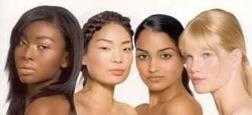
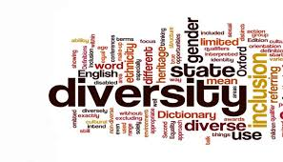
Race (faculty of color) versus representative diversity
University of Cambridge – “Race” is a protected characteristic that refers to an individual's race, color, nationality and ethnic or national origins.
National Education Association -
“Representative Diversity” can be defined as the sum of the ways that people are both alike and different. The dimensions of diversity include race, ethnicity, gender, sexual orientation, language, culture, religion, mental and physical ability, class, and immigration status”

Slide 4
Why is “Faculty Diversity” important for our students and our college?
Supports Cultural Sensitivity.
Strongly encourages conversations about “Race”. Goal: Eliminate Discriminatory Practices & Bias.
Promotes “Equity Centered” campus learning and social activities.
Values ones personal “Heritage”.
Promotes Intercultural Collaboration.
Increases Cultural Creativity & Innovations:
Examples: Soul Food Festival, African American Gospel Celebration (LMC), LGBTQ Coming Out Day, Cesar Chavez Day, Asian Campus Fairs
Increase “Social Tolerance” .
Promotes Inclusive Thinking!
Inspires “New” and “Active” Leaders (Faculty & Students).
Improves “Transfers Outcomes” for our Students & “Career Mobility” for our Campus Professionals.
GROWS CAMPUS ENROLLMENTS!
“People don’t want to talk about race because it is not the politically correct thing to do. If we don’t talk about race, then we ignore one aspect of who they are as young people.”
http://laschoolreport.com/lausd-leaders-need-to-confront-racism-in-schools-ucla-educator-says/
Dr. Tyrone C. Howard is professor in the Graduate School of Education and Information Studies’ at UCLA. He is also the Associate Dean for Equity, Diversity & Inclusion

Slide 5
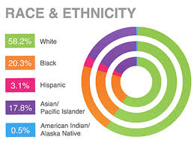
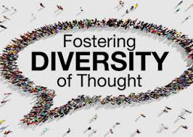
Is the concept of building “Diversity” and individual person or a way of thinking?
Various Ethnic Groups – Racial Identification
Diversity of thoughts?
Race & Ethnicity
Does racial identity matter at all?
Discussion?
Susan Wood (2008) “Diversity of thought—the idea of more-than-one-way— is key to understanding the potential of diversity and inclusion as an organizational resource”.
https://digitalcommons.ilr.cornell.edu/cgi/viewcontent.cgi?article=1573&context=articles

Slide 6
What is Mentorship for Diverse Faculty?
What is Mentorship
Mentoring is most often defined as a professional relationship in which an experienced person (the mentor) assists another (the mentoree) in developing specific skills and knowledge that will enhance the less-experienced person’s professional and personal growth.
https://www.management-mentors.com/resources/corporate-mentoring-programs-resources-faqs
EFFECTIVE MENTORSHIP PROMOTES CULTURAL CIVILITY
BENEFITS
Research shows that faculty with mentors have:
Increased productivity, including more publications, more NSF or NIH grants, and an increased likelihood of publishing in a top-tier journal (Blau et al. 2010; Carr et al. 2003);
Enhanced tenure and promotion prospects (Johnson 2007; Kosoko-Lasaki et al. 2006; Stanley & Lincoln 2005);
Increased sense of support for their research (Carr et al. 2003);
Heightened teaching effectiveness (Luna & Cullen 1995);
Higher career satisfaction (Carr et al. 2003);
Lower feelings of isolation (Carr et al. 2003; Christman 2003; National Academy of Sciences 1997);
A greater sense of fit – especially for women and faculty of color – which has been shown to be critical to job satisfaction and retention (Trower 2012)
http://live-uarizona-diversity.pantheon.arizona.edu/sites/default/files/benefits_0.pdf

Slide 7
Strategies for Mentoring Diverse Faculty (Part I)
Promote group mentoring and peer mentoring opportunities for faculty.8,9.
Take your junior faculty to lunch every few months to check in with them as a group.
Offer regular mentoring workshops discussing topics such as career goals, ethical behavior, handling departmental politics and personal issues, developing productive collaborations and competitive research proposals, and how to be an effective mentor or mentee.
If you cannot act as a mentor, be a sponsor diverse faculty. Advocate on their behalf and mention them when important opportunities arise such as grants, awards, important committees, and high profile collaborative proposals,

Slide 8
Strategies for Mentoring Diverse Faculty (Part II)
Include men in initiatives to promote gender equity by encouraging cross-gender mentoring and providing guidance on how to be effective mentors for female faculty.
Protect women and other URM faculty from the demands of “tokenism.” Do not ask them to sit on all diversity committees or ask them to speak on topics associated with ‘their’ group.
Assign short-term (one semester/quarter) allies to new faculty who can help them identify where to go for specific answers to questions.
Work with the administration to officially recognize women and diverse faculty "unofficial mentoring” as part of their formal service load and as a contribution to supporting diversity and equity at the institution.
https://advance.washington.edu/resources/docs/LiY-Primer_MentoringDiverseFaculty.pdf

Slide 9
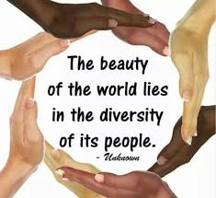
Can Diverse Faculty inspire “Workplace Equity”?
Sophie Johnson (2018) – “Equity in a workplace means everyone receives fair treatment”
Discussion
http://work.chron.com/advantages-equity-workplace-2635.html

Slide 10
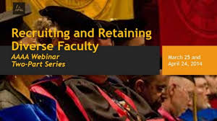
The Travel from “Mono-culturalism” to “Cultural Relativism” - Social Justice Institutional Culture – Retains Faculty!
Want to Retain Faculty of Color? Support Them as Faculty of Color (National Center for Institutional Diversity)
“Valuing faculty of color means changing the language about them from “having diverse perspectives” to “embodying critical knowledges,” and being open to the ways that these faculty might unsettle current power structures. It means taking the risk of being critiqued by white faculty for being exclusionary. Importantly, it means responding to these critiques with the insistence that supporting faculty of color is a form of social and educational justice”. (Larrissa Mercado Lopez - 2018)
https://medium.com/national-center-for-institutional-diversity/want-to-retain-faculty-of-color-support-them-as-faculty-of-color-9e7154ed618f
Mono-Culturalism
Mono-culturalism is the policy or process of supporting, advocating, or allowing the expression of the culture of a single social or ethnic group. ...
https://en.wikipedia.org/wiki/Monoculturalism
Cultural Relativism
Cultural relativism is the idea that a person's beliefs, values, and practices should be understood based on that person's own culture, rather than be judged against the criteria of another.
https://en.wikipedia.org/wiki/Cultural_relativism

Slide 11
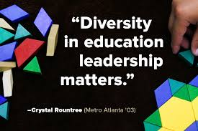
Questions & Comments
Please feel free to contact each of us for more information.
Professor Silvester Henderson Shenderson@losmedanos.edu
Dr. LaTonya Parker LaTonya.Parker@mvc.edu
Dr. Nathaniel Donahue donahue_nathaniel@smc.edu

