Slide 1
Myths and Murkiness of Noncredit Curriculum Madelyn Arballo, Mt. San Antonio College Cheryl Aschenbach, Lassen College Jan Young, Glendale College Curriculum Institute July 2019

Slide 2
Myths of Noncredit

Slide 3
Noncredit Myth #1
Noncredit students move on to credit classes, but credit students don’t take noncredit classes.

Slide 4
Myth: Students move only from Noncredit to Credit
Myth that students’ pathways are strictly linear from noncredit to credit classes only.
Co-requisites in noncredit permissible AB705.
Benefit of short-term noncredit review classes, particularly math.

Slide 5
Noncredit Myth #2
The goal of most noncredit students is to start a credit program as soon as possible.

Slide 6
Myth: immediate goal of noncredit students is to move to credit classes
The immediate goal of most noncredit students is to get a job.
Goals often include improved communication and literacy to better assist their children
Longer term goal is to pursue more education.
C

Slide 7
Noncredit Myth #3
Noncredit courses are not as rigorous as credit courses.
Noncredit courses are just lab courses.

Slide 8
Myth: Noncredit courses aren’t rigorous.
Noncredit courses include assessment, instruction, and often homework.
Noncredit instructors may use different pedagogy, but courses are not “watered” down.
Short-term vocational courses are often followed by state licensing exams.

Slide 9
Noncredit Myth #4
Like credit courses, noncredit courses are not repeatable.

Slide 10
Myth: Noncredit courses are not repeatable.
▪︎Noncredit courses are repeatable so that a student doesn’t have to complete the course in a prescribed period of time.
▪︎ Title 5 §55002 Standards and Criteria for Courses: Noncredit (c) (4) (4) Repeated enrollment only in accordance with provisions of article 4 of subchapter 1 of chapter 6 (…) 58161
▪︎ § 55044 Repetition of variable course units …silent on noncredit.

Slide 11
Noncredit Myth #5
SEA Program funds are not intended for noncredit students and noncredit programs.

Slide 12
Myth: SEA funds are not for noncredit students or programs.
EDC 78222(a) Funds for SEA support CCC in advancing the systemwide goal to boost achievement for all students with an emphasis on eliminating achievement gaps for students from traditionally under-represented groups through the following:
--Implementing activities and practices pursuant to the CCC Guided Pathways Grant
--Providing quality curriculum, instruction, and support services to students who enter college deficient in English and mathematics to ensure these students complete a course of study in a timely manner (AB705)

Slide 13
Murky Areas of Noncredit
This Photo by Unknown Author is licensed under CC BY-SA

Slide 14
Noncredit: Murky Matters
Can I just change a credit course to a noncredit course?

Slide 15
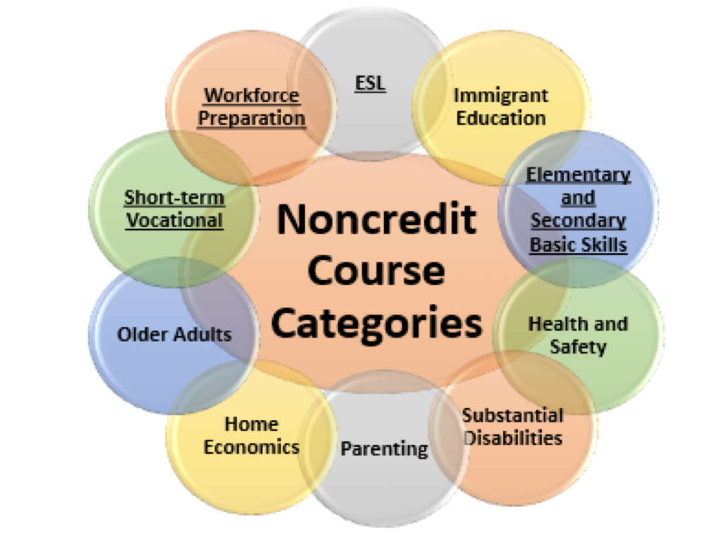
Eligible Noncredit Courses: Ten Categories
English as a Second Language (ESL)*
Immigrant Education
Elementary and Secondary Basic Skills*
Health and Safety
Substantial Disabilities
Parenting
Home Economics
Courses for Older Adults
Short-term Vocational*
Workforce Preparation*
*Areas (1), (3), (9), (10) are eligible for Enhanced Funding if associated with an approved noncredit program.

Slide 16
Can’t I just change a credit course to a noncredit course?
Noncredit Public Safety Courses
Can not reclassify degree-applicable courses that are advanced and highly specialized public safety courses into noncredit courses. This includes “in-service training” courses; advanced and highly specialized courses for continued professional development or legally mandated on-going professional training.
(Memo: AA 19-18 Noncredit Advanced and Specialized Public Safety Curriculum Proposals)
Public safety courses for which the pre-requisite skills are learned in a basic academy do not meet the criteria for courses in the noncredit “Short-term Vocational” category.
Can offer these specialized public safety courses in Community Education

Slide 17
Can I create a mirrored noncredit course within a credit course?
Mirrored noncredit courses can only be offered in credit classes that fall within the 10 noncredit categories.
Used frequently with CTE or ESL credit courses.
COR the same for credit and noncredit course. Noncredit students will receive a grade of P or NP. Held to the same standards of credit students.
Noncredit mirrored course will have a unique control number different from credit.

Slide 18
Noncredit: Murky Matters
What constitutes a CDCP (Career Development, College Preparation) Program?
Sequence of courses (more than one). Cannot just split one course into two parts and label course A and course B. Current legislation (AB1727) would change the word “sequence” to “complement” of courses.
For ESL and Basic Skills programs, students would earn a Certificate of Competency. For Short-Term Vocation and Workforce Preparation programs, students would earn a Certificate of Completion.
Special population courses (Adults with Disabilities, Older Adults) are not eligible for CDCP funding.

Slide 19
Noncredit: Murky Matters
What is the difference between Short-Term Vocation and Workforce Preparation certificates?
Short-Term Vocational programs consist of courses with high employment potential that lead to a career-technical objective, or a certificate or award directly related to employment.
Workforce Preparation programs are designed to provide instruction for speaking, listening, reading, writing, mathematics, decision-making and problem-solving skills that are necessary to participate in job specific technical training (Title 5 § 55151)

Slide 20
Noncredit: Murky Matters
Can you include courses from different noncredit areas in a CDCP certificate?
YES. You can combine courses from more than one noncredit category to create a noncredit program.
For example: Healthcare Readiness – Workforce Preparation Certificate may include the following courses:
Math for Health Careers – Basic skills
Healthcare Test and Program Prep – Workforce Prep
Health Careers Employability Skills – Workforce Prep

Slide 21
Noncredit: Murky Matters
Do I follow the same process in creating a Short-Term Vocational program as I do for a credit CTE program?
Unlike credit, noncredit Short-Term Vocational programs are not required to create an advisory board. Additionally, noncredit programs do not require the approval of the Regional Consortium. LMI or equivalent data must be included in the noncredit COR.
With the new noncredit streamlining approval process, Short-term Vocational certificates still must be approved by the Chancellor’s Office. Short-Term Vocation courses ,however, will be eligible for approval at the local level.

Slide 22
Noncredit Murkiness: Case Study
A colleague wants to offer a CDCP Short-Term Vocational program in Photography. The courses that will be required are Intro to Photography and Wedding Photography. The curriculum committee argues that Photography is not one of the 10 categories of noncredit. The instructor states that a Wedding Photographer is an occupation, and it only requires short-term preparation. What are the factors that should be considered? Should this noncredit program be approved?

Slide 23
Noncredit Murkiness: Case Study
Credit students from a robust manufacturing program struggle to complete their projects in an entry-level Fabrication course. There is a credit lab component, but many students need more hands-on time to practice foundational skills. Currently, many students are paying a fee to use Makerspace equipment for extra practice with the professor often accompanying the students. The professor has approached Short-term Vocational faculty to collaborate on creating a noncredit support lab course. The credit manufacturing professor believes that holding a noncredit STV class in addition to the credit lab would allow students ample time for hands-on practice as well as removing the barrier of the Makerspace cost to the students.
What factors should be considered and should this class be offered in noncredit?

Slide 24
Questions?
Madelyn Arballo:
marballo@mtsac.edu
Cheryl Aschenbach: caschenbach@lassencollege.edu
Jan Young:
jyoung@glendale.edu

