Slide 1
Noncredit CTE
Cheryl Aschenbach
ASCCC Noncredit Regional
April 16, 2016

Slide 2
Noncredit Categories Pertaining to CTE
Two categories are CDCP-eligible:
Short-term Vocational
Workforce Preparation
Other categories may apply (not CDCP-eligible)
Immigrant Education
Substantial Disabilities
Home Economics

Slide 3
Workforce Preparation
Provide instruction for skills necessary for job-specific technical training
Speaking
Reading
Listening
Writing
Mathematics
Decision-making
Problem-solving
Career Development

Slide 4
Short-term Vocational
Designed for high employment potential
Lead to a CTE objective, certificate, or award related to employment
Should do one or more of the following:
Improve employability,
Provide job placement opportunities,
Prepare students for further college-level coursework
Also need to
Meet documented labor market demand
Ensure no unnecessary duplication of other training programs in region
Demonstrate effectiveness as measured by employment and completion success of students
Be reviewed by program review process every two years

Slide 5
Common CTE-related Noncredit Programs
General enough to support employment possibilities in a wide variety of settings
Customer Service
Office Clerk
Beginning
Advanced
Field-specific: General, Medical, Dental
Executive or Administrative Assistant
Computer Skills / Keyboarding
Business Office Systems / Microsoft Office

Slide 6
Common CTE-related Noncredit Programs
General enough to support employment possibilities in a wide variety of settings
In-Home Support Service / Health Aide
Medical Assistant
Retail Sales
Culinary and Service Skills
Project Management

Slide 7
More Specific CTE-related Noncredit Programs
Designed for employment in specific jobs but applicable to a variety of employment settings:
Graphic Design
Tax Preparation
Warehousing
Food Preparation
Multimedia Artists and Animators
Supervision or Management
Carpenter
Gardener or Landscape Management

Slide 8
Very Specific CTE-related Noncredit Programs
Designed for employment in specific jobs in specific fields:
Recreation Assistant in a Marine Environment
Shelter Dog Training
Construction Technology
Paraprofessional Mental Health Worker
Textile and Fabric Design
Bakeshop
Linux Server Administration

Slide 9
Very Specific CTE-related Noncredit Programs
Designed for employment in specific jobs in specific fields:
Appliance/Refrigeration/Air Conditioning Repair
Cisco Certified Network Associate
Building Information Modeling and CADD
CA Conditional Real Estate License
Welder
Automotive Welding, Cutting and Fabrication
Gas Tungsten, Arc Welding
Semiautomatic Arc Welding

Slide 10
Very Specific CTE-related Noncredit Programs
Designed for employment in specific jobs in specific fields:
Horse Ranch Management
Electronic Cabling and Wiring
Utilities and Construction Preparation
Bank Teller
Mechanic – Auto, Maintenance, Manufacturing
Auto Body and Paint Technician
Pipe Welding / Pipe Fitting
Braille Transcribing

Slide 11
Selecting New CTE-related Noncredit Programs
Look for links to existing programs
Look at entry level training for credit programs
Funeral Service Assistant noncredit program (North Orange School of Continuing Ed) to help address demand for Mortuary Science credit program (Cypress College)
Medical Assisting to help address demand for LVN credit programs
Look at credit courses that could be more accessible in noncredit
Electronic Systems Technology @ Mt. SAC
Pharmacy Technician @ North Orange SCE

Slide 12
Selecting New CTE-related Noncredit Programs
Examine local and regional labor market data
http://doingwhatmatters.cccco.org

Slide 13
Selecting New CTE-related Noncredit Programs
Partner with other efforts
Adult Education Consortiums
Regional Trainers
Workforce Centers
Employers

Slide 14
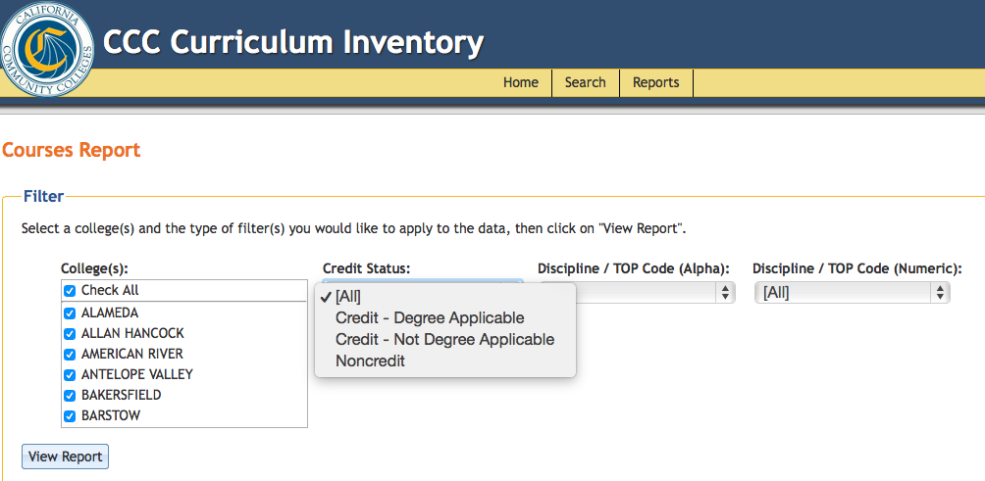
Selecting New CTE-related Noncredit Programs
Review other programs in the Chancellor’s Office Curriculum Inventory
http://curriculum.cccco.edu
Reports → Programs Report → Program Award: Noncredit
Reports → Courses Report → Credit Status: Noncredit

Slide 15
Anything new in progress at your college?
Any ideas for new noncredit CTE programs?

