Slide 1


Pathways:
Investigating Possibilities and Exploring Options
Julie Bruno, President, Facilitator
Brian Gosney, Sierra College
Ginni May, Sacramento City College
Andrea Neptune, Sierra College
Mark Staller, Bakersfield College

Slide 2
Preview
Bakersfield College
  BC Pathways
Sierra College
  R4S – Reengineering Sierra College for Student Success
Sacramento City College
  TBD

Slide 3
Bakersfield College & BC Pathways
Academic Senate

Slide 4
BC Timeline
2012: SSSP, SEPs work
2012-2014: redoubled efforts for AA-Ts and Degreeworks
September 2015:Applied for AACC Pathways – campus-wide survey and assessment
Fall 2015—On-campus Book Discussions (Redesigning)
February 2016: AACC Institute #1 and BC Pathways Summit
April 2016: AACC Institute #2
October 2016: AACC Institute #3
October 2016: Draft proposal for BC Pathways Implementation Task Force

Slide 5
Book Discussions – Redesigning America’s Community Colleges
- https://www.bakersfieldcollege.edu/employees/professional-development/book-discussion
Chapter 1: Redesigning College Programs
  October 16, 10:30 to 11:15. B8. Nan Gomez-Heitzeberg, Lesley Bonds , Billie Jo Rice, Cindy Collier
  November 30, 2:45-3:30 pm. Fireside Room
Chapter 2: Guiding Students
  October 19. 3:15 to 4:00 p.m. Fireside Room Zav Dadabhoy, Paul Beckworth, Marisa Marquez, Keri Kennedy. View Video
  November 16, 3:15-4:00 p.m. Fireside Room. Student Panel members: Patricia Chavez, Adeana Williams, Alia Brost, Chad Hidalgo
Chapter 3: Rethinking Student Instruction.
  October 16. 11:15 to 12:00 noon. B8 Janet Fulks, Bill Moseley, Rebecca Monks, Jessica Wojtysiak. View Video
  November 20. 9:45-10:30 am. Levan Center. Student Panel Members: Linda Esquivel, Anna Alcauter, Tonysha Miles, Janell Orozco.
Chapter 4: Helping Underprepared Students.
  November 13. 11:15 to 12:00 noon. B8 Kimberly Bligh, Eileen Pierce, Reggie Bolton, Corny Rodriguez. Students Manuel Menchaca, Jennifer Crissman.
Chapter 5: Engaging Faculty and Staff.
  October 26. 2:30 p.m. to 3:15 p.m. Fireside Room. Kate Pluta, Manny Mourtzanos, Edie Nelson, Mark Staller. View Video.
  Dec. 4, 9:45-10:30 am. Levan Center. Clayton Fowler, Samantha Mayo, Wesley Lyons.
Chapter 6: The Economics of College Redesign.

Slide 6
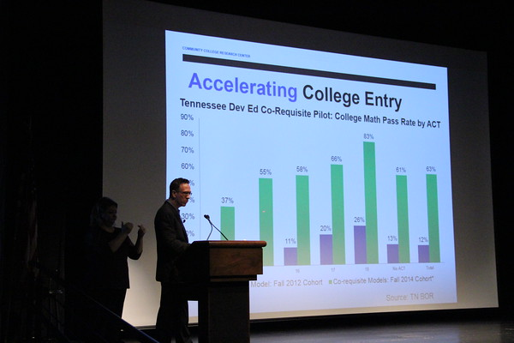
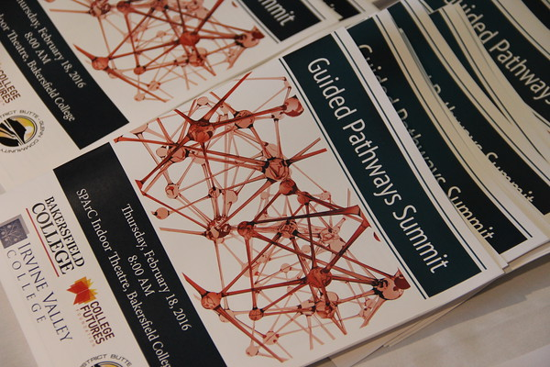
Pathways Summit hosted by BC February 18, 2016
Davis Jenkins

Slide 7
Design Principles | What BC has done
1. Every student’s postsecondary education begins with an intake process to choose an academic direction and identify the support needed to pass relevant credit-bearing gateway courses in the first year. | HS site visits Renegade day Specialized advisors Cohort tracking Get Focused Stay Focused Dual Enrollment Summer Bridge Degreeworks Convocation
2. Enrollment in college-level math and English courses or course sequences aligned with the student’s program of study is the default placement for the vast majority of students. | Registration strategies Abbreviated SEP STEM & MESA Multiple Measures Title 5 & ASTEP Rural Initiatives & Rural Bridge
3 Academic and nonacademic support is provided in conjunction with gateway courses in the student’s academic or career area of interest through co-requisite or other models with evidence of success in which supports are embedded in curricula and instructional strategies. | Habits of Mind Completion Coaches (MIH Mentors) SI, Writing Center, Tutoring Math Tutor STEM center Library courses

Slide 8
Design Principles | What BC has done
4. Students for whom the default college-level course placement is not appropriate, even with additional mandatory support, are enrolled in rigorous, streamlined remediation options that align with the knowledge and skills required for success in gateway courses in their academic or career area of interest. | Accelerated Reading, English and Math Engl B53 & Math B65 Cohorts Compressed course work New Success Lab ACDV B72 Multiple Measures Contextualized coursework Dual Enrollment
5. Every student is engaged with content of required gateway courses that is aligned with his or her academic program of study—especially in math. | Broadening gateway based on majors – e.g. Anatomy & Physiology, Psychology, Accounting, Drafting etc
6. Every student is supported to stay on track to a college credential, from intake forward, through the institution’s use of effective mechanisms to generate, share, and act on academic performance and progression data. | Cohorts Early alert Starfish Equity AAMP & Hispanic Cohort Institutional Scorecard Vets, DSPS, EOPS

Slide 9

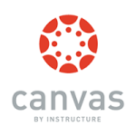






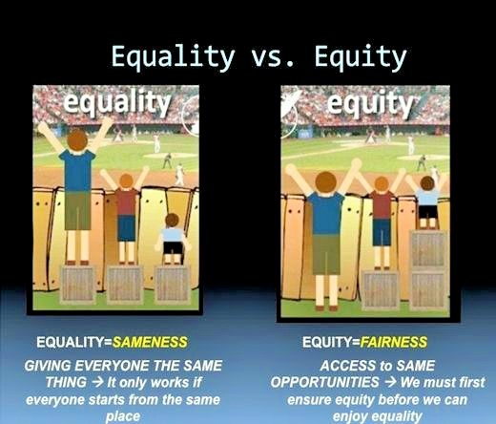


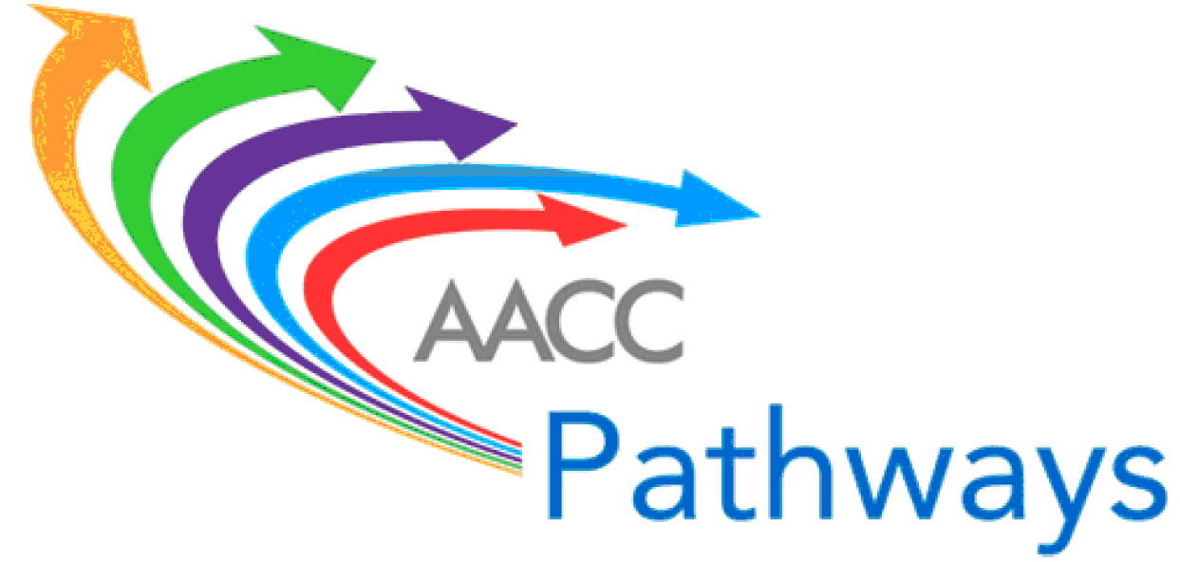







Challenge 1: FOCUS
California Career
Pathways Trust (CCPT)
STUDENT SUCCESS AND SUPPORT PROGRAM (SSSP)
Basic Skills and Student Outcomes Transformation Program

Slide 10
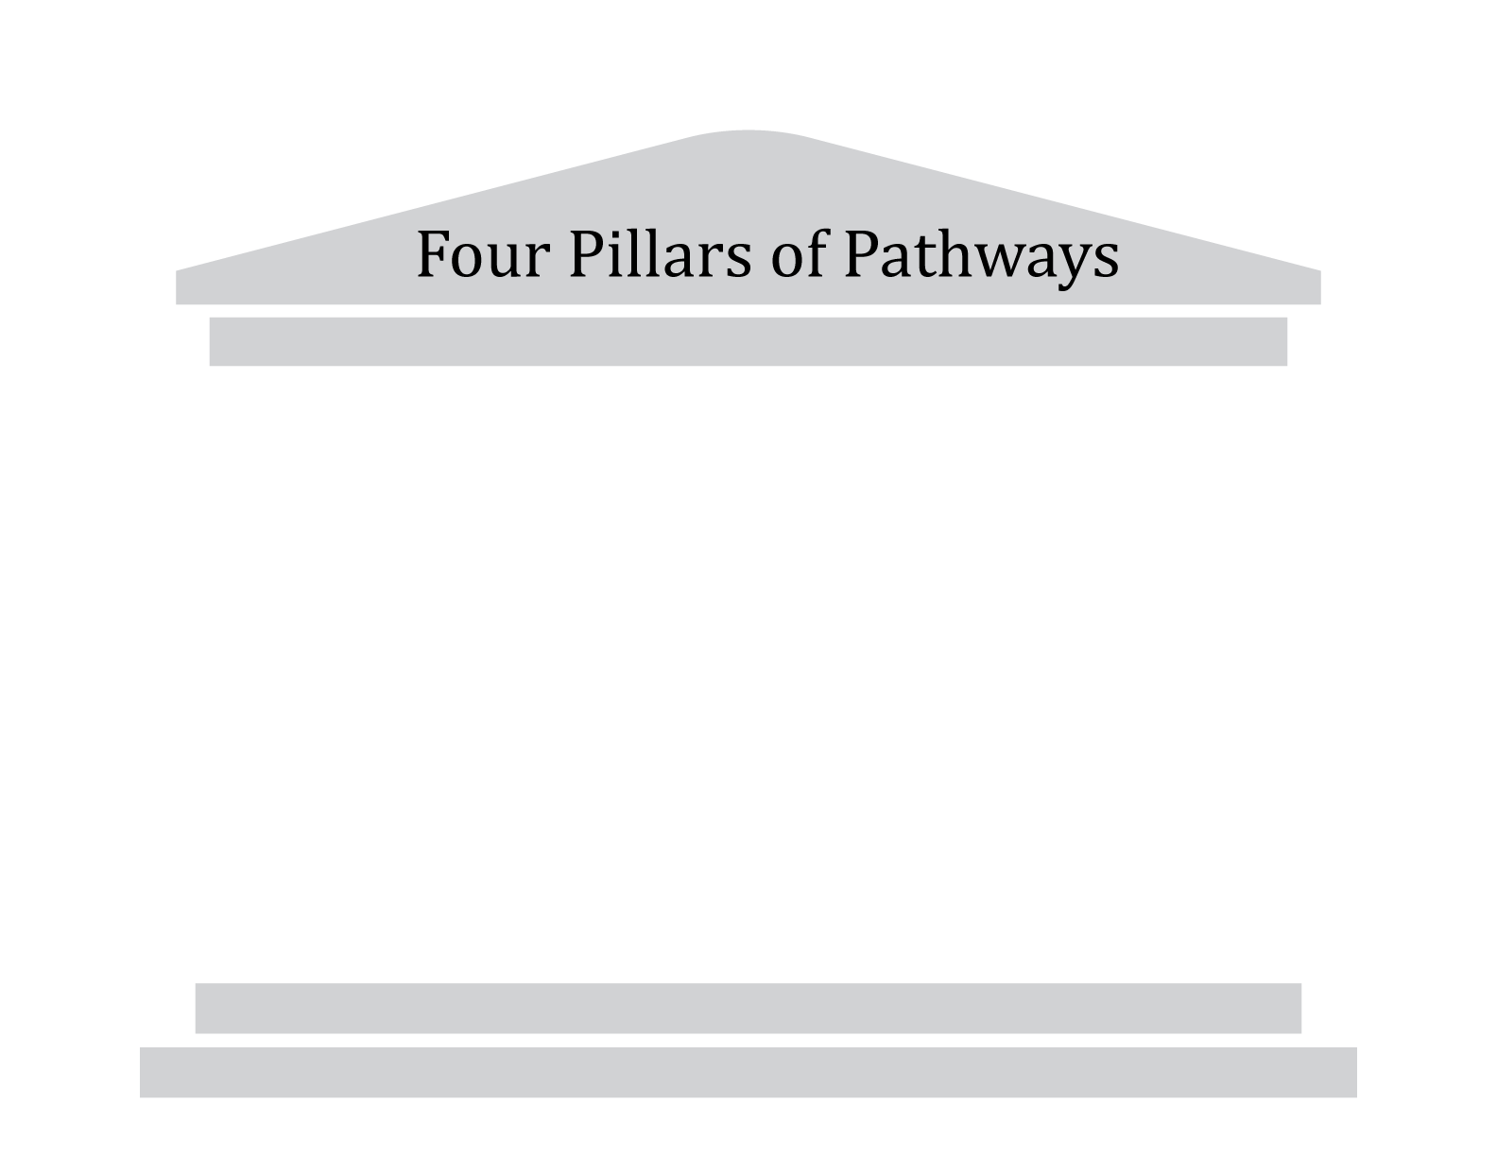






Guided Pathways
California Career
Pathways Trust (CCPT)
Equity, Social Mobility, Economic Health
California Pathways – Redesigning California’s Community Colleges

Slide 11



Guided Pathways
SSSP
Equity, Social Mobility, Economic Health
California Pathways – Redesigning California’s Community Colleges

Slide 12
Guided Pathways
SSSP
Supplemental Instruction/Tutoring
Contextualized Learning
BSI e-Resource
Noncredit
Equity, Social Mobility, Economic Health
California Pathways – Redesigning California’s Community Colleges

Slide 13
Guided Pathways
Equity, Social Mobility, Economic Health
California Pathways – Redesigning California’s Community Colleges

Slide 14
Guided Pathways
Defining Competencies
Assessing
Competencies

Slide 15


Slide 16
BC Pathways
Questions?

Slide 17
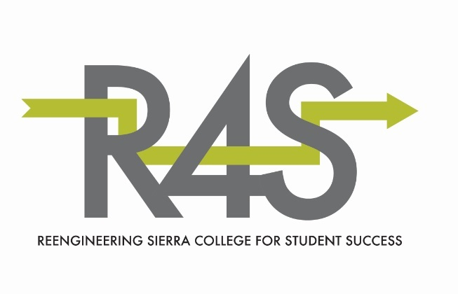

Slide 18
Reengineering Sierra College for Student Success
Problem statement:
Students at Sierra College
are not reaching their educational goals
in a timely manner, or at all.

Slide 19
Reengineering Sierra College for Student Success
Problem statement:
Students at Sierra College
are not reaching their educational goals
in a timely manner, or at all.
R4S Taskforce began work in January 2016:
How can we respond to this problem statement?

Slide 20
Spring 16 semester
  Held series of visits, informational meetings, and open forums (close to 30 events)
  Researched promising practices that improve student success
  All roads led to Guided Pathways

Slide 21
Big Ideas for Re-engineering Sierra:
Make navigating the institution user-friendly to all students
Help students understand, explore, and choose appropriate educational goals
Give students clear and efficient paths to reach those goals

Slide 22
Big Ideas for Re-engineering Sierra:
Make navigating the institution user-friendly to all students
Help students understand, explore, and choose appropriate educational goals
Give students clear and efficient paths to reach those goals
Ensure those paths are available
Provide support and resources to keep students on those paths
Measure institutional progress toward/success at these goals and respond accordingly

Slide 23
Guided Pathway Defined:
  An easy-to-use plan that guides a student into and through college to successful completion of a program of study that leads to transfer or a career.
  It integrates student services and instruction into a coherent, intentional, and informed student experience.

Slide 24
Spring 16 semester
In May, the Academic Senate and Sierra College President supported moving forward with a comprehensive Guided Pathways approach with five components:
    Academic maps and interest areas

Slide 25
Spring 16 semester
In May, the Academic Senate and Sierra College President supported moving forward with a comprehensive Guided Pathways approach with five components:
    Academic maps and interest areas
    Structured onboarding processes

Slide 26
Spring 16 semester
In May, the Academic Senate and Sierra College President supported moving forward with a comprehensive Guided Pathways approach:
    Academic maps and interest areas
    Structured onboarding processes
    Proactive academic and career counseling

Slide 27
Spring 16 semester
In May, the Academic Senate and Sierra College President supported moving forward with a comprehensive Guided Pathways approach:
    Academic maps and interest areas
    Structured onboarding processes
    Proactive academic and career counseling
    Enhancement of early alert system

Slide 28
Spring 16 semester
In May, the Academic Senate and Sierra College President supported moving forward with a comprehensive Guided Pathways approach:
    Academic maps and interest areas
    Structured onboarding processes
    Proactive academic and career counseling
    Enhancement of early alert system
    Instructional support and co-curricular activities (professional development)

Slide 29
Reengineering Sierra College for Student Success
Fall 16: Ready 2 Map!

Slide 30
Fall 16 Goals:
Create academic map templates as the first step toward Guided Pathways
Work with departments to have all degrees and certificates mapped by the end of the semester (training and workdays)
Develop process to determine Interest Areas

Slide 31

Definitions

Slide 32
Template:
Outlines the recommended sequence of courses a student must complete in order to earn a degree, certificate or transfer with ADT.
Provides recommended choices for General Education (GE) and electives.

Slide 33

Map:
My Academic Plan
Counselors will use templates in Degree Works to create personalized academic maps that detail the sequence of courses students need to complete to reach their goals.

Slide 34
Template Mind-Set:
Assume students are full-time and can take 15 units each semester
Assume students are college ready
Create template according to what is best for the student,
    not on what classes are currently offered—or when
    not on what classes professors want to teach—or when
Academic maps will be personalized for individual students

Slide 35
Future Goals:
    Academic maps and interest areas
    Structured onboarding processes
    Proactive academic and career counseling
    Enhancement of early alert system
    Instructional support and co-curricular activities (professional development)

Slide 36
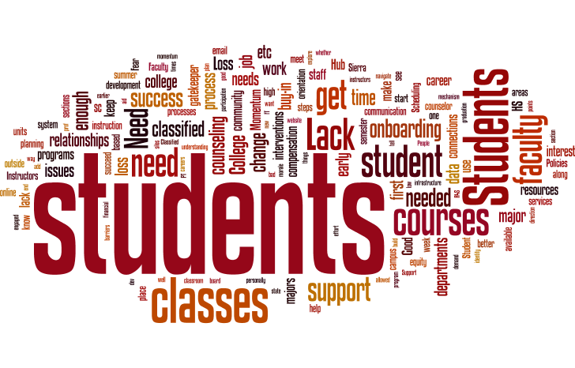

Slide 37
R4S
Questions?

Slide 38
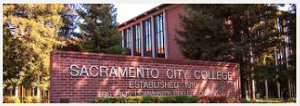
Sacramento City College

Slide 39

Sacramento City College
Fall 2015...
9-7-2015: The Academic Senate President notified of college plan to apply for an AACC Pathways Pilot Project.
9-15-2015: First Reading at Academic Senate
9-21-2015: AACC Pathways Pilot Project application submitted
9-22-2016: Second Reading at Academic Senate
10-20-2015: Resolution on Pathways and Partnerships passed
Time to look at things another way... 👀

Slide 40

Sacramento City College

Slide 41

Sacramento City College
Spring 2016…
Los Rios Community College District Strategic Plan: Goal 1. Establish effective pathways that optimize student access and success.
SCC List of Pathways, Partnerships, and Projects distributed:
  22 ADTs
  2+2+3 Law School Program
  Non STEM Pathway to Statistics
  Sacramento Pathways to Success
  And more…

Slide 42

Sacramento City College
Are these pathways limited to be boutique programs?
Can some or all be brought to scale?
Are Guided Pathways the way to go?

Slide 43

Sacramento City College
Fall 2016…
IEPI PRT on Enrollment Management and Pathways – all four colleges and the district
IEPI Leadership Development Grant (?) with first focus on Pathways – all four colleges and district
Discussions on California Guided Pathways
2nd 100 Year Transition Team (2CTT) at SCC
Sacramento City College Strategic Plan…

Slide 44

Sacramento City College
Faculty and Administration will work in tandem…
including the classified staff and students.

Slide 45

Sacramento City College
QUESTIONS?

Slide 46
Pathways:
Investigating Possibilities and Exploring Options
Questions or Comments?

Slide 47
Resources
AACC The Pathways Project
  http://www.aacc.nche.edu/resources/aaccprograms/pathways/Pages/default.aspx
Sierra College R4S
  http://www.sierracollege.edu/planning-governance/r4s/index.php
Bakersfield College BC Pathways
  https://www.bakersfieldcollege.edu/conference/redesigning-community-colleges
Redesigning America’s Community Colleges

Slide 48
Presenters
Mark Staller, Bakersfield Community College
  mstaller@bakersfieldcollege.edu
Andrea Neptune and Brian Gosney, Sierra College
  aneptune@sierracollege.edu
  bgosney@sierracollege.edu
Ginni May, Sacramento City College
  MayV@scc.losrios.edu

Slide 49
Thank You!

