Slide 1
Accessibility for Online Course Design

Slide 2
When is my course accessible?
Notes:
When we mention Accessibility for online courses, what comes to mind for you? Confusion, more work, why can’t I just wait until there is a confirmed need? It’s really pretty simple. Your course either is accessible or it’s not

Slide 3
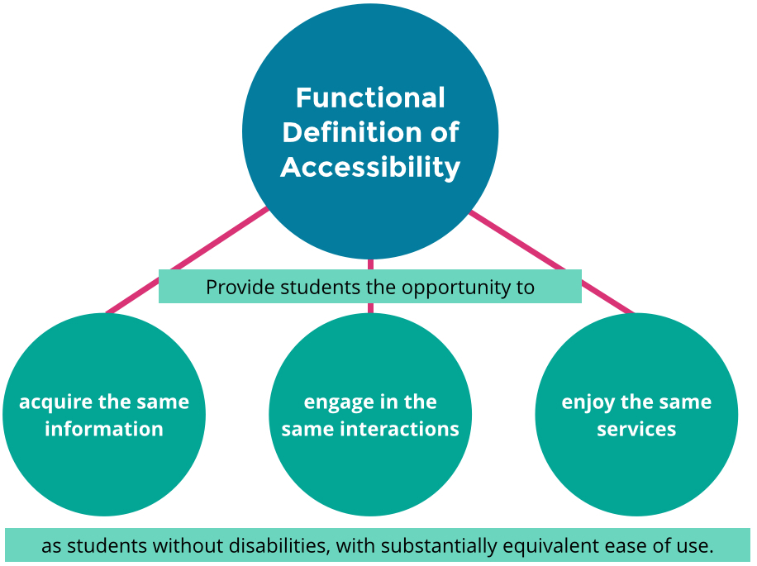
Remember?
http://udloncampus.cast.org/page/policy_legal#.WBX1CltLRNE
Notes:
All of this, and with the same equivalent ease of use! (Equity)
It’s good for students.. Ask people what closed captioning is? They may say when captions appear, but the real answer is when captions can be turned on or off. There’s a difference because of how people learn. For some, like ESL captions have a different use than for hearing impaired students, for others, like Attention Deficit students, it may get in the way. The choice to use the function is important.

Slide 4
What is.
Notes:
Don’t learn the hard way, through an OCR complaint. Be forward thinking and proactive

Slide 5
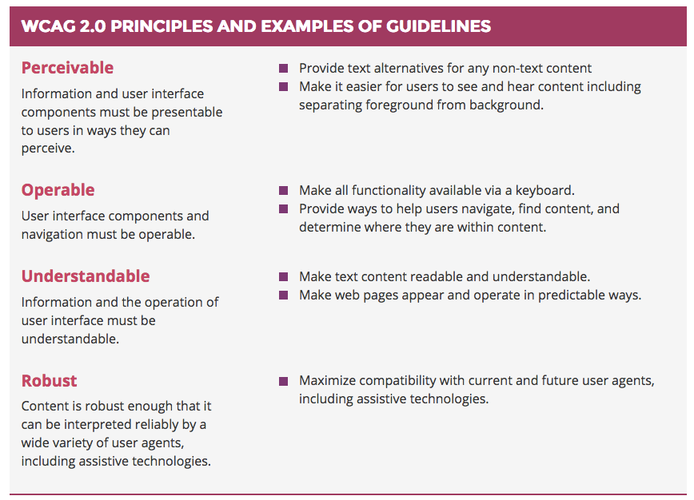
Notes:
What it will be Optional now but coming soon……

Slide 6
How is the OEI helping?
Common Course Management that is Accessible
Creating professional development materials
Accessibility web information http://tinyurl.com/OEIable
Online Resource Documents http://tinyurl.com/OEIable2
OEI Course Design Rubric http://ccconlineed.org
Providing instructional design support through @ONE,
Accessibility Guidance with @ONE Certification Course on Accessibility
Making funds available via cost savings
Advocating for additional funding for Digital Education Captioning and Transcription grant.
Notes:
Encouraging ongoing and new collaboration between the HTCTU, Butte Technology Center, DECT, and ASCCC.
OEI Steering Committee Accessibility Working Group – Laurie is the ASCCC appointed representative (Conan should probably join… ;-D )

Slide 7
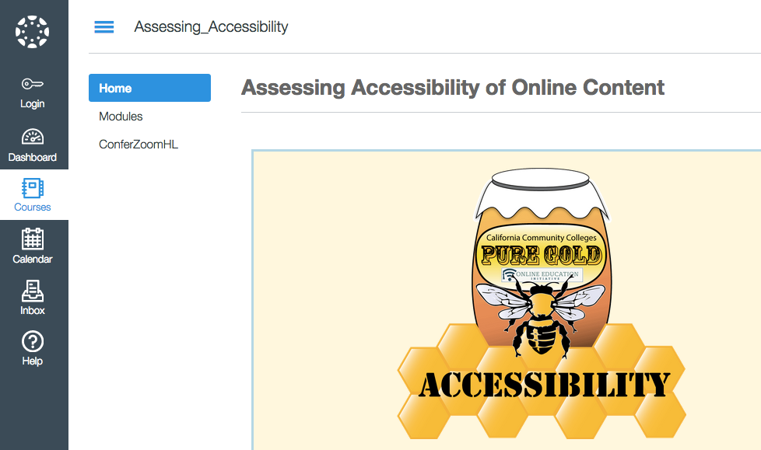
Creating Accessible Materials
Accessibility web information http://tinyurl.com/OEIable2
Notes:
Pat will show this site

Slide 8
Canvas
Conforms to 508 requirements.
Conforms to WCAG 2.0 AA standards.
Canvas engages in continuous accessibility review.
Canvas agreement to our system is to maintain high accessibility standards as a priority for future development of the platform.
Benefits of a common system
Notes:
is currently being reviewed for accessibility again by Access Technology Higher Education Network, and expecting another review from the National Federation of the Blind. Explain mention common system 98 colleges

Slide 9
Redirecting Funds
The entire cost of Canvas is being covered at least through OEI until 2020.
BCP for ongoing cost coverage has been approved by Chancellor’s Office.
ASCCC Resolution to return savings to DE via professional development. (Resolution 12.04 S15)

Slide 10
How do colleges do this well?
Start with a plan. (Tech Edge Newsletter)
Mission to help students succeed
Inclusion of all stake holders
Provisioning of Resources
Provide support for course design.
Connect DSPS with DE services!
Hire instructional designers with accessibility expertise to fix the problems while working with faculty
Notes:
See the plan outline at the blog post at the tech edge newsletter

Slide 11
What can teachers do?
Heading Styles
Image Descriptions (textual description for non-textual content)
Identifying Complex Data
Notes:
We are going to treat you to a quick tutorial

Slide 12
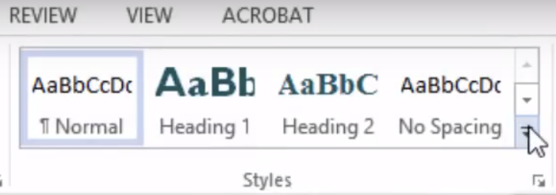
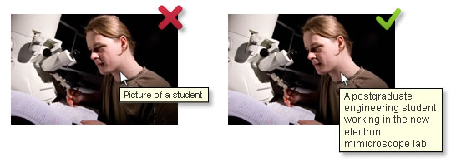
Simple steps with powerful impact.
Heading Styles in Word
Placing Alt tags
See 5 minute videos at: http://tinyurl.com/OEIable2
Notes:
Styles. Explain why Alt tags explain why and how talk about resources that are at the site, go to the video page, discuss how this can be used for professional development.

Slide 13
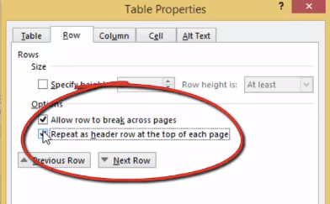
Complex Data isn’t always complicated.
Identifying Complex Data
Table Properties for setting Table Headers
Notes:
Explain how.

Slide 14
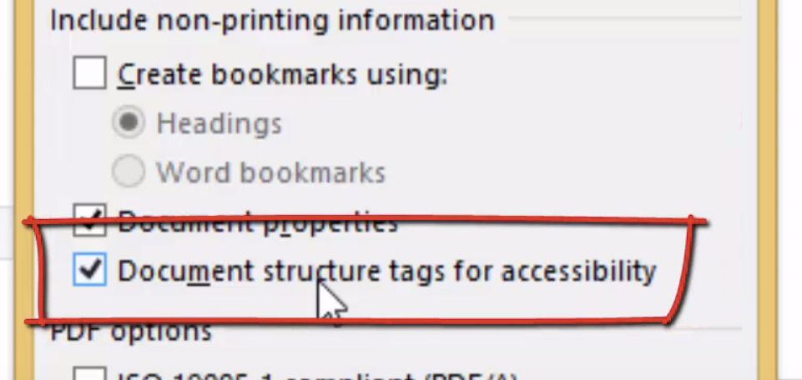
Saving as an accessible .pdf
Save as .pdf
Select options
Select Document structure for accessibility.
Notes:
Styles.

Slide 15
Captioning?
Use 3CMedia or DECT for captioning.
Caption yourself in Youtube
Set up an account
Upload your videos
Wait a few minutes
Check and edit the garbage captions
*** - Make sure you are clear on COPYRIGHT
National Research Study: Student Uses and Perceptions on Closed Captions and Transcripts
Video in higher education has become commonplace. According to the students surveyed, almost 100% of courses included some video content in both online and face-to-face environments. Closed captioning and transcription are also becoming a lot more common, but questions abound. Why do students use captions/transcripts and how do they support learning? Why and how often do students who are not deaf or hard of hearing use captions/transcripts? Which subgroups of students use captions/transcripts and how much do they rely on them?
Notes:
WE can do a demo.

Slide 16
Captioning Revisited…
Question | Answer
Is a transcript good enough? | No
Are YouTube auto captions sufficient? | No
Can I caption 3rd party videos with DECT? | Yes, if you have copyright clearance.
Do I have to caption peer review student videos? | Only in the presence of a student who requires captions.
Can speech recognition do captioning? | In very rare situations yes, but generally NO.
Is the OEI going to pay for my captioning? | Not likely… Responsibility is at local campus. Remember 3C Media and DECT.

Slide 17
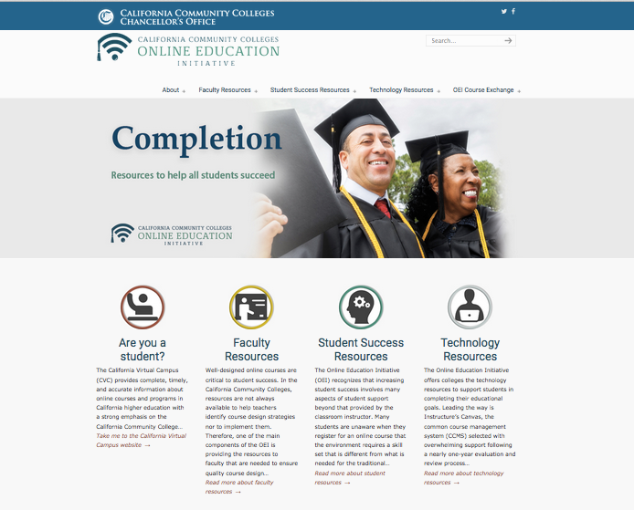
http://CCCOnlineEd.org
Notes:
New Web site: Brief Tour

