Slide 1
Welcome!
ONLINE PROGRAM
Use this QR code
CTE and Noncredit Regional Meeting
March 20, 2023 at Compton College

Slide 2
Session Description
On your mark, get set, let’s go! Join us for this opening session, where we will frame the day in our values, as we support our diverse CTE and noncredit students in meeting them where they are at.

Slide 3
Land Acknowledgement
We begin today by acknowledging that we are holding our gathering on the land of the Tongva/Gabrieleño Nations. We recognize the sovereign people who have lived and continue to live here. We recognize the Tongva/Gabrieleño Nations and their spiritual connection to the ocean and the land as the first stewards and the traditional caretakers of these areas.
As we begin, we thank them for their strength, perseverance, and resistance. We also wish to acknowledge the other Indigenous Peoples who now call these areas their home, for their shared struggle to maintain their cultures, languages, worldview, and identities in our diverse cities.
We invite you to research your area at https://native-land.ca.
Notes:
Welcome and centering (Michelle) 2 minutes
Laney: Ohlone/Muwekma
Compton: Tongva/Gabrieleño
Huge brain in the room—we value and acknowledge you.
Breathe and community norms:
Be present
Be true to yourself
Acknowledge each other and connect
Commit to learning and open-minded
Have fun

Slide 4
Committee Introductions
CTE Leadership Committee
Carrie Roberson, Chair
Amber Gillis, Second Chair
Shelley Eckvahl
John Grounds
Rich Harlan
Armie Javadyan
Eugene Mahmoud
Laura Manyweather
Eva Mercier
Bernardino Rodriguez
Doug Sallade
Noncredit, Pre-Transfer, & Continuing Education Committee
Michelle Bean, Chair
Christopher Howerton, Second Chair
Liliana Martinez-Kaufman
Luciano Morales
Carolina Kussoy
Leticia Barajas
Nadia Khan
Maryanne Galindo
Janue Johnson

Slide 5
Today’s Agenda
10:05 am –10:30 am Welcome
10:40 am –11:40am Hot & Emerging Topics in CTE and Noncredit
11:50 am –12:30 pm Lunch (Main Room)
12:30pm –1:30pm
*Using the Career Technical Education Faculty Minimum Qualifications Toolkit
*Let’s Collaborate: Building Noncredit to Credit Pathways
1:30pm – 1:40pm BREAK
1:40 pm – 2:40 pm
*Leveraging Regional Resource$: Collaborating with Your Regional Consortium
*Time to Connect: Noncredit ESL and CTE
2:40 pm – 2:50 pm BREAK
2:50 pm – 3:00 pm Wrap Up and Prizes! (Main Room)
Notes:
Carrie (quick review of day)

Slide 6
Welcome
Dr. Keith Curry, CEO President
Notes:
Carrie intro Jolena
Jolena—15 minutes

Slide 7
Presenters
EMERGING TOPICS
Significant changes have impacted CTE and noncredit programs including enrollment, fiscal unpredictability, and distance education. This session will provide an overview of emerging topics that impact CTE and noncredit programs. Presenters will cover various trends and opportunities in enrollment, funding, recent changes in math and English, impacts on CTE degree attainment, noncredit opportunities, minimum qualifications (for both CTE and noncredit faculty), workplace learning, Credit for Prior Learning (CPL), and Competency Based Education . . . to name a few!
Leticia Barajas, ASCCC Noncredit, Pre-transfer, Continuing Education Committee
Louis Quindlen, Peralta CCD Trustee

Slide 8
Noncredit Emerging Topics
Enrollment - Statewide declines; continued demand for flexible, online options
Impacts AB 1705 - Restrictions on Enrollment in Noncredit Math and English for HS Grads/HSE Completers
Noncredit as a Tool for Early Preparation (K-12) and Adults
Trend for Greater Coordination - Within System and K-14 Providers LAO Report (December 2022) & Within College
In-Language Instruction - Courses in Languages Other than English
Full-Time Faculty/FON & Noncredit
Access -
SB 1141 - Updates on Nonresident Tuition - eliminates cap on years for waiver eligibility
Noncredit CCCApply & “Paper App”

Slide 9
Emerging Trends CTE & Noncredit
Opportunities for Noncredit & CTE Collaboration
Enrollment Opportunities
CTE & ESL - In-Language Instruction
Integrated Education Training = ESL/literacy activities+CTE/Workforce Training + Workforce Prep
Perkins Supports, Student Equity
Noncredit to Credit Transitions
Mirrored Credit/Noncredit Courses
Evidence Based Practices, Metrics, & Dashboard
Flexible Learning Opportunities and Options
Competency Based Education
Credit for Prior Learning
Funding
Healthcare Pathways for English Language Learners Training - $30/50/50 $130 Million Total Sector based approach released combining noncredit and CTE
Opportunities for Noncredit and Credit Collaboration

Slide 10
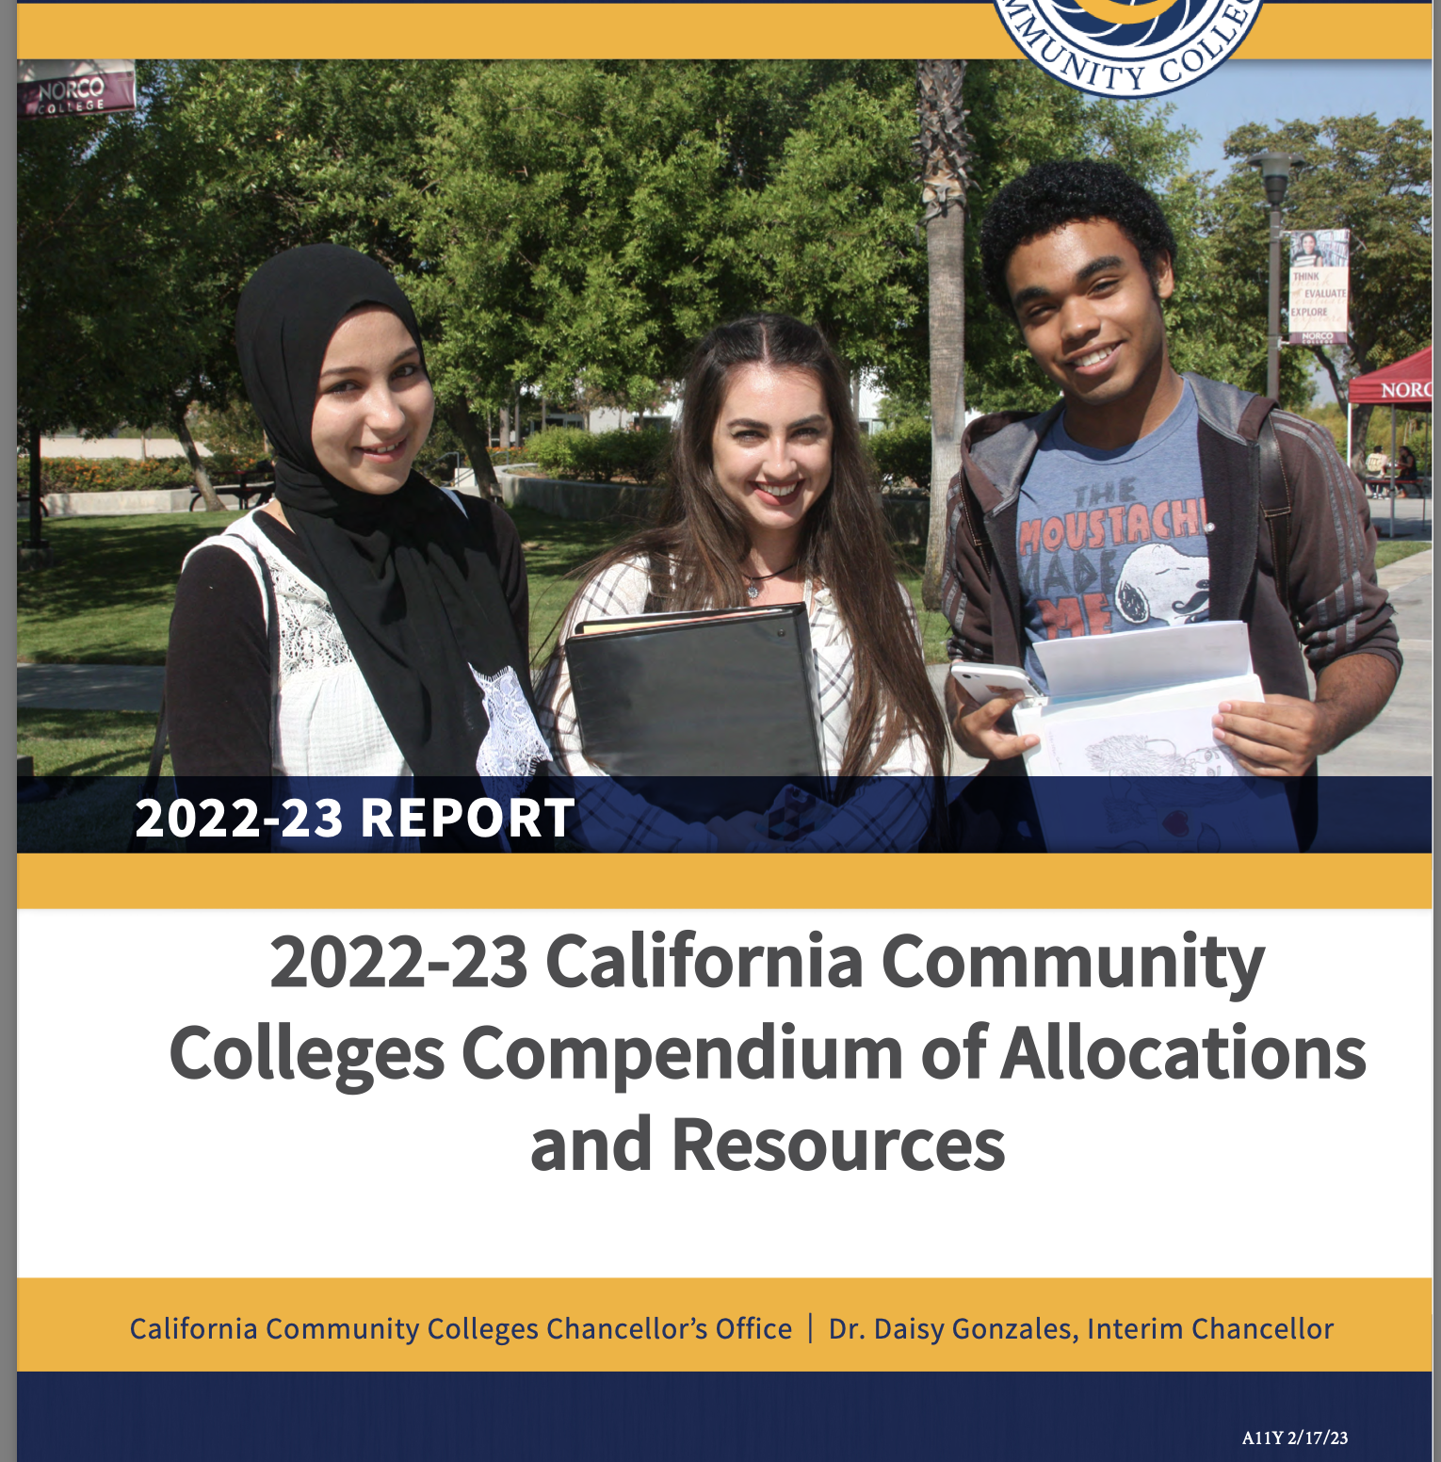
Resources & Key Readings
Rostrum article: “10 Noncredit Instruction in Guided Pathways Efforts”
•ASCCC Noncredit Instruction - Copies available today!
Budget - Noncredit (Adult Ed) ONLY:
•California Adult Education Program (CAEP) –local/district funds for operations, course and program development, college transitions, equipment
•Workforce Innovation and Opportunity Act, Title II (federal funds) – ESL, VESL, Citizenship, Adult Basic Education, Adult Secondary, and integrated CTE and ESL; course and program development, professional development, equipment, literacy
•Strong Workforce Program (SWP) – local SWP fund distribution determined at college/district level; regional funds open for NC Short-term Vocational programs; NC outcomes generate college SWP funding
•Student Equity and Achievement Program (SEAP) – college/district determination for distributing SEAP funds tied to equity populations and achievement
•Perkins - CTE Noncredit enrollments and activities support allocation; Recent 22-23 Supplementary Allocation opportunity for NC course to address gaps
California
https://www.cccco.edu/-/media/CCCCO-Website/College-Finance-and-Facilities/BudgeEnt-News/2022-23-Compendium-of-Allocations-and-Resources/2022-23-compendium-of-allocations-resources-a11y.pdf?la=en&hash=12A26009701B3AA7033A3B233C334AB60BD9CE75

Slide 11
CTE Emerging Topics

Slide 12
Questions for the Panel?

Slide 13
Reflection
What are the successes of CTE and/or Noncredit at your college?
What are the challenges?
What is the one thing you wish others knew about being a CTE or Noncredit faculty?

Slide 14
Thank You!
ONLINE PROGRAM and MAP
Use this QR code
Any questions?
Email info@asccc.org
Lunch Table Questions
What have you done at 5 years old that you will still enjoy at 85 years old?
If you could be any profession (other than your current one), what would it be?
Who has influenced you the most in the past year and why?
If you could meet anyone, living or dead, who would it be and why?
What is your favorite song or TV show and why?
If you had a day all to yourself, what would you do?

Slide 15
Closing Session
CTE and Noncredit Regional Meeting
March 20, 2023 at Compton College

Slide 16
Session Description
Don’t Leave Us Yet: Let’s
wrap it up! Join us for this
closing session where we will
share resources and
opportunities for leadership,
empowerment, and voice.

Slide 17
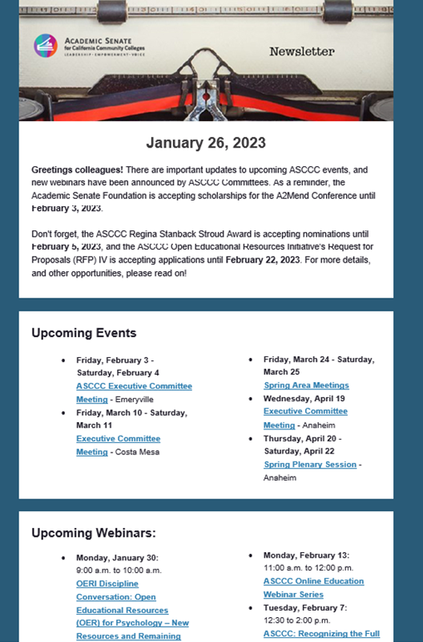
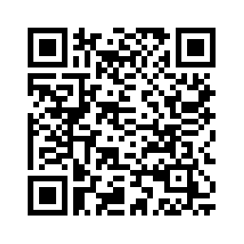
ASCCC Newsletter
Sign up for ASCCC Newsletter

Slide 18
Additional Resources/Opportunities
Sign up for ASCCC Official Listerservs
ASCCC Local Senate Handbook
Make sure your local senate has identified liaisons to ASCCC (check for your college on ASCCC College Directory):
A CTE Liaison
A Noncredit Liaison
Need to add or update? Have your local senate president email directoryupdate@asccc.org
ASCCC Local Senate Visits

Slide 19
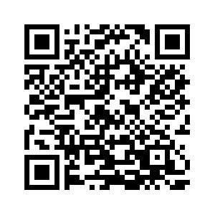
Consider Signing up for ASCCC Service
Volunteer to Serve on an ASCCC Committee
Online Application

Slide 20
Thank You!
On behalf of the ASCCC CTE Leadership Committee and the ASCCC Noncredit, Pre-Transfer & Continuing Education Committee
Any questions?
Email: info@asccc.org
Notes:
On behalf of the ASCCC CTE Leadership Committee and the ASCCC Noncredit, Pre-Transfer & Continuing Education Committee

