Slide 1
Regular and Substantive Interaction in Oral Communication and Laboratory Science
Anna Bruzzese, South Representative Geoffrey Dyer, Online Education Committee Chair Julie Oliver, Cosumnes River College

Slide 2
Today’s Topics
Updates to Title 5 §§ 55200-55208
Regular & Substantive Interaction/Regular & Effective Contact
DE Addendum
Oral Communication Courses Online
Lab Science Courses Online
Notes:
Anna

Slide 3
Why Offer Courses Online?
To give students access to courses that will fit into their schedules
To allow students who are geographically far from colleges to enroll
Don’t we do almost everything online now?
To provide students with opportunities
Notes:
Ask Participants to Provide Answers First (Anna)

Slide 4
What happens when we exclude GE requirements?
Creates barrier for students who seek to complete their degree fully online
Ultimately a local decision—faculty expertise must be honored
Notes:
Ask Participants to Provide Answers First (Anna)

Slide 5
Regulations & Definitions

Slide 6
Title 5 §§ 55200-55208
ASCCC Resolution 6.08 S18 “Support for Changes to Title 5 § 55200-55210” endorsed proposed changes
Reviewed and Approved by Board of Governors, Sept. 2018
Notes:
Geoffrey

Slide 7
Title 5 §§ 55200-55208
“traditional classroom courses” replaced with “in person classes”
Instructors prepared to teach in DE
Separate Course Approval: Addendum specifies:
How course meets requirements for regular and effective contact
How course materials are ADA/508 compliant
Regular and Effective Contact
“either synchronously or asynchronously”
“correspondence” [This is consistent with Code of Federal Regulations §600.2]
Notes:
Geoffrey

Slide 8
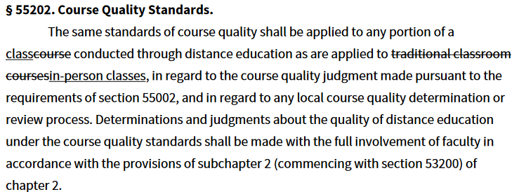
Classes
Notes:
Geoffrey

Slide 9
Instructors
Notes:
Geoffrey

Slide 10
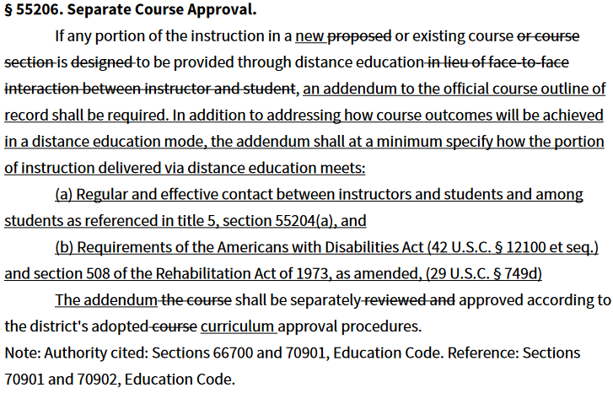
Separate Course Approval
Notes:
Geoffrey

Slide 11
Instructor Contact
Notes:
Geoffrey

Slide 12
Regular & Substantive Interaction / Regular & Effective Contact
“Regular & Substantive Interaction” used in Code of Federal Regulations to distinguish between distance education and correspondence courses.
“Regular & Effective Contact” used in Title 5 §§ 55204, 55206
Updated language excludes “correspondence”
Notes:
Geoffrey

Slide 13
Regular & Substantive Interaction / Regular & Effective Contact
Ensuring an Effective Online Program: A Faculty Perspective attempts to synthesize these terms and guidance around them
consistent and predictable
faculty-initiated
interactions with students about the course content and about more than just a boilerplate assessment of student work
Notes:
Geoffrey

Slide 14
Regular & Effective Contact
Academic & Professional Matter
How courses provide regular & effective contact must be specified in DE addendum, per updated Title 5 Langauge
Notes:
Geoffrey

Slide 15
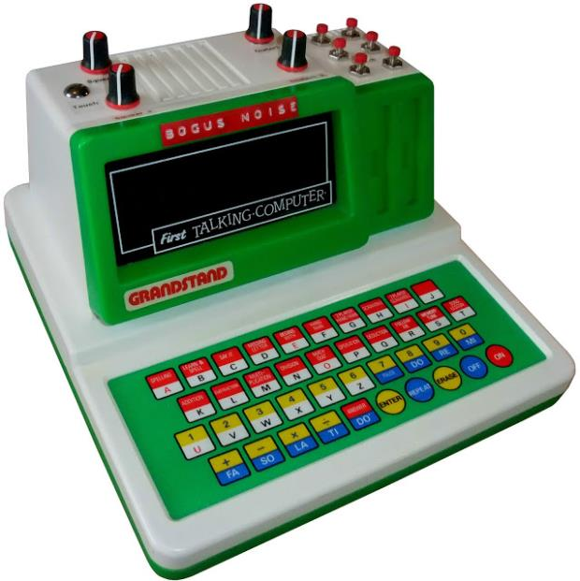
Oral Communication & Lab Science Courses Online
Image: Matrixsynth
Notes:
Julie

Slide 16
Oral Communication & Lab Science Courses Online
Historically, fewer courses satisfying these GE requirements online than in many other disciplines
Resolutions 9.03 S18 and 9.04 S18 direct ASCCC to gather information from discipline experts regarding effective and promising practices in courses meeting these requirements
Notes:
Julie

Slide 17
CSU Executive Order 1100
Aug, 2017
“3.2 Instructional Modality
GE requirements may be satisfied through courses taught in all modalities (e.g., face-to-face, hybrid, or completely online). Pursuant to California Education Code Section 66763, an online course shall be accepted for credit at the student's home campus on the same basis as it would be for a student matriculated at the host campus.”
Notes:
Julie

Slide 18
Satisfying the CSU A1 Oral Communication Requirement Online
CSU Guiding Notes for GE Course Reviewers:
“faculty-supervised, faculty-evaluated oral presentations in the presence of others (physically or virtually)
course outlines should be very specific regarding methods of instruction and methods of evaluation
student presentations will be made either in front of faculty or other listeners, or in online environments ...”
Notes:
Geoffrey

Slide 19
Satisfying the CSU A1 Oral Communication Requirement Online
CSU Guiding Notes for GE Course Reviewers:
“. . . rhetorical principles must be included and specified in the course outline (for example, the study of effective communication in formal speeches or social interaction would be appropriate)
courses must require students to speak their own words, not recite words written by others
Interpersonal communications and debate courses are not a natural fit”
Notes:
Geoffrey

Slide 20
Presentations in the Presence of Others
Faculty have used the following approaches:
Synchronous presentation to classmates using web conferencing software
Speech before live, in-person audience (such as a school, church, or business group) recorded by video and submitted to instructor
Speech recorded by video and uploaded for class to review
Other ways to meet requirement?
Notes:
Ask group if they believe this meets requirements in CSU guiding notes . . . (Geoffrey)

Slide 21
Online Oral Communication Survey
Survey Sent to Field on October 3
141 Responses from communication faculty
Notes:
Geoffrey

Slide 22
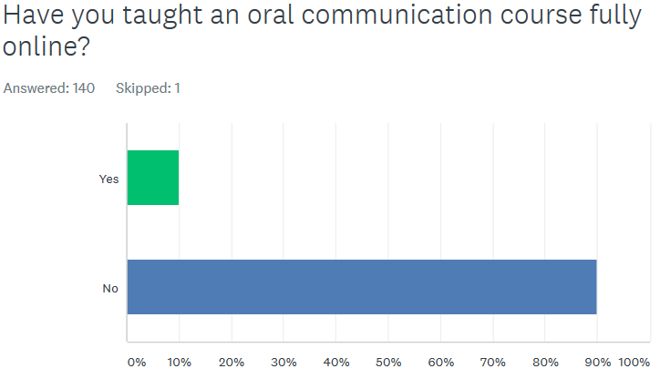
Online Oral Communication Survey
Notes:
Geoffrey

Slide 23
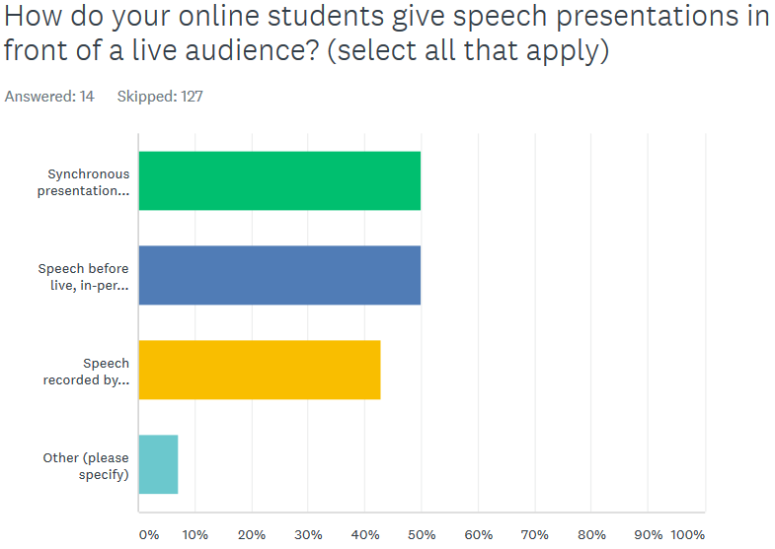
Online Oral Communication Survey
Notes:
Geoffrey

Slide 24
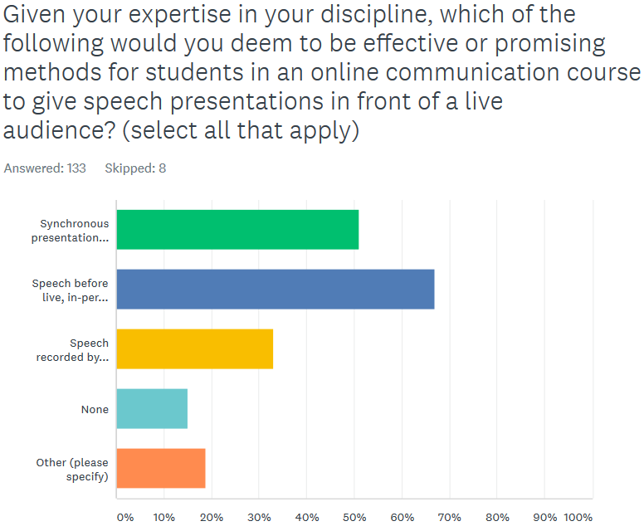
Notes:
Geoffrey

Slide 25
Online Oral Communication Survey
Broad range of narrative responses addressing:
Specific content concerns:
Adapting to audience feedback and interference
Conquering fear of public speaking
Requiring class to evaluate uploaded videos
Leveraging hybrid modality
Interpersonal/Small Group Comm and Speech & Debate Courses
Specific technologies: YouSeeU, Google Hangouts
Concerns about captioning and accessibility of student-generated videos
Need for physical interaction
Stalwart objections & supporting narrative responses
Notes:
Geoffrey

Slide 26
Meeting the B3 Lab Science Requirement
Ensuring an Effective Online Program: A Faculty Perspective notes that:
“State apportionment requires faculty supervision of student work, and as such all labs taught in the distance education modality, including online, must include faculty supervision and regular and effective contact.
Faculty must be diligent in the curriculum development and review process to ensure that this contact occurs when all courses are approved for online education, but particularly for laboratory classes.
While in some fields online labs are currently considered pedagogically unsound, particularly in the natural sciences, experimentation with online labs is occurring in many fields where such instruction would have been once considered impossible, and as such it behooves faculty to remain familiar with the pedagogy around online instruction.”
Notes:
Julie

Slide 27
Conducting Online Science Labs
Which science lab courses might it be appropriate to have in an online format?
What techniques would be considered best practices in an online lab course?
ASCCC Online Lab Science Survey asking these questions.
Notes:
Julie

Slide 28
Big Takeaways
Offering Courses Online Remains a Local Decision and is an academic and professional matter (CCR §55206)
Distance Education Addendum must specify how courses provide regular and effective contact and meet accessibility requirements
CSU Guiding Notes require specific information on COR for GE courses

Slide 29
Resources
Ensuring an Effective Online Program: A Faculty Perspective
Notes:
Julie

Slide 30
Thank You!
Anna Bruzzese, bruzzeaa@piercecollege.edu
Geoffrey Dyer, GDyer@taftcollege.edu
Julie Oliver, OliverJ@CRC.losrios.edu

