Slide 1
REVAMPING THE RECRUITMENT PROCESS TO ATTRACT DIVERSE FACULTY
Mayra Cruz, Area B Representative ASCCC
Michelle Bean, At-Large Representative ASCCC
Robin Allyn, Miracosta College, ASCCC Equity & Diversity Action Committee
Manjit (Manny) Kang, Evergreen College, ASCCC Faculty Development Committee
Leigh Anne Shaw, Skyline College, ASCCC Equity & Diversity Action Committee
Faculty Development Committee
Notes:
Intro team and thank each member.

Slide 2
Session Outcomes
Participants will
Explore issues with attracting and hiring ethnically and racially diverse faculty
Discuss recruitment processes and strategies to share with their campus hiring committees
Understand the use of modern technology and social media to attract ethnically and racially diverse faculty
Notes:
Session description: Inclusive marketing and recruitment strategies are key to increasing an ethnic and racial diverse pool. This session will focus on successful marketing processes and recruitment strategies.

Slide 3
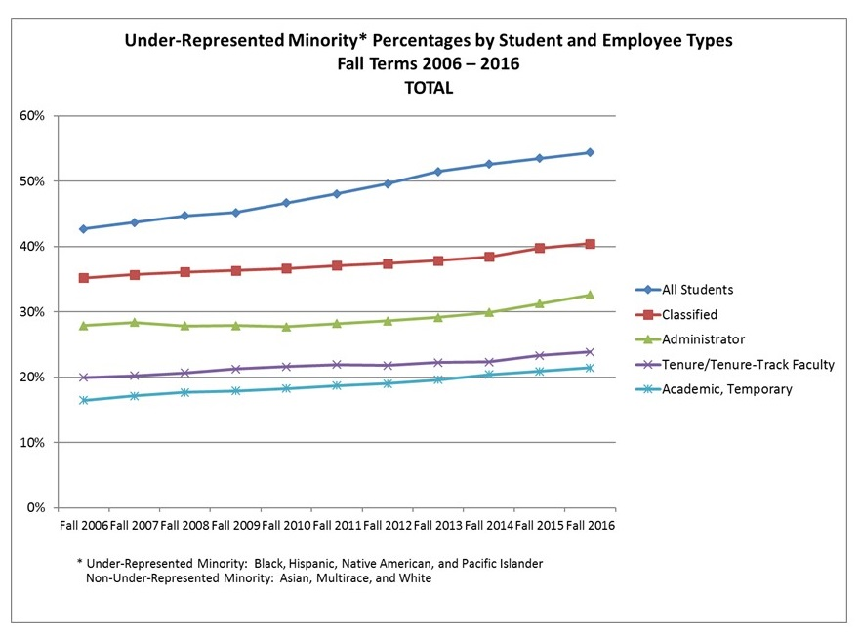
Why are we doing this?
Notes:
While the majority of our student population in California is Latinx, African American, Asian American, Native Hawaiian and Pacific Islanders, there are stark differences in representation across classified staff, faculty and leadership
Emphasize that we are talking first about racial and ethnic diversity because it the area we see the greatest disparity. That does not mean that other forms of diversity are not important, just not the focus of this effort today.

Slide 4
Elbow Discussion:
Why is it so difficult for colleges to attract and hire faculty of color?
Notes:
4 min Elbow discussion - 1-2 minutes discussion; large group 1-3 ideas

Slide 5
Common Myths: Why colleges don’t attract, hire, and retain Faculty of Color
Myth #1: Lack of qualified faculty of color in pool means lack of faculty of color getting degrees
Reality: The pipeline is not the problem
2014-2015: 758,708 Masters degrees conferred
325,602 went to faculty of color (42.9%)*
*Source: National Center for Education Statistics 2014. Certificates and Degrees Conferred by Race/ Ethnicity. https://nces.ed.gov/programs/coe/pdf/coe_svc.pdf

Slide 6
Common Myths: Why colleges don’t attract, hire, and retain Faculty of Color
Myth #2: Face-to-face hiring might be biased, but paper-screening by faculty committee is blind
Reality: Implicit bias exists in all stages of a screening process
Study* of emails sent to professors by “prospective students” with conspicuously white or nonwhite names
67% of faculty responded
Far greater number of responses to white-sounding names than to non-white sounding names
*Source: Chugh, Milkmen, Akinola. 2014. Professors are Prejudiced, too. New York Times. May 9, 2014. https://www.nytimes.com/2014/05/11/opinion/sunday/professors-are-prejudiced-too.html

Slide 7
Common Myths: Why colleges don’t attract, hire, and retain Faculty of Color
Myth #3: Campuses who don’t have a lot of students of color don’t need FOC
Reality: The goal is not to match a quota of FOC to SOC, but to create a more equitable teaching and learning experience
Study* showed equity gaps reduced up to 50% in classes taught by FOC
*Source: Fairlie, Robert W., et al. “A Community College Instructor Like Me: Race and Ethnicity Interactions in the Classroom.” The American Economic Review, vol. 104, no. 8, 2014, pp. 2567–2591. JSTOR, www.jstor.org/stable/42920900.

Slide 8
Inclusion of Diverse Voices and Experiences in Hiring
Makes faculty groups more knowledgeable, sensitive, efficient, creative, and successful
Affords rich opportunities to respond more effectively to the challenges of society that require multiple perspectives and broad approaches to complex problem-solving¹
Notes:
Increased diversity (in its broadest sense, i.e., gender, ethnicity, national origin, age, sexual orientation, disability, religious and socioeconomic background) affords groups rich opportunities to respond more effectively to the challenges of society that require multiple perspectives and broad approaches to complex problem-solving¹

Slide 9
Framework for Increasing Faculty of Color
How are you presenting your college?
Making an institutional commitment to equity
http://skylinecollege.edu/aboutskyline/mission.php
Creating equity-minded job announcements with
A district values statement on diversity
College’s minority-serving status
Clear statements of intent to hire a diverse faculty
Specific competencies related to equity listed in the desired qualifications
Equity statements required from candidates
Use of equity-focused language instead of deficit-focused language
Notes:
Internships and how to use them to recruit faculty of color.

Slide 10
Language Matters
Use of equity-focused language instead of deficit-focused language
Happy Valley College seeks ethnically diverse faculty to help close achievement gaps with minority and nontraditional students.
Lovely Valley College seeks a diverse faculty to join a team committed to transformative education and social justice for a diverse student body.
Notes:
Illustrate differences in how colleges end up perpetuating deficit thinking instead of transforming it.
Address implicit bias in recruitment that unconsciously may happen in the language used on applications.
•Identify the bias
Unconscious Bias (UB) or Conscious Bias (CB)
• By understanding & managing UB, open up larger pool of potential talent for faculty recruitment
Conscious Bias (CB)
•Perceptions about individual/group on conscious level –Preference for working with younger vs. older, men vs. women
How to mitigate the bias
•Realize biases inherent in all ethnic, racial, and cultural groups
•Transform college faculty culture
•Slow down and focus to reduce “just do it ”
•Bring to light deeply-seated biases
•Systematically de-bias
•Create initiatives to mitigate practices

Slide 11
Types of language
Deficit-minded language
At-risk/high need
Underprepared/ disadvantaged
Untraditional/non-traditional
Underprivileged
Learning styles*
Achievement gap
*if assuming that someone with X learning style is somehow “other”
Notes:
Equity mindedness language to build a common language. Language for recruitment, language for the job announcement, language for the interview questions and other components of the hiring process

Slide 12
Types of Language Continued
Diversity language
Diversity/diverse
Underrepresented/underserved
Multicultural
Students of color
Minority-Serving Institutions

Slide 13
Types of language Continued
Equity-minded language
Racial/ethnic equity
Hispanic Serving Institutions (HSI)
Predominantly Black Institution
Ethnicity
Latino/Latina/Latinx
African-American/Black
Native American
Culture/cultural appreciation
Culturally relevant/responsive pedagogy
Social Justice

Slide 14
Framework for Increasing Faculty of Color
What’s happening in your hiring process?
Interrogating bias in the hiring process
Recognize human susceptibility to bias and assumption
Use inclusive vs. exclusive practices
Create diverse hiring committees
Use a rubric with specific evaluation criteria (e.g., “mentions work with minoritized or underserved populations” or “demonstrates cultural competence”)
Prioritize multiple measures to balance resume and experience
Allow sufficient time to review all applicant materials
Allow individual review before whole committee debriefing; avoid “groupthink”
Be able to defend every decision to accept or reject
Notes:
Inclusive vs. exclusive: Being open to candidates from schools not well-known, or with limited experience.

Slide 15
Framework for Increasing Faculty of Color
What’s happening in your hiring process?
Disrupting inequitable hiring practices
Challenge traditional notions of “merit” and “fit”
Work relentlessly to achieve buy-in
Listen for comments in committee that indicate bias
Take responsibility for addressing it teachably
Ask questions to help the person reflect on the comment
Challenge resistance by shifting focus and reframing conversations
Q: “Does this mean we can’t hire white men?”
A: “Our focus is on increasing student success, not on hiring a quota.”
Transform fears of lowering standards into opportunities to reshape campus culture
Notes:
Comments that indicate bias: “I don’t think s/he would fit in here.” “He doesn’t have enough experience.” “I’ve never heard of her university - is that a real degree?” “Why did it take him/her so long to get through a grad program?”
Fears of lowering standards: “Does hiring FOC mean hiring someone without required experience or MQs?”

Slide 16
Framework for Increasing Faculty of Color
How welcoming and supportive is your campus culture?
Creating a campus culture that supports diversity
Invest in training for deans on issues faculty of color face
Hire faculty of color in cohorts to combat isolation
Create a supportive onboarding and peer mentoring process
Support creation of affinity groups where faculty of color can network with other faculty of color
Identify and disrupt “organizational silence” which prevents people from speaking up
Notes:
Unsupportive dean language: “Don’t take it personally.” “Everyone has to be treated equally.”

Slide 17
Discussion
What strategies have you used to recruit ethnically & racially diverse faculty?
Notes:
Call/Response format
Facilitators record responses.

Slide 18
Recruitment and Outreach
Proactive outreach for applicants to achieve racial and ethnic equity
Professional development of departments’ faculty and administrators
Review of the Diversity Statement
Is this a strong diversity statement?
Demonstrate sensitivity in working with students and staff of diverse racial, ethnic, academic and socio economic backgrounds, sexual orientation, and disabilities by showing respect for differences and the dignity of others.
Self-test to discover own biases https://implicit.harvard.edu/implicit/takeatest.html
Notes:
Recuitment
Proactive outreach for applicants to achieve racial and ethnic equity
Professional development of departments’ faculty regarding how to best search, attract, and retain diverse faculty
Strong Diversity Statement (this could be an activity- look for a weak statement in which participants could revised with stronger equity minded language- racial and ethnic equity, cultural relevant pedagogy
Self-test to discover own biases https://implicit.harvard.edu/implicit/takeatest.html
Cultivating potential candidates²
Generate a large and diverse pool of candidates
Publicize the position among ethnic, racial and cultural groups
Periodically review and discuss practices for building a pool
Periodically review the job description
- Ask participants to add other ways to cultivate potential candidates
Use of technology and social media (Manny to search and add)
D. Implicit Bias in the recruitment & marketing process (3-4 short points)
Identify the bias
How to mitigate the bias

Slide 19
Recruitment and Outreach Continued
Cultivating potential candidates
Generate a large and diverse pool of candidates (includes full time and part time faculty)
Publicize the position among ethnic, racial, and cultural groups (Hispanic Association for Colleges and Universities, The Journal of Black in Higher Education, Diverse Issues in Higher Education & Diverse Academia)
Periodically review and discuss practices for building a pool

Slide 20
Recruitment and Outreach Continued
Use of technology and social media
Online College Faculty job marketing can be more effective by advertising on college websites in a more prominent location (home page) as well as CCC Registry and Higher Ed
Social Media Networks: LinkedIn, Facebook, Twitter, Youtube
Mobile applications

Slide 21
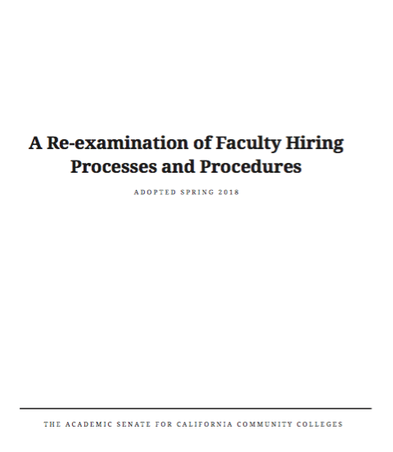
Recruitment & Outreach
https://asccc.org/sites/default/files/Hiring_Paper.pdf
Notes:
Page 13 Targeting related-discipline departments at other colleges that have large populations of historically underrepresented groups.
Working with national organizations that represent historically underrepresented groups to develop further postings. Working with local regional consortia, industry, and other organizations to promote teaching in the community college system to potential faculty in career technical elds. Advertising in a variety of locations that increase the likelihood of reaching the most diverse pool of potential candidates possible. Connecting with discipline specific organizations representing historically underrepresented groups.

Slide 22
Notes:
Fuzzy clear cards- Participants will write on an index card a
Takeaway (side of the lines) and a Fuzzy/Wonders/Questions (back of the index card)

Slide 23
For more information contact:
Mayra Cruz, Area B Representative ASCCC
cruzmayra@deanza.edu
Michelle Bean, At-Large Representative
mbean@riohondo.edu
Robin Allyn, Miracosta College, Equity & Diversity Advisory Committee‎
rallyn@miracosta.edu
Manjit (Manny) Kang, Evergreen College, ASCCC Faculty Development Committee
Manjit.Kang@sjcc.edu ‎ ‎‎
Leigh Anne Shaw, Skyline College, ASCCC Equity & Diversity Action Committee
shawl@smccd.edu

Slide 24
Resources
Aldemaro Romero Jr.. March 2017 Best Practices for Recruiting and Retaining Diverse Faculty for Institutions of Higher Education. Council of Colleges of Arts and Sciences, Committee on Cultural Diversity.
https://www.ccas.net/files/public/Publications/Best%20Practices%20CCAS_March%202017_FINAL.pdf
Guidelines for MAA Selection Committees: Avoiding Implicit Bias
https://www.maa.org/sites/default/files/pdf/ABOUTMAA/avoiding_implicit_bias.pdf
Stewart, Abigail & Valian Virginia. Recruit Diverse and Excellent New Faculty. Inside Higher Ed.: July 2018.
https://www.insidehighered.com/advice/2018/07/19/advice-deans-department-heads-and-search-committees-recruiting-diverse-faculty

Slide 25
Resources
Morgan, John. January 2019. Trying to “De-Bias” Faculty Recruiting
https://www.insidehighered.com/news/2019/01/31/new-effort-britain-tries-remove-bias-faculty-recruiting?utm_source=Inside+Higher+Ed&utm_campaign=bb4c6705ef-DNU_2019_COPY_01&utm_medium=email&utm_term=0_1fcbc04421-bb4c6705ef-198507429&mc_cid=bb4c6705ef&mc_eid=362e78a4c4
A Re-Examination of Hiring Policies and Procedures. Spring 2018: ASCCC.
Center for Urban Education. (2017) Institute on Equity in Faculty Hiring at Community Colleges Toolkit. Los Angeles, CA: Rossier School of Education, University of Southern California.

Slide 26
Thank You!

