Slide 1
RUNNING A SENATE MEETING BY ZOOM DURING A STATE OF EMERGENCY
Geoffrey Dyer, ASCCC Area A Representative
Ingrid Greenberg, San Diego Continuing Education
Jeffrey Hernandez, East Los Angeles College
April 3, 2020

Slide 2
INTRODUCTION
Many local academic senates are meeting remotely via Zoom or will need to meet remotely via Zoom during the COVID-19 emergency.
Senate leaders find themselves tasked with responding to 10+1 issues related to crisis, while adhering to the Brown Act, and for many—learning to use Zoom for the first time.

Slide 3
TOPICS
Agenda Setting
Special, Emergency, and Regular Meetings
Teleconference Requirements of EO N-29-20
Zoom Basics
Practical Considerations
How to Avoid Zoom Bombing

Slide 4
AGENDA SETTING & TYPES OF MEETINGS

Slide 5
Set Agenda & Prioritize Accordingly
Does the meeting need to happen?
Do special concerns need to be addressed in light of the emergency?
What business can or should be postponed?
Will members have sufficient bandwidth for meeting of regular duration?
Can agenda be compressed?
Is a special or emergency meeting appropriate?

Slide 6
Special & Emergency Meetings
Pressing matters may require additional meetings outside of the normally scheduled academic senate meeting calendar.
Special meetings, per the Brown Act, require 24 hours notice
Emergency meetings, subject to certain applicable criteria, require only 1 hour notice

Slide 7
Special Meetings – 24 Hours
A special meeting may be called by the presiding officer or by a majority of the members of a legislative body.
Written notice of the special meeting must be posted and sent at least 24 hours in advance to each member of the legislative body and to each local newspaper and radio or TV station that has requested notice in writing.
The body may only consider business identified in the notice (no urgency item additions).

Slide 8
Emergency Meetings – 1 Hour
An emergency meeting may be called with one hour advance notice to media outlets.
An emergency is limited to “a work stoppage, crippling activity, or other activity that severely impairs public health, safety, or both, as determined by a majority of the members of the legislative body.” -GC Section 54956.5
The one hour notice requirement is waived for “dire emergencies.”

Slide 9
Regular Meetings with Teleconference
By now, many California Community Colleges have continued their business according to their regular schedules but are meeting remotely via Zoom.
Governor Newsom’s Executive Order N-29-20 makes it easier for academic senates to conform to the Brown Act during the COVID-19 pandemic
EO N-29-20 waives certain requirements of Brown Act for duration of emergency but leaves most in place

Slide 10
Highlights of Executive Order N-29-20
Notes:
*Use Zoom poll here with this question: Did you participate in the ASCCC Webinar on Governor’s Eos and the Brown Act Yesterday? Answer Choices: Yes/No

Slide 11
EO N-29-20 Highlights
Signed by Governor Gavin Newsom March 17
Supersedes requirements in N-25-20 (March 12, 2020) specific to Brown Act
Requires advertisement and implementation of procedure to provide accommodations and resolve accessibility requests
Requires the legislative body provide notice to public regarding how public can observe and comment

Slide 12
EO N-29-20 Highlights
Waives all Brown Act requirements that require physical presence
Directs legislative bodies to “maximize transparency and provide the public access to their meetings”
Only applies “during the period in which state or local public health officials have imposed or recommended social distancing measures”

Slide 13
PHYSICAL PRESENCE
Waives all requirements “expressly or impliedly requiring the physical [emphasis mine] presence of members, the clerk, or other personnel of the body, or of the public”

Slide 14
GUIDING PRINCIPLES of EO N-29-20
“All state and local bodies are urged to use sound discretion and to make reasonable efforts to adhere as closely as reasonably possible to the provisions of the Bagley-Keene Act and the Brown Act, and other applicable local laws regulating the conduct of public meetings, in order to maximize transparency and provide the public access to their meetings.”

Slide 15
EO N-29-20 Specifically Suspends:
Any otherwise applicable requirements that
(i) state and local bodies notice each teleconference location from which a member will be participating in a public meeting;
(ii) each teleconference location be accessible to the public
(iii) members of the public may address the body at each teleconference location
(iv) state and local bodies post agendas at all teleconference locations (v) at least one member of the state body be physically present at the location specified in the notice of the meeting*;
(vi) during teleconference meetings, at least a quorum of the members of the local body participate from locations within the boundaries of the territory over which the local body exercises jurisdiction
*This suspension is a reversal of a condition in the previous N-25-20

Slide 16
Accessibility Requirements
If a local legislative body or state body holds a meeting via teleconferencing and allows members of the public to observe and address the meeting telephonically or otherwise electronically, the body shall also:
Implement a procedure for receiving and swiftly resolving requests for reasonable modification or accommodation from individuals with disabilities, consistent with the Americans with Disabilities Act and resolving any doubt whatsoever in favor of accessibility; and
Advertise that procedure each time notice is given of the means by which members of the public may observe the meeting and offer public comment . . .

Slide 17
Accessibility Procedure
Your local senate should already have a means of providing alternative versions of agendas, materials, and minutes per Government Code sections 54953.2, 54954.1, 54954.2, and 54957.5.
Zoom provides closed captioning resources, which include real-time transcription by an assigned panelist, and third-party closed-captioning through integrated API
Teleconference meetings should not be conducted in such a manner as to exclude individuals with disabilities.
EO N-29-20 requires legislative bodies using teleconference technology to IMPLEMENT a procedure for SWIFTLY resolving requests for accommodations and ADVERTISING the procedure EACH TIME notice is given of the means for the public to participate
Err on the side of caution

Slide 18
Same Rules Apply for Posting Agendas
The timeframes and means of posting agendas required by the Brown Act are still in effect.
Except to the extent this Order expressly provides otherwise, each local legislative and state body shall:
(i) Give advance notice of the time of, and post the agenda for, each public meeting according to the timeframes otherwise prescribed by the Bagley-Keene or the Brown Act, and using the means otherwise prescribed by the Bagely-Keene Act or the Brown Act, as applicable . . .

Slide 19
Advertising Changes in Comment or Accessibility Procedure
EO N-29-20 allows that if agendas have already been posted which do not state the means by which the public can observe/comment or state the accessibility procedure (or in cases of agendas posted prior to the order), the legislative body may advertise the means by using “the most rapid means of communication available at the time” including “posting such means on the body’s internet site.”

Slide 20
Sample Notice
Notice is Hereby Given That Pursuant to Executive Order N-29-20 the Happy Valley Academic Senate will meet on April 6, 2020 via Zoom Conferencing.
Consistent with Executive Order N-29-20, members of the Happy Valley Academic Senate may participate remotely by Zoom video conferencing using the link above or by calling in to the meeting at (123) 456-7891 Webinar ID: 111 222 333
Consistent with Executive Order N-29-20 and Government Code sections 54953.2, 54954.1, 54954.2, and 54957.5, the Happy Valley Academic Senate will provide to individuals with disabilities reasonable modification or accommodation including an alternate, accessible version of all meeting materials. To request an accommodation, please contact expert@happyvalley.edu or call (222)444-6666
Members of the public wishing to comment on an agenda item or other topic within the purview of the Happy Valley Academic Senate will be given the opportunity via Zoom or may submit commentary to helper@happyvalley.edu

Slide 21
Zoom Basics

Slide 22
Get CCC Confer Zoom Pro Account
Do you have a ZOOM PRO account? Sign up for Free! https://cccconfer.zoom.us/
Make sure to use CCC Confer link above
If you have an existing, non CCC Confer Account:
You may not have all of the pro features
You may experience a delay in having your CCC Confer Zoom activated
Plan for this accordingly
Access ZOOM:
Sign into ZOOM at: https://cccconfer.zoom.us/signin or
Download and sign in with the ZOOM app at: http://cccconfer.zoom.us/download

Slide 23
Schedule a Meeting
Meeting options:
Allow join before host: Allows participants to join the meeting without you or before you join. TURN OFF FOR PUBLIC MEETINGS.
Mute Participants Upon Entry: Automatically mute all participants when they join the meeting. The host controls whether participants can unmute themselves. TURN ON FOR PUBLIC MEETINGS.
Use Personal Meeting ID: Check this if you want to use your Personal Meeting ID. If not selected, a random unique meeting ID will be generated. DO NOT USE FOR PUBLIC MEETINGS
Record the meeting automatically when launching Zoom session: Check this if you want the meeting to be automatically recorded. Select if you want it to be recorded locally (to your computer) or to the cloud.
Registration: Select this option to require participants to provide their full name and email address prior to joining the meeting.
Recurring meetings: Use the same join URL for daily, weekly, monthly meetings. Select “No Fixed Time” to meet with the same group and use the same URL, regardless of meeting date and time.
Invite participants:
After you schedule a meeting, select “Copy the Invitation” or just copy the Join URL. If participants are joining via the app, they will only need the member ID (numbers in the URL). Example: https://cccconfer.zoom.us/m/3795642508

Slide 24
Features
Mute/Unmute: This allows you to mute and unmute your microphone.
Start/Stop Video: This allows you to start and stop your own video.
Invite: Invite others to join your meeting.
Manage Participants: This opens up the Participants window. Here you can Mute all of your participants!!! You can also make another participant a host.
Polling: This allows you to create, edit, and launch your polls.
Share Screen: Click on this to start a screen share. You will be able to select the desktop or application you want to share.
Chat: Access the chat window to chat with the participants.
Record: Start or stop a cloud or local recording.
Closed Caption: If you have enabled closed captioning for your account, click here to access the closed caption options.
Breakout Rooms: Start multiple breakout rooms.
End Meeting: This will end the meeting for all participants. If you want to have the meeting continue, you should give another participant host control (in Manage Participants) before leaving the meeting.

Slide 25
Annotate

Slide 26
Video Recording and Closed Caption Transcripts
Local download: Record your meeting video and audio locally to a computer to later upload to a file storage website such as Dropbox or Google Drive and/or a public streaming server such as YouTube or Vimeo.
Cloud recording: Record your meeting to the cloud before or during your meeting. Video, audio, and chat text will be immediately sent to you in an email and can also be managed from your Zoom account at https://cccconfer.zoom.us/signin
Audio transcripts: Turn on. Zoom automatically creates audio transcripts of recorded Zoom meeting, but needs several days. Transcripts can be easily edited, but plan time for it. Transcripts can be shared with a link

Slide 27
Practical Considerations

Slide 28
Respect Your Academic Senate Members’ Needs
Remember that we are in a state of emergency. Consider addressing self-care through an agenda item, by presenting resources, or including a check-in item.

Slide 29
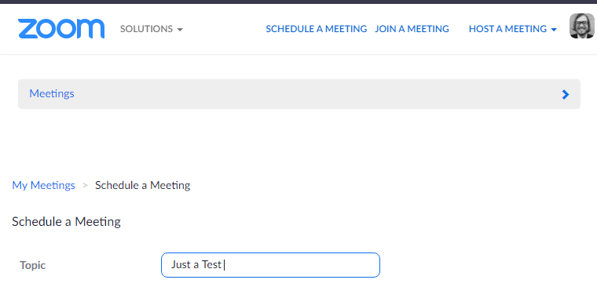
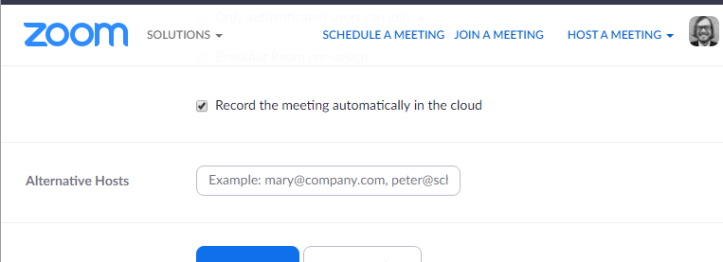
Designate Someone Else to Operate Zoom
So that you can chair the meeting effectively, consider asking someone else to host the zoom meeting and/or monitor the chat.

Slide 30
Consider How You Will Facilitate Conversation
If you have a relatively small academic senate/committee, you may feel comfortable letting everyone mute/unmute themselves (Multiple people who are unmuted can create feedback and an echo effect)
If you have a larger group, you or your designated host may want to control who can speak when
Use Hand Raise Tool, comments in chat, or physical hand-raising (if all participants’ video is enabled) to determine que and unmute.

Slide 31
Ways to Incorporate Public Commentary
Remember that per EO N-29-20, however the public will be allowed to observe and make public comment must be noticed each time the agenda is posted.
Consider using chat and/or providing a member’s email address if member can monitor during meeting and report at designated point in agenda
Meeting can be recorded, and chat can be viewed by all in teleconference (if “private chat” is disabled in settings), making chat a place to not only create a que but also to comment

Slide 32
Roll Call Votes
All votes in a teleconference meeting of a legislative body must be by roll call (GC 54953)

Slide 33
Consent Agenda
Since some find it more difficult to participate uninterrupted in Zoom meetings than in-person meetings, and since all have additional pressures and stresses related to COVID-19, consider using a consent agenda for non-controversial agenda items that may not require discussion or debate.
Assigning multiple items to consent agenda can save time, but you will still need a roll call vote to approve consent agenda because of GC 54953
If members ask to have items pulled from consent, vote on those items individually per your adopted rules, but still use
roll call.

Slide 34
Practical Consideration
Don’t expect your first Zoom meeting to run perfectly and don’t be too hard on yourself if it doesn’t.

Slide 35
AVOID ZOOM BOMBING

Slide 36
Zoom Bombing
Avoid Zoom Bombing by managing participants carefully. Specifically:
Mute participants upon entry (in user or meeting settings)
Manage screensharing carefully
“6 Tips to Deter Zoom-bombers in Times of Disruption”—Google Doc by Michelle Pacansky-Brock
“How to Keep the Party Crashers from Crashing Your Zoom Event”—Zoom Blog
“How to Avoid the Zoom Bomb”—Sable Cantus, CISSP

Slide 37
Resources
California Government Code, sections 54950-54693. The Ralph M. Brown Act. California Legislative Information.
Executive Department, State of California. “Executive Order N-29-20.” 17 Mar. 2020
“Getting Started with Closed Captioning.” Zoom.
Julius, Jim. “Zoom Tips for MiraCosta Faculty”—Spring 2020 Google Doc
“March 23, 2020.” ASCCC COVID-19 Faculty Resources. –[Concise summary of current Brown Act issues]
O’Hare Anderson, Eileen. “Governor Newsom Amends Brown Act Changes in Subsequent Executive Order.” Liebert Cassidy Whitmore. 20 Mar. 2020
Velasquez Bean, Michelle and Jake Knapp. “The Brown Act: Making the Process Work for You.” ASCCC. 14 jun. 2019

