Slide 1
Faculty Role in Institutional Planning as it Relates to Strategic Enrollment Management Thursday April 20, 2023 | 10:45am – 11:45am | Online

Slide 2
Session Description
Declining enrollment has impacted almost every district in our community college system. Local and statewide efforts are being made to increase enrollments while addressing challenges that impact student preparation and success. Join this session as representatives from the RP group will share SEM research and resources while we discuss the important role for faculty voice and collaboration throughout. An update on the ASCCC Enrollment Management Revisited paper will be provided.

Slide 3
Introductions
Presenters:
Michelle Barton, RP Group Stephanie Curry, ASCCC Area A Representative Christopher Howerton, ASCCC North Representative Michelle White, RP Group
Notes:
Take turns introducing ourselves and roles, our experience with SEM?

Slide 4
Questions we hope to answer for you today
What exactly is Strategic Enrollment Management and impact on planning?
Why the emerging focus on SEM?
What are some SEM tools and resources?
What is the faculty and academic senate role in these conversations?
What’s new in the updated ASCCC Enrollment Management Paper (developed by ASCCC Education Policy Committee) that is being considered during this plenary?
Notes:
Christopher – Preview Presentation

Slide 5
What is SEM and SEM’s Purpose ?

Slide 6
What is SEM?
Strategic Enrollment Management (SEM) is a holistic concept and a process that enables the fulfillment of an institution’s mission and its students’ educational goals
Definition adapted from: Bontrager, B., and K. Pollock. 2009. Strategic enrollment management at community colleges. Applying SEM at the Community College. Washington, DC: American Association of Collegiate Registrars and Admissions Officers.

Slide 7
How do we put the S in SEM?
What makes strategic enrollment management strategic?
How is SEM different than enrollment management?
Notes:
We can open the chat or ask participants to unmute and share their ideas.

Slide 8
Changing Nature of SEM
Core Purpose
Optimize Enrollment
Promote Student Success
Ensure Fiscal Viability
Quality and Relevant Programs
Equitable Access and Outcomes
Data-rich Environment
Communications and Marketing
Collaboration
Notes:
Based on the IEPI SEM Purpose Statement
Within California Community Colleges, SEM is a shared responsibility. Student success is
central to all related planning, practices, and processes. The purpose of SEM is to:
Establish comprehensive student enrollment goals that are aligned with the college’s mission and strategic plan.
Promote student success by improving access, engagement, persistence, and completion.
Ensure fiscal stability and viability by optimizing enrollments and integrating SEM into the college financial planning, budgeting, and allocation processes.
Offer quality and relevant programs with clear educational pathways, course offerings, and appropriate student support.
Implement strategies that lead to equitable access and outcomes.
Create a data-rich environment to inform decisions and evaluate strategies.
Design and implement communications and marketing with internal and external stakeholders to increase understanding of SEM and to meet SEM goals.
Increase collaboration among departments across the campus to support the enrollment program.

Slide 9
Why is this Important Work?

Slide 10
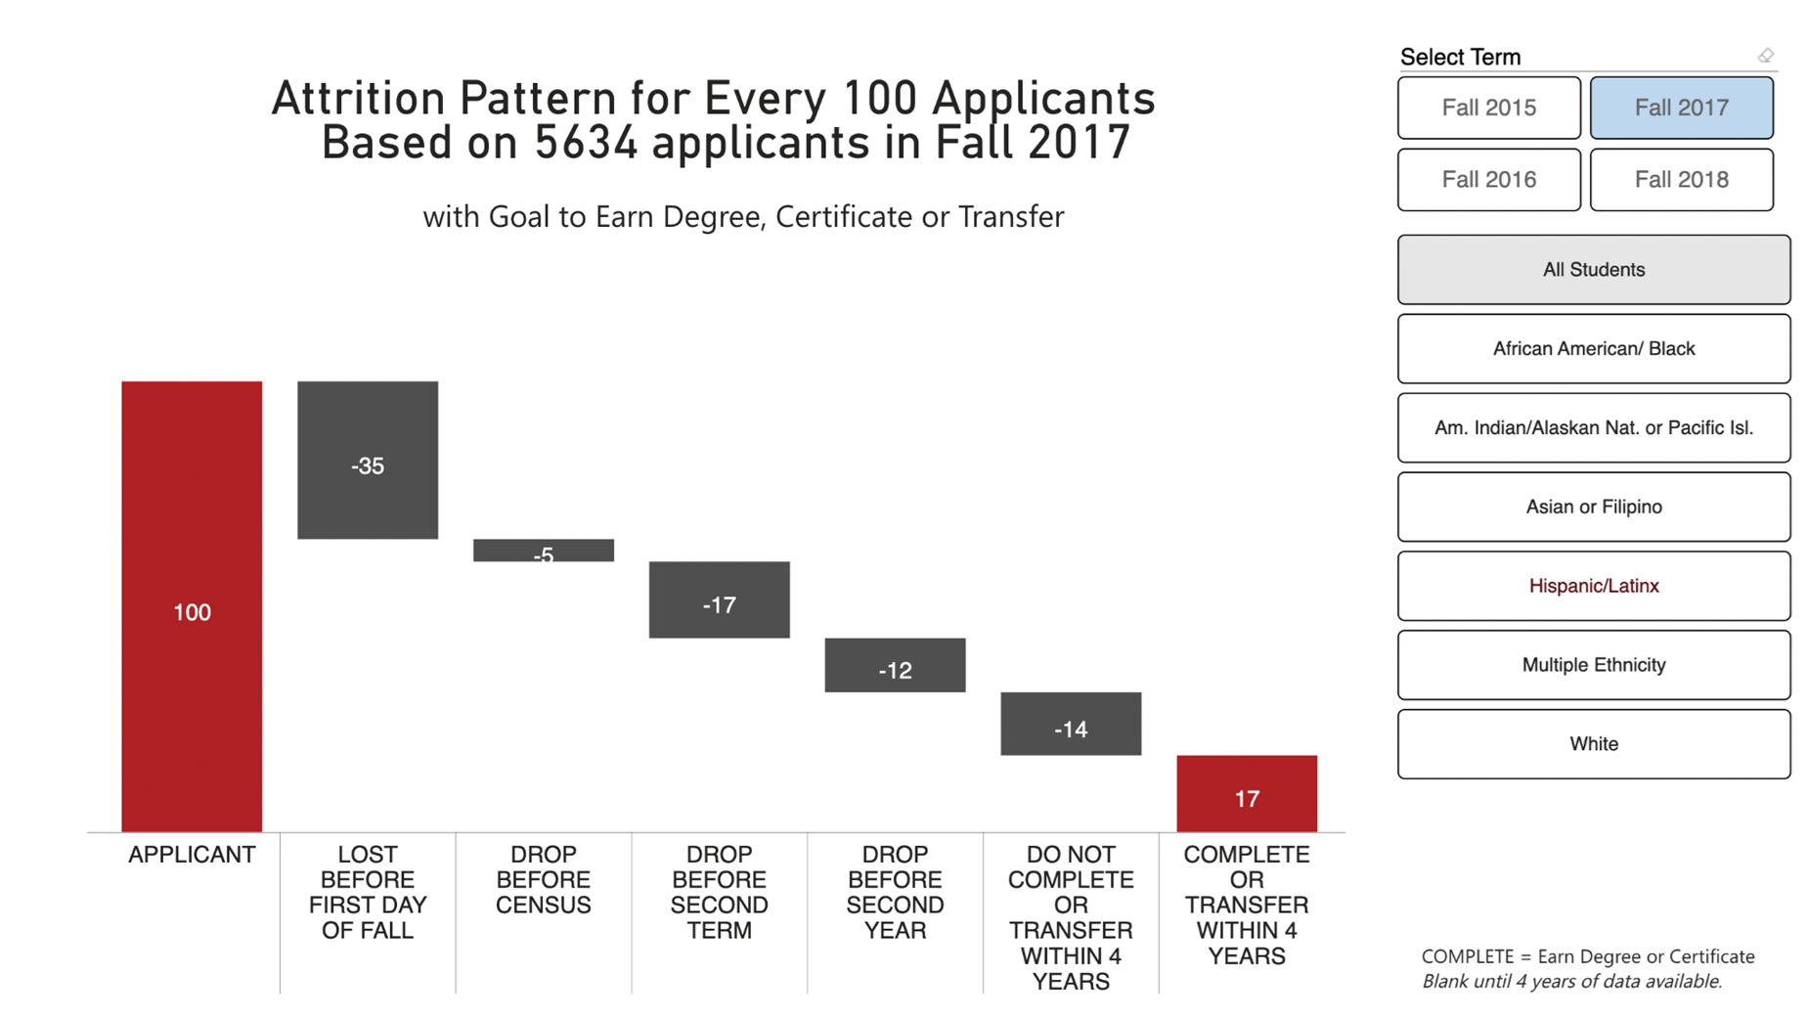
Attrition Pattern for Every 100 Applicants
Notes:
Slides 5-6 (James)
11:08-11:13
Emphasize student journey and 17 completions by the end

Slide 11
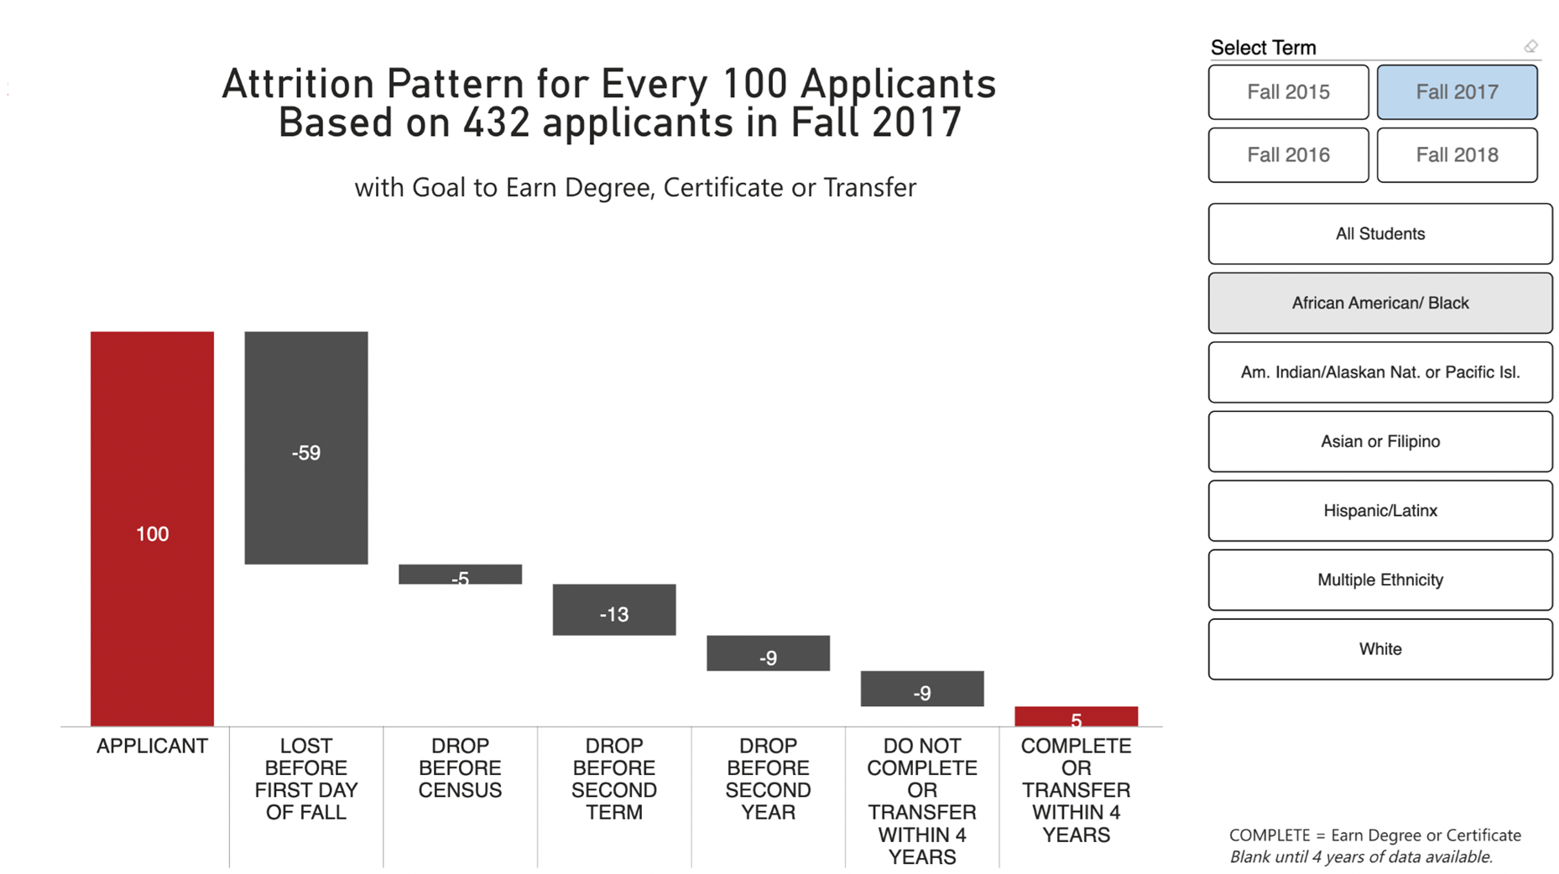
Attrition Pattern for Every 100 Applicants
Notes:
Done by 11:13

Slide 12
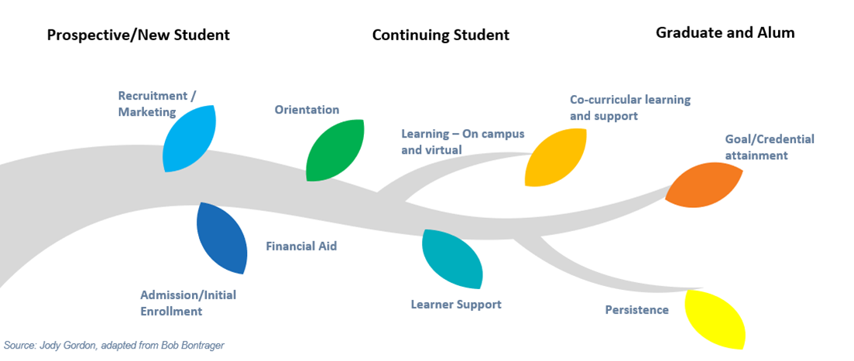
Holistic Approach to the Student Learning Journey

Slide 13
What about Planning & Support ?

Slide 14
Big Picture:
Institutional Planning and SEM
Strategic, Strategic Enrollment, Guided Pathways, and Equity Plans
Integrated
Data Guided
Student Enrollment Groups of Focus
Adult Learners
New First-time students
Equity groups
Other?

Slide 15
SEM and the Classroom/Student Support
What are some of the strategies and practices we are currently doing or could start now locally to support retention and persistence?
Classroom strategies to support student sense of belonging?
DEI in Curriculum
Reflecting on data from our own classes/programs
Professional Development
Academic Support and other Support Services?
Are they siloed, or is there connection and opportunity for synergy?
Early Alert Programs and other intervention programs?
How are support services presented?
Other ways?
Notes:
Christopher
From IEPI
Support & Services – Wrap around support services that promote student success
Scalable strategies and interventions that improve student success and completion outcomes
Examples “todo list”
ask for some examples from the participants

Slide 16
SEM Community of Practice & Other Resources
CCC CoP | Strategic Enrollment Management Community of Practice
Webinars
Tools and Resources
Learning Modules
Community Engagement
SEM Academy/Program
Additional Resources
Resource Guides
Promising Practices
Integration Crosswalks
SEM Institutional Self-Assessment

Slide 17
What is the Faculty and Academic Senate Role in SEM Work

Slide 18
Where do we see SEM in contact with the 10+1?
Title 5 §53200 (c) "Academic and professional matters" means the following policy development and implementation matters:
(1) curriculum, including establishing prerequisites and placing courses within disciplines;
(2) degree and certificate requirements;
(3) grading policies;
(4) educational program development;
(5) standards or policies regarding student preparation and success;
(6) district and college governance structures, as related to faculty roles;
(7) faculty roles and involvement in accreditation processes, including self-study and annual reports;
(8) policies for faculty professional development activities;
(9) processes for program review;
(10) processes for institutional planning and budget development; and
(11) other academic and professional matters as are mutually agreed upon between the governing board and the academic senate.
Notes:
Open discussion? Ask for input of examples?

Slide 19
Faculty and Senate Role in SEM Discussions
The academic senate is the official voice of faculty in academic and professional matters, and as such, should take the faculty lead in enrollment management policy discussions.
Title 5 and Education Code both codify a rationale for faculty participation vis `a vis the academic senate in identifying and prioritizing course offering
Notes:
Refer to Resolution 17.01 F18 –
Resolved, That the Academic Senate for California Community Colleges urge local academic senates to review the faculty representation on enrollment management committees to ensure broad representation, program expertise, and general education expertise; and

Slide 20
Faculty and Senate Role in SEM Discussions
Connection between 10 + 1 Areas of Curriculum, Professional Development, Student Success and Enrollment Management
Need for academic senates to review their policies and consider whether their rights, responsibilities, and roles are correctly clarified in policies and procedures.
Faculty are not the only ones with a role. Collaboration with Admin, Classified Professionals, Community Members and Students

Slide 21
Enrollment Management Revisited Again: Post Pandemic
Resolution 13.02 S23
New Recommendations
Support Professional Learning on SEM
Review data used in SEM and ensure disaggregation
Work with Admin to create emergency plans for academic interruptions
Work with Admin to support SCFF
Faculty should have access to real time data
Consult Collegially on expansion of new programs (e.g.DE, DuE, Early College)
Keep up to date with legislative change and mandates
Continuing Recommendations
Senates should create a forum to review local policies and procedures
Senates should make a case for Faculty Role in SEM
Clarify areas of SEM that should be in Senate purview.
Notes:
Stephanie
Resolution F18 17.01– Directed ASCCC to update this paper. (originally had a request to bring the paper back by Spring 2020)

Slide 22
Additional Resources
DEI in Curriculum Model Principles and Practices
IEPI ASK-SEM Organizing Framework

Slide 23
Thank You
info@asccc.org

