Slide 1
Understanding Noncredit Education for Equity and Access
ONLINE BREAKOUT SESSION
DATE/TIME: Friday, April 21 at 1:15 p.m. to 2:15 p.m.

Slide 2
SESSION DESCRIPTION
Join this session to hear our noncredit students' stories as they claim their place. Hear from noncredit practitioners who will share promising practices and useful tools for how to make space that supports belonging for successful programs. Understand how noncredit education provides access and equitable pathways to help students meet their educational and career goals.

Slide 3
AGENDA
Welcome and Opening
Brief Overview
Panel Discussion
Q&A
Closing Remarks
Thank you

Slide 4
Panelists
Dr. Tina King, President, San Diego College of Continuing Education
Julia Kogan, Student Trustee, San Diego College of Continuing Education
John Bromma, President, Academic Senate, San Diego College of Continuing Education
Dr. Janue Johnson, Faculty, Noncredit Committee, San Diego Mesa College
Travon Reed, Student, East Los Angeles College
Leticia Barajas, Faculty, Noncredit Committee, East Los Angeles College

Slide 5
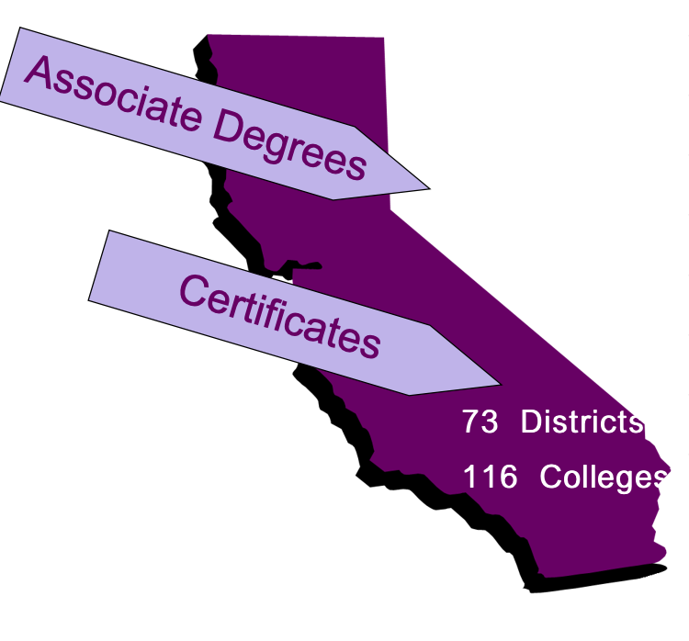
Demystifying Non-Credit
O
Open Access to Higher Education
Transfer Education
Career Technical Education
Adult/Continuing Education
Basic Skills/Remedial Education
Support Services
Economic Development
Bachelor’s Degree Program
NON-CREDIT EDUCATION

Slide 6
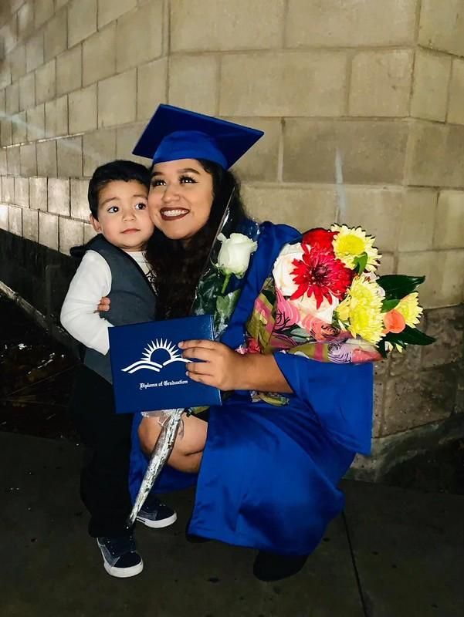
Demystifying Non-Credit
Why Non-Credit?
Free!
A focus on skill attainment, not grades
Flexible scheduling
A point of entry to 2- and 4-year colleges
Non-credit IS Guided Pathways
THE leader in transforming students’ lives.
One of the most valuable investments a person can make.
A commitment to student success and community enrichment.

Slide 7
Demystifying Non-Credit
Students with a CTE certificate earn $132,000 more over a working lifetime.
Our CTE programs contribute nearly $250 million to the regional economy.
Students earn $3.10 for every $1 they invest in their career education.
CTE supports nearly 3,000 regional jobs annually.

Slide 8
Panelist Questions
In your role how would you wish students were supported to bring awareness to non credit at your college (e.x., as senate president, as a student, as a faculty member, an administrator)
How do you actualize belonging in your respective roles?
What are your recommendations to advocate for non credit pathways at the local and statewide levels?

Slide 9
Any Questions?
Email info@asccc.org
Resources:
Noncredit paper
Rostrum articles:
How the Pandemic Impacted Noncredit Students
Demystifying the Narrative of Noncredit Education: San Diego College of Continuing Education Student Stories

