Slide 1
Mark Edward Osea, Mendocino College Erik Reese, ASCCC Area C Representative Carrie Roberson, ASCCC At-large Representative Manuel Vélez, ASCCC Area D Representative
The Disciplines List, Minimum Qualifications, Equivalency, and Assigning Courses to Disciplines Oh My!

Slide 2
Session Description
Wondering when and how to use the Disciplines List? Curious about the implications of minimum qualifications? What does equivalency even mean? Need to learn about assigning courses to disciplines? Where do Career and Technical Education or the new Ethnic Studies requirement fit in? Join us to learn about all of this and engage in lively discussion around the effective principles and practices that support student success.

Slide 3
Overview
Academic and Professional Matters
Minimum Qualifications
Equivalency
Assigning Courses to Disciplines
Disciplines List Process

Slide 4
Academic and Professional Matters
AB 1725 (Vasconcellos, 1988): From Credentials to Minimum Qualifications
Ed. Code. §87357(a)(1): Empowers ASCCC such that the BOG must “with regard to minimum qualifications for faculty, consult with, and rely primarily on the advice and judgment of, the statewide Academic Senate.”
Notes:
Important to highlight that faculty have been empowered by state law to know be the experts in determining who is qualified to be employed as faculty in the CCCs

Slide 5
Disciplines List & Minimum Qualifications
Curriculum including establishing prerequisites and placing courses within disciplines
Notes:
The discipline represent the faculty member’s assignment. The Minimum Qualifications Handbook contains all the disciplines that faculty can be hired under.
Minimum qualifications represent the degree and/or training/experience a faculty must have to have that discipline be a part of their assignment.

Slide 6
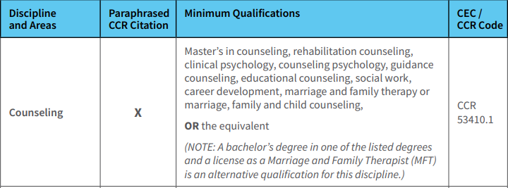
Disciplines List & Minimum Qualifications (Cont.)
Notes:
The discipline represent the faculty member’s assignment. The Minimum Qualifications Handbook contains all the disciplines that faculty can be hired under.
Minimum qualifications represent the degree and/or training/experience a faculty must have to have that discipline be a part of their assignment.

Slide 7
Equivalency
Education Code §§ 87359 and 87360, individuals who do not possess the minimum qualifications for service may be hired as faculty members if they possess “qualifications that are at least equivalent to the minimum qualifications.”
Equivalency processes at California community colleges are locally established, vary widely, and may or may not include a means for evaluating equivalency
Every district must have an equivalency process, with process, criteria, and standards by which the governing board determines that faculty possess qualifications at least equal to the minimum qualifications (Ed Code §87359).
“The process, as well as criteria and standards…shall be developed and agreed upon jointly by …the [local] governing board and the [local] academic senate” and “that the governing board relies primarily upon the advice and judgment of the academic senate” (Ed Code §87359/Title 5 §53430).
Notes:
The enactment of the Community College Reform Act, commonly known as AB 1725, in 1988 began the process of replacing the former teaching credential system in favor of a process for establishing minimum qualifications for faculty based on academic preparation in a discipline. Part of that process included the establishment of authorization to determine equivalencies to the minimum qualifications at least equal to the state-adopted minimum qualifications for a particular discipline.
Equivalency and the “agreed upon process shall include reasonable procedures to ensure that the governing board relies primarily upon the advice and judgment of the academic senate to determine that each individual faculty member employed under the authority granted by the regulations possesses qualifications that are at least equivalent to the applicable minimum qualifications”
Every district must have an equivalency process, and the determination of equivalency is the purview of the academic senate. Education Code §87359 (b) requires that “[t]he process, as well as criteria, and standards by which the governing board reaches its determination regarding faculty members shall be developed and agreed upon jointly by representatives of the governing board and the academic senate, and approved by the governing board. The agreed upon process shall include reasonable procedures to ensure that the governing board relies primarily upon the advice and judgment of the academic senate to determine that each individual faculty member employed under the authority granted by the regulations possesses qualifications that are at least equivalent to the applicable minimum qualifications specified in regulations adopted by the board of governors.”
Faculty are the legally recognized professional experts in academic and professional matters, and academic senates are granted the legal authority to recommend policies and procedures on academic and professional matters to the governing board. Professional guidance for the use of equivalence to minimum qualifications is provided in the 2016 ASCCC paper, Equivalence to the Minimum Qualifications.[3] This paper includes the principled framework of the standards to follow when using local equivalency processes. Equivalence to the minimum qualifications means equal to the minimum qualifications by a different means other than the completion of the formal education requirements stated in the faculty minimum qualifications. As such, the use of equivalency is not a substitute for meeting minimum qualifications, nor does it constitute the lowering of professional standards for faculty. Rather, it is an assessment of whether or not an applicant’s educational and/or professional background equates to the minimum qualifications for service as faculty in the California community colleges.

Slide 8
Principles for Granting Equivalency
Equivalency promotes diversity by broadening the applicant pool.
Equivalent to the minimum qualifications means equal to the minimum qualifications, not nearly equal.
Applicants must provide evidence that they have attained the breadth of coursework or experience equal to the general education component of an earned associate’s or bachelor’s degree.
Applicants must provide evidence demonstrating attainment of the skills and knowledge provided by specialized coursework required for the degree listed in the Disciplines List.
Notes:
The Academic Senate for California Community Colleges believes that faculty members must exemplify to their students the value of an education that is both well-rounded and specialized. The ASCCC has consistently supported the following basic principles for granting equivalency:

Slide 9
Principles for Granting Equivalency (Cont.)
Local hiring procedures should support applicants seeking equivalency by providing public-facing information that makes clear the…process…and provides resources to help applicants.
Faculty members exemplify to their students the value of an education that is both well-rounded and specialized and has consistently defined associate’s degree parameters. Faculty should act as models for students by demonstrating a breadth of general education knowledge and a depth of knowledge that is discipline specific.
Eminence should not be used as the sole criteria for granting equivalence (ASCCC Resolution 10.01 SP09).
No provisional or conditional equivalency should exist

Slide 10
Single Course Equivalency?
•Ed Code and Title 5 refer to qualifications in terms of disciplines not courses or subject areas within a discipline (Ed Code §87357; Title 5 §53410 and §53430).
•Legal Opinion L 03-28, Chancellor’s Office Legal Division reinforces that single course equivalency is not permitted.
•Faculty are hired to teach within disciplines and are therefore qualified to teach all courses assigned to that discipline.

Slide 11
So you know…
An applicant is either qualified to teach the full range of courses in a discipline or not, regardless of whether applying for a full-time position or a part-time position- Education Code §87359 (a)[4]
Equivalency applies to the entirety of the minimum qualifications for a discipline.
The opportunity to seek equivalency does not guarantee the right to be granted equivalency.
An applicant that meets the minimum qualifications DOES NOT guarantee either an interview nor an offer of employment to fill a faculty position.
Notes:
Education Code §87359 (a)[4] states, “No one may be hired to serve as a community college faculty ... unless the governing board determines that he or she possesses qualifications that are at least equivalent to the minimum qualifications specified” (italics added). In addition, minimum qualifications are determined for disciplines, not for courses or subject areas within disciplines. Legal Opinion L 03-28 (R. Black, 2004)[5], supports the position that “a district is not authorized to establish a single course equivalency as a substitute for meeting minimum qualifications in a discipline.”
For example, in the chemistry discipline, a person may teach courses assigned to the chemistry discipline only if he or she has a master’s degree in chemical engineering as well as a bachelor’s degree in chemistry or biochemistry.
Rather, equivalency process should guarantee that each candidate has the right to the application of the equivalency policies and procedures in a consistent, fair, and objective manner, with equivalency granted only if sufficient and conclusive evidence is provided by the candidate that he or she possesses qualifications at least equal to the minimum qualifications for the discipline.
Regardless of whether equivalency to the minimum qualifications is granted to an applicant, the process for selecting applicants to be interviewed is established through the local faculty hiring process, and the authority to hire a faculty member recommended through the hiring process is reserved for the district’s governing board.

Slide 12
CTE Minimum Qualifications Toolkit
Strong Workforce Program (2015), the Chancellor’s Office established a Career Technical Education (CTE) Minimum Qualifications Advisory Work Group to address the issue of CTE faculty qualifications.
“Increase the pool of qualified CTE instructors by addressing CTE faculty recruitment and hiring practices.
A.Clarify legislative and regulatory barriers to hiring CTE instructors who may not meet existing college hiring standards but possess significant industry experience.
B.Disseminate effective practices in the recruitment and hiring of diverse faculty and the application of minimum qualifications and equivalencies.
C.Develop pipelines to recruit community college faculty with industry expertise through collaborations with higher education, business, and industry professional organizations.
D.Establish a mentorship model that delineates pathways for industry professionals to intern at colleges to gain teaching skills, knowledge, and experience while pursuing an associate degree or an equivalent.”
Notes:
CCCCO CTE Minimum Qualifications Work Group: Academic Senate, Chief Instructional Officers, College Presidents, Human Resources, California Community College Chancellor’s Office

Slide 13
CTE Min Quals Toolkit
•Pre-planning checklist for Equivalency by Department
•Equivalency Checklist for Human Resources Departments
•Model Equivalency Committees Composition and Policies
•Information and Checklist for Potential Equivalency Applicants
•Credit for Prior Learning
Notes:
An equivalency process that expands teaching opportunities to qualified industry experts and those with substantial potential to teach.
An equivalency process that ensures that qualified people are hired as faculty.

Slide 14
Assigning Courses to Disciplines
Local senates maintain responsibility for placing courses in disciplines [Title 5 Regulations §53200(c)(1)]
All credit & noncredit courses must be placed within a discipline or disciplines
Assignment based on course content, not personnel issues, enrollment or FTE
Placement should be based on knowledge required to teach the course
Not all programs or department titles are disciplines
TOP codes are NOT disciplines

Slide 15
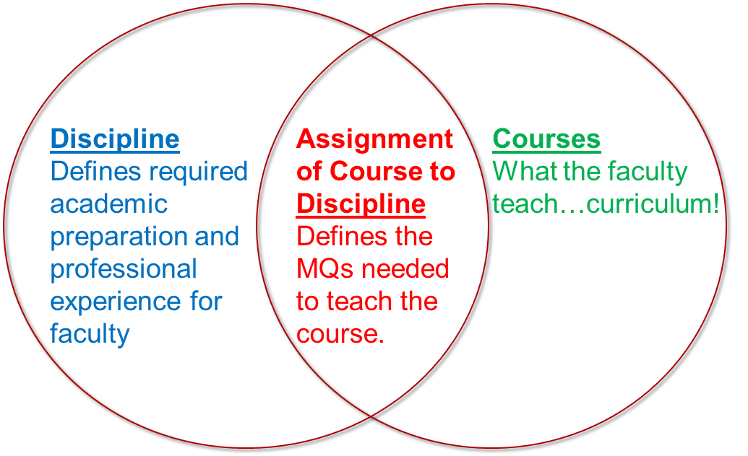
Assigning Courses to Disciplines (Cont.)

Slide 16
Options for Assigning Courses
Course assigned to a single discipline.
Example: ENGL 101 assigned to English. The minimum qualifications for English provides adequate preparation to teach the course content.
Course assigned to more than one discipline with an “or”
Example: ARTS 101 assigned to Art or Graphic Design. The minimum qualifications for either discipline provide adequate preparation to teach the course content.
Course assigned to more than one discipline with an “and”
HUMA 120 assigned to Humanities and Ethnic Studies. The minimum qualifications for both disciplines together provide adequate preparation to teach the course content.

Slide 17
Cross-listing Courses
Very little formal guidance, but transfer partners define the practice as identical course outlines of record (CORs) submitted in different disciplines.
For example, University of California course submission criteria require only one COR be offered “for courses that are ‘cross-listed’ or ‘cross-referenced’ (e.g., Psych. 10 is the same as Soc. 10)”
C-ID submission requirements refer to cross-listed courses as “same-as” and state that a cross-listed COR should be reviewed only once.
Local practices may also depend on the capabilities of the local curriculum management system (CMS) or student information system (SIS)
Standard definition of this practice requires that the CORs for each cross-listed course be identical except for the assigned subject code—e.g., SOC 10 and PSYCH 10—and the Chancellor’s Office course control number.

Slide 18
Cross-listing and Ethnic Studies
Ethnic studies, as defined by Assembly Bill 1460, is an interdisciplinary field of critical race studies that focuses on four historically aggrieved racialized groups in the United States: African Americans, Native Americans, Latinas/os, and Asian Americans.
CSU does allow for cross-listing, but it should not happen without participation of faculty from all impacted disciplines. Colleges might reach out to ethnic studies faculty from other colleges or districts if none are currently employed locally until the college can hire Ethnic Studies faculty
Not all courses that cover topics of race or social justice are considered ethnic studies!
Any pre-existing course that will be newly cross-listed with ethnic studies should be able to be taught by either the original discipline or ethnic studies faculty

Slide 19
Cross-listing Best Practices
Cross-listed courses should be identical in everything except the subject code: description, title, content, conditions of enrollment, SLOs, materials, EVERYTHING
Make sure that all appropriate teaching disciplines/minimum qualifications (MQs) are listed on both CORS
Example: PSYCH 10 and SOC 10 should each list teaching disciplines of "PSYCH or SOC" (if you say "PSYCH and SOC" the instructor needs to meet both!)
Learn how your CMS handles cross-listing and adjust local review and approval processes to ensure that the CORs are created, revised, reviewed, and approved together
Ensure that associated programs reflect both subject headings in program requirements (e.g., PSYCH 10 or SOC 10)
Ensure that your local processes include direct input and approval from discipline experts

Slide 20
Disciplines List Process
February: Disciplines list process distributed to all colleges;
September: Proposals due by September 30;
October: Proposals disseminated to colleges and discussed at Area meetings;
November: First disciplines list hearing at fall plenary session;
January/February: ASCCC Executive Committee confirms that process was followed and that sufficient evidence exists for the proposal to be debated at plenary session;

Slide 21
Disciplines List Process (Cont.)
March: Discussion at Area meetings;
April: Second disciplines list hearing at spring plenary session and vote at the plenary session on proposals via the resolutions process;
July: Submission to Board of Governors for approval, with approved updates reflected in a new version of the Minimum Qualifications for Faculty and Administrators in California Community Colleges that is distributed by the Chancellor’s Office.

Slide 22
Disciplines List Example: Ethnic Studies
Updates to the Ethnic Studies discipline is in process
Second Disciplines List Hearing occurred this morning
Tomorrow vote on the resolution that proposes:
Master’s in African American Studies, Black Studies, Africana Studies, Latino Studies, La Raza Studies, Chicana/o Studies, Asian American Studies, Native American Studies, or American Indian Studies
OR
Master’s in Ethnic Studies
OR the equivalent
DL resolutions may only be voted up or down, no amendments

Slide 23
Resources
Local Senates Handbook
Min Quals Handbook 2022
PCAH (8th ed) and Tech Manual
Some papers:
Equivalence to the Minimum Qualifications 2020
Equity Driven Systems
CTE Toolkit
Apply for statewide service

Slide 24
Questions?
info@asccc.org
Request local visits
Local senate visits
Collegiality in action visits

