Slide 1
Welcome to the Spring 2021 ASCCC Plenary Session

Slide 2
Adoption of the Procedures
It is time to adopt the procedures for the Spring Plenary Session 2021 on the Resolutions page of the Spring Plenary Session 2021 Conference website.
Is there a motion to approve?
Is there a second to the motion?
Please use the Poll feature to vote.

Slide 3
ASCCC Foundation Report Silvester Henderson, ASFCCC President

Slide 4
State of the Senate Spring Plenary 2021 Dolores Davison, ASCCC President

Slide 5
Land Acknowledgement
We begin today by acknowledging that we are holding our gathering on the land of the Nisenan Nations who have lived and continue to live here. We recognize the Nisenan Nations and their spiritual connection to the ocean and the land as the first stewards and the traditional caretakers of this area we now call Sacramento. As we begin we thank them for their strength, perseverance and resistance.
We also wish to acknowledge the other Indigenous Peoples who now call Sacramento their home, for their shared struggle to maintain their cultures, languages, worldview and identities in our diverse City.

Slide 6
This Year’s Plenary Theme
Working Collectively: Transforming and Decolonizing Institutions

Slide 7
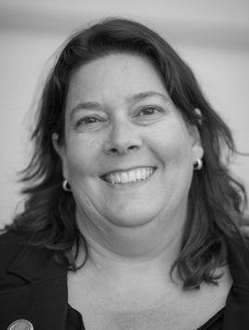
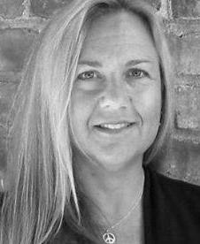
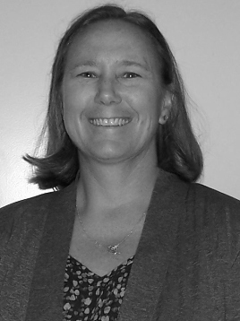
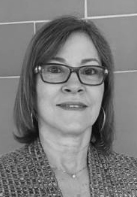
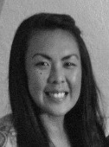
ASCCC Executive Committee 2020-21
Officers
Dolores Davison
President
Virginia May
Vice President
Cheryl Aschenbach
Secretary
Mayra Cruz
Treasurer
Krystinne Mica
Executive Director

Slide 8
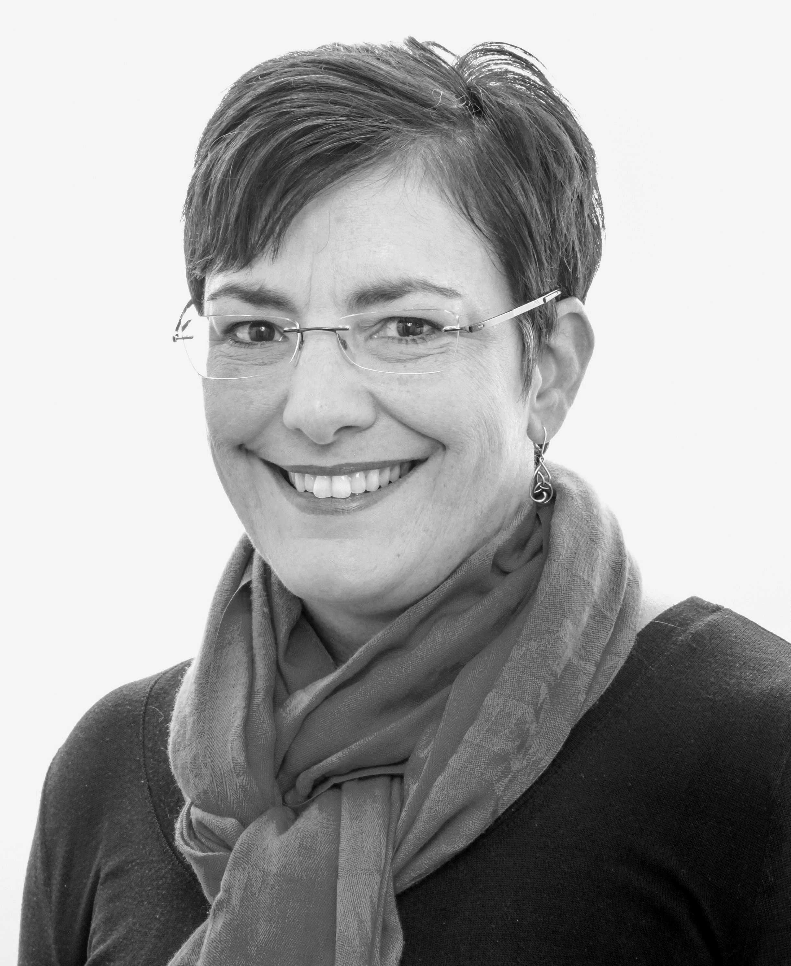
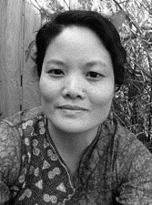
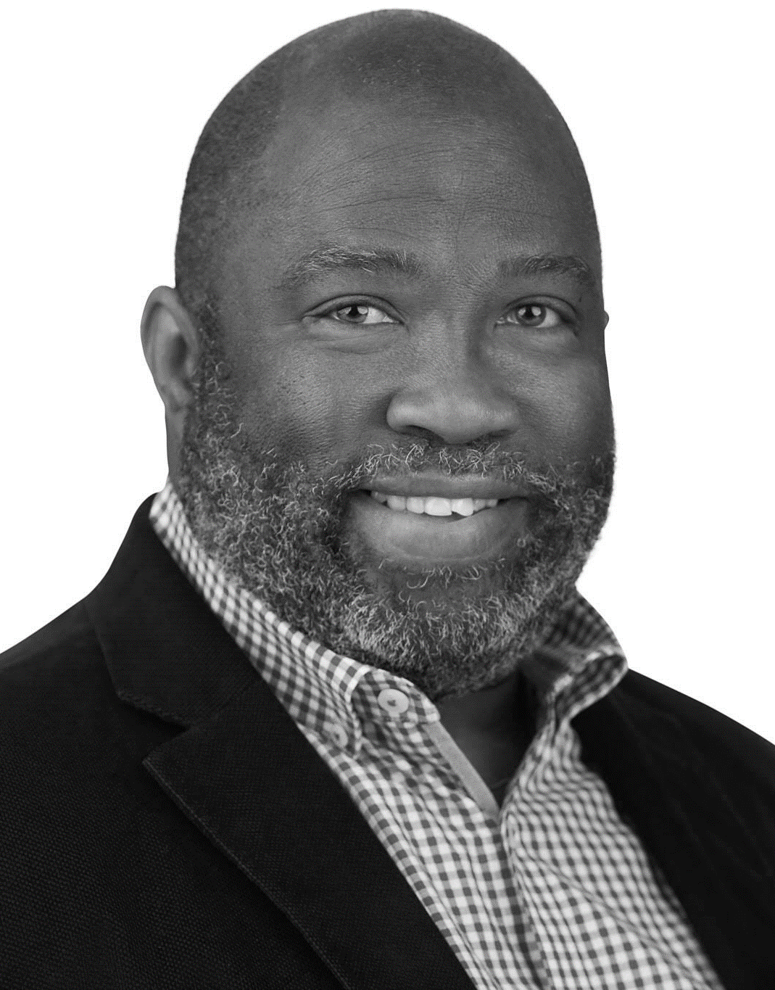
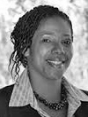
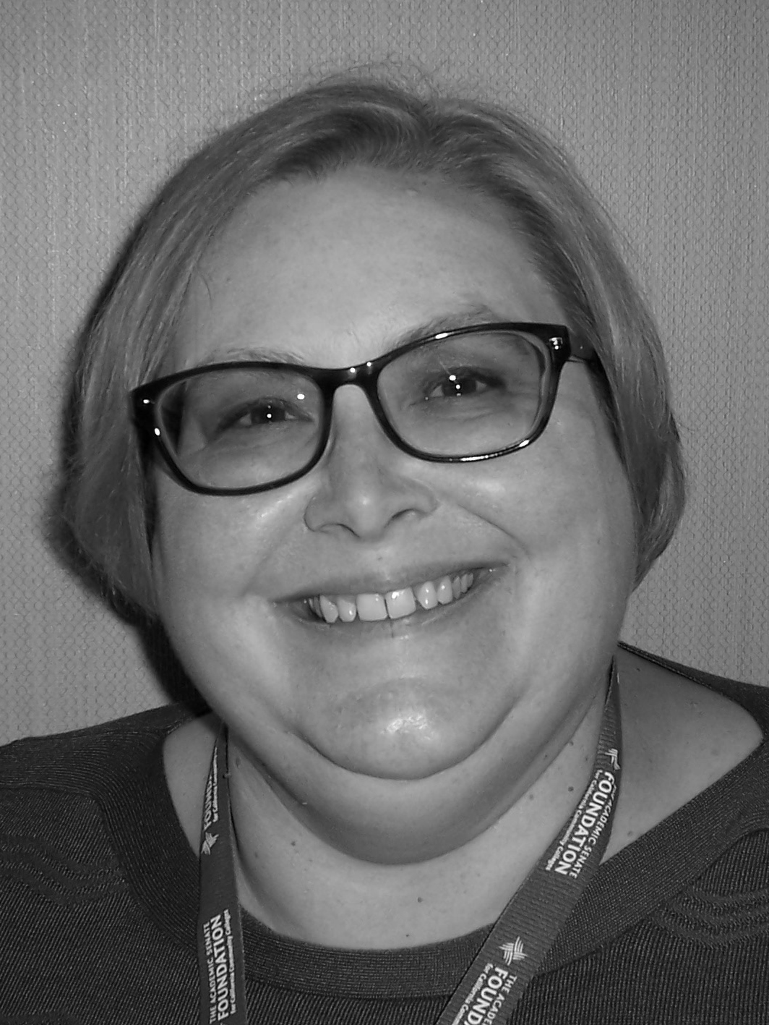
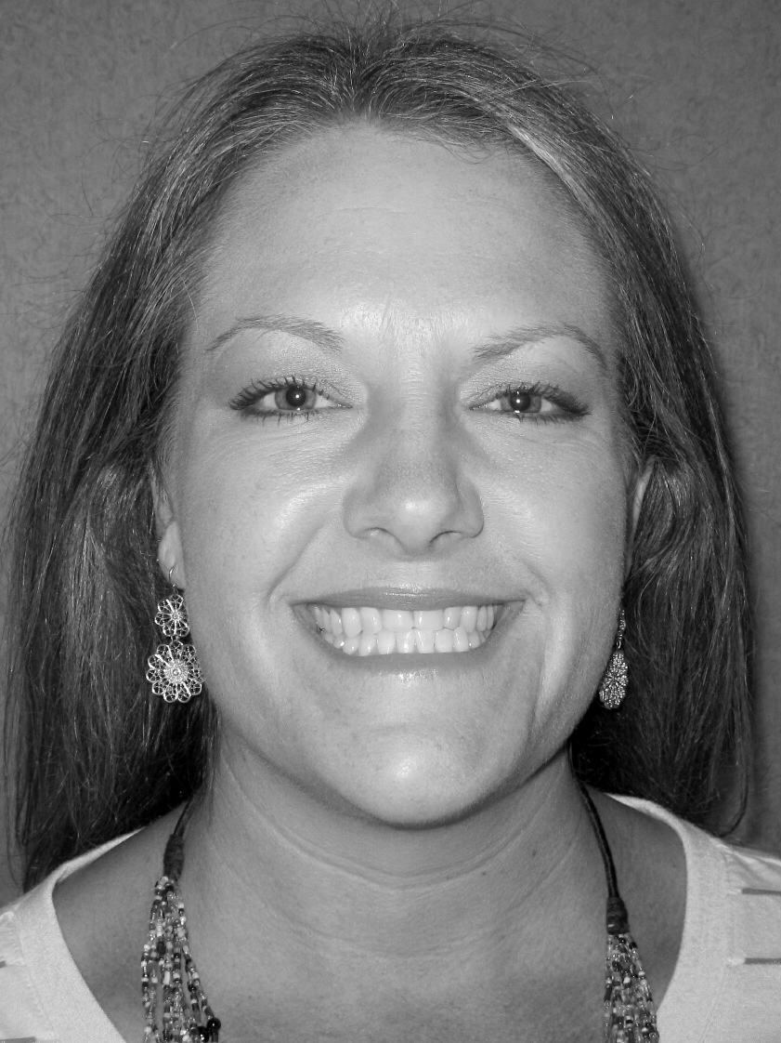
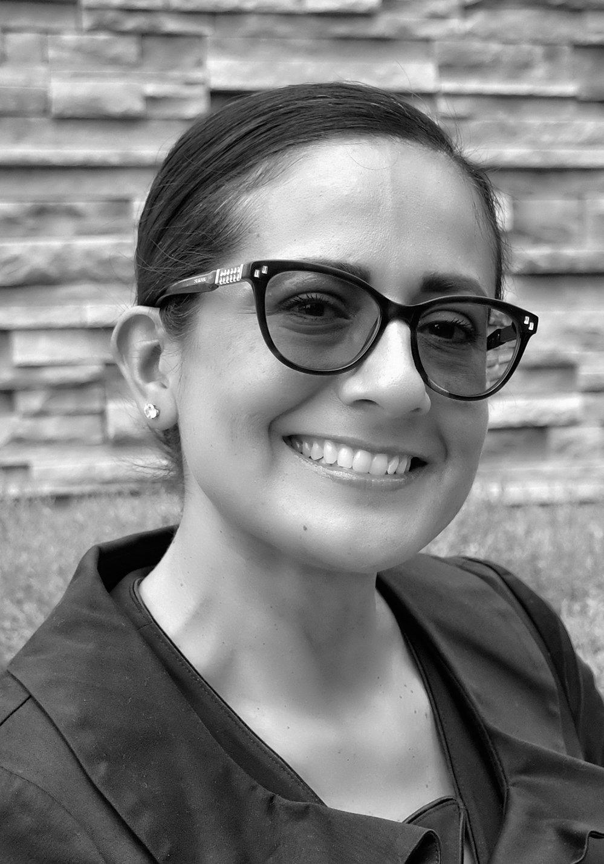
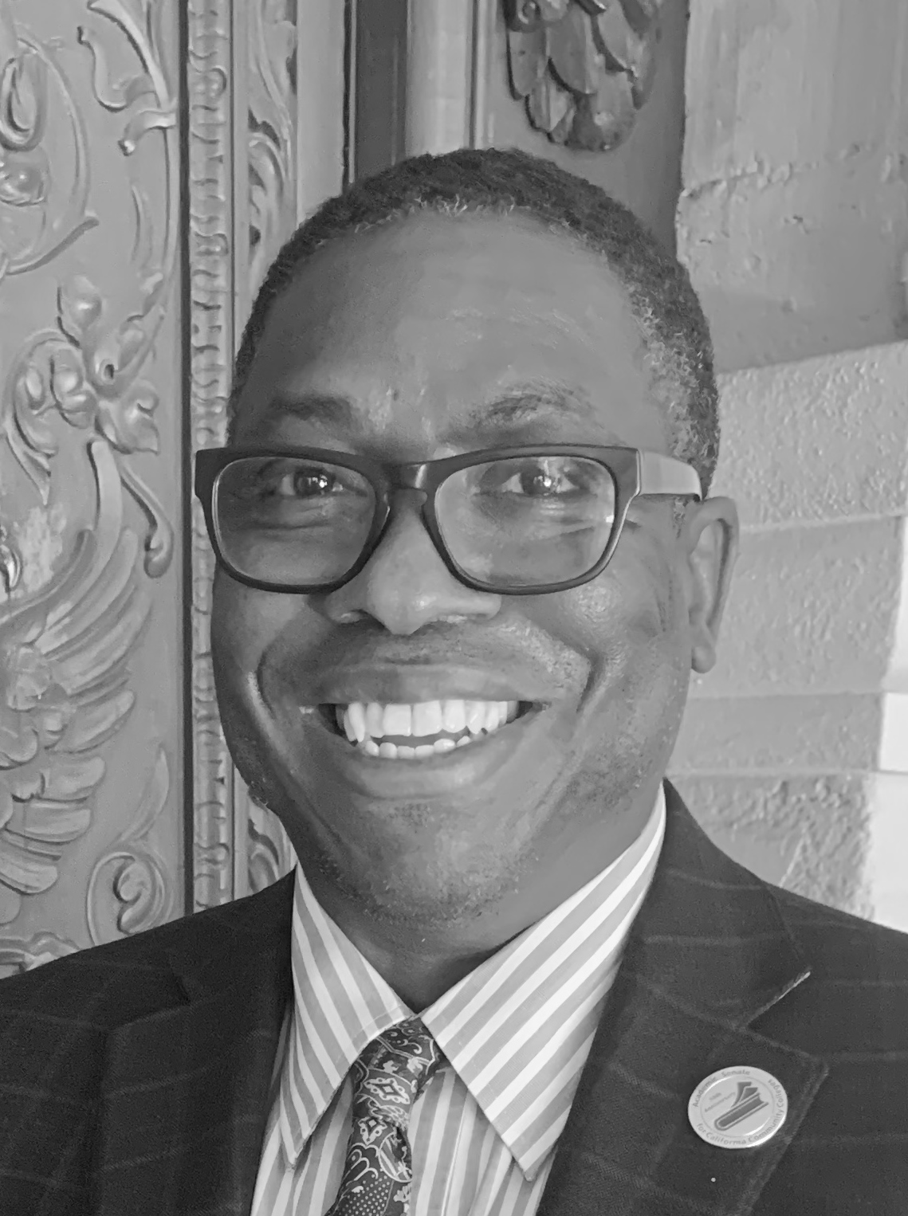
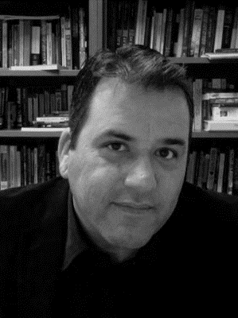
ASCCC Executive Committee 2020-21
Representatives
Julie Oliver
Area A Representative
Karen Chow
Area B Representative
Robert L. Stewart Jr. Area C Representative
LaTonya Parker
Area D Representative
Stephanie Curry
North Representative
Carrie Roberson North Representative
Silvester Henderson
At-Large Representative
Michelle Bean
At-Large Representative
Sam Foster
South Representative
Manuel Velez
South Representative

Slide 9
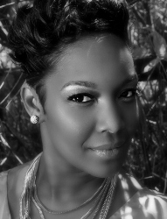
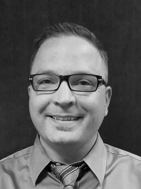
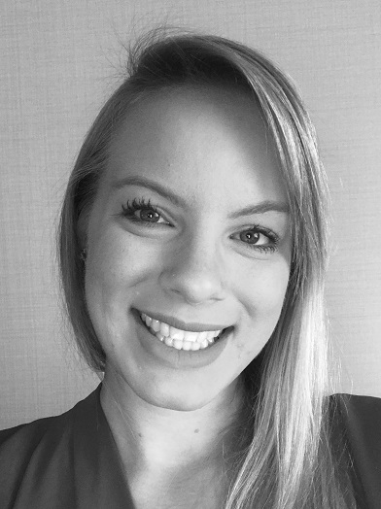
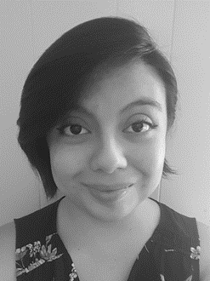
ASCCC Staff
Krystinne Mica
Executive Director
Tonya Davis
Director of Administration
Alice Hammar Director of Finance
Miguel Rother
Director of Grants & Initiatives
April Lonero Executive Assistant
Selena Silva
Program Manager

Slide 10
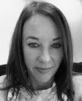
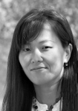
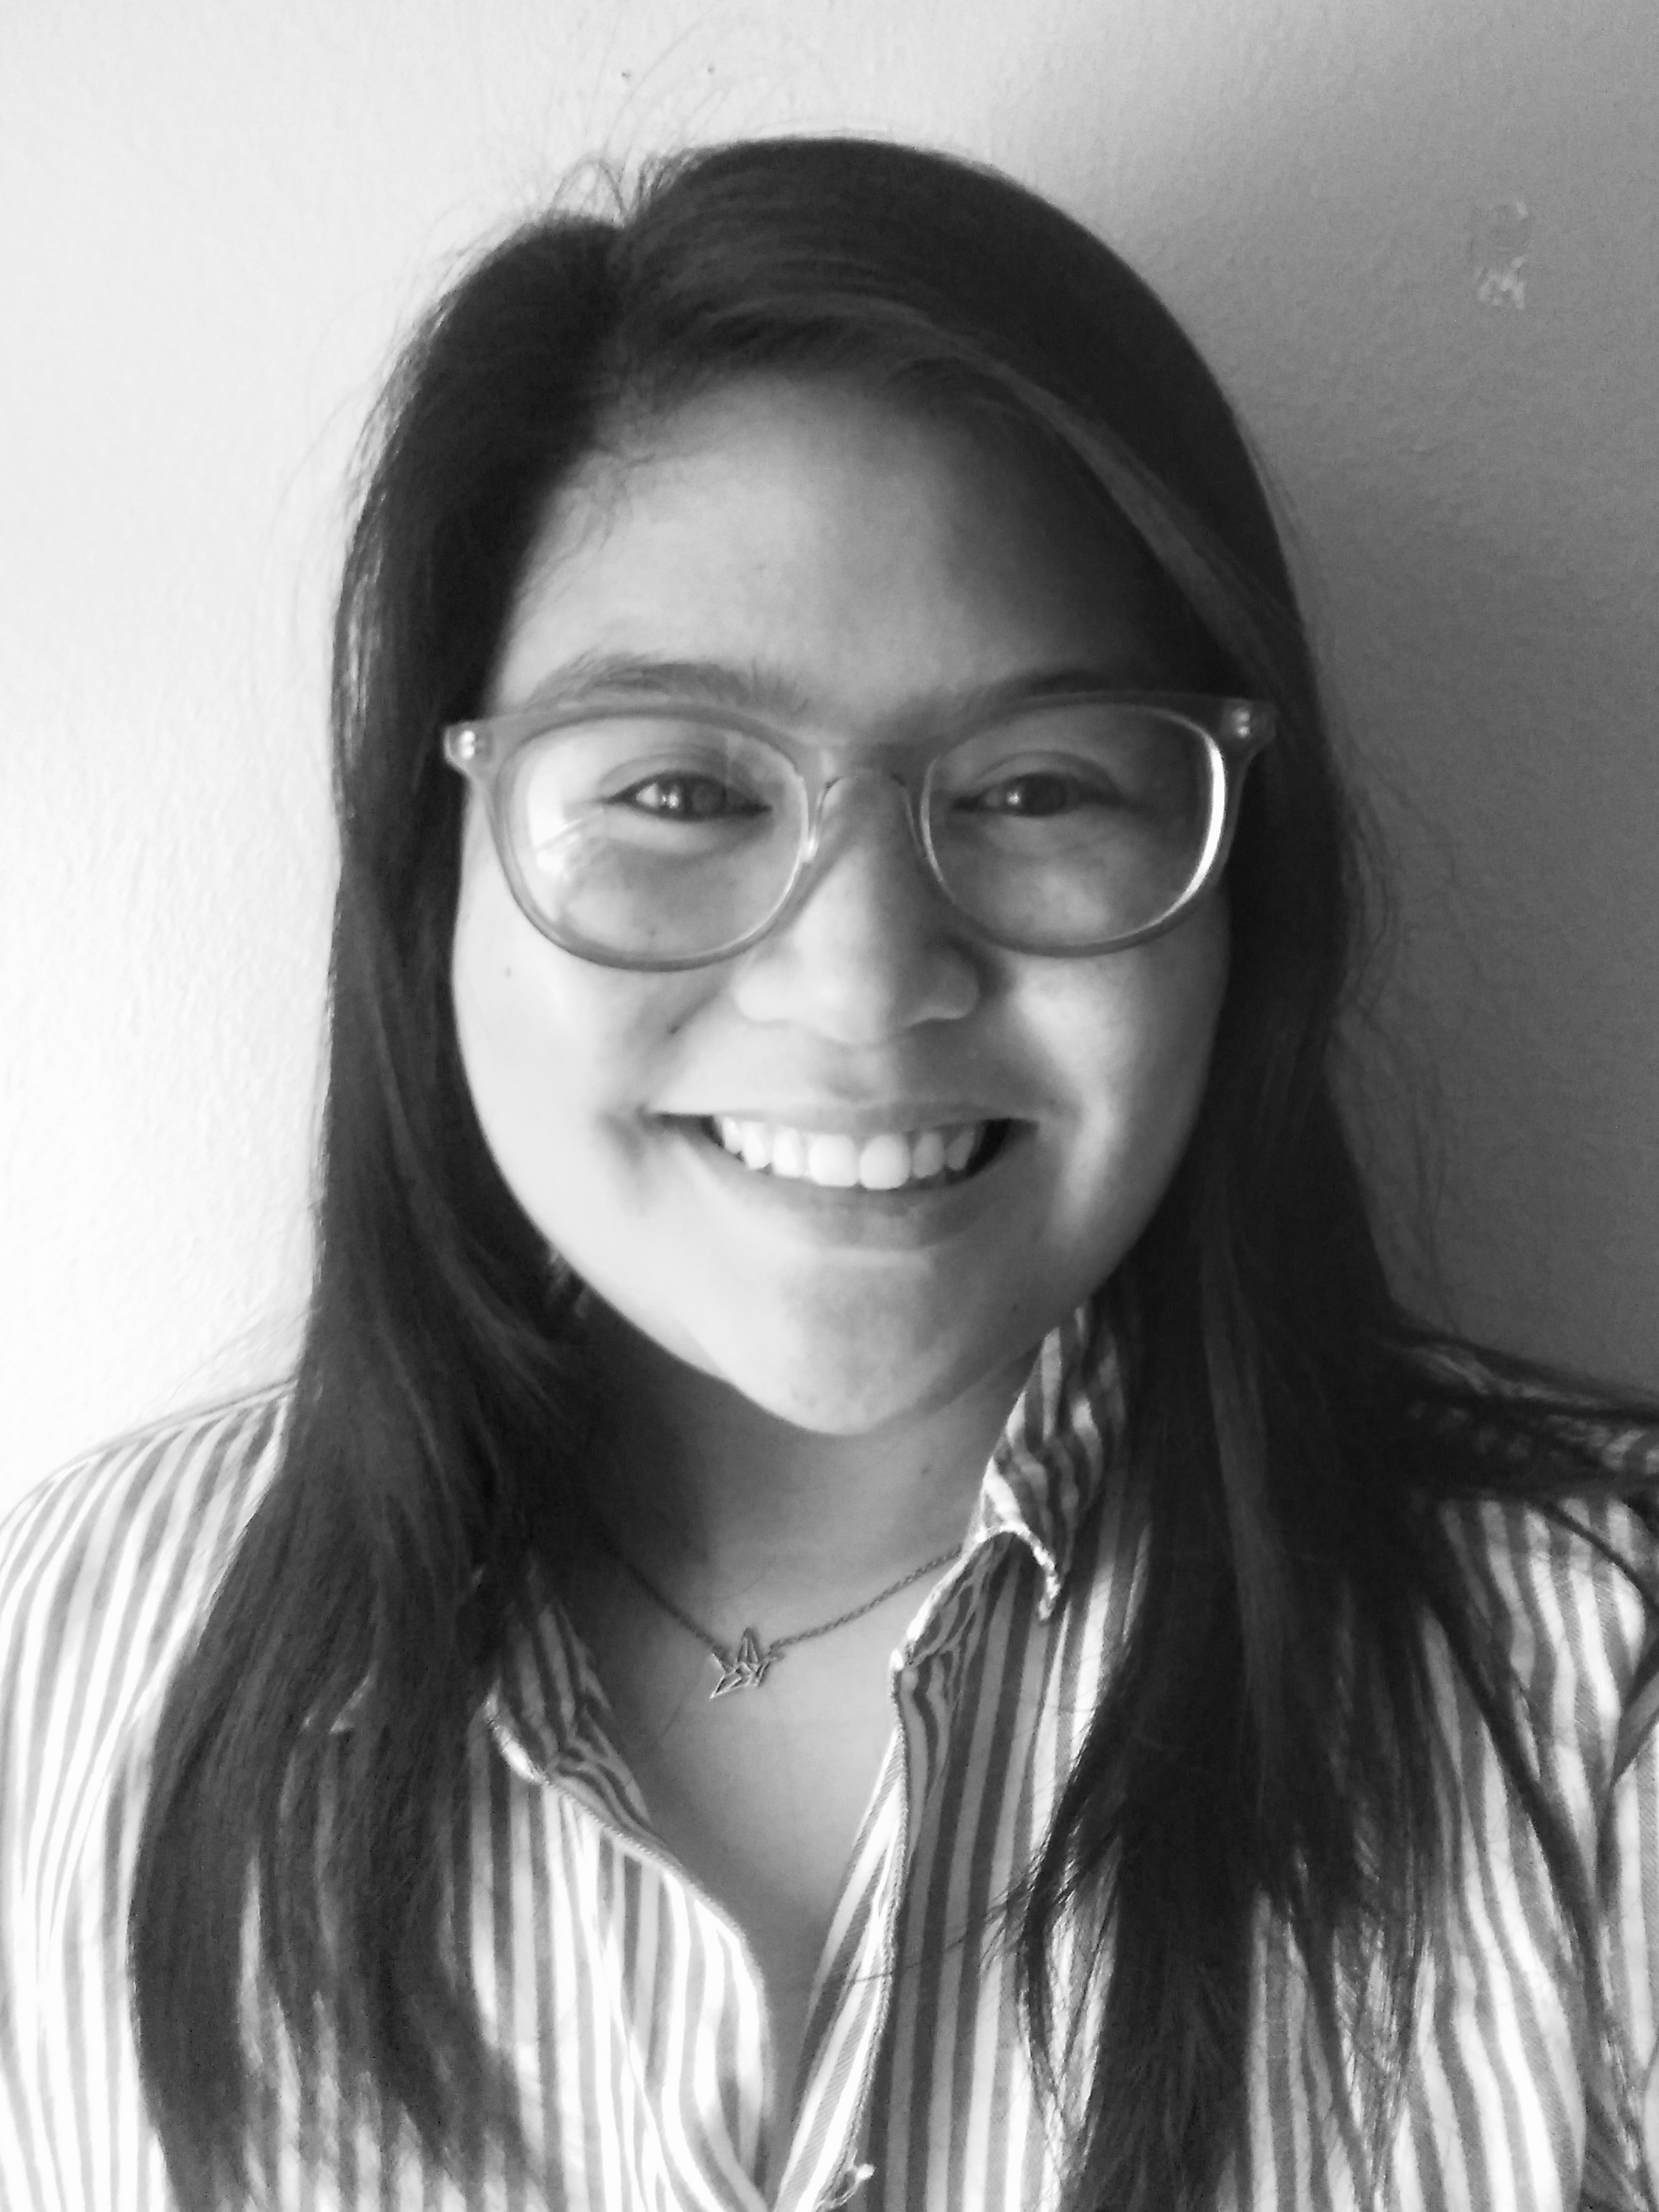
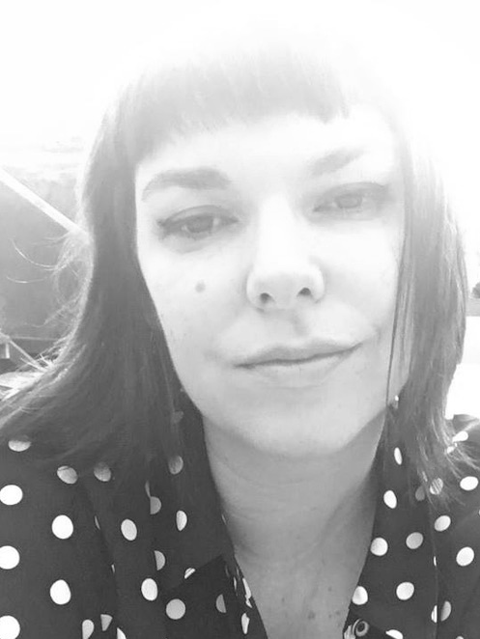
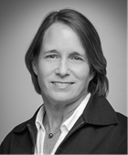
ASCCC Staff
Edie Martinelli Events Manager
Kyoko Hatano Administrative Assistant
Melissa Marquez Administrative Assistant
Meuy Rosales
Accounting Clerk II
Megan Trader Program Coordinator
Katie Nash
Visual Designer

Slide 11
What We’ve Been Doing
Three Areas of Focus:
Culturally Responsive Curriculum, Student Services, and Student Support
Equity Driven Systems
Implementation and Integration of Guided Pathways

Slide 12
Culturally Responsive Curriculum, Student Services, and Student Support
Ethnic Studies Graduation Requirement
Language brought to Consultation Council in March
Board of Governors for First Read in May
Work with ES Faculty Council around FDRG and DIG for creation of new TMC and C-ID Descriptors
Rising Scholars Network/Justice Involved Students
Examination of Public Safety Curriculum and Campus Police Efforts
Career Technical Education Engagement with New Partners

Slide 13
Equity Driven Systems
Diversity, Equity, and Inclusion Implementation Taskforce
Joint EEO/DEI Taskforce Workgroup – Diversity Summit in September
New EEO Regulations and Requirements
Hiring Modules in ASCCC Canvas Module
Open Education Resources Initiative
Faculty Empowerment Leadership Academy (FELA)
Examination of Minimum Qualifications
Second Minimum Qualification around Diversity
Minimum Qualifications in Ethnic Studies

Slide 14
Implementation and Integration of Guided Pathways
Conclusion of ASCCC GP Grant in December, although new monies may be possible going forward
Webinars about varied GP Topics
Use of GP to drive discussions around transfer
Leverage GP as a Framework to advance DEI
Student-centered implementation
Focus on teaching and learning that encompasses all
Intentionally designed pathways to increase student success and close equity gaps: Equitable Placement

Slide 15
Transfer Alignment
Transfer Alignment project – with ICW and C-ID advisory
7 Disciplines considered at first
3 more are underway
Need support to bring discipline faculty together from all three segments to dialogue about alignment
Current pilots in Chemistry and Physics

Slide 16
Legislation
AB 417 (McCarty): Rising Scholars Network
AB 421 (Ward): CDCP Funding
AB 927 (Medina) Baccalaureate Degrees
AB 928 (Berman): Transfer
AB 1040 (Muratsuchi): Ethnic Studies
AB 1111 (Berman): Common Course Numbering

Slide 17
Campus Reopenings
Governor Newsom’s announcement about 15 June
Chancellor’s Office and College/County Board of Health Guidance
Safety Protocols
Brown/Bagley-Keene Act Committees/Boards
Regional Dialogues
Will Continue to Push Information Out As We Receive It

Slide 18
Partnerships with the Chancellor’s Office and Other Stakeholders
RP Group – Academic Academy on Transfer (October 2021)
CCCCIO Board – CIO Conference
ICAS – Transfer/Mental Health/Other Shared Concerns
CCLC – Collegiality in Action Visits (with 4CS and SSCCC)
FACCC – Legislation/Advocacy
CoFO – Legislation and Budget/College Reopening
Chancellor’s Office
5C/TTAC/DEETAC/EWPAC/Rising Scholars/Veterans Summit/GPAC

Slide 19
Upcoming Events
Career and Noncredit Education Institute (30 April – 1 May)
Webinars on:
Part Time Faculty Nexus Workshops
Guided Pathways
CTE Leadership
Disciplines List
Faculty Leadership Institute (16-18 June)
Curriculum Institute (7-9 July)
All events can be found at: https://www.asccc.org/calendar/list/events

Slide 20
Thank You and Enjoy Plenary!

