Slide 1
Comprehensive Dual Enrollment Programming

Slide 2
Conference Presenters
Michelle Sampat,
Associate Dean of Instruction
Mt. San Antonio College
msampat@mtsac.edu
Andrea Vizenor,
Dean Strategic Partnerships and Workforce Development
Skyline College
vizenora@smccd.edu

Slide 3
Session Topics at a Glance
Robust Partnership Development
College Faculty and High School Partner Teacher Collaboration
Student-Ready Services and On-Boarding

Slide 4
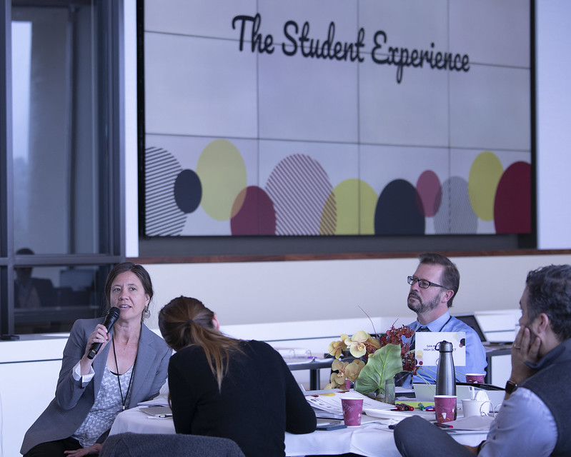
Robust Partnership Development
Shared Vision Across All Stakeholders
Formal CCAP Agreements
Increase Access for disproportionally impacted students to Engage in Clear and Distinct Guided Pathways designed to Transition to a Vibrant
Career or Transfer
Accelerate Program Completion
Grounded in Equity-Minded Practices
REGULAR ENGAGEMENT
SOLUTION CENTRIC
EMPOWER OTHERS
Notes:
Varying interests, needs, and operational cultures
Its messy work, through strengthened relationships, constant communication and a shared vision - trust, respect and solutions evolve -
consistent engagement is at the core of making this kind of programming work –
Comprehensive Dual Enrollment Program designed to address inequities that students may have encountered in their education thus far –

Slide 5
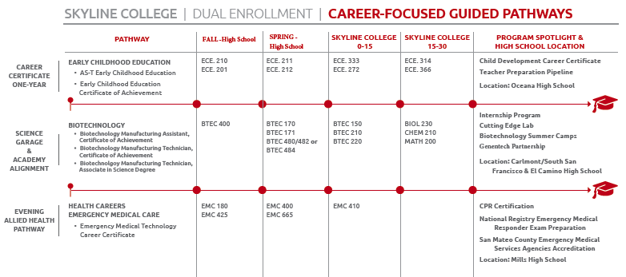
Notes:
Initialliy it was clear -Varying interests, needs, and operational cultures
Its messy work, trust, respect and consistent engagement is at the core of making this kind of programming work.
Comprehensive Dual Enrollment Program designed to address inequities that students may have encountered in their education thus far –

Slide 6
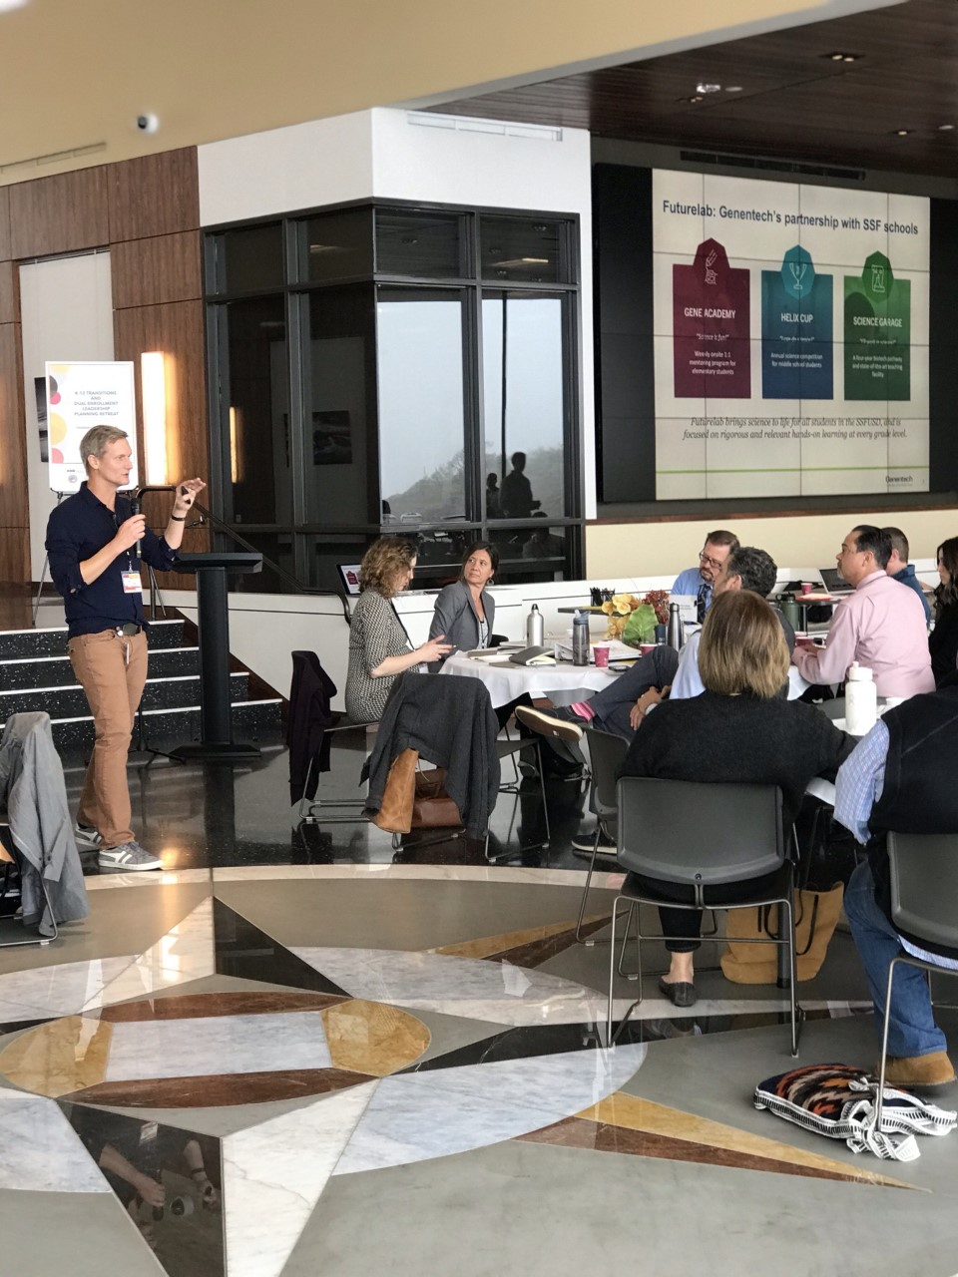
Yearly K-12 Transitions and Dual Enrollment Leadership Planning Retreat
Student Panel
Highlight Industry Partnerships and Share the Work
Principal’s Perspective
Annual Look at Data
Robust Partnership Development
TRUST
RESPECT
EMPATHY
Notes:
K-12 Transitions and Dual Enrollment Leadership Planning Retreat
Annually looking at the data of student participants and better understanding their needs
Student Panel
Principal Perspective
Industry Engagement – Biotechnology Pathway – Genentech sharing their

Slide 7
Partnership Meetings
Multiple Dual Enrollment Pre-Partnership Meetings
District and School Site Administrators
Faculty
Counselors
High School Coordinator Meetings on Campus
District and School Site Administrators
Faculty
Counselors
Department Chairs
Dual Enrollment Team
Orientations at the High School Site
High School Administrators
High School Counselors
College Counselors
Dual Enrollment Director and Assistant Director
Parents and Students

Slide 8
Regional Learning Collaborative (RLC)
Intersegmental Collaboration to Develop Pathways to Higher Education
Claremont Graduate University
Pomona Unified School District
Mt. San Antonio College
Chaffey College
Citrus College
Cal Poly Pomona
University of La Verne
Community Organizations

Slide 9
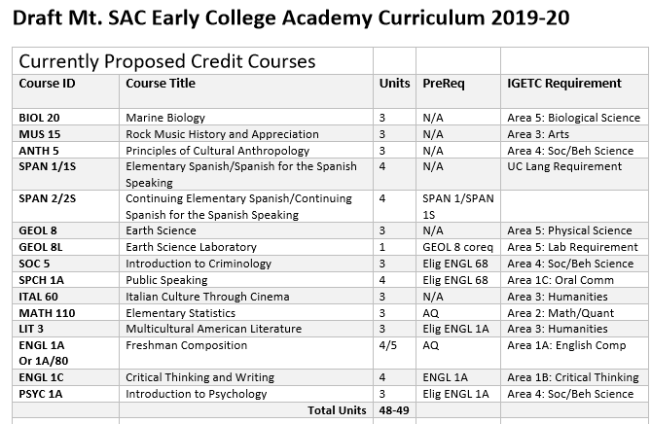
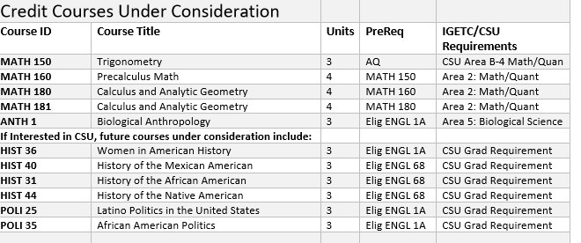
General Education Pathways

Slide 10
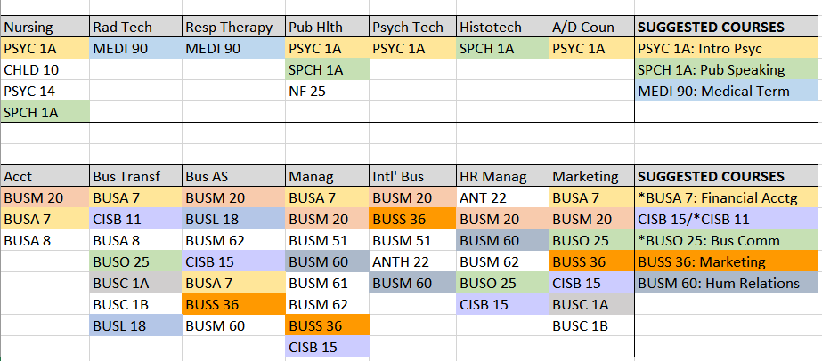
Career Education Pathways

Slide 11
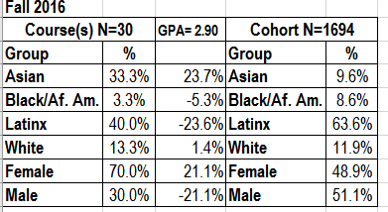
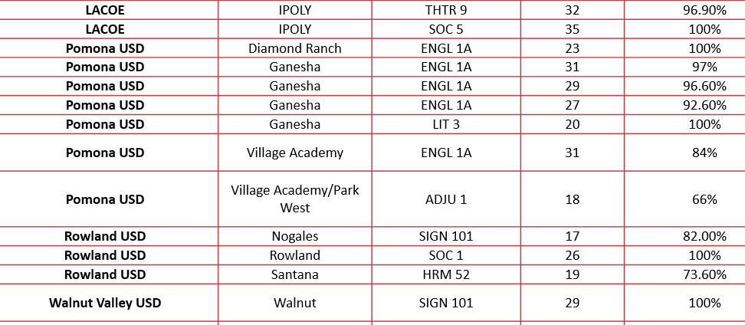
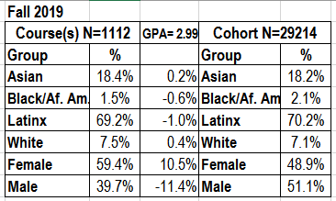
Data Drives Equity Conversations
Dual Enrollment Course Success Rates
DE Demographics

Slide 12
Q & A Session
Robust Partnership Development

Slide 13
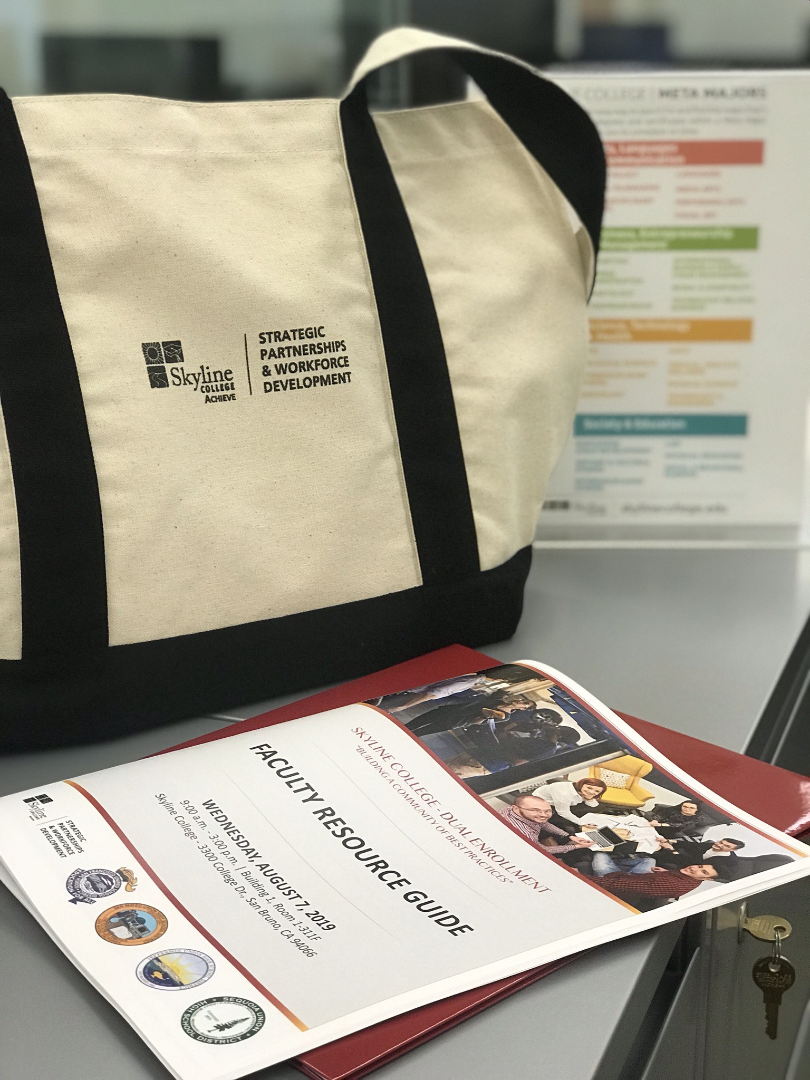
College Faculty and High School Partner Teacher Engagement Strategies
Pre-COVID:
Yearly Launch
Faculty Resource Guide
Professional Development Sessions
Topics: Culturally Relevant Instructional Delivery Strategies, One Hour Teaching Practices, Innovative Technology Integration, Student-Centered Teaching Strategies
Monthly Teacher Best Practice Sharing Meetings
Notes:
Our program is about 50/50 – College Faculty deliver instruction at high school and High School Partner Teachers who meet minimum qualification to teach have aligned and work thoughtfully together to design a dynamic framework for teaching and core learning outcomes
Moving away from Emergency Program Delivery and building core practices, preservations of rigor and tools that strengthen students college readiness skill development -

Slide 14
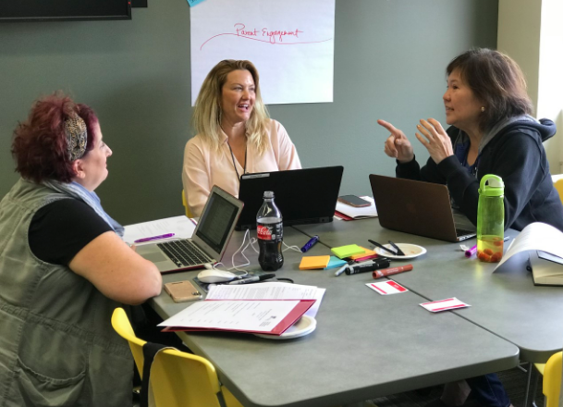
College Faculty and High School Partner Teacher Engagement Strategies
Post-COVID:
Bi-Monthly Pathway Collaborations focused on Innovative Lesson Plan Design and Distance Education Practices via Zoom
Preparation for Fall 2020
Dynamic 3-Week CANVAS Training
One-On-One Course Design Support
Pathway Planning Meetings
Take Home Kits for Hand’s On Learning
Notes:
Our program is about 50/50 – College Faculty delivering instruction at high schools and High School Partner Teachers who meet minimum qualifications to teach college courses and have aligned curriculum and teams work thoughtfully together to design a dynamic framework for teaching and meeting core learning outcomes
Moving away from Emergency Program Delivery and building core practices, preservations of rigor and tools that strengthen students college readiness skill development -

Slide 15
Instructor Orientations
Fully Online by Mutual Agreement Readiness Training:
Four hours of online training is required prior to teaching online
The training includes Canvas readiness, grading, and regular and effective contact
Adjunct Faculty Campus Orientation
Faculty Association Orientation for new adjunct faculty
Remote Orientation to the High School Site:
Must be completed before the first day of the course via Zoom
Introduce instructor to high school administrators, HS counselor, HS coordinator, and anyone else involved with the DE program
Contact information list requested
Instructor Learning Platforms
Student Accessibility
Absences (Instructor/Student)

Slide 16
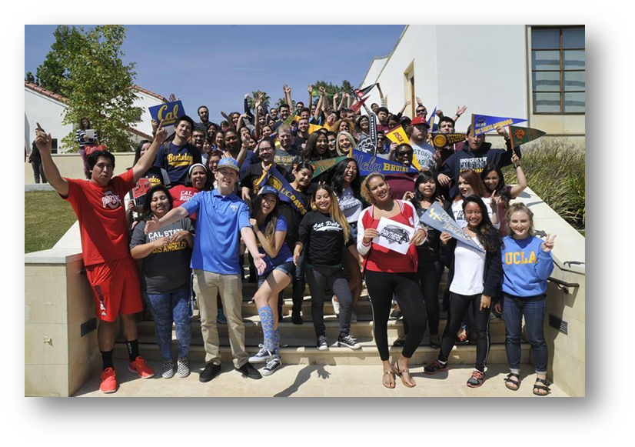
Faculty Support
Department Chairs
Dual Enrollment faculty work with department chairs who provide support as needed
Dual Enrollment Faculty Coordinators
Two Senate-appointed faculty members, one counseling faculty member and one non-counseling faculty member, are provided 3 LHE each per term to support the dual enrollment program, including outreach and support for faculty
Dual Enrollment Team
DE Director and Assistant Director
Four Adjunct Counseling Faculty
Professional Development
https://www.mtsac.edu/pod/resources/adjunctfaculty/

Slide 17
Q & A Session
College Faculty – High School Teacher Collaboration

Slide 18
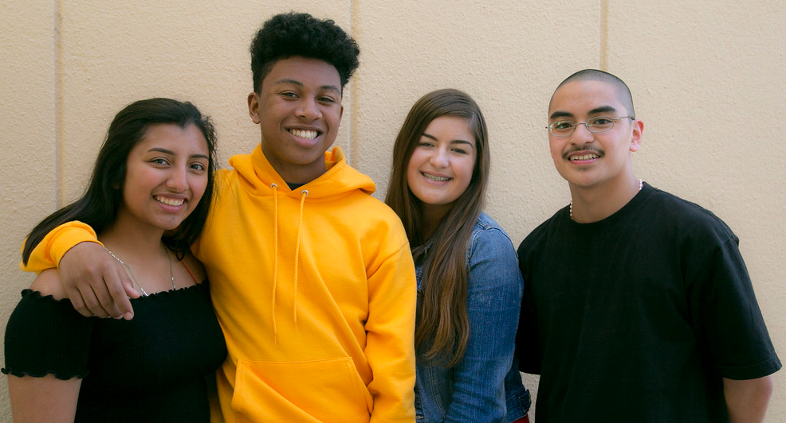
Student-Ready
Engagement
Reduce Barriers to Entry
Counselor Engagement
Course Cards
Student / Family Resource Guide
Welcome Bag
Notes:
“2.0 GPA Recommended – REMOVE Barriers! Use DE as an opportunity to nurture students and get them excited about their future!
Opportunity to reengage students in their education
Challenge perceptions of community college
Welcome Bag – Congratulations and Welcome to Skyline College! – Tablet, Pen, Folders and Program Tool
Student / Family Resource Guide link on the last slide

Slide 19
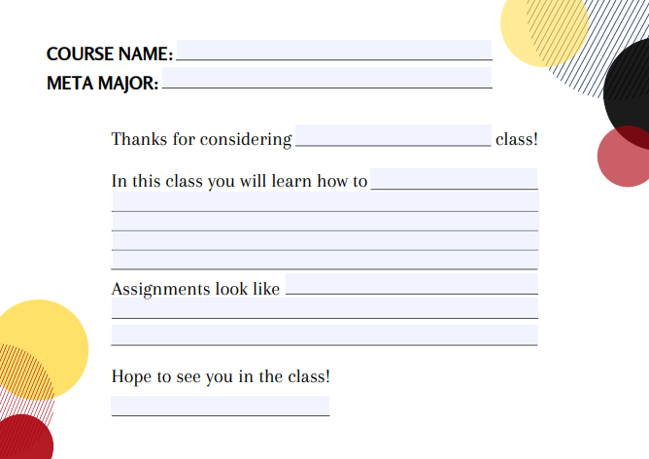
Notes:
Student friendly language and dialogue – conversational – elevator pitch of sorts ☺

Slide 20
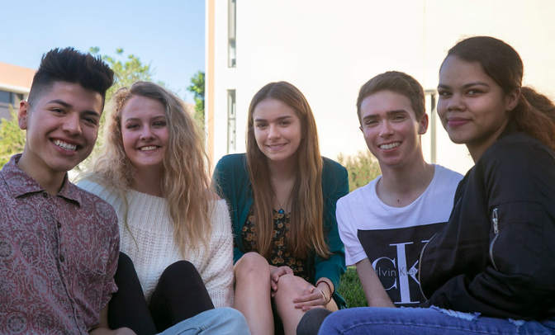
Student-Ready Practices and On-Boarding
On-Boarding
College Connection Form Online using FormStack
Pre-Populated Selections
Designee for each District just a “Click”
Parent E-Signature
Virtual Application and Enrollment Sessions
Concierge Style Support
Notes:
Provide increased access to clear and distinct pathways for all students, particularly those from underserved populations, to accelerate program completion and successful transitions to work or transfer

Slide 21
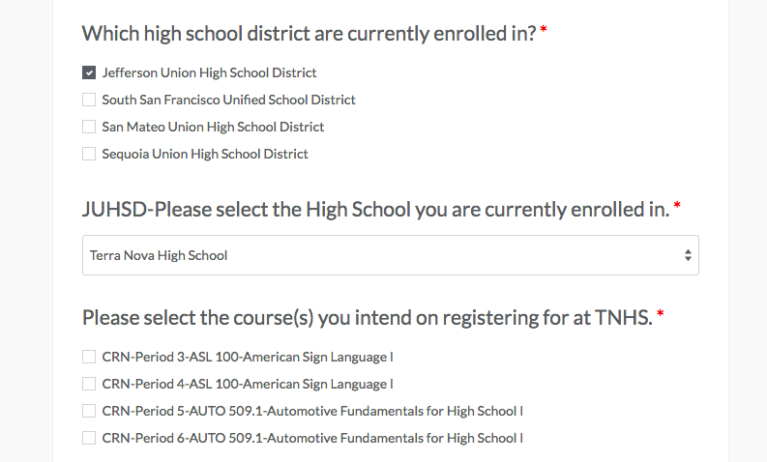
Notes:
Provide increased access to clear and distinct pathways for all students, particularly those from underserved populations, to accelerate program completion and successful transitions to work or transfer

Slide 22
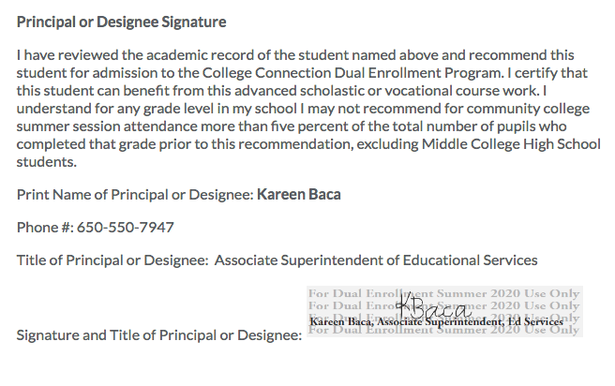
Notes:
Provide increased access to clear and distinct pathways for all students, particularly those from underserved populations, to accelerate program completion and successful transitions to work or transfer

Slide 23
Parent/Student Orientations
Traditionally offered at School Sites in English and Spanish
Online link: https://youtu.be/mZky4bjVHmM

Slide 25
Student Instructional Videos
Step 1: How to Apply https://www.youtube.com/watch?v=LTmDJxYSPPo
Step 2: How to Claim Your Account https://www.youtube.com/watch?v=VkZpAahKiTQ&t=5s
Step 3: Activate Student Email https://www.youtube.com/watch?v=evmmx7XGZkQ
Step 4: Complete AQ (Coming Soon)
Step 5: Parent/Student Orientation (Coming Soon)
Step 6: How to Register (Coming Soon)

Slide 26
Mt. SAC Student Support Resources
College Counselors
Traveling College Counselors
Visit high school sites, reach out to students, work with HS Counselors
Available for college-related support
Early College Academy College Counselors
Located at the Mt. SAC Early College Academy site
Mountie Academic Plans created with each student
Library
Tutoring Centers
Health Services
Online Tutoring

Slide 27
ACCESS Program Services:
Accessibility Resource Centers for Students
The Accessibility Resource Center for Students provides additional services and accommodations for students based on the educational limitations or barriers that are directly caused by a disability, diagnosis, or medical condition. Accommodations CANNOT fundamentally change academic requirements for degrees, certificates, programs, courses or assignments.
STEPS TO BECOME AN ACCESS STUDENT THROUGH DUAL ENROLLMENT:
Apply to Mt. SAC/Dual Enrollment
Apply to ACCESS www.mtsac.edu/access
Complete the AQ and Orientation
(may have done already based on courses you want to take)
See an ACCESS Counselor
Request Accommodations

Slide 28
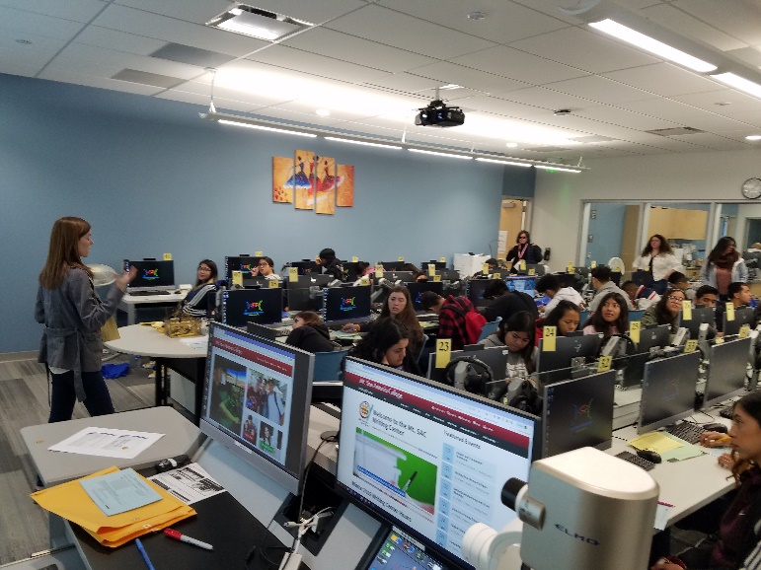
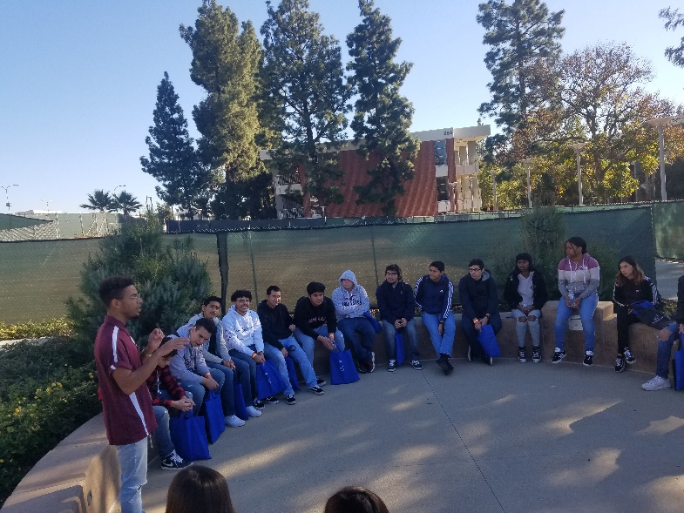
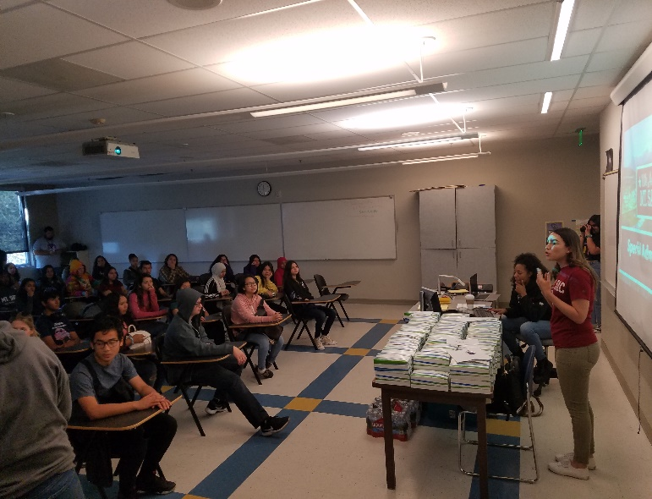
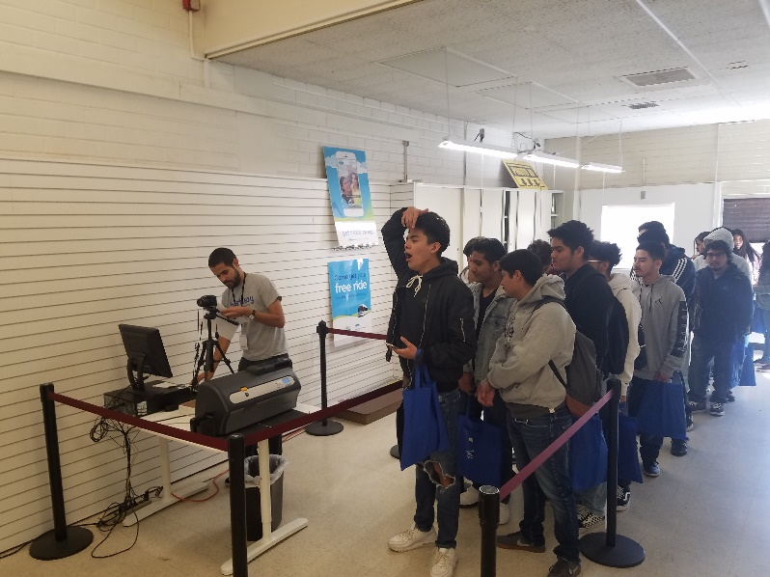
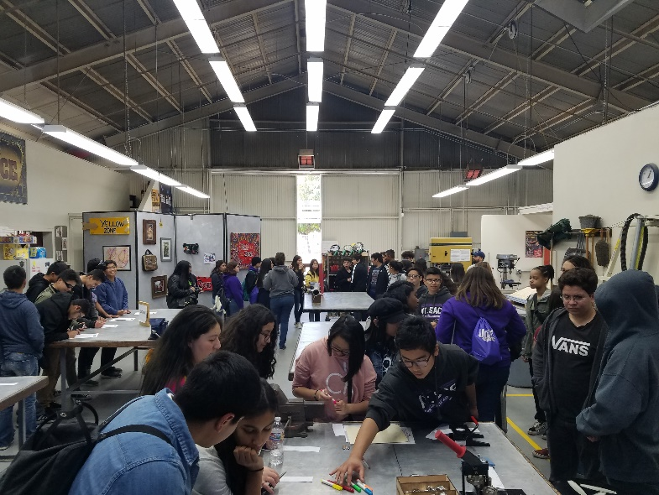
Campus Visits

Slide 29
Q & A Session
Student Ready Practices and On-Boarding

Slide 30
For More Information – Please Contact us!
Michelle Sampat,
Associate Dean of Instruction
Mt. San Antonio College
msampat@mtsac.edu
Andrea Vizenor,
Dean Strategic Partnerships and Workforce Development
Skyline College
vizenora@smccd.edu

Slide 31
Resource Links
Faculty Resource Guide:
https://drive.google.com/file/d/1Mh1QDIBa63efLZEAfDX2E5gNt-1qAo3D/view?usp=sharing
Student Resource Guide:
https://drive.google.com/file/d/1ZqIk2UhM3XRCCXmyiF5ufDSojag23Uzm/view?usp=sharing

